Slide 1
Effect of Cash Withdraws in Purchases and Payments of Credit Cards
Another Study by Patrick Walsh

Slide 2
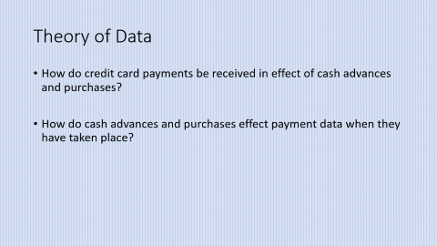
Data
CUST_ID BALANCE BALANCE_FREQUENCY PURCHASES Length:8950 Min. : 0.0 Min. :0.0000 Min. : 0.00 Class :character 1st Qu.: 128.3 1st Qu.:0.8889 1st Qu.: 39.63 Mode :character Median : 873.4 Median :1.0000 Median : 361.28 Mean : 1564.5 Mean :0.8773 Mean : 1003.20 3rd Qu.: 2054.1 3rd Qu.:1.0000 3rd Qu.: 1110.13 Max. :19043.1 Max. :1.0000 Max. :49039.57 ONEOFF_PURCHASES INSTALLMENTS_PURCHASES CASH_ADVANCE Min. : 0.0 Min. : 0.0 Min. : 0.0 1st Qu.: 0.0 1st Qu.: 0.0 1st Qu.: 0.0 Median : 38.0 Median : 89.0 Median : 0.0 Mean : 592.4 Mean : 411.1 Mean : 978.9 3rd Qu.: 577.4 3rd Qu.: 468.6 3rd Qu.: 1113.8 Max. :40761.2 Max. :22500.0 Max. :47137.2 PURCHASES_FREQUENCY ONEOFF_PURCHASES_FREQUENCY Min. :0.00000 Min. :0.00000 1st Qu.:0.08333 1st Qu.:0.00000 Median :0.50000 Median :0.08333 Mean :0.49035 Mean :0.20246 3rd Qu.:0.91667 3rd Qu.:0.30000 Max. :1.00000 Max. :1.00000 PURCHASES_INSTALLMENTS_FREQUENCY CASH_ADVANCE_FREQUENCY CASH_ADVANCE_TRX Min. :0.0000 Min. :0.0000 Min. : 0.000 1st Qu.:0.0000 1st Qu.:0.0000 1st Qu.: 0.000 Median :0.1667 Median :0.0000 Median : 0.000 Mean :0.3644 Mean :0.1351 Mean : 3.249 3rd Qu.:0.7500 3rd Qu.:0.2222 3rd Qu.: 4.000 Max. :1.0000 Max. :1.5000 Max. :123.000 PURCHASES_TRX CREDIT_LIMIT PAYMENTS MINIMUM_PAYMENTS Min. : 0.00 Min. : 50 Min. : 0.0 Min. : 0.02 1st Qu.: 1.00 1st Qu.: 1600 1st Qu.: 383.3 1st Qu.: 169.12 Median : 7.00 Median : 3000 Median : 856.9 Median : 312.34 Mean : 14.71 Mean : 4494 Mean : 1733.1 Mean : 864.21 3rd Qu.: 17.00 3rd Qu.: 6500 3rd Qu.: 1901.1 3rd Qu.: 825.49 Max. :358.00 Max. :30000 Max. :50721.5 Max. :76406.21 NA's :1 NA's :313 PRC_FULL_PAYMENT TENURE Min. :0.0000 Min. : 6.00 1st Qu.:0.0000 1st Qu.:12.00 Median :0.0000 Median :12.00 Mean :0.1537 Mean :11.52 3rd Qu.:0.1429 3rd Qu.:12.00 Max. :1.0000 Max. :12.00
>
Data is credit card data on Kaggle.
Variables:
https://www.kaggle.com/datasets/arjunbhasin2013/ccdata

Slide 3
Theory of Data
How do credit card payments be received in effect of cash advances and purchases?
How do cash advances and purchases effect payment data when they have taken place?

Slide 4
Argument to Explain
How do elements of a credit card relate?
How do cash advances effect customer payments?
How do purchases effect customer payments?

Slide 5
Descriptive Statistics
PURCHASES Length:8950 Min. : 0.0 Min. :0.0000 Min. : 0.00 Class :character 1st
Qu.: 128.\
3 1st Qu.:0.8889 1st Qu.: 39.63 Mode :character Median : 873.4 Median :1.0000
Median : 3
61.28 Mean : 1564.5
Mean :0.8773 Mean : 1003.20 3rd Qu.: 2054.1 3rd Qu.:1.0000 3rd Qu.: 1110.13
Max. :19043.
1 Max. :1.0000 Max. :49039.57
ONEOFF_PURCHASES INSTALLMENTS_PURCHASES CASH_ADVANCE Min. : 0.0 Min. : 0.0 M
in. : 0.0 1st
Qu.: 0.0 1st Qu.: 0.0
1st Qu.: 0.0 Median : 38.0 Median : 89.0 Median : 0.0 Mean : 592.4 Mean : 41
1.1 Mean : 9
78.9 3rd Qu.: 577.4 3rd Qu.: 468.6 3rd Qu.: 1113.8 Max. :40761.2 Max. :22500.0 Max.
:47137.2

Slide 6
Standard Cash Advance Result
Coefficients: Estimate Std. Error t value Pr(>|t|) (Intercept) 1.121e+03 3.011e+01 37.23 <2e-16 *** CASH_ADVANCE 6.257e-01 1.301e-02 48.10 <2e-16 ***
Multiple R-squared: 0.2054

Slide 7
Standard PurchasesResult
Coefficients: Estimate Std. Error t value Pr(>|t|) (Intercept) 913.12329 26.96432 33.86 <2e-16 *** PURCHASES 0.81740 0.01142 71.55 <2e-16 ***
Multiple R-squared: 0.3639

Slide 8


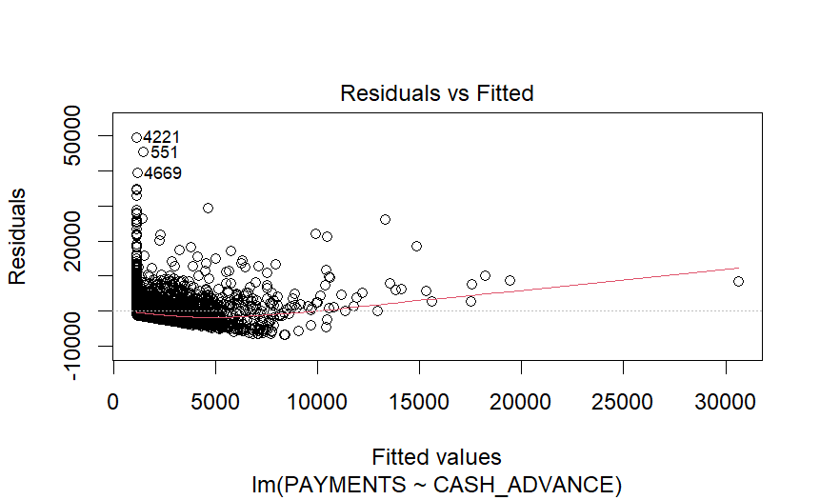
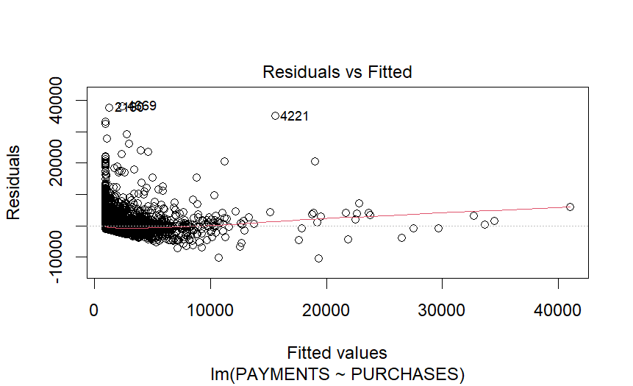
Regression Plot
GGplot

Slide 9
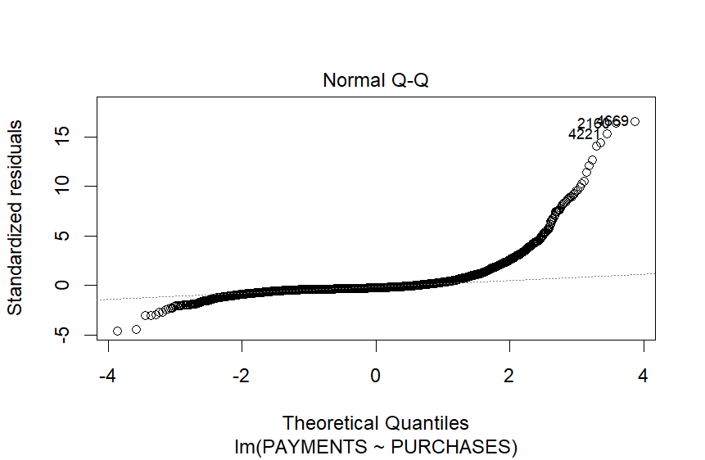
Depiction of Quantile regression with RSE as the slope

