Slide 1
Effect of Fraudulent Transactions in Credit Card Purchases and Detection.
Another Study by Patrick Walsh

Slide 2
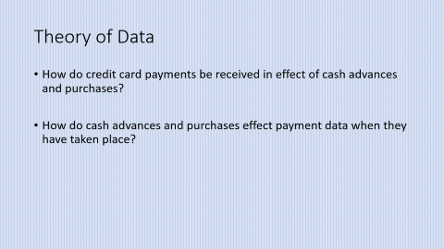
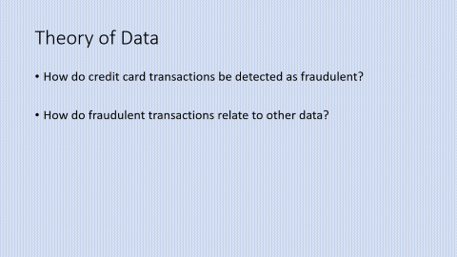
Data
distance_from_home | distance_from_last_transaction | ratio_to_median_purchase_price | repeat_retailer | used_chip | used_pin_number | online_order | fraud
>
Data is from cRedit Card Data from Kaggle
Variables:
Credit Card Transactions | Kaggle

Slide 3
Theory of Data
How do credit card transactions be detected as fraudulent?
How do fraudulent transactions relate to other data?

Slide 4
Argument to Explain
How do distances from dimensions of purchase effect a credit card sale?
How does fraudulent transactions relate empirically to these dimensions?
How effective can fraud be detected?

Slide 5
Descriptive Statistics
0.0 912597 1.0 87403

Slide 6
Standard Cash Advance Result
Coefficient: 95.86

Slide 7
Fraudlent Detection Results
95.86% of time a non-fraudulent transaction is found
4.14% of the time a fraudulent transaction is found.
Improvement from 8.74%

