Slide 1

PRODUCT PREMIUM OPTIMIZATION IN HEALTH INSURANCE
USING MACHINE LEARNING

Slide 2
Problem statement
The main foundational block of health insurance industry is to estimate the future events and measure the associated risk/value of these events, hence it is needless to say that predictive analytics is used widely to determine the risk, insurance premium and enrich overall customer experience.
Judicious use of predictive analysis has empowered health insurers to improve their premium pricing accuracy, create customized health insurance plans and services, and build stronger customer relationships.
Thus, the main goal of this project is to predict the insurance premiums based on the behavioural data collected from the individuals so that insurance companies can make useful and accurate predictions. Based on these predictions, they can then evaluate the following decisions and make better.
judgement calls:
• Which individuals deserve which kind of insurance plan?
• Based upon an individual’s behaviour, predicting their premium helps in better risk management.

Slide 3
Data Description
The dataset used in this project is with dummy values prepared by myself.
This dataset contains information on individual attributes such as memberID, Name, DOB, age, BMI, gender, relation, nationality, marital status, emirates id, nationality, No. of maternity claims, no. of chronic illness, no. of critical illness, no. of other claims, Is high-risk professional, covid high claim, premium, etc.
It has:
- 5511 rows
- 17 columns

Slide 4
No: | Column Name | Description | Data Type
1. | Member ID | Beneficiary’s unique identification number | Character
2 | Age | Beneficiary’s age | Integer
3 | Gender | Beneficiary’s gender | Character
4 | Relation | Beneficiary’s relationship ased on visa status | Character
5 | Marital Status | Beneficiary’s Marital status | Character
6 | Nationality | Beneficiary’s nationality region | Character
7 | BMI | Body Mass Index, providing an understanding of body weights that are relatively high or low relative to height | Numeric- float
8 | Is high risk profession | Whether the employee works in high risk profession | Binary - character
9 | No. of maternity claims | The no. of maternity claims member has claimed in the policy period | Numeric
10 | No. of critical illness claims | The no. of critical illness claims member has claimed in the policy period | Numeric
11 | No. of chronic illness claims | The no. of chronic illness claims member has claimed in the policy period | Numeric
12 | No. of other claims | The no. of other claims member has claimed in the policy period | Numeric
13 | Premium | Individual insurance premiums billed by health insurance | Numeric- float

Slide 5
Project Methodology
The main goal of the project is to predict the insurance premium charge based upon other attributes.
The dependent variable is premium.
There are 12 independent variables: age , gender , marital status ,bmi ,Relation , Nationality, Is_High_Risk_Prof , No_Mat_Claims, No_Crit_Claims, No_Chro_Claims, No_Oth_Claims,Covid_H_Claims

Slide 6
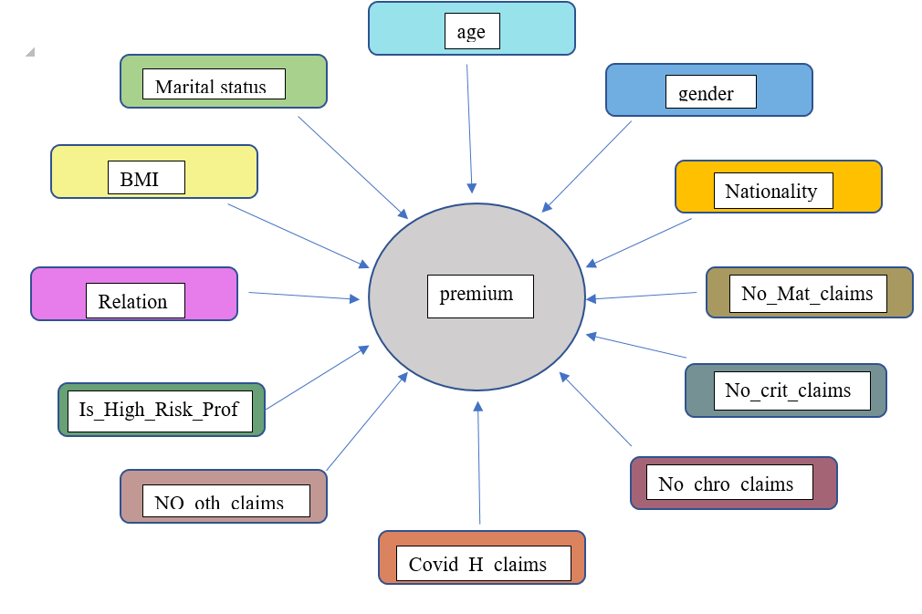

Slide 7
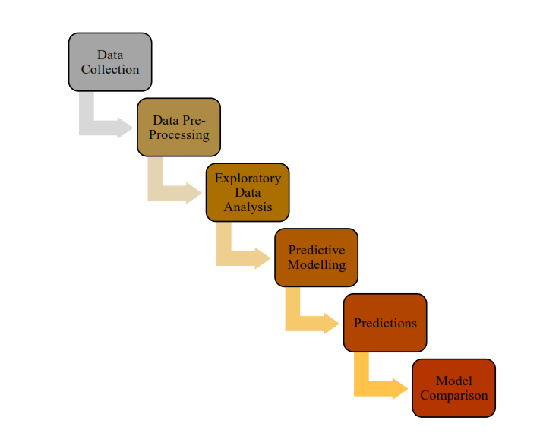
Data Pre-processing
Steps of data analysis:

Slide 8
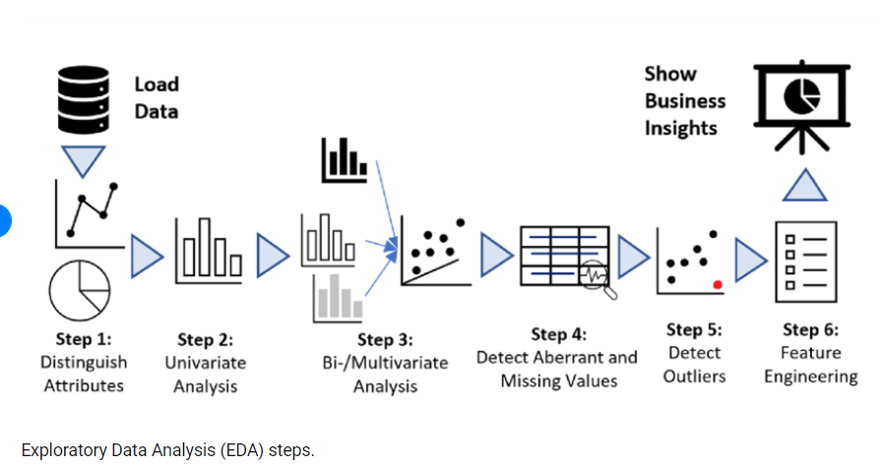
Exploratory Data Analysis
Exploratory data analysis (EDA) is a process where we explore the data set to get familiar with it. We find out the shape of the data, missing values, data type, etc. All the tasks that are done on data before building a machine learning model come under EDA.

Slide 9
Steps in EDA:
1. Observe the dataset , find out the number of rows and columns. This will help us to predict any future issues related to data. No. of rows – No. column –
2. Cleaning the dataset . This includes removing redundant variables, removing outliers, removing null values
3. Analysing relationships between variables using heat map and scatter plots
4. Feature engineering

Slide 10
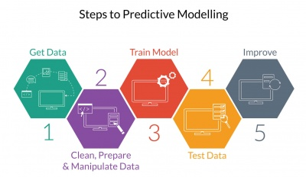
Predictive Modelling
Predictive Modelling is the process of uncovering relationships within the data by using a
mathematical model for predicting some desired outcome. It uses historical data to make
predictions about unseen data.
The following figure depicts the cycle of the predictive modelling:

Slide 11
Measuring Model Performance
When predictions are made using a model, there is a need to estimate the accuracy of the predictions through the evaluation metrics that are able to evaluate how well the model performs compared to other models.
For evaluating regression performance, the evaluation metrics commonly considered are :
Variance Score
Mean Absolute Error
Mean Square Error
Median Absolute Error
R² Error

Slide 12
Predictive Models – Algorithms selected
To predict the premium, four predictive models are using and compared against each other.
Each model is explained in detail in the following pages:
Multiple Linear Regression
SVR (Support Vector Regression)
Random Forest
Gradient Boosting Regression

Slide 13
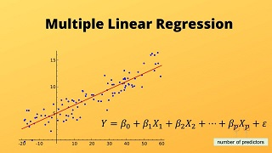

Multiple Linear Regression
Multiple Linear Regression is one of the important regression algorithms which models the linear relationship between a single dependent continuous variable and more than one independent variable.
For MLR, the dependent or target variable(Y) must be the continuous/real, but the predictor or independent variable may be of continuous or categorical form.
Each feature variable must model the linear relationship with the dependent variable.
MLR tries to fit a regression line through a multidimensional space of data-points.
MLR equation:
Y= Output/Response variable
b₀, b₁, b₂, b₃ , b_{n}....= Coefficients of the model.
x₁, x₂, x₃, x₄,...= Various Independent/feature variable

Slide 14
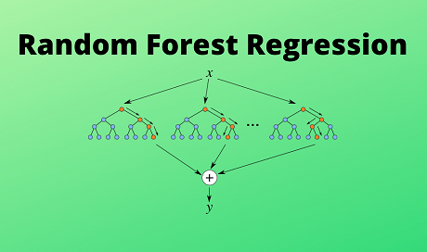
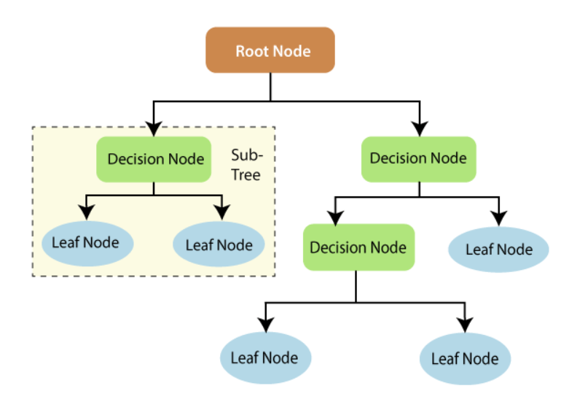
2. Random Forest
A random forest is a machine learning technique that’s used to solve regression and classification problems. It utilizes ensemble learning, which is a technique that combines many classifiers to provide solutions to complex problems.
A random forest algorithm consists of many decision trees. The ‘forest’ generated by the random forest algorithm is trained through bagging or bootstrap aggregating. Bagging is an ensemble meta-algorithm that improves the accuracy of machine learning algorithms.

Slide 15
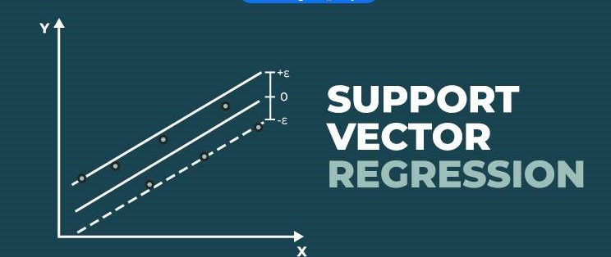
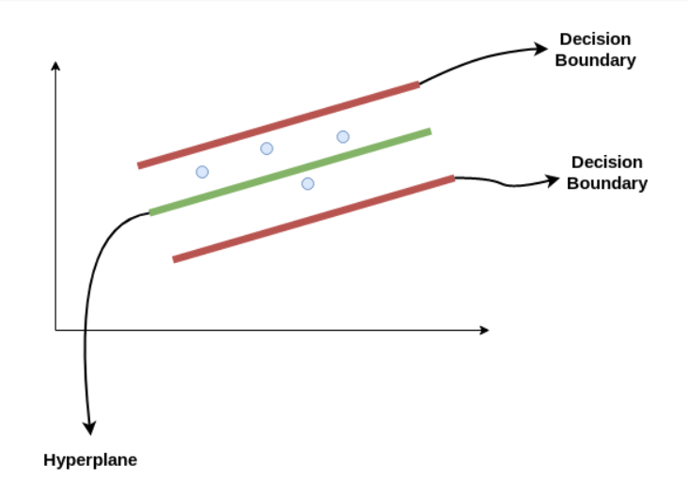
3. SVR (Support Vector Regression)
Support Vector Regression (SVR) uses the same principle as SVM, but for regression problems. The problem of regression is to find a function that approximates mapping from an input domain to real numbers on the basis of a training sample.
Consider these two red lines as the decision boundary and the green line as the hyperplane. Our objective, when we are moving on with SVR, is to basically consider the points that are within the decision boundary line. Our best fit line is the hyperplane that has a maximum number of points.
The first thing that we’ll understand is what is the decision boundary (the danger red line above!). Consider these lines as being at any distance, say ‘a’, from the hyperplane. So, these are the lines that we draw at distance ‘+a’ and ‘-a’ from the hyperplane.

Slide 16
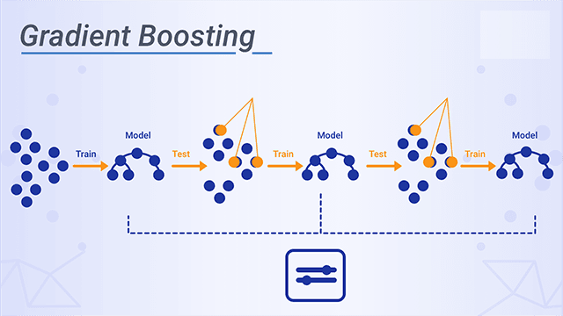
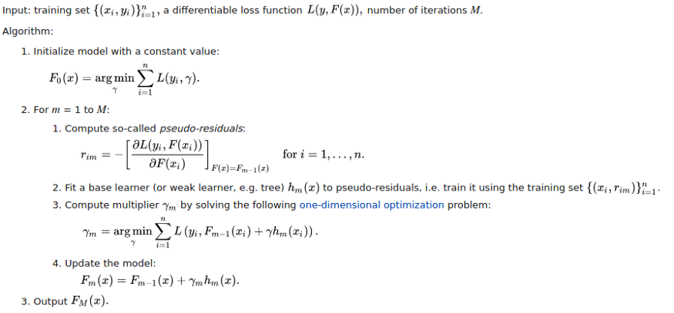
4. Gradient Boosting Regression
Gradient boosting is a machine learning ensemble technique for regression and classification problems which produce output by ensemble several weak learners especially decision trees.
Gradient boosting can be simplified in 3 sentences:
A loss function to be optimized
A weak learner to make prediction
Final model which adds these weak learners to minimize loss and make better predictions.

Slide 17
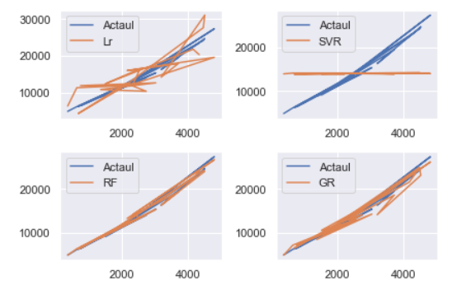
Evaluation of Prediction Models
Compare performance visually
Since the number of data are very high if we plot with whole data its difficult to identify the best model. So here we are taking first 20 sample to show the comparison. Below figure shows the comparison.

Slide 18
Evaluating the algorithms
Comparison of Regression metrics for Validation Set
Method | Explained variance score | Mean absolute error | Mean squared error | Median absolute error | R2 score
Multilinear Regressor | 0.80 | 3121.38 | 19453052.70 | 2356.34 | 0.80
Sample Vector Regressor | 0.02 | 7351.76 | 101418172.36 | 6265.19 | -0.03
Random Forest Regressor | 0.99 | 433.74 | 1373418.24 | 103.09 | 0.99
Gradient Boosting Regressor | 0.98 | 677.64 | 1722918.44 | 363.81 | 0.98

Slide 19
Conclusion & Future Work
Conclusions
In this thesis, four regression models are evaluated for health insurance market place data. The health insurance market place data we have collected from gateway insurance broker was used to develop the four regression models, and the predicted premiums from these models were compared with premiums to compare the accuracies of these models. It has been found that Random Forest is the best performing model
The models can be applied to the data collected in coming years to predict the premium. Since the model was built on the historic data, when it was made public, the best accuracy of the model was 0.99. It is expected that if the model is built on larger dataset with several years than the accuracy of the model may further increase.

Slide 20
Future Work
A web application can be built that takes two parts; client side application and server side application. On the client side, predictions based on plan options can be visualized and compared. On the server side, the training of data and prediction queries from clients are handled. The server should have the necessary computing power and implementation libraries. Such a web application should consider the following functionalities:
1) Future premium rates that are based on user specifications such as age, demographics, inline diseases, plan types etc.
2) Suggest different plans based on user’s anticipated services such as no of visits, requirements of prescription drugs, future pregnancy or joint replacement surgeries etc.
As possible future work for this project, we can add new features to the dataset we are already using. These newly added features can be totally new or can be derived from the dataset itself. More features can improve the accuracy of prediction as we can add randomness in the selection of features while building the individual trees for the Random Forest algorithm.
Another addition in the future work can be, making the system even more scalable. Right now we are using few thousands of records to train and test the algorithm. In future, we can try to scale the algorithm for a larger dataset having at least a million records and see the results for it. To make the system scalable we can make use of distributed frameworks like Spark and Hadoop. These frameworks can handle big data efficiently.

