Slide 1
Spotify Dataset
First Analysis Cadoni, Finiletti

Slide 2
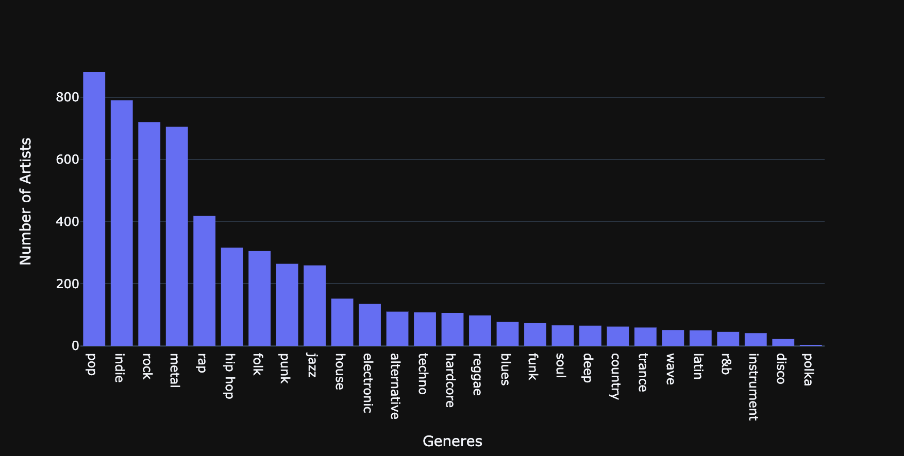
Artists per Genre

Slide 3
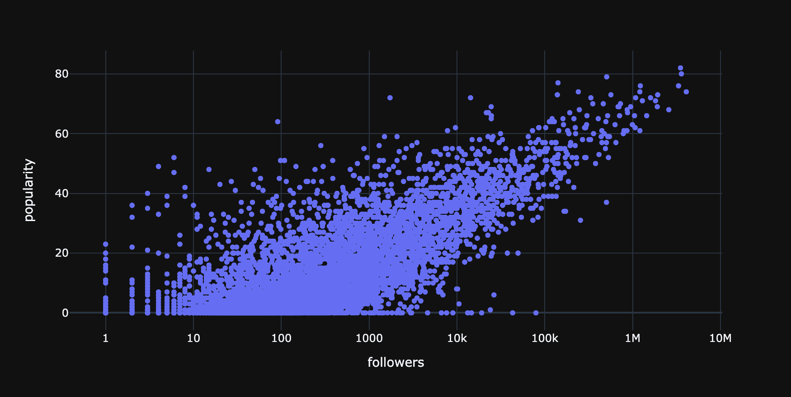
Relationship Followers / Popularity

Slide 4
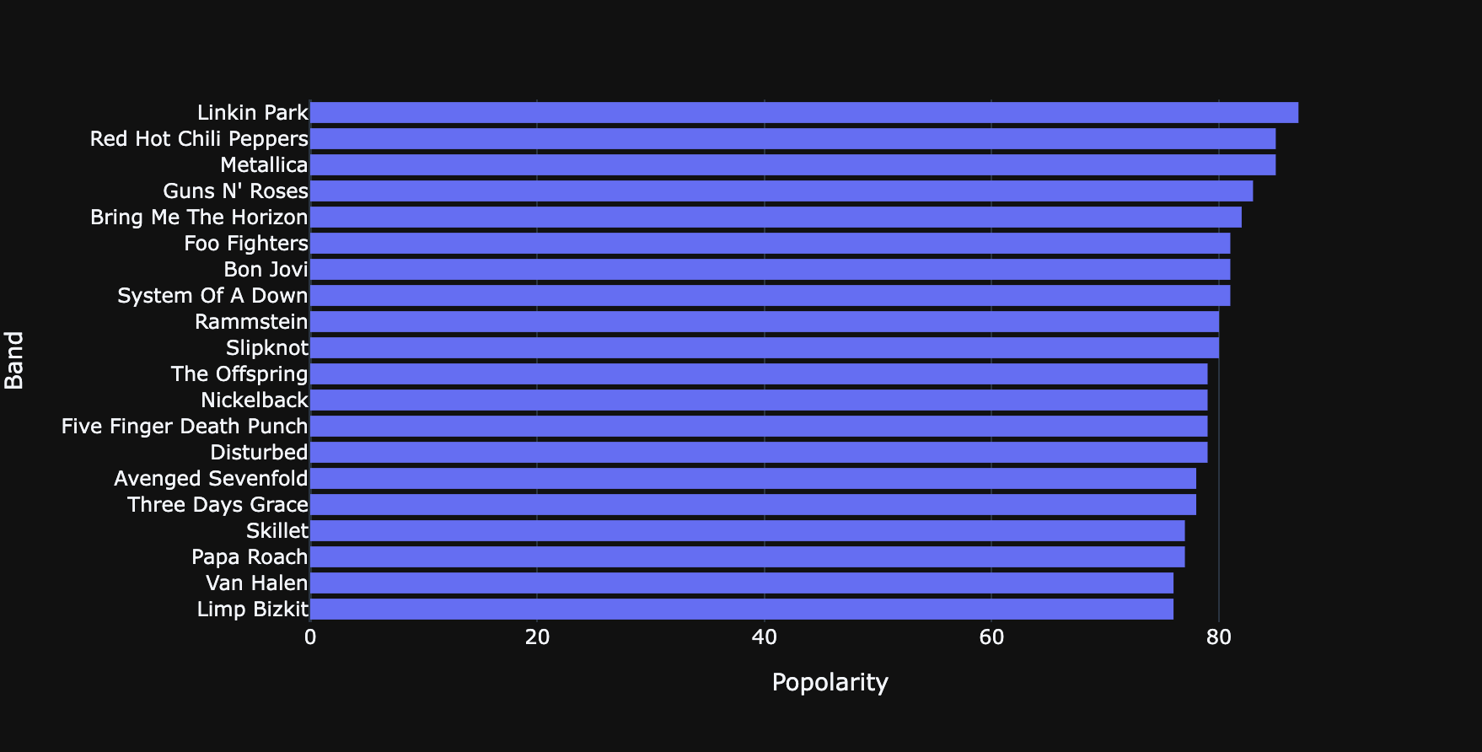
Most popular Metal Bands

Slide 5
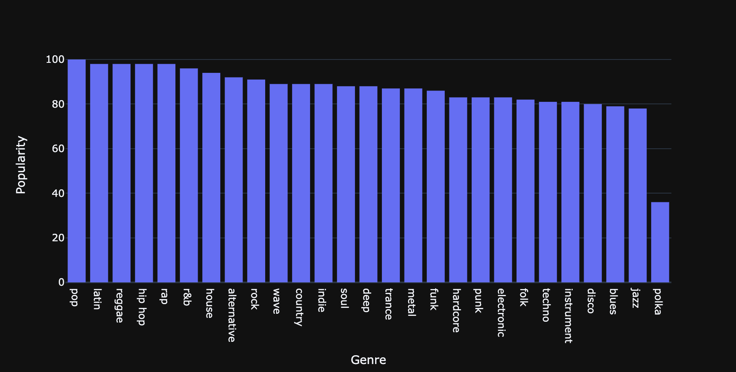
Most popular Genres

Slide 6
Some questions..

Slide 7
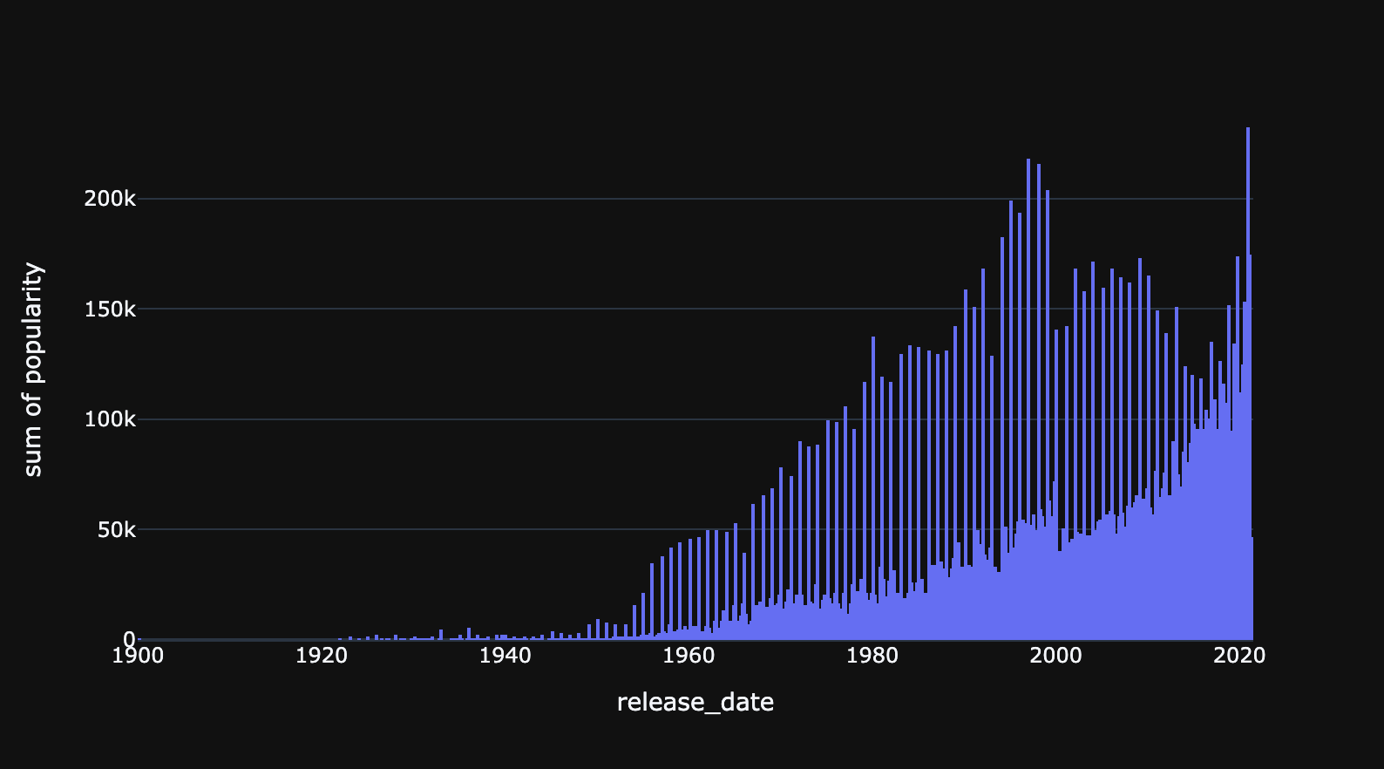
Is total Popularity related to Release Date ?

Slide 8
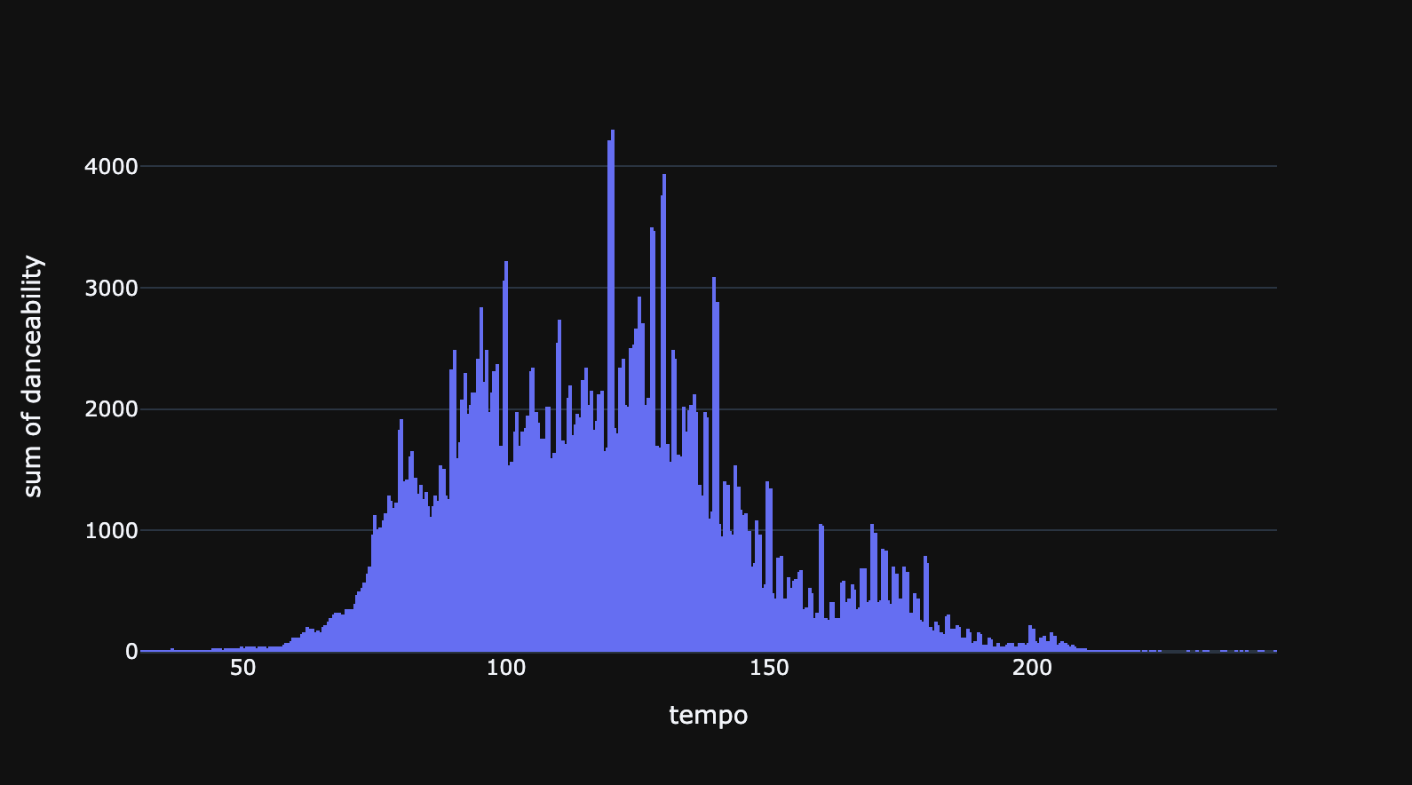
Is danceability related to tempo ?

