Slide 1
Directed Graphs
Computing 2 COMP1927 16x1

Slide 2
Directed Graphs
In our previous discussion of graphs:
an edge indicates a relationship between two vertices
an edge indicates nothing more than a relationship
In many real-world applications of graphs:
edges are directional (v → w ≠ w → v)
For example a one way street
Liking a fan page on facebook, following someone on twitter
Directed graphs include
edges that are directional
Self -loops

Slide 3
Potential Digraph Application Areas
Domain | Vertex | Edge
Web | Web page | Hyperlink
Chess | Board Pos | Legal Move
Scheduling | Task | Precedence
Program | Function | Function Call
Science | Journal Article | Citation

Slide 4
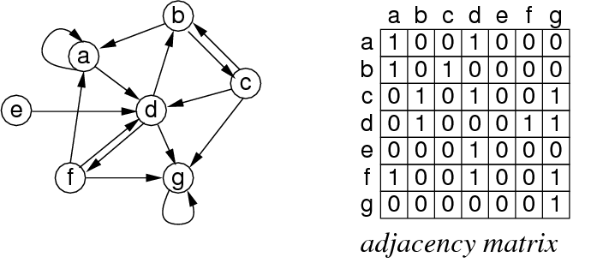
Example of a Directed Graph

Slide 5
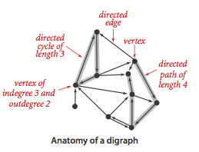
Terminology for Directed Graphs
Out-degree (d(v))
The number of directed edges leading out of the vertex
In-degree (d⁻¹(v))
The number of directed edges leading into a vertex
Directed acyclic graph (DAG):
graph containing no directed cycles

Slide 6
Terminology for Directed Graphs
Reachability:
w is reachable from v if there exists a directed path v,...,w
Strongly Connected:
Two vertices v and w are strongly connected if they are mutually reachable: there is a directed path from v to w and a directed path from w to v.
Strong connectivity:
every vertex is reachable from every other vertex
Strongly connected components:
A digraph that is not strongly connected consists of a set of strongly-connected components, which are maximal strongly-connected subgraphs.

Slide 7
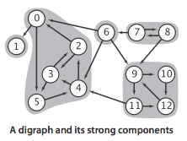
Strong Connected Components

Slide 8
Problems To Solve on Digraphs
is there a directed path from s to t? (transitive closure)
what is the shortest path from s to t? (shortest path)
are all vertices mutually reachable? (strong connectivity)
how to organise a set of tasks? (topological sort)
how to build a web crawler? (graph traversal)
which web pages are "important"? (PageRank)

Slide 9
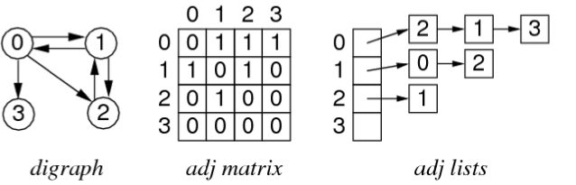
Digraph Representation
Similar set of choices as for non-directional graphs:
V vertices identified by 0 .. V-1
vertex-indexed adjacency matrix (non-symmetric)
vertex-indexed adjacency lists
What needs to be modified to turn our undirected graph implementations into directed graphs?

Slide 10
Cost of Representations
Where d(v) is the degree (out degree) of vertex v.
 | Storage | Add Edge | Edge Exist? | Get edges leaving v
Adj matrix | V + V² | 1 | 1 | V
Adj list | V + E | d(v) | d(v) | d(v)
Notes:
Overall, adjacency sets representation is best
real graphs tend to be sparse
large number of vertices
small average degree d(v)
algorithms frequently iterate over edges from v

Slide 11
Directed Graph Traversal
Can use some of the same algorithms as for non-directed graphs
depth-first searching (DFS)
breadth-first searching (BFS)
Example: Web Crawling
visit every page on the web
Solution:
breadth-first search with "implicit" graph
visit operation scans page and collects e.g. keywords and links
Assumption:
web is fully connected

Slide 12
Web Crawling Pseudo-Code
webCrawl(startingURL):
mark startingURL as alreadySeen
enqueue(Q, startingURL)
while not empty(Q)
nextPage = dequeue(Q)
visit nextPage
foreach (hyperLink in nextPage)
if (hyperLink not alreadySeen)
mark hyperLink as alreadySeen
enqueue(Q, hyperLink)
visit scans page and collects e.g. keywords and links

