Slide 1
Graph Search
Computing 2 COMP1927 16x1

Slide 2
Problems on Graphs
What kinds of problems do we want to solve on/via graphs?
Is there a simple path from A to B
Is the graph fully-connected?
Can we remove an edge and keep it fully connected?
Which vertices are reachable from v? (transitive closure)
What is the cheapest cost path from v to w?
Is there a cycle that passes through all V? (tour)
Is there a tree that links all vertices (spanning tree)
What is the minimum spanning tree?
Can a graph be drawn in a place with no crossing edges?
Are two graphs “equivalent”? (isomorphism)

Slide 3
Graph Search
We learn about properties of a graph by systematically examining each of its vertices and edges, for example
to compute the degree of all vertices, we visit each vertex and count it’s edges
for path related properties, we have to move from vertex to vertex, along the graphs edges
We implement a general graph search algorithms we can use to solve a wide range of graph problems

Slide 4
Simple Path Search
Problem: is there a path from vertex v to vertex w ?
Approach to solving problem:
examine vertices adjacent to v
if any of them is w, then we are done
otherwise check if there is a path from any of the adjacent vertices
repeat looking further and further from v
Two different approaches to order of searching: breadth-first search (BFS), depth-first search (DFS)

Slide 5
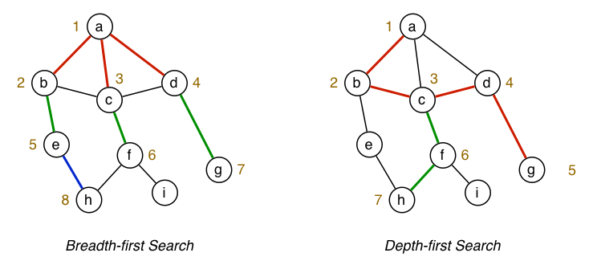
BFS vs DFS path finding
Is there a path from a to h?

Slide 6
DFS vs BFS Approaches
DFS and BFS are closely related.
Implementation differs only their use of a stack or a queue
BFS implemented via a queue of to-be-visited vertices
DFS implemented via a stack of to-be-visited vertices (or recursion)
Both approaches ignore some edges and avoid cycles by remembering previously visited vertices.

Slide 7
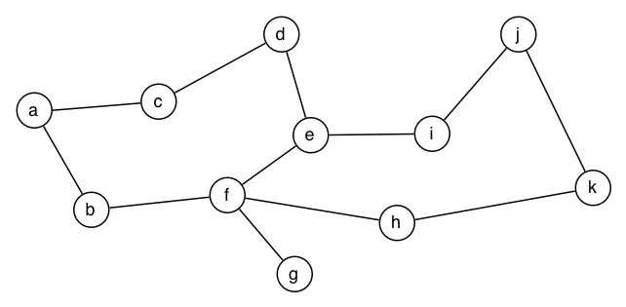
Exercise: DFS and BFS Traversal
Show the DFS order we visit to determine isPath(a,k)
Show the BFS order we visit to determine isPath(a,k)
Assume neighbours are chosen in alphabetical order

Slide 8
Depth First Search
Basic approach to depth-first search:
visit and mark current vertex
for each neighbour, traverse it recursively
Notes:
need a mechanism for "marking" vertices
in fact, we number them as we visit them (so that we could later trace path through graph)
Make use of three global variables:
count ... counter to remember how many vertices traversed so far
pre[] ... array saying order in which each vertex was visited (pre stands for preorder)
st[] … array storing the predecessor of each vertex (st stands for spanning tree)

Slide 9
Depth First Search Tree
The edges traversed in a graph walk form a tree
It corresponds to the call tree of the recursive dfs function
Represents the original graph minus any cycles or alternate paths
We can use a tree to encode the whole search process
Each time we visit a vertex we record the previous vertex we came from - if the graph is connected this forms a spanning tree
We store this in the st array

Slide 10
Depth First Search (DFS)
0
1
0
2
2
6
7
6
1
7
5
5
4
3
4
3
// Assume we start with dummy Edge {0,0}
// assume we start with count = 0
// pre[v] = -1 for all v
// st[v] = -1 for all v (stores the predecessor)
// assume adjacency matrix representation
void dfsR (Graph g, Edge e) {
Vertex i, w = e.w;
pre[w] = count++;
st[w] = e.v;
for (i=0; i < g->V; i++){
if ((g->edges[w][i] == 1) && (pre[i] == -1)
dfsR (g, mkEdge(g,w,i));
}
}
}

Slide 11
Depth First Search (DFS)
0
1
0
2
2
0
6
7
6
1
7
2
5
5
4
3
4
3
6
pre
st
0 | 1 | 2 | 3 | 4 | 5 | 6 | 7
0 | 7 | 1 | 4 | 3 | 5 | 2 | 6
0 | 7 | 0 | 4 | 6 | 3 | 2 | 4
4
3
7
the edges traversed in the graph walk form a tree
the tree corresponds to the call tree of the depth first search
and to the contents of the st array - spanning tree
pre contains the pre-ordering of the vertices
5
1

Slide 12
Properties of DFS forests
If a graph is not connected it will produce a spanning forest
If it is connected it will form a spanning tree
we call an edge connecting a vertex with an ancestor in the DFS tree that is not its parent a back edge
0
2
0
6
1
7
2
back edge
5
6
3
4
4
3
7
5
1

Slide 13
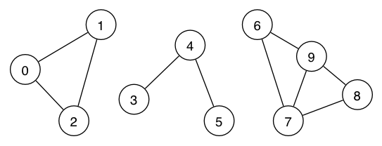
Exercise: DFS Traversal
Which vertices will be visited during dfs(g):
How can we ensure that all vertices are visited?
Notes:
Which vertices will be visited during dfs(g):

Slide 14
Graph Search function
The graph may not be connected
We need to make sure that we visit every connected component:
void dfSearch (Graph g) {
int v;
count = 0;
pre = malloc (sizeof (int) * g->nV));
st = malloc(sizeof (int) * g->nV));
for (v = 0; v < g->nV; v++){
pre[v] = -1;
st[v] = -1;
}
for (v = 0; v < g->V; v++) {
if (pre[v] == -1)
dfsR (g, mkEdge(g,v,v));
}
}
The work complexity of the graph search algorithm is O(V²) for adjacency matrix representation, and O(V+E) for adjacency list representation

Slide 15
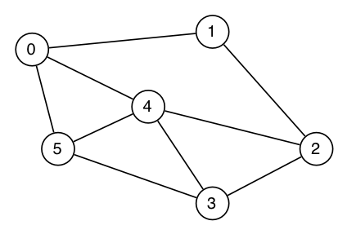
Exercise: DFS Traversal
Trace the execution of dfs(g,0) on:
What if we were using DFS to search for a path from 0..5? We would get 0-1-2-3-4-5. If we want the shortest (least edges/vertices) path we need to use BFS instead. See later slides for this.
Notes:
Trace the execution of dfs(g,0) on:

Slide 16
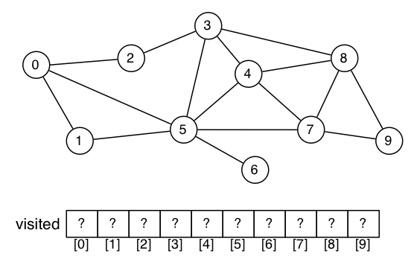
Exercise: DFS Traversal
Show the final state of the pre and st arrays after dfs(g,0):
Notes:
Show the final state of the visited array after dfs(g,0):

Slide 17
Non-Recursive Depth First Search
We can use a stack instead of recursion:
void dfs (Graph g, Edge e) {
int i;
Stack s = newStack();
StackPush (s,e);
while (!StackIsEmpty(s)) {
e = StackPop(s);
if (pre[e.w] == -1) {
pre[e.w] = count++;
st[e.w] = e.v;
for (i = 0; i < g->nV; i++) {
if ((g->edges[e.w][i] == 1)&&
(pre[i] == -1)) {
StackPush (s,mkEdge(g,e.w,i));
}
}
}
}
}

Slide 18
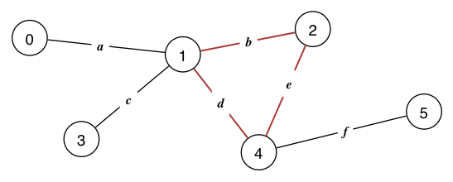
DFS Algorithms: Cycle Detection
Cycle detection: does a given graph have any cycles?
if and only if the DFS graph has back edges, it contains cycles
we can easily detect this in the DFS search:
Notes:
A graph has a cycle ifit has a path of length > 1
with start vertex src = end vertex dest
Function bool hasCycle(Graph g) tells us this.We are not required to give the path, just indicate its presence.

Slide 19
DFS Algorithms: Cycle Detection
We are only checking for the existence of cycle, we are not returning it
//Return 1 if there is a cycle
int hasCycle (Graph g, Edge e) {
int i, w = e.w;
pre[w] = count++;
st[w] = e.v;
for (i=0; i < g->V; i++){
if ((g->edges[w][i] == 1) && (pre[i] == -1)) {
if(hasCycle (g, mkEdge(g,w,i)))
return 1;
} else if( (g->edges[w][i] == 1) && i != e.v){
//if it is not the predecessor
return 1;
}
}
return 0;
}
Notes:
Can be

Slide 20
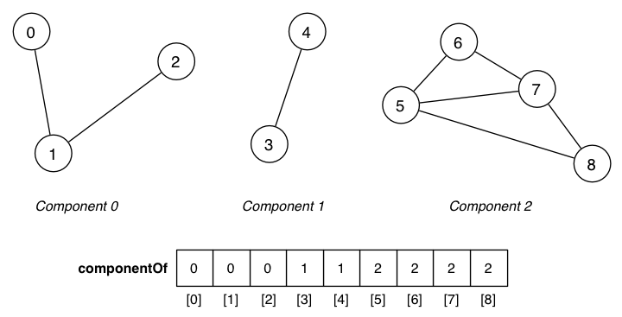
DFS Algorithms: Connectivity
Each vertex belongs to a connected component
The function connectedComponents sets up the array cc to indicate which component contains each vertex
cc
Notes:
Each vertex belongs to a connected componentFunction components(Graph g) sets up componentOf[]
componentOf[v] indicates which component contains v

Slide 21
DFS Algorithms
Connectivity:
maintain an extra array cc for connected components
void connectedComponents (Graph g) {
int v;
count = 0;
ccCount = 0;
pre = malloc (g->nV *sizeof (int));
cc = malloc (g->nV *sizeof (int));
st = malloc (g->nV *sizeof (int));
for (v = 0; v < g->nV; v++) {
pre[v] = -1;
st[v] = -1;
cc[v] = -1;
}
for (v = 0; v < g->V; v++) {
if (pre[v] == -1) {
connectedR (g, mkEdge(g,v,v));
ccCount++;
}
}
}
void connectedR (Graph g, Edge e) {
int i, w = e.w;
pre[w] = count++;
st[w] = e.v;
cc[w] = ccCount;
for (i=0; i < g->V; i++){
if ((g->edges[currV][i] == 1) &&
(pre[i] == -1)) {
dfsR (g, mkEdge(g,w,i));
}
}
}

Slide 22
Breadth-First Search
What if we want the shortest path between two vertices?
DFS doesn’t help us with this problem
To find the shortest path between v and any vertex w
we visit all the vertices adjacent to v (distance 1)
then all the vertices adjacent to those we visited in the first step (distance 2)
0
2
0
6
2
3
7
1
7
5
6
4
5
1
3
4

Slide 23
Breadth-First Search
We observed previously that we can simply replace the stack with a queue in the non-recursive implementation to get breadth -first search:
void bfs (Graph g, Edge e) {
int i;
Queue q = newQueue();
QueueJoin(q,e);
while (!QueueIsEmpty(q)) {
e = QueueLeave(q);
if(pre[e.w] == -1){
pre[e.w] = count++;
st[e.w] = e.v;
for (i = 0; i < g->nV; i++){
if ((g->edges[e.w][i] != 0)&&
(pre[i] == -1)) {
QueueJoin (q,mkEdge(g,e.w,i));
}
}
}
}
}

Slide 24
Improved Breadth-First Search
We can mark them as visited as we put them on the queue since the queue will retain their order. Queue will have at most V entries
void bfs (Graph g, Edge e) {
int i;
Queue q = newQueue();
QueueJoin (q,e);
pre[e.w] = count++;
st[e.w] = e.v;
while (!QueueIsEmpty(q)) {
e = QueueLeave(q);
for (i = 0; i < g->V; i++) {
if ((g->edges[e.w][i] != 0)&&(pre[i] == -1)) {
QueueJoin (q,mkEdge(g,e.w,i));
pre[i] = count++;
st[i] = e.w;
}
}
}
}

Slide 25
Exercise: BFS Traversal
Show the final state of the pre and st arrays after bfs(g,0):
Write code to print out the shortest path from 0 to a given vertex v using the st array.
Notes:
Show the final state of the visited array after dfs(g,0):

Slide 26
Breadth-First Search
For one BFS: O(V^2) for adjacency matrix and O(V+E) for adjacency list
We can do BFS for every node as root node, and store the resulting spanning trees in a V x V matrix to store all the shortest paths between any two vertices
To store and calculate these spanning trees, we need
memory proportional to V * V
time proportional to V * E
Then, we can
return path length in constant time
path in time proportional to the path length

