Slide 1
Priority Queues and Heaps
Computing 2 COMP1927 17x1

Slide 2
PRIORITY
Some applications of queues require items processed in order of "key" or priority rather than in order of entry (FIFO)
Priority Queues (PQueues or PQs) provide this via:
  Insert item with a given priority into PQ
  Remove item with highest priority key
    Highest priority key may be one with smallest or largest value depending on the application
Plus generic ADT operations:
new, drop, empty, …

Slide 3
PRIORITY QUEUE INTERFACE
typedef struct priQ * PriQ;
//We assume we have a more complex Item type that has
//a key and a value, where the key is the priority and the
//value is the data being stored
// Core operations
PriQ initPriQ(void);
void insert(PriQ q, Item i);
//retrieve and delete Item with highest priority
Item delete(PriQ q);
// Useful operations
int sizePriQ(PriQ q);
void changePriority(PriQ q, Key k, Item i);
void deleteKey(PriQ q, Key k);
int maxSize(PriQ q);

Slide 4
COMPARISON OF PRIORITY QUEUE IMPLEMENTATIONS
Data Structure | Insert | Delete | IsEmpty
Sorted Array | O(N) | O(1) | O(1)
Unsorted Array | O(1) | O(N) | O(1)
Sorted List | O(N) | O(1) | O(1)
Unsorted List | O(1) | O(N) | O(1)
Can we implement BOTH operations efficiently?
Yes with a heap
O(log N) for insert and delete
Heap | O(logN) | O(logN) | O(1)

Slide 5
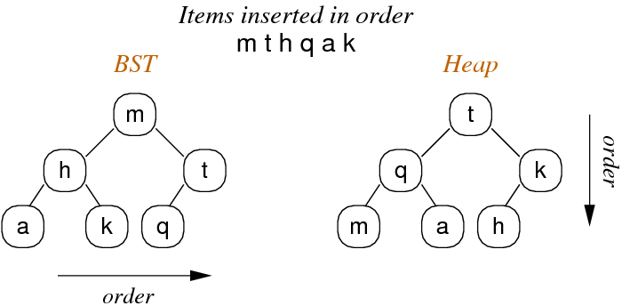
HEAP ORDER PROPERTY
Heaps can be viewed as trees with top-to-bottom heap ordering
    for all keys both subtrees are ≤ root
    property applies to all nodes in tree (i.e. root contains largest value in that subtree)

Slide 6
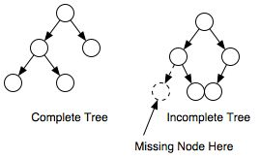
COMPLETE TREE PROPERTY
Heaps are "complete trees“
  every level is filled in before adding a node to the next level
  the nodes in a given level are filled in from left to right, with no breaks.

Slide 7
HEAP IMPLEMENTATIONS
BSTs are typically implemented as linked data structures
Heaps CAN be implemented as linked data structures
  Heaps are TYPICALLY implemented via arrays.
  The property of being complete makes array implementations suitable

Slide 8
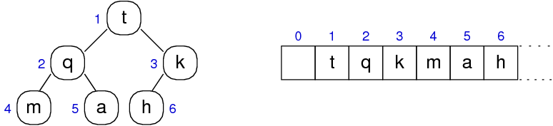
ARRAY BASED HEAP IMPLEMENTATION
Simple index calculations allow navigation through the tree:
  left child of node at index i is located at 2i
  right child of node at index i is located at 2i+1
  parent of node at index i is located at i/2

Slide 9
ARRAY BASED HEAP IMPLEMENTATION
Heap data structure:
typedef struct HeapImp { Item *items; // array of Items int nitems; // #items in array } HeapImp; typedef HeapImp *Heap;

Slide 10
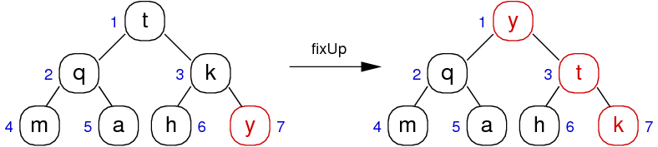
HEAP INSERTION : BOTTOM-UP HEAPIFY
Insertion is a two-step process
  add new element at bottom-most, rightmost position
  reorganise values along path to root to restore heap property

Slide 11
HEAP INSERTION FIX-UP CODE
  // force value at a[k] into correct position
  void fixUp(Item a[], int k) {
  while (k > 1 && less(a[k/2],a[k])) {
  swap(a, k, k/2);
  k = k/2; // integer division
  }
  }
Notes:
Exercise m t h q a k

Slide 12
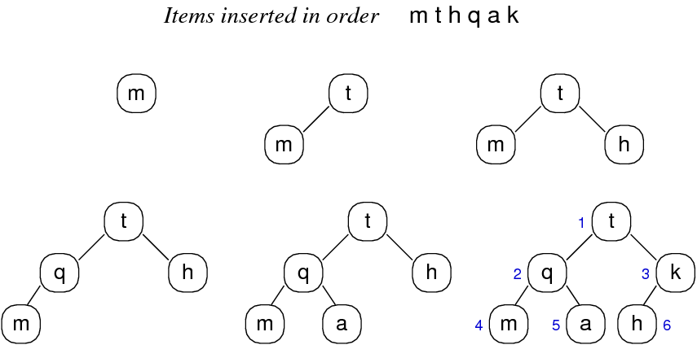
HEAP INSERTION

Slide 13
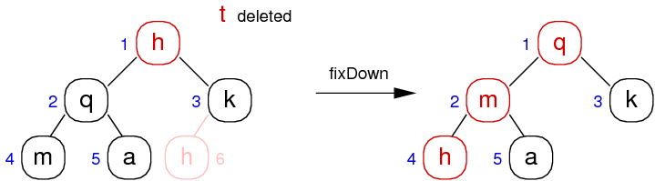
DELETION WITH HEAPS – TOP-DOWN HEAPIFY
Deletion is a three-step process
To delete node at position, k
  replace node[k] by bottom-most, rightmost value
  remove bottom-most, rightmost value
  restore heap by reorganizing values by moving down the heap, exchanging node[k] with the larger of the node’s children, stopping when node[k] is not smaller than either child or bottom is reached.

Slide 14
HEAP DELETION FIX-DOWN CODE
void fixDown(Item a[], int k) {
int done = 0;
while (2*k <= N && !done) {
int j = 2*k; //choose larger of two children
if (j < N && less(a[j], a[j+1])){
j++;
}
if (!less(a[k], a[j])){
done =1;
}else{
swap(a, k, j);
k = j;
}
}
}

Slide 15
EXERCISE:
Show the construction of the max heap produced by inserting
  H E A P S F U N
Show the heap after an item is deleted.
Show the heap after another item is deleted.

Slide 16
HEAPS AS PRIORITY QUEUES
Heaps are typically used for implementing Priority Queues
  - priorities determined by order on keys
  - new items added initially at lower-most, right-most leaf
  - then new item "drifts up" to appropriate level in tree
  - items are always deleted by removing root (top priority)
Since heaps are dense trees, depth = floor(log₂N)+1
Insertion cost = O(logN), Deletion cost = O(logN)

