Slide 1
Chapter 9-Silent Spring
By Changxin Fu
Fei Wang
Yuxuan Zhang

Slide 2
Part 1 introduction&Evaluation
silence spring
problem
jugement
solution
consequences
chapter1-3
chapter15-16
chapter17
nature
human
chapter4-10
chapter11-14
chapter 9 — RIVERS OF DEATH
calamity aquatic organism

Slide 3
Part 2:Discussion & Comment
Discussion 1:
1.What do you feel about the fate of salmon （trout ）and other creatures influenced by the spread of pesticide?
My feeling is:
Nothing except the greed of human can be responsible for the tragic lot of the fishes and all the lives in the waters. It is a total man-made disaster.

Slide 4
Part 2:Discussion & Comment
Discussion 2:
2.What did we do to improve the situation in China?
As is mentioned in Page 144, our China was facing the same problem. And we also have an easy access to the shocking statistics supporting how serious the solid and water pollution in China is.
However, we are not doing nothing as some articles argues. According to China Pesticide Information Network[1],the process of pesticide using has been standardized and limitation has been set to prevent abuse.

Slide 5
Part 2:Discussion & Comment
Discussion 2:
Also, according to a bulletin of China’s solid pollution status provided by Ministry of Environmental Protection of China (2014)[2], five main methods are being taken to improve the situation, and great resolution has been showed.
There are plans for solving water pollution as well. According to a notice by the government(2015)[3] , effective actions are being taken.

Slide 6
Part 2:Discussion & Comment
Discussion 2:
But this is far not enough.
Over the last 40 years, many efforts have been made to save the Atlantic salmon. Hundreds of millions of dollars have been spent on Atlantic salmon hatcheries, enhancement programs, and research. Over the last 30 years, there have been over 10,000 primary scientific research publications devoted to Atlantic salmon biology, ecology, and management. Still the salmon continue to decline. There are renewed calls for more money and more research to explain the "mystery" in the decline of Atlantic salmon in New Brunswick.(2000)[4]

Slide 7
Part 2:Discussion & Comment
Discussion 2:
In a word, we should be neither too negative nor too confident to view the problem. All we should do is to be sufficiently aware and try our best.

Slide 8
Part 2:Discussion & Comment
Comment:
We are always told to have long-term vision. We are short-sighted though, both in time and space -- unable to really care about what we cannot see and feel, or about what the future consequences of our actions might be.

Slide 9
Part 2:Discussion & Comment
Comment:
We care about fishery, care about the outputs of our agriculture, so we hope a sincere effort to cut down half dosage of insecticides will help. We invested heaps of money in killing the “harmful” insects and passingly killing most of the fishes in the rivers, but we are not willing to afford the funds for the proposes to research for the influences and interactions of pesticides. We are pushing some of the species towards one-way road of distinction, and still not so aware of our plight.

Slide 10
Part 2:Discussion & Comment
Language:
Although Rachel Carson earned her fame of being too emotional and literal in her work The Silent Spring, in the part of example illustration, her words seem objective and reasonable. Her words enjoy an ability to convince everyone.

Slide 11
Part 2:Discussion & Comment
Language:
Sometimes, too persuasive that we may accept her idea without critical thinking. We have to admit that nothing is perfect. Some of her citations led to some researches themselves controversial.[5]In this chapter, unfortunately, her poetic lines do not display its beauty very much.

Slide 12
Part 3:Literature
In this chapter, Rachel Carson mainly talks about the effects of spraying DDT and other pesticides on aquatic animals.
Rachel Carson mainly focused on:
1.salmon( trout )
2.the whole wildlife(different fishes)
3.fishery

Slide 13
Part 3:Literature
Q:How Rachel Carson dealt with the literature or the sources
A:Firstly, she divided all the literature into three parts as I’ve mentioned
Part 1: DDT to Salmon—fishes of running streams. (budworm)
Part 2: all the pesticides to wildlife—fishes and so on.
Part 3: Effects on human (fishery as hobby and as commerce)

Slide 14
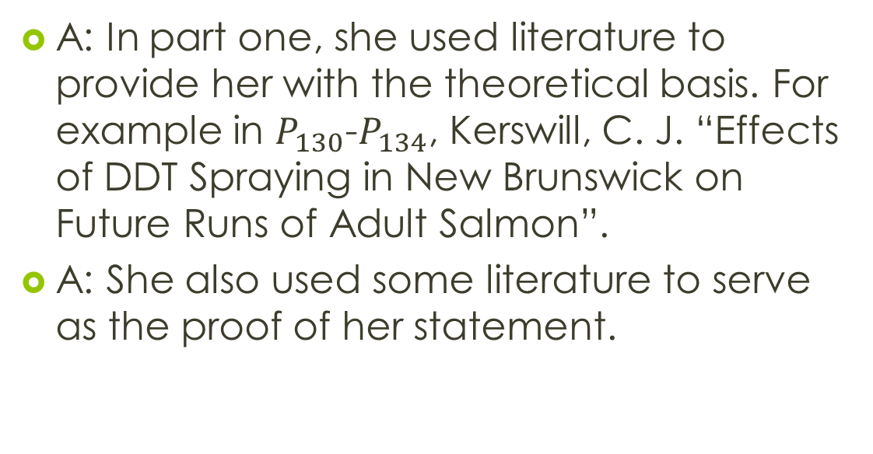
Part 3: Literature
A: In part one, she used literature to provide her with the theoretical basis. For example in $P_{130}$-$P_{134}$, Kerswill, C. J. “Effects of DDT Spraying in New Brunswick on Future Runs of Adult Salmon”.
A: She also used some literature to serve as the proof of her statement.

Slide 15
Part 3: Literature
A: In part two, most of the literature she referred to were paraphrased by herself and used, which could bring some conclusions of the harm of different pesticides on all species in river.
A:But the rest were direct citation. For example, Harrington, R. W. and W. L. Bidlingmayer,“Effects of Dieldrin on Fishes and Invertebrates of a Salt Marsh ”.

Slide 16
Part 3: Literature
A: While in part three, she only referred to a few literature. One of them showed the progress in sport fishery, while others described the disastrous effects of pesticides on shrimp and oysters which are the supply for the market.

Slide 17
Part 4:References
[1]中国农药信息网，http://www.chinapesticide.gov.cn/
[2]环境保护部，环境保护部和国土资源部发布全国土壤污染状况调查公报，2014年04月17日。http://www.mep.gov.cn/gkml/hbb/qt/201404/t20140417_270670.htm
[3] 水资源管理网，国务院关于印发水污染防治行动计划的通知，2015年06月27日。http://szy.mwr.gov.cn/zdgz/sstwmjs/201506/t20150627_686661.html
[4] Inka Milewski, June, 2000, Rivers of Death Revisited --A Tribute to Rachel Carson, EcoAlert , http://www.elements.nb.ca/theme/artists/inka/milewski.htm
[5]Dr. J. Gordon Edwards ,The Lies of Rachel Carson, the Summer 1992 21st Century, http://www.21stcenturysciencetech.com/articles/summ02/Carson.html

Slide 18
Thank you for watching!

