Slide 1
Group 5
Exploring the effects of
background music
Reporter: 徐菲，于沛钰
李梓铉，王菲
Notes:
Hi, everyone. We’re group 5 and going to talk about the effects of music on our working efficiency.
Before going any further, please allow me and my partner to introduce ourselves.
I’m 于沛钰 from the Department of Automation, and;

Slide 2
Introduction
Reporter: 徐菲

Slide 3
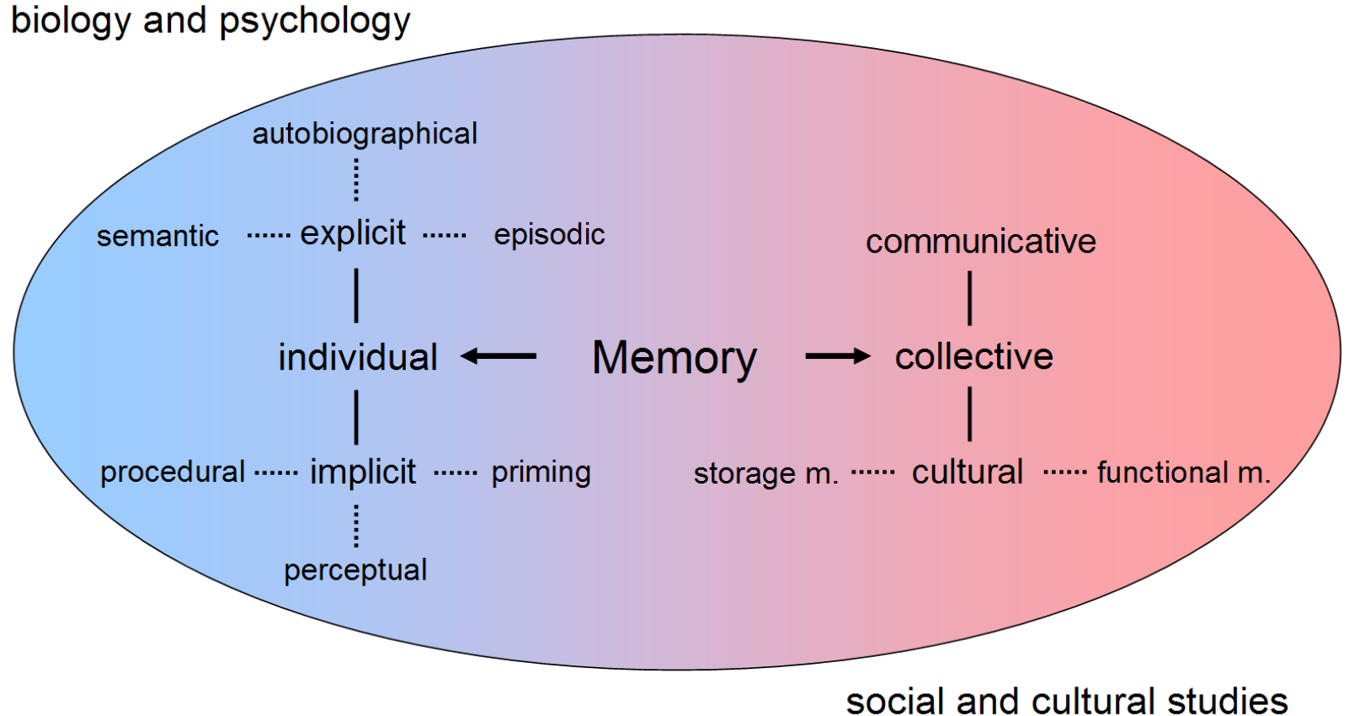
Memory
- Encoded
- Stored
- Retrieved
Notes:
Memory is the faculty of the mind by which information is encoded, stored, and retrieved.
Memory is vital to experiences and related to limbic systems, it is the retention of information over time for the purpose of influencing future action. If we could not remember past events, we could not learn or develop language, relationships, nor personal identity.
Often memory is understood as an informational processing system with explicit and implicit functioning that is made up of a sensory processor, short-term (or working) memory, and long-term memory. This can be related to the neuron. The sensory processor allows information from the outside world to be sensed in the form of chemical and physical stimuli and attended to with various levels of focus and intent. Working memory serves as an encoding and retrieval processor. Information in the form of stimuli is encoded in accordance with explicit or implicit functions by the working memory processor. The working memory also retrieves information from previously stored material. Finally, the function of long-term memory is to store data through various categorical models or systems.

Slide 4
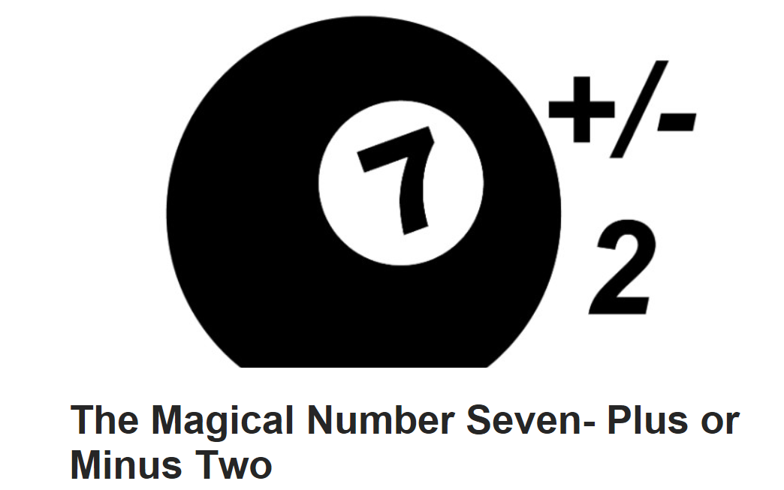
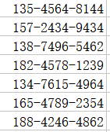
Short-term memory
- 123
Chunking
- 4567
12345678910
- 8910
Acoustic Code
Notes:
Short-term memory is also known as working memory. Short-term memory allows recall for a period of several seconds to a minute without rehearsal.
Its capacity is also very limited: George A. Miller (1956), when working at Bell Laboratories, conducted experiments showing that the store of short-term memory was 7±2 items (the title of his famous paper, "The magical number 7±2").
Modern estimates of the capacity of short-term memory are lower, typically of the order of 4–5 items; however, memory capacity can be increased through a process called chunking. For example, in recalling a ten-digit telephone number, a person could chunk the digits into three groups: first, the area code (such as 123), then a four-digit chunk (4567) and lastly a four-digit chunk (8910). This method of remembering telephone numbers is far more effective than attempting to remember a string of 11 digits; this is because we are able to chunk the information into meaningful groups of numbers. This may be reflected in some countries in the tendency to display telephone numbers as several chunks of two to four numbers.
Short-term memory is believed to rely mostly on an acoustic code for storing information, and to a lesser extent a visual code. Conrad (1964) found that test subjects had more difficulty recalling collections of letters that were acoustically similar (e.g. E, P, D). Confusion with recalling acoustically similar letters rather than visually similar letters implies that the letters were encoded acoustically.

Slide 5
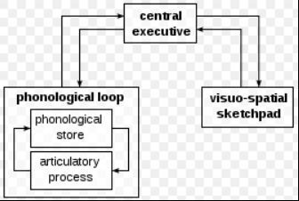
Short-term memory and background
Visual
Spatial
Verbal
Chronological ordering
The episodic buffer
link
Notes:
The central executive essentially acts as an attention sensory store. It channels information to the three component processes: the phonological loop, the visuo-spatial sketchpad, and the episodic buffer.
The phonological loop stores auditory information by silently rehearsing sounds or words in a continuous loop: the articulatory process (for example the repetition of a telephone number over and over again). A short list of data is easier to remember.
The visuospatial sketchpad stores visual and spatial information. It is engaged when performing spatial tasks (such as judging distances) or visual ones (such as counting the windows on a house or imagining images).
The episodic buffer is dedicated to linking information across domains to form integrated units of visual, spatial, and verbal information and chronological ordering (e.g., the memory of a story or a movie scene). The episodic buffer is also assumed to have links to long-term memory and semantical meaning.

Slide 6
Research purpose
Some studies have used background music to explore the effect of irrelevant speech
Previous research
their memory materials are usually not suitable for short-term memory and subjects are various
Gap:
explore the effects of background music on short-memory of college students
Aim:
Notes:
Since the 1960s, scientists have been doing research about the influence of music on human’s memory. Some studies have used background music to explore the effect of irrelevant speech, and it has been found that different types of background music have different effects on current learning tasks.
Previous studies have proved that the auditory input of speech unrelated to the memory task will affect the subjects' current visual memory task. It is found that their memory materials are usually not suitable for short-term memory and subjects are various. Although some studies divided different types of music specifically, we believe that the most important factor is whether the background music has lyrics. Thus we chose three experimental background to do our research.
The research aims to explore the effects of background music on short-memory of college students. We hope that our research can guide college students to listen to music scientifically in the learning process, thus improving our learning efficiency.

Slide 7
Method
Reporter: 于沛钰
Notes:
I’m glad that 徐菲 has given a wonderful report about the introduction section of our study.
Now let’s take a brief look at the method section. And I hope you find it interesting: )

Slide 8
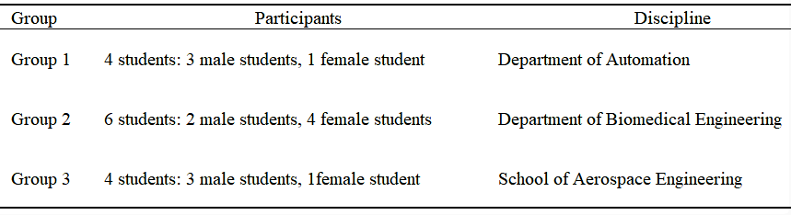
Participants
- Department of Automation (DA)
in their second year of study (mean age: 20.5, sd: 0.3)
- Department of Biomedical Engineering (DBE)
- School of Aerospace Engineering (SAE)
Notes:
（动画0）In our study, the participants were students recruited from Department of Automation (DA) （动画1）, Department of Biomedical Engineering (DBE) （动画2） and School of Aerospace Engineering (SAE) （动画3）. （动画 4 5 6） A total of 14 students including 8 males and 6 females, who were in their second year of study with a mean age of 20.5 and standard deviation of 0.3, were divided into three groups, as is shown in the table.
Each group was homogeneous with regard to discipline, as issues pertinent to understanding the effects of background music might be discipline specific, and would therefore impact on the outcome. The age difference was considered to have minor impact, whilst the impact of gender differences was exclusively investigated and gender was designed as one of the independent variables in the study.

Slide 9
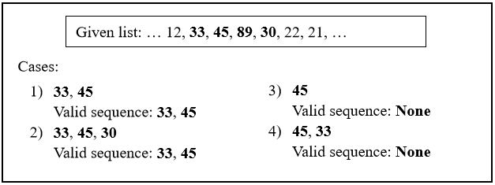
Design
Self-control study
immediate test
Control Section
Treatment 1 Mozart’s Sonata
Treatment 2 self-selected
Brown-Peterson task
(Brown, 1958)
Random 2-bit decimal integers
Notes:
（动画0）This is a self-control study（动画1）, where we managed to collect quantitative data by engaging participants in a deliberately designed immediate test（动画2）, which consisted of three sections. The test is a variant of the Brown-Peterson task (Brown, 1958)（动画3）, （动画4、5、6）which aimed to test the quantity of objects that can be held in working memory while preventing participants from using mnemonics(ni;monics) or other memory techniques separated from the working memory to increase recall capacity.
Basically, the three sections were assigned as a Control section (no audio messages)（动画7）, and two Treatment sections: （动画8）Treatment 1 with Mozart’s Sonata, and （动画9）Treatment 2 with self-selected music via CloudMusic. In each section background music maintained a time period of 30s as BGM session.
During the session, each participant was provided with a sheet of 100 random 2-bit decimal integers（动画10）, where their goal was to memorize as many sequences of numbers as they could, with background music played correspondingly.
（动画11）Well, in order to weaken the stochastic error, the valid sequence in the test, is defined as a substring of the given numbers, with its length greater than or equal to 2, as demonstrated in the Figure.
You might have noticed that Length here refers to the number of （重读）2-bit decimal integers which doesn’t follow the convention of Cstring.
For example, Length of the string 33, 45 is 2 but not 4.

Slide 10
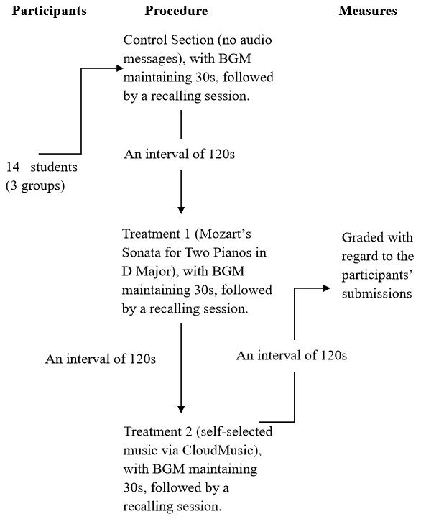
Whole procedure
Notes:
（动画0）The overall procedure is illustrated in the Figure.（动画1）In each section, the BGM session was followed by a recalling session and then an interval for participants to buffer. As the BGM session ended, sequences were recalled and recorded in reports by participants and then submitted to the moderator in the following recalling session. The interval between sections was set to a time period of 120s to eliminate or minimize the interference of sessions in the former section. Finally, after the whole three sections, each participant was graded with regard to their submissions.

Slide 11
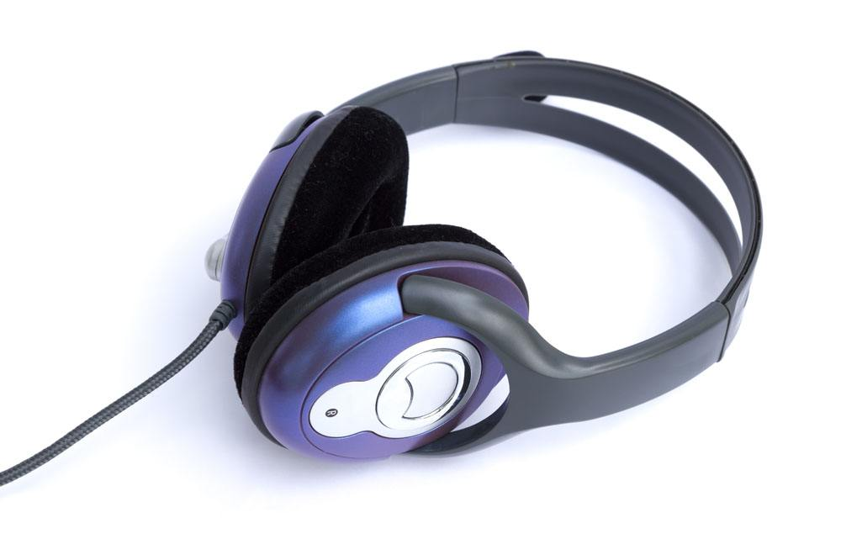
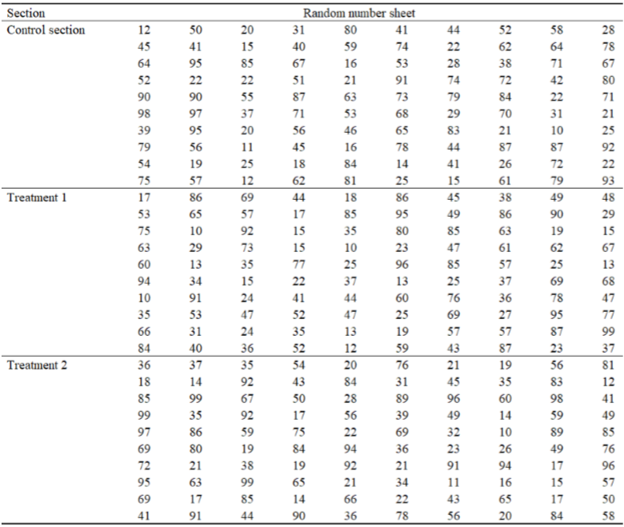
Materials
Notes:
（动画0）As for the textual materials（动画1）, three distinct random number sheets were provided for each section, to ensure removal of interference from the former section. Each sheet contained 100 2-bit decimal integers.
As for the audio materials（动画2）, background music for each section was played by CloudMusic, and each participant was asked to put on an on-ear headphone to circumvent the possible perturbations of environment noise. The volume of background music was set by participants to meet their personal needs, as an ablation of its impact.

Slide 12
Data Analysis
Dependent variable:
Independent variables:
participant’s achievement of each section, as well as an aggregate score for the whole process
discipline (3 levels – DA, DBE, and SAE)
gender (2 levels – male and female)
audio (3 levels – none, Mozart’s music, and self-selected)
the score had a positive correlation with the attention and immediate memory
Notes:
（动画0）Inspired by Sittler’s (2015) study, （动画1）the present study utilized a 3, 2, 3 factorial immediate test with three independent variables: （动画2）discipline, gender and audio. （动画3）The dependent variable measured （动画4）participant’s achievement of each section, as well as an aggregate score for the whole process. We assumed that （动画5） the score had a positive correlation with the attention and immediate memory of participants, and each participant was evaluated on the principle.

Slide 13
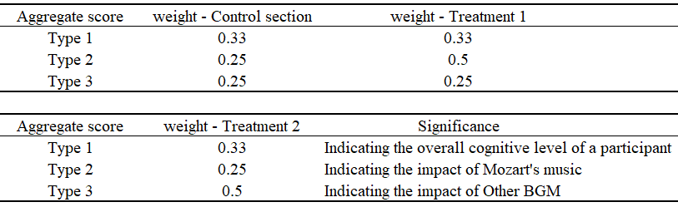
Data Analysis
a maximum score per participant was 100 points (100 numbers * 1 point)
the weighted sum model (WSM)
(Fishburn, 1967)
Notes:
For each section, the summation of the valid sequences’ lengths was documented as the score, and （动画1） a maximum score per participant was 100 points. For the whole procedure, （动画2）the weighted sum model (WSM) (Fishburn, 1967) was employed for the aggregate score, which contained three different patterns to help analyze how the impact of background music varies with its type.
As a self-control study, the variation of each section’s score per participant indicated the distinctive effects of different background music types, while this variation could probably be individual specific. For further investigation of the interindividual differences in perception (Simmons et al., 2008), an inclusion of three sets of weights for WSM （动画 3） was considered to be necessary. The principle of setting the weights was increasing the weight of the specified section that might contribute to the manifestation of background music’s impact while maintaining the influence of control section. The detailed composition of aggregate score and its related significance are illustrated in the Table.
Well, I guess that’s a little bit more than enough for a brief look. And I’m Sorry about that.
So that’s all about the method section. Now let’s welcome our next reporter to introduce the result section to you.
Thank you for your time.

Slide 14
Discussion
Reporter: 王菲
Notes:
Thanks for zixuan’s report for result section, I’m wangfei.
And here I ‘ m going to briefly introduce the section of discussion in a light-hearted way.

Slide 15
Higher basic attention and immediate memory level (AIML)
Other participants
math
Notes:
it is necessary to consider the interindividual differences of perception. The scores of the tests can indicate the attention and immediate memory level. It seems that gender and discipline appeared to have a distinct correlation with the level. In our control group, female and participants fond of math had higher basic AIML. The key reason of their score advantage may be their indifference with the music. we’ll analyze it in detail later.

Slide 16
Improvement ? Distraction?
Other participants
math
Notes:
We can divide the participants into three kinds to help analysis. As we see in the result section, For those who have accepted systematical music training, music served as a distraction. Mozart’s music seemed impair the attention and immediate memory level more slightly than self-selected music. For those who are fond of math, Mozart’s music help them memorized better while self-selected music badly influenced them. And for other participants, music may bring them an slightly improvement in working memory.

Slide 17
Why？
Music
Distraction
Due to proficiency
Math
interfere
Other participants
Mozart’s music $↑$ mental task (Phillips, 2003)
Mozart’s music ↑ mental task (Phillips, 2003)
math $∝$ music (Bhat et al., 2015)
math ∝ music (Bhat et al., 2015)
Mozart’s effect
the “meaningless” BGM $↓$ stress and anxiety (Dolegui, 2013)
the “meaningless” BGM ↓ stress and anxiety (Dolegui, 2013)
Notes:
What is behind these phenomenon? We made some assumptions according to some literature. The proficiency of music may let them focus more attention on the music itself spontaneously. Music then serve as a distraction to the first kind of participants. A research shows that math has a certain correlation with music, so that musical accomplishment is an equivalent of proficiency in math to some extent. Many research about Mozart’s effect has showed that Mozart’s music can help the brain work better by affecting people’s emotional condition. That’s why Mozart’s music can improve the AIML of participants who are not well-trained in music. Also , for other participants, music might be meaningless, and the “meaningless” BGM may alleviate stress and anxiety.

Slide 18


Our suggestions
Mozart
Mozart
No music
Other participants
math
No music
Notes:
After analyzing the reasons, we can reach a conclusion as below. When people are working, we have different suggestions for different people. For those who have accepted systematical music training, they should try to avoid any background music. For those who are fond of math, Mozart’s music would be their better choice, but no music is ok. And for other people, they can choose to listen to any kinds of music or no music . The efficiency can be ranked as:no music, Mozart’s music, and other kinds of music.

Slide 19
Limitations
Small sample size
One-time group
Unrepresentative
Insufficient testing method
Notes:
However, those suggestions are for reference only, since there are many limitations in our research. For example, the sample size was too small to form valid statistics. Our group is a one-time group. That means that we made our conclusions only depending on a certain set of tests. Actually, all participants are from the three departments, far not enough to represent the group of our study subject. What’s more, our testing method was insufficient and no very scientific to measure the participants attention and immediate memory level.

Slide 20
Further study
Bigger sample size
Follow-up study
Representative
Develop a set of scientific methods
Notes:
To solve those problems, we have these suggestions for the further study. The sample size should be much more bigger and the selection of the participants should be more representative. There may be requirement to make a follow up study and it is badly needed to develop a set of scientific methods to help evalution.
That’s a brief talk about the discussion section. Next, lets welcome Peiyu to make a review or summary for our presentation.

Slide 21
Review & Summary
Aim:
Investigating the effects of background music
Offering applicable advice
Design:
Brown-Peterson Task
Notes:
Well, yes, it’s me again.
（动画0）In summary, （动画1）this is a study conducted in Tsinghua University which investigated（动画2） the effects of background music (BGM) on working efficiency and manages to offer applicable advice to inform practice. The participants were students recruited across discipline areas queried through a questionnaire, and were asked to complete a variant of Brown-Peterson task.

Slide 22
Review & Summary
Result:
Three patterns of how BGM would impact on working efficiency
Theory:
Miller’s law(Miller, 1956)
some applicable approaches to boosting working efficiency are proposed accordingly
Significance:
Notes:
On the whole, three patterns of how BGM would impact on working efficiency were summarized, although the actual impact might be individual specific. Participants with distinguished musical accomplishment appeared to have a decreased efficiency as opposed to participants with no musical accomplishment. The reasons for the diversified patterns are discussed on the basis of Miller’s law, and some applicable approaches to boosting working efficiency are proposed accordingly.

Slide 23
Reference
Brown, J. (1958). "Some Tests of the Decay Theory of Immediate Memory." Quarterly Journal of Experimental Psychology 10(1): 12-21.
Furnham, A., & Bradley, A. (1997). Music while you work: The differential distraction of background music on the cognitive test performance of introverts and extraverts. Applied Cognitive Psychology, 11(5), 445-455.
Miller, G. A. (1956). "The magical number seven, plus or minus two
: some limits on our capacity for processing information."
Psychological Review 63(2): 81-97.
Notes:
Here is part of our reference list.

Slide 24
Question Time
Thanks for listening!
Notes:
Now, the question time.
Please feel free to ask questions about our presentation, although we mightn’t be able to answer all of them.

