Slide 1
Information Centric Networking
Fiona Guerin

Slide 2
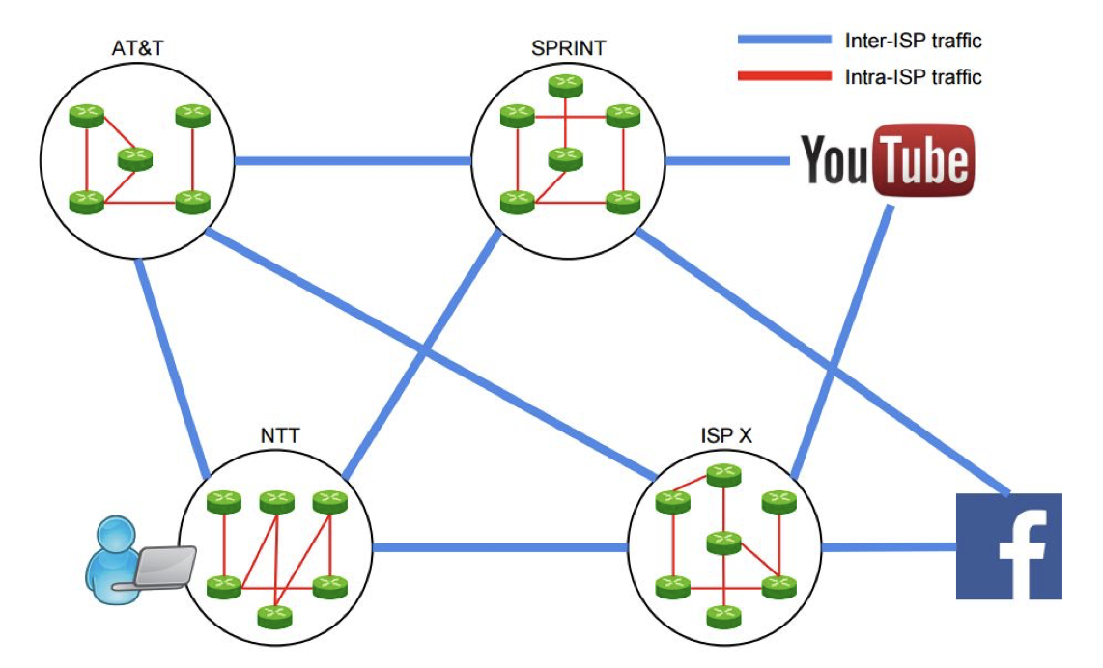
The Internet
Notes:
Our Internet today is made up of Internet Service Providers that are connected to each other.
When an end user wants to consume information from the Internet, he first identifies the host of that information, then connects to the host, and finally sends him a request.

Slide 3


What is wrong with the Internet?
Notes:
In the 80's we designed the Internet to exchange data packets between a few dedicated, stationary computers.
Traditionally, the Internet has been dominated by the dedicated host instead of the data packet.
However, today we use the Internet primarily to exchange information.
For example, today's total Internet traffic is about 80% video traffic.
An Internet designed around hosts has problems with the distribution of large-scale information concerning efficiency, security, and privacy.
So while we designed the Internet to be host-centric, today we need an information-centric Internet.

Slide 4
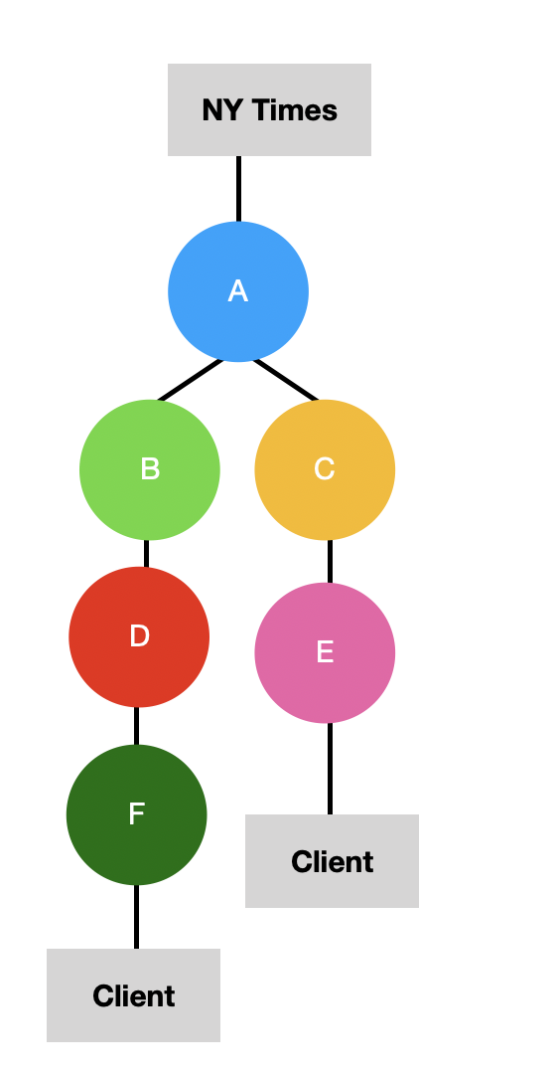
Information Centric Networking
Notes:
The idea of ICN is to name information and to address and match it regardless of its network position.
By moving away from the host model to an information model with Information Centric Networking, information reception is receiver-driven.
It is no longer the sender who has control over what data he sends, but information is only received when the receiver explicitly requests it.
After the receiver sends such a request, the network finds the best source of the required information.
The routing thus seeks to find the best source of information for the request, based on a location-independent name of the information.

Slide 5
Service Centric Networking
Information = f (Information)
Notes:
Information does not have to be static, but can also be dynamic.
For example, an actor in the network could measure the current temperature, convert it to another unit, and then send it back to the client.
In this way, we transform information providers into service providers.
Such services filter, edit, and combine information to provide new information.

Slide 6
Literature
Xylomenos, George, et al. "A survey of information-centric networking research." IEEE Communications Surveys & Tutorials 16.2 (2013): 1024-1049.
Wang, Liang. “Information-Centric Networking“, https://www.cl.cam.ac.uk/~lw525/publications/icn-basics.pdf

