Slide 1

Lua-based Dynamic Local Orchestration of Networked Microcontrollers
Fiona Guerin, Teemu Kärkkäinen, Jörg Ott
Technical University of Munich
Department of Informatics
Chair of Connected Mobility
CHANTS 2019, Los Cabos, Mexico
25. October 2019
Notes:
- Welcome to my presentation about a Lua-based Dynamic Local Orchestration of Networked Microcontrollers.
My name is Fiona Guerin and I work at the Technical University of Munich at the Chair of Connected Mobility.
The motivation for our work comes from our efforts to build and understand pervasive applications.

Slide 2
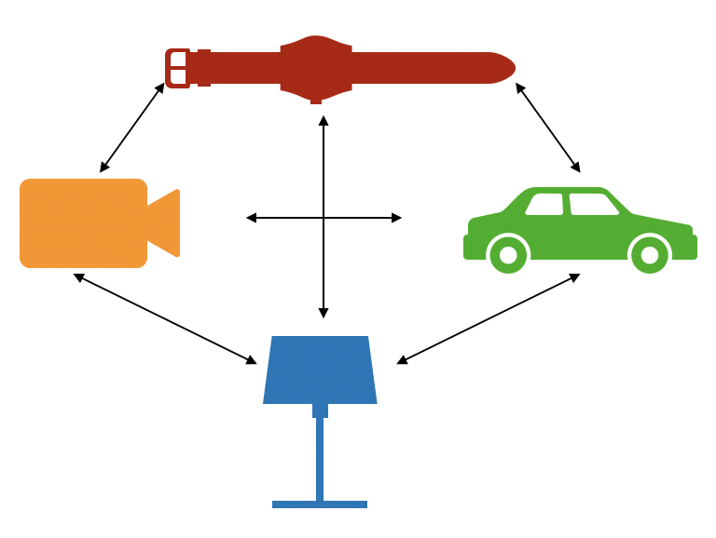
Motivation: Dynamically Programmable World
Chair of Connected Mobility
Department of Informatics
Technical University Munich
Notes:
The devices in such a pervasive environment orchestrate each other's services.
This means that they offer their own services to other devices and they consume the services of other devices in the network.
Today's networks usually orchestrate services statically, i.e. several dedicated clients request a fixed service from a dedicated server, with client requests and server responses each having a fixed format.
But the devices in a pervasive environment are peer to peer, heterogeneous and temporarily available.
In other words, there is no fixed server. When the devices in the network communicate with each other, they must dynamically adapt their services to each other.

Slide 3
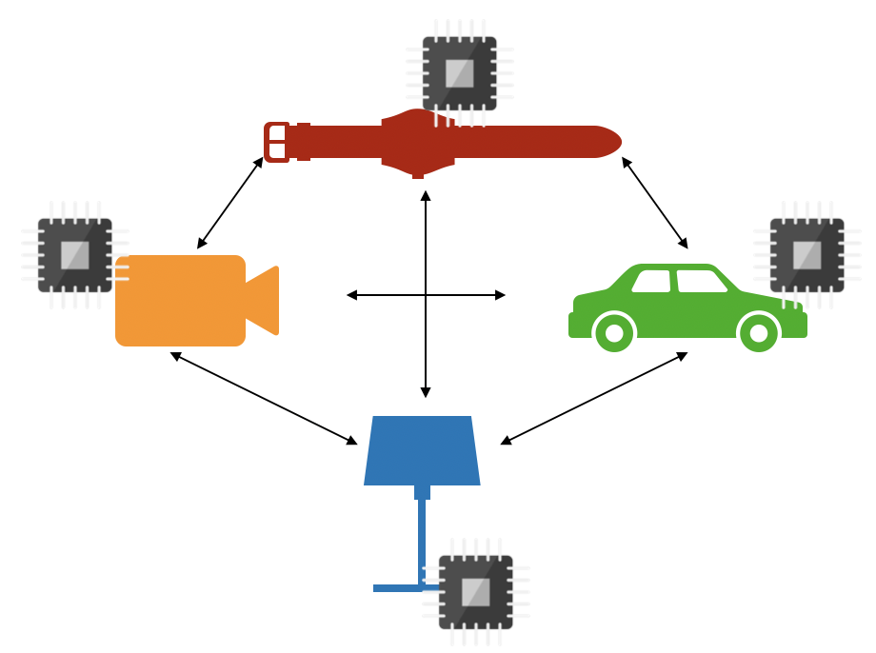
Motivation: Microcontrollers
Chair of Connected Mobility
Department of Informatics
Technical University Munich
Notes:
Microcontrollers run many of the applications around us, for example in smart homes or cars.
In recent years, research has significantly improved the performance of microcontrollers:
They contain several 32 bit processor cores.
They integrate wireless communication such as WiFi and Bluetooth.
They cost little, on average less than $3 per unit.
Although microcontrollers have a lot to offer these days, they still often run fixed, burnt-in logic.
We now want to use the new capacity of microcontrollers.
In particular, their new network capacities allow microcontrollers to communicate with each other.
We try to make microcontrollers pervasive network nodes and let them offer and consume dynamic, adaptable services.

Slide 4
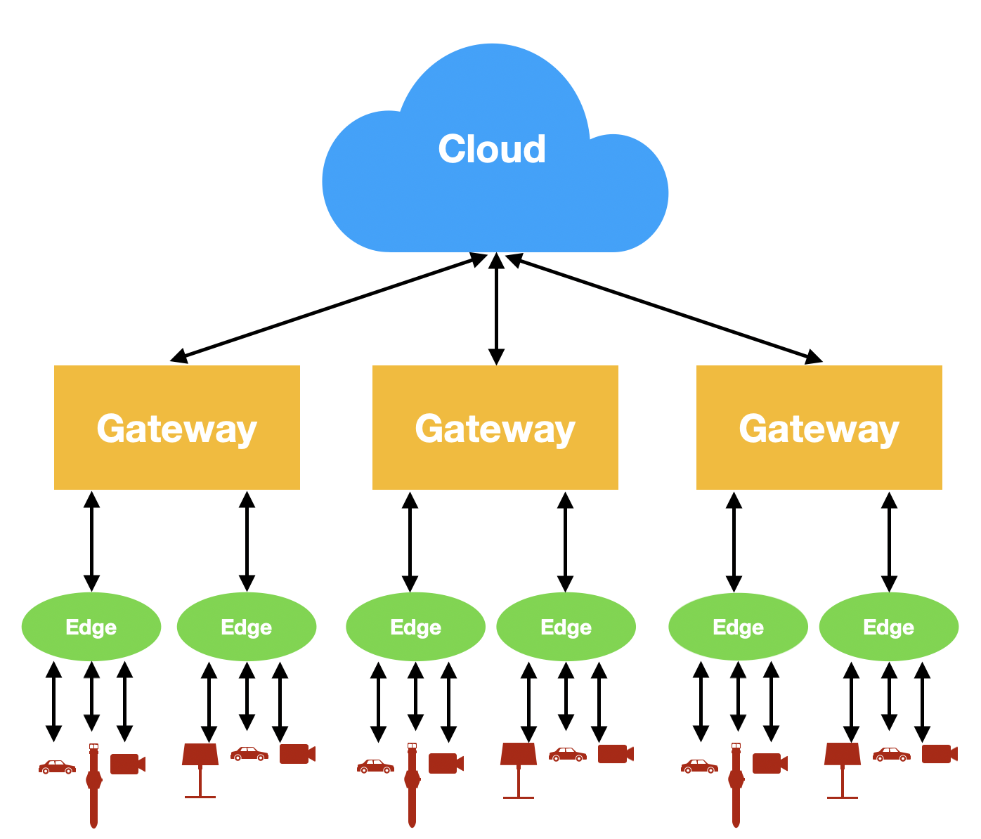
Design: Structured or Unstructured Infrastructure
Chair of Connected Mobility
Department of Informatics
Technical University Munich
Structured Infrastructure
Notes:
Common edge computing infrastructures are highly structured:
Devices push their data to the edge.
The edge passes the data via gateways to the cloud.
Computational intelligence is centralized in the cloud.

Slide 5
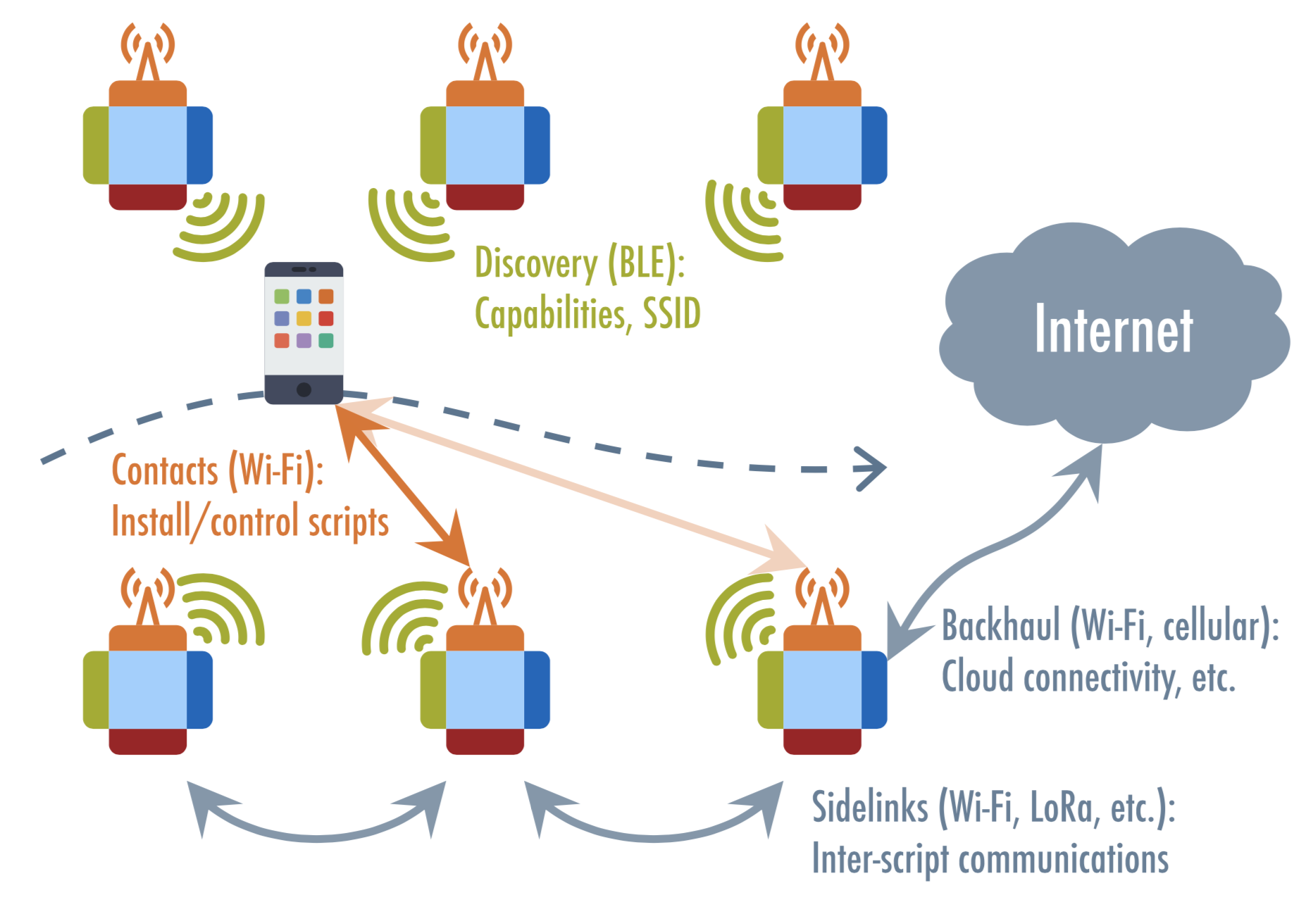
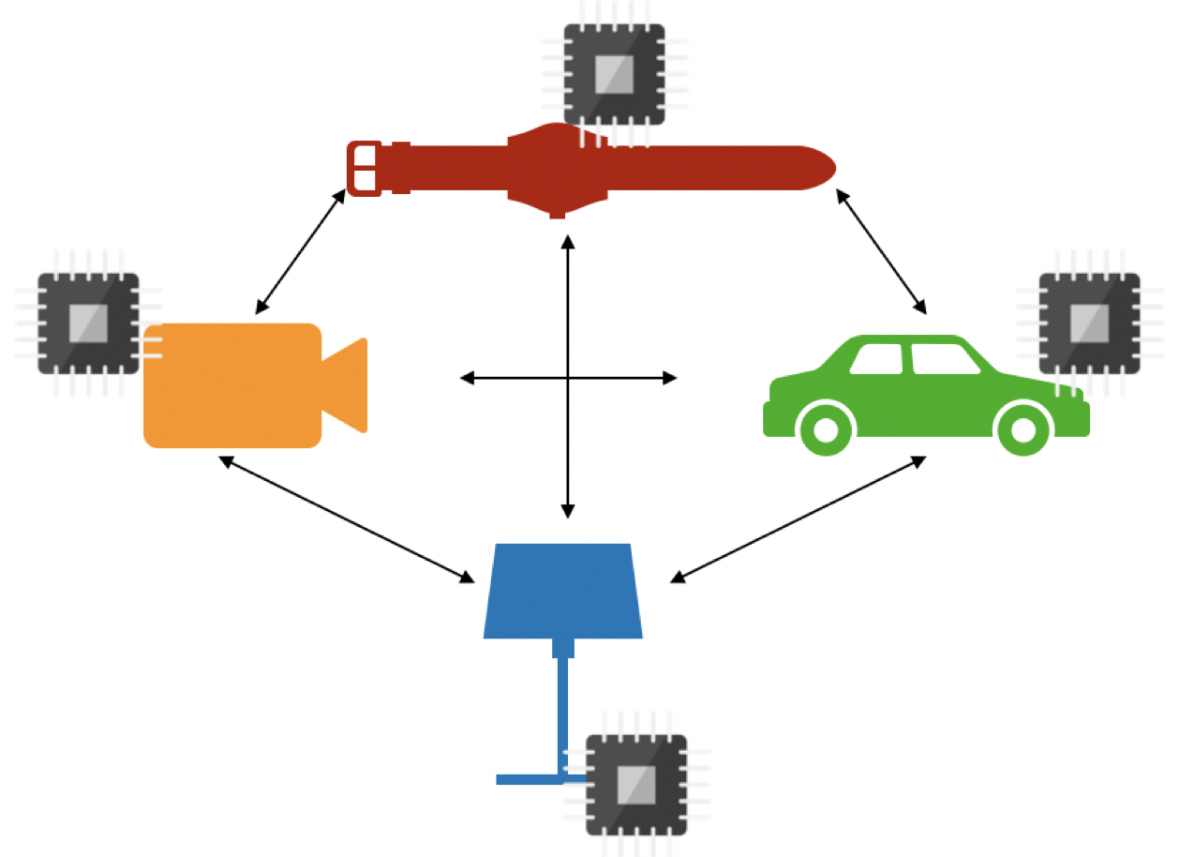
Design: Structured or Unstructured Infrastructure
Chair of Connected Mobility
Department of Informatics
Technical University Munich
Unstructured Infrastructure
Different scalability characteristics
Openness
Different security characteristics
Notes:
Our pervasive network, in contrast, is unstructured:
It is not organized as a multi tiered architecture.
Computational intelligence is centralized within every device.
In such an unstructured model, a central coordinator controls the devices.
Through the coordinator, the network is self-contained and does not need to connect to the Internet.
This approach has three characteristics:
Our unstructured network has different scalability characteristics than a structured one.
The devices in our network perform their own calculations and communicate their results independently.
So there is no central server to which the devices send their calculation requests and for whose response they have to wait.
The direct communication of the devices therefore has a lower latency than the communication via the central instance and
avoids that the central server becomes a communication system bottleneck.
The network is more open.
Cloud architectures and edge architectures usually contain gatekeepers that filter requests from endpoints.
So if a device in a cloud or edge architecture wants to offer or consume a service, the gatekeeper must permit it to do so first.
In contrast, our platform can be dynamically programmed directly from a mobile phone without having to obtain permission.
Our unstructured network has different security characteristics.
Since our network does not have a gateway that can reject certain devices, it is more difficult for our network to avoid attack.
However, since we do not need to connect our network to the Internet, it cannot be attacked globally.

Slide 6
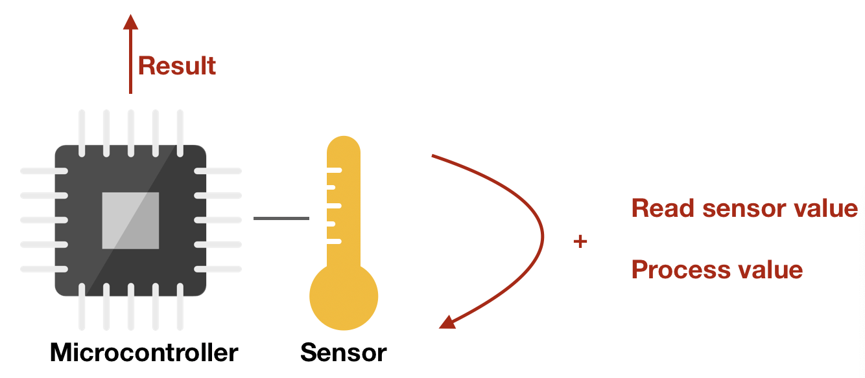
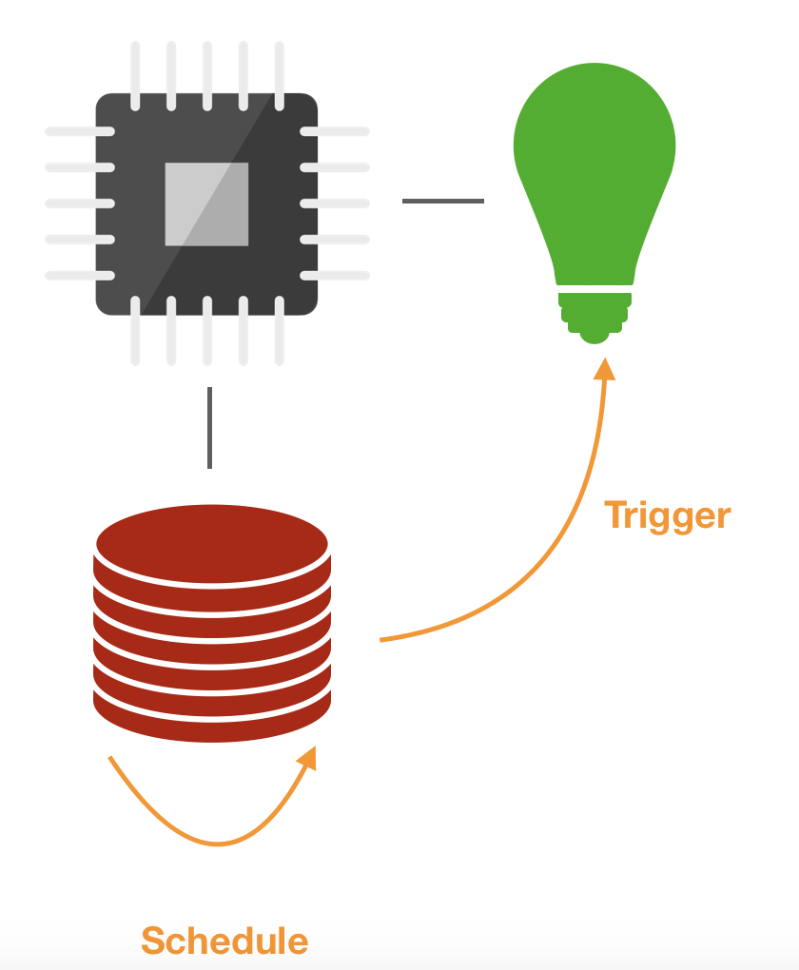
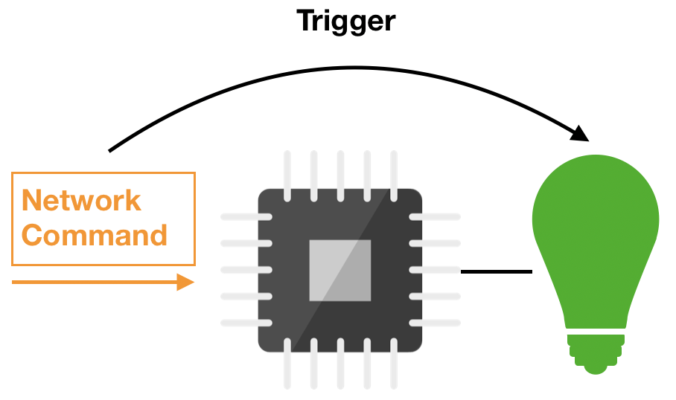
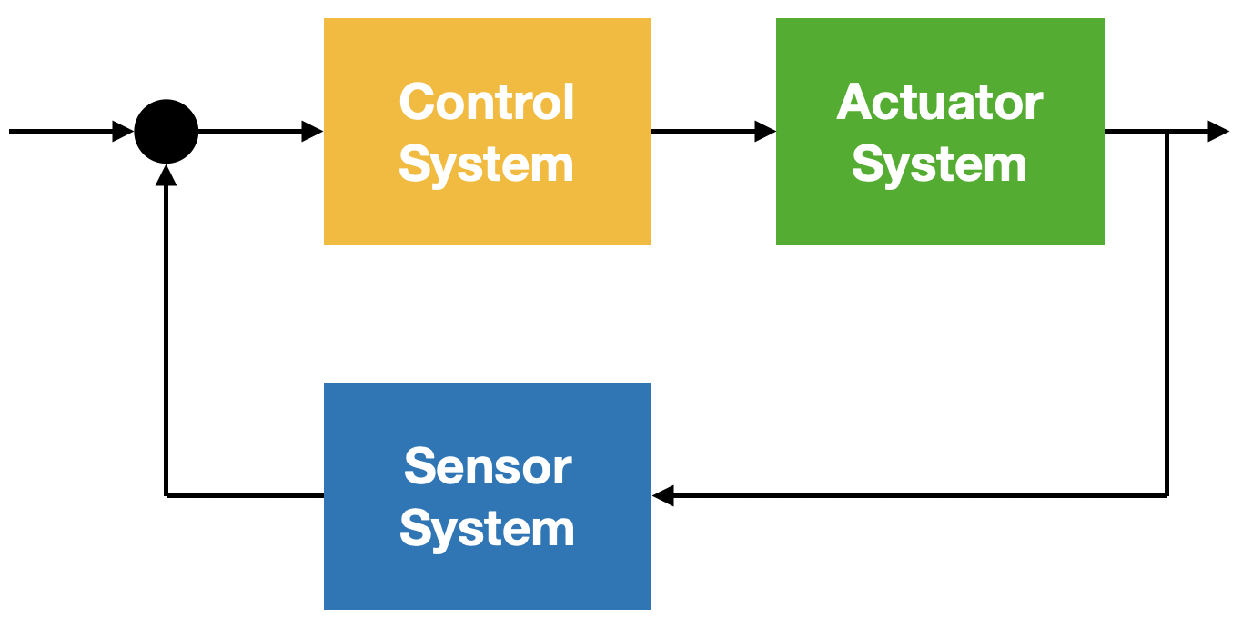
Use Cases
Data Collection/Edge Analytics
Industrial/Home Automation
Remote Control
Feedback Loop
Notes:
The typical use cases of our network are Data Collection, Edge Analytics, Industrial/Home Automation, Remote Control, Feedback Control Logic.
In data collection, an appliance continuously reads from local sensors and sends the read values to the network.
This also applies to edge analytics, but here the appliance can perform desired analytical calculations directly and return processed results.
In Industrial Automation or Home Automation, the appliance contains a schedule in its local memory. This schedule can trigger attached actuators of the appliance.
With Remote Control, the appliance receives commands from the network and triggers attached local actuators.
The Feedback Control Logic is implemented as a Lua Loop. This Lua loop reads a sensor value, calculates an error value from it and corrects the error by regulating actuators accordingly.

Slide 7
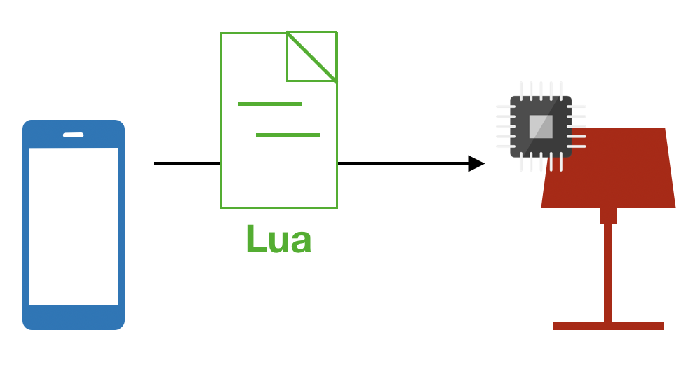
Design: Dynamically Programmable World
Chair of Connected Mobility
Department of Informatics
Technical University Munich
Lua:
Simple
Fast
Integrates C
Encodeable as String
Saves resources
Notes:
Every device in our network can be dynamically programmed.
This means that the device adapts at runtime to the needs of its consumers.
To do this, the service consumer interprets a script from the service producer.
The consumer can then send requests and receive responses in a format that suits its needs.
Dynamic services bridge programming language differences between devices in the network.
By allowing consumers to choose which services they want to consume from a device, they can bridge different availabilities of network services.
We decided to program the scripts in the language Lua.
Lua has the following advantages:
It is a simple language.
Instructions can be executed fast.
Lua integrates C and C integrates Lua. This is crucial because we program microcontrollers in C.
Lua scripts can be encoded and transfered as Strings.
Interpreting a Lua script instead of a script in another language serves the microcontroller energy resources and computational resources.

Slide 8
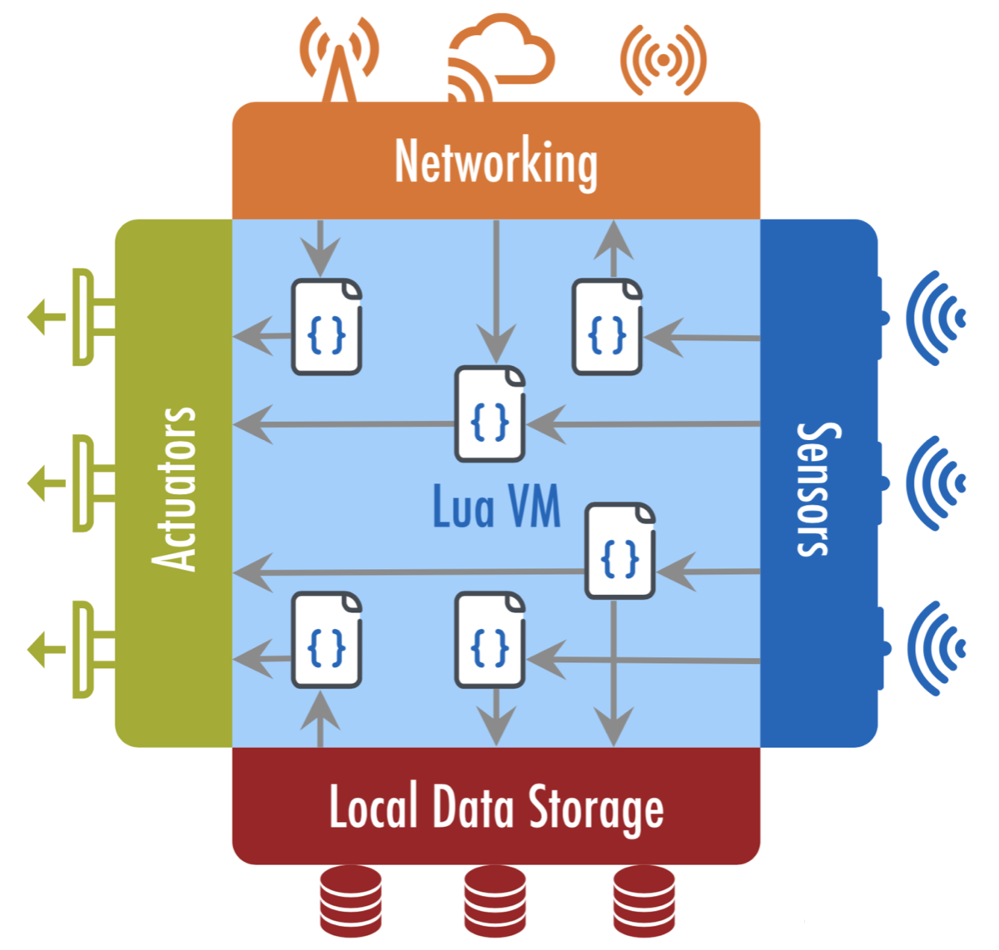
Functional Design
Chair of Connected Mobility
Department of Informatics
Technical University Munich
Notes:
To provide dynamic services, an appliance must execute scripts.
For this, the system contains an execution environment.
The execution environment consists of a loader and a runtime environment.
The loader receives scripts, decides on their admission and, if applicable, forwards them to the runtime environment.
The runtime environment executes the scripts and accesses their hardware and software resources.
Specifically, the runtime has the resources sensors, actuators, local data storage, and networking.
It makes these resources available to the script via well-defined interfaces.

Slide 9
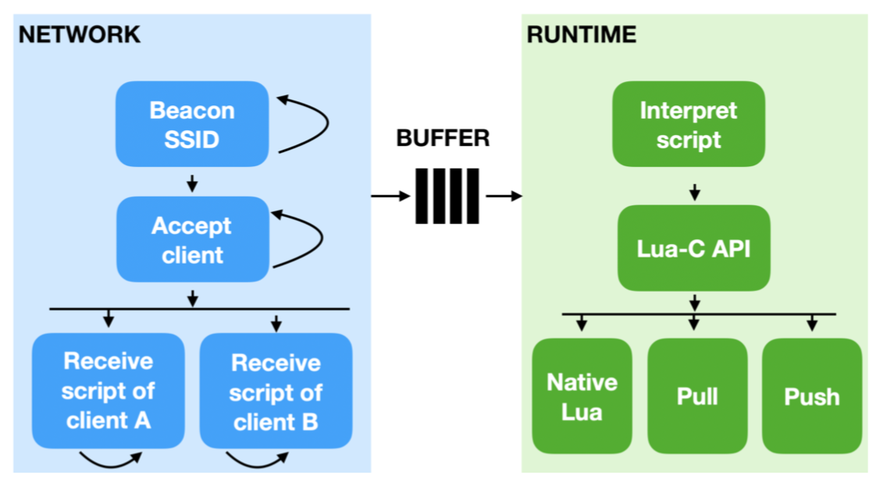
Proof of Concept
Chair of Connected Mobility
Department of Informatics
Technical University Munich
Notes:
The execution environment consists of the two components network and runtime:
The network component receives Lua scripts from clients and pushes them into a script buffer.
It also sends platform responses to the client.
More precisely, the network component configures the appliances as WiFi access points.
Each access point uses Bluetooth Low Energy to beacon its SSID and hardware resources.
The client receives such beacons, selects the Access Point with its required resources and connects to the access point using the SSID.
The platform accepts the connection requests of its clients and then receives their scripts.
The runtime component concurrently pops the next script from the buffer and executs it.
Then the runtime component pops the next script, and so on.
More precisely, the runtime component interprets a script using the Lua-C API of its C environment.
The C environment receives Lua commands via the Lua-C-API, interprets them in a Lua Virtual Machine, and returns calculation results and status codes.
The Lua Virtual Machine executes native Lua commands in a so-called native Lua environment.
It executes commands that require hardware resources in a push environment or in a pull environment.
One-time hardware accesses concern the pull environment and multiple hardware accesses concern the push environment.

Slide 10
Evaluation: Micro Tests
Chair of Connected Mobility
Department of Informatics
Technical University Munich
Efficient system:
Amortize overheads of larger tasks
Pipeline executions of multiple scripts from a single client.
Complex Lua script increases execution time
Platform can serve >100 concurrent clients
Notes:
We evaluated how long a client waits for the appliance to respond after sending it a script.
This time consists of 70% network delay, 20% execution time, and 10% other delays.
From that we conclude that an efficient system will need to amortize overheads of larger tasks and will need to pipeline the executions of multiple scripts from a single client.
The execution time depends strongly on the complexity of the script.
In particular, an appliance takes longer to run if it needs to access hardware resources such as sensors and actuators.
Nevertheless, our platform can usually serve more than a hundred concurrent clients.

Slide 11
Evaluation: Macro Tests
Chair of Connected Mobility
Department of Informatics
Technical University Munich
Discovery process:
Near instantaneous
Increases if the beaconing is less aggressive
Increases if there are more devices.
Association time:
Decreases if WiFi control methods are more optimal
Limiting factor for device orchestration
Notes:
We evaluated how the orchestration of multiple appliances performs.
For this, we set up ten microcontrollers whose services are orchestrated by a laptop.
All microcontrollers beacon their SSIDs and their resource capabilities at their most aggressive advertisement interval.
The laptop discovers the microcontrollers by receiving beacons.
The discovery process is near instantaneous but will increase if the beaconing is less aggressive or if there are more devices.
The laptop decides which microcontrollers’ services it will orchestrate.
For this, it associates with every microcontroller one after the other.
The association time can be decreased by using more optimal WiFi control methods such as WiFi Aware.
However, the association time will always be the limiting factor for device orchestration.

Slide 12
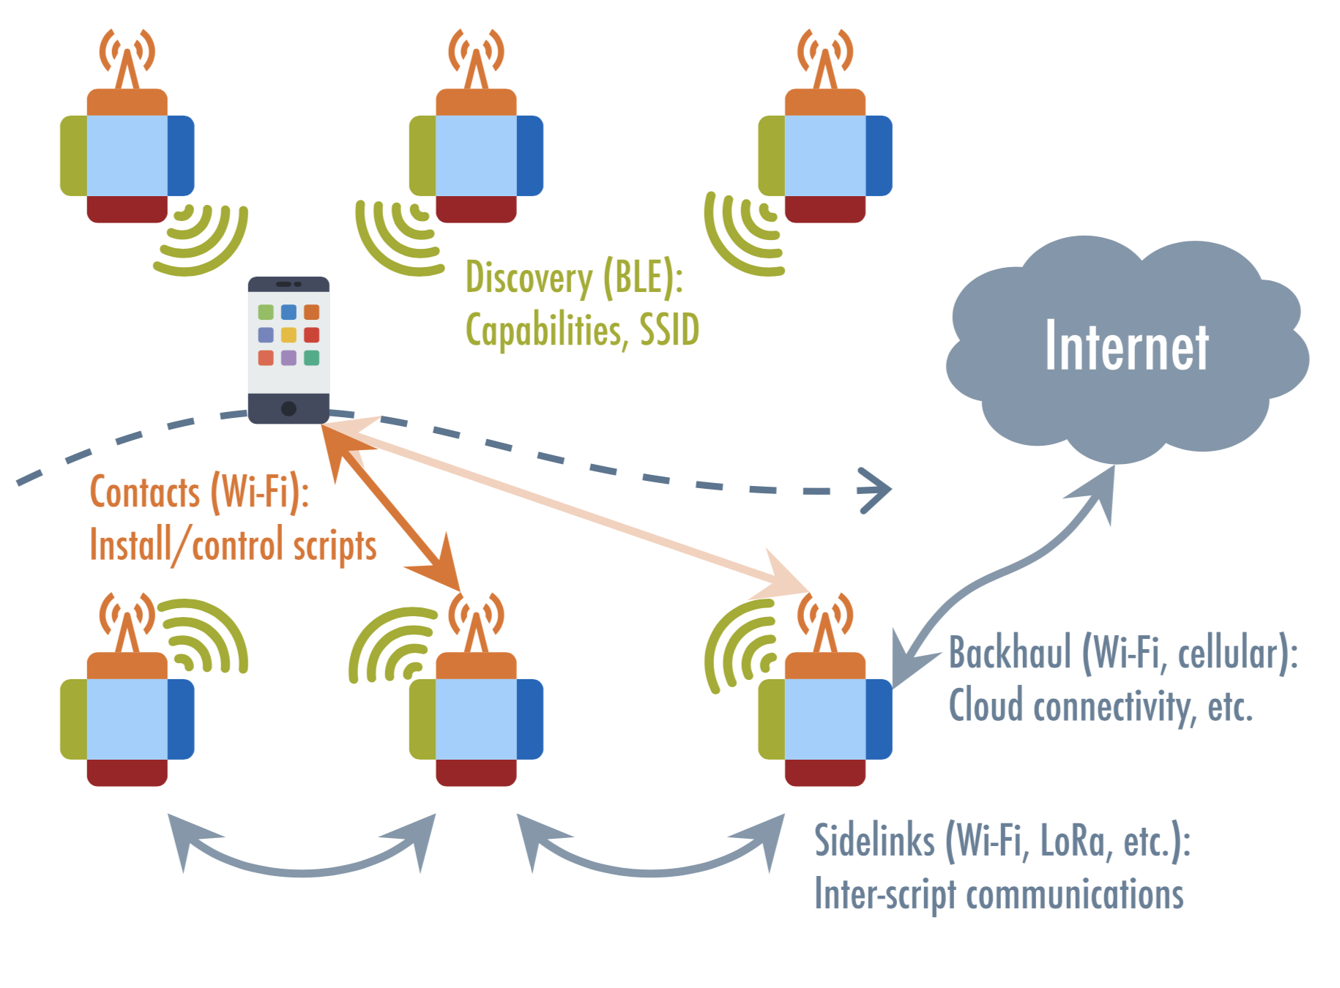
Thank you ☺
Chair of Connected Mobility
Department of Informatics
Technical University Munich
Contact:
fiona.guerin@tum.de
kaerkkae@in.tum.de
Fiona Guerin | Chair of Connected Mobility | TUM
Notes:
Thank you & Questions

