Slide 1
git
Presentation by Fiona

Slide 2
What is git
Version control (this is one of them)
Making it easy and simple
Newest version control implementation tool
Not only programmer designer and document authors
Focus on content not files
Why Git?
Many other requires complicated server set ups
GIT is LOCAL ENABLED

Slide 3
HISTORY TRACKING
Many people contribute to the project
You can take turn at the keyboard
- add command line
- $git init myproject (name of project)
-$ cd my project (creates a file and control file to store historic elements)
-$ git add (notice the file and put them in to hoding zone, ready permenatly commited)
-$ git commit (permanently record historical version or snapshot as existed given point time

Slide 4
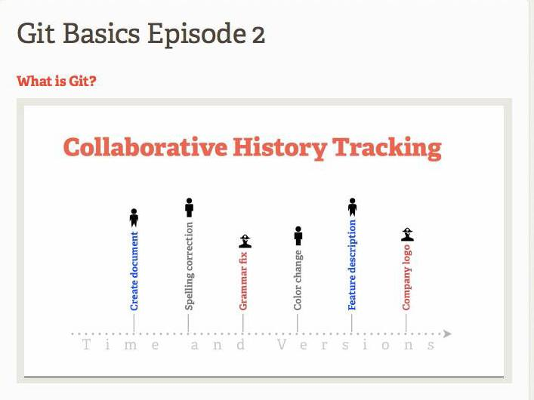
Sequential fashion

Slide 5
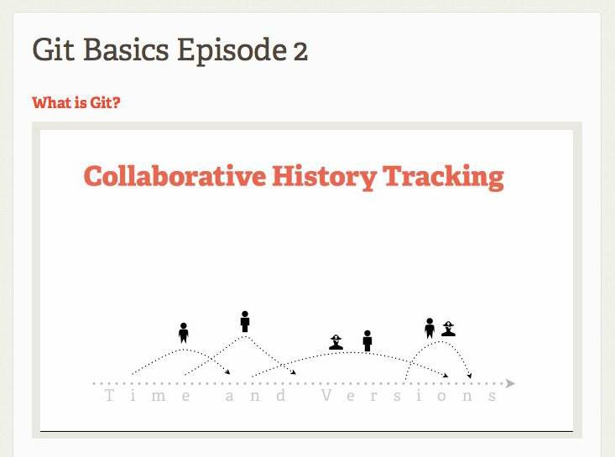
Almost different time with overlap

Slide 6
How it works?
Everyone can take file of their own and work on it, than, bring it back to the central file
-MERGE the changes

Slide 7
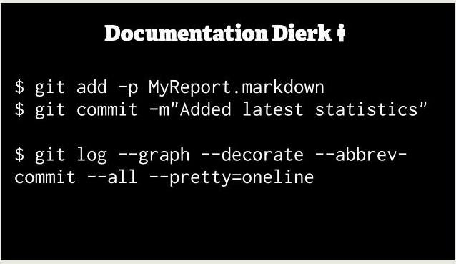
Doug & dana

Slide 8
Advanced and customize
Add little segment
Commit only small portion
A graphical representation showing:
-when they branch
-merge them back together
-who did WHAT WHEN
-which date
(it is hard for beginner but it is extremely convenient for advanced user

Slide 9
