Slide 1
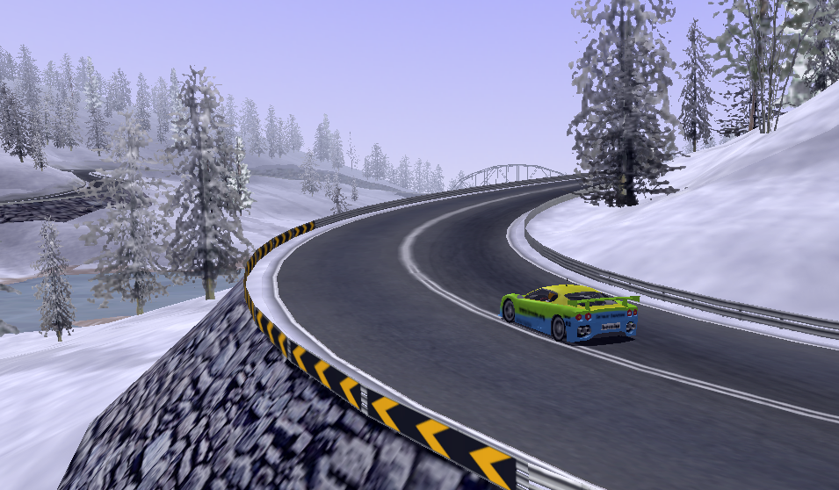
Developing a Competitive TORCS Controller
using Evolutionary Strategies
Group 38: Arran Lyon and Fiona Lippert

Slide 2
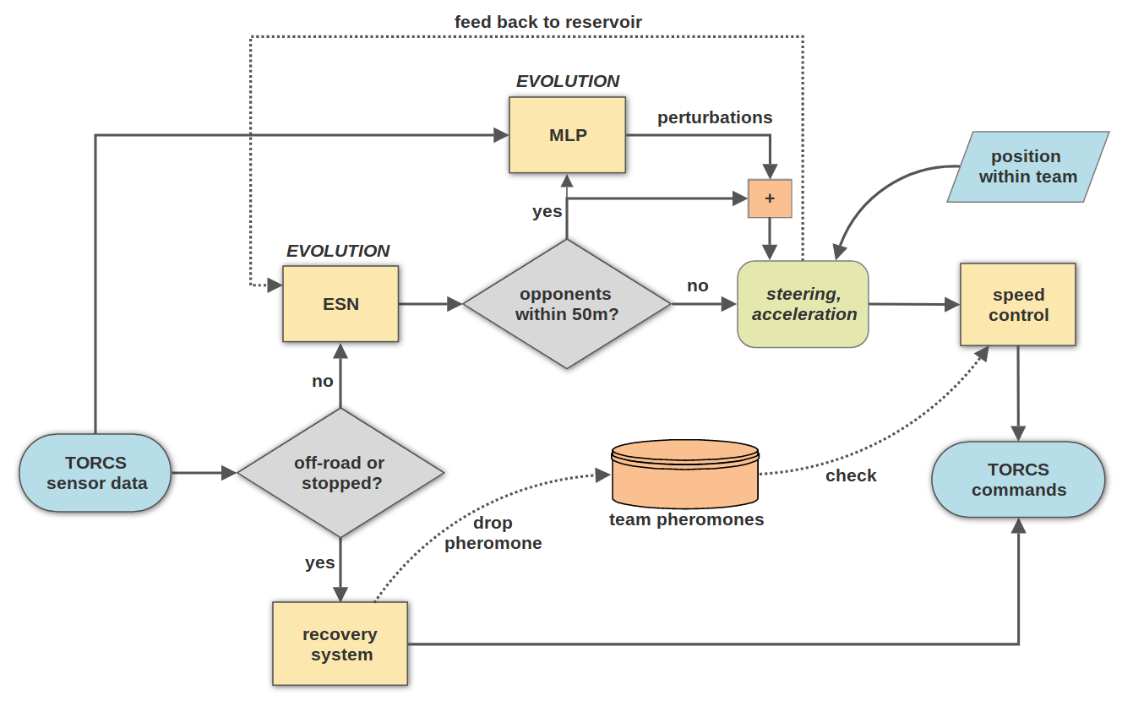
Controller Architecture

Slide 3
Echo State Network
Complex short-term memory facilitates smooth actions
Separation between reservoir and readout
  Training speed up
  Reservoir optimisation through evolutionary strategies
Training data collected from TORCS driver ‘damned’

Slide 4
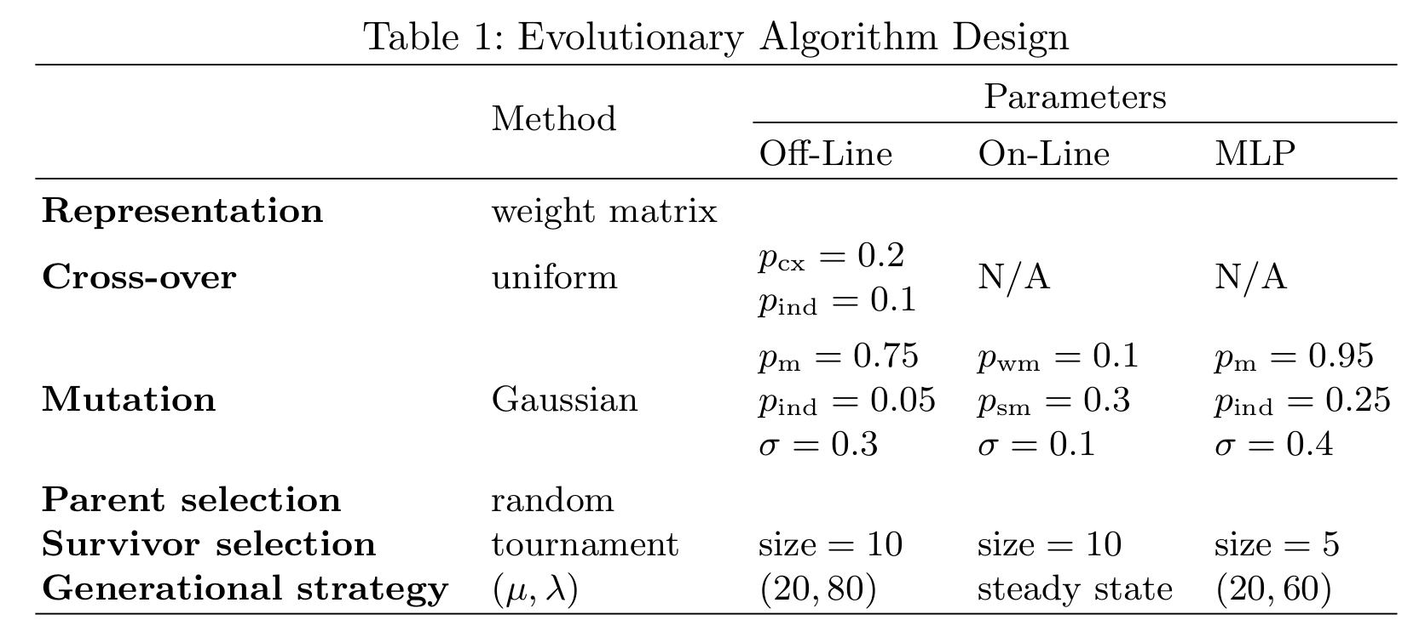
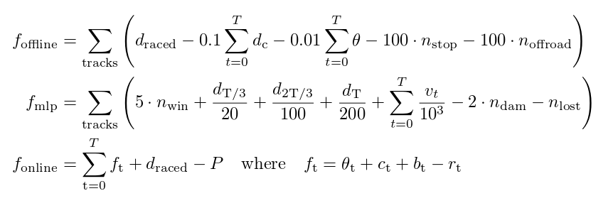
Evolutionary Strategies

Slide 5
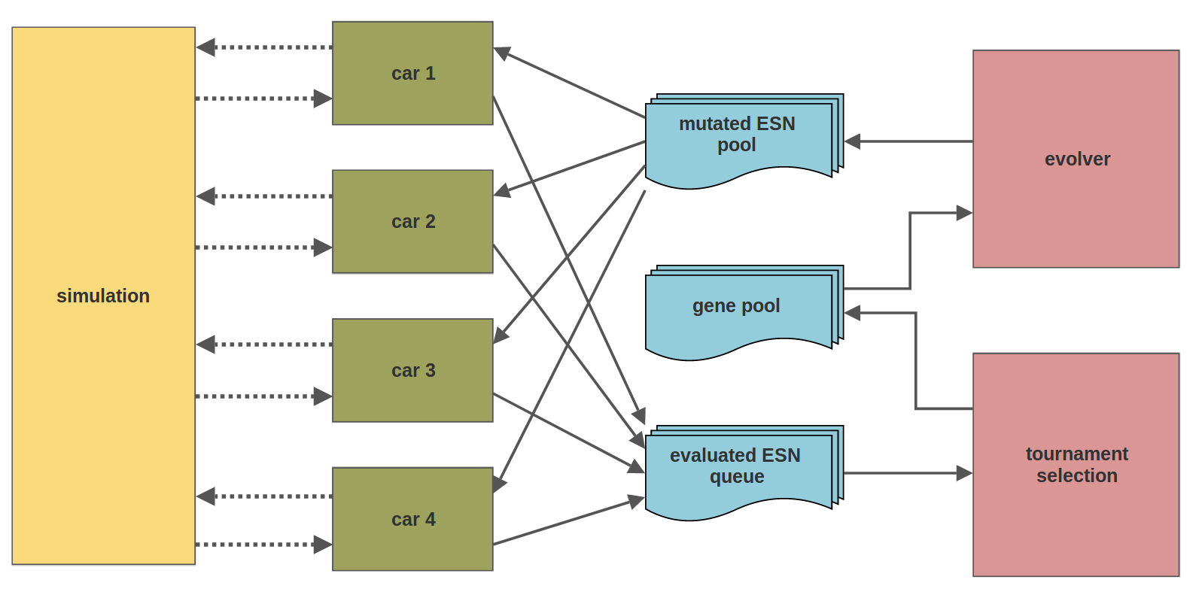
On-Line Evolution

Slide 6
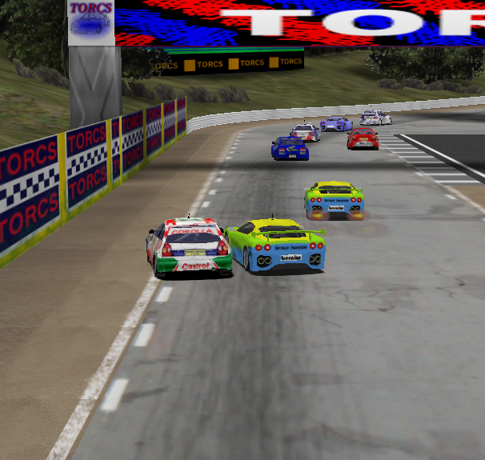
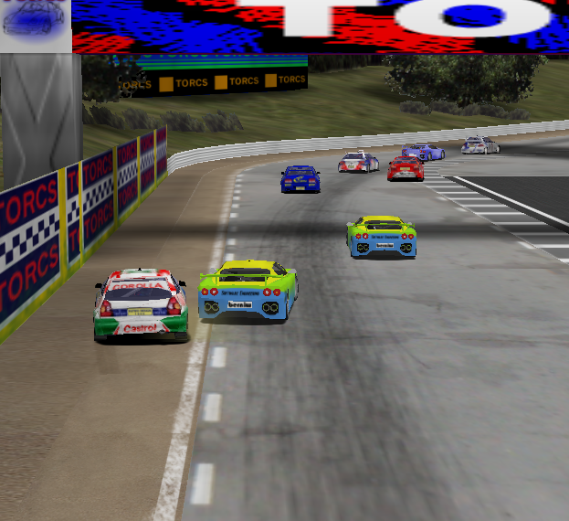
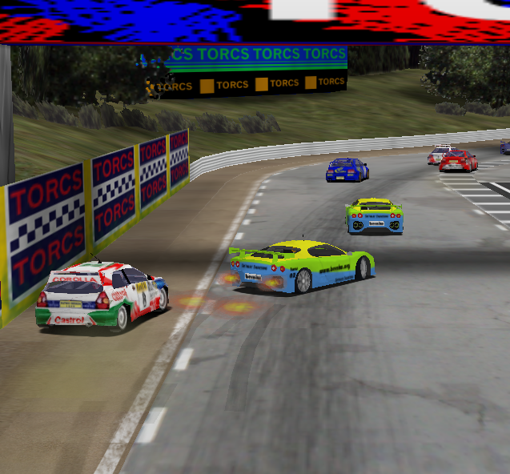
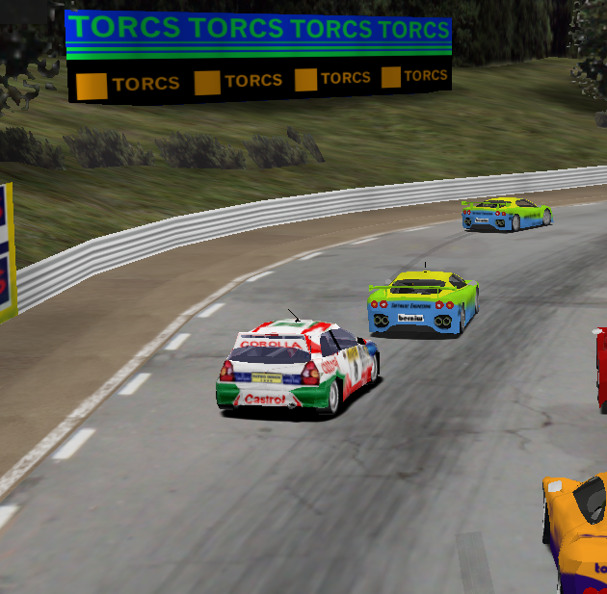
Team Strategy
Pheromones
  Warning team mates of difficult track sections
  Cars slow down on detection of nearby pheromone
Blocking Strategy
  If trailing team mate: block approaching opponents
  Improves overall team performance

Slide 7
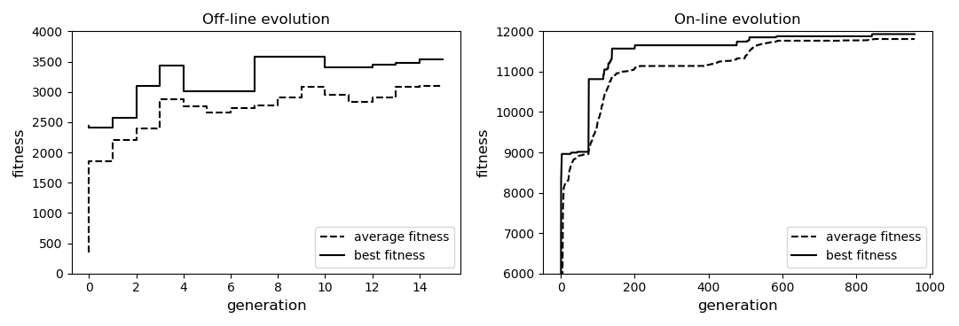
Results: Progress of Evolution

Slide 8
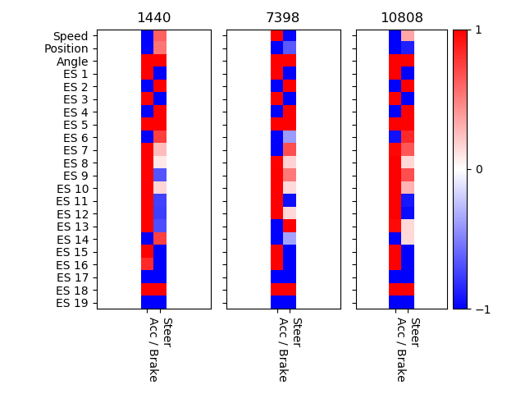
Results: Progress of ESN Driving Logic

Slide 9
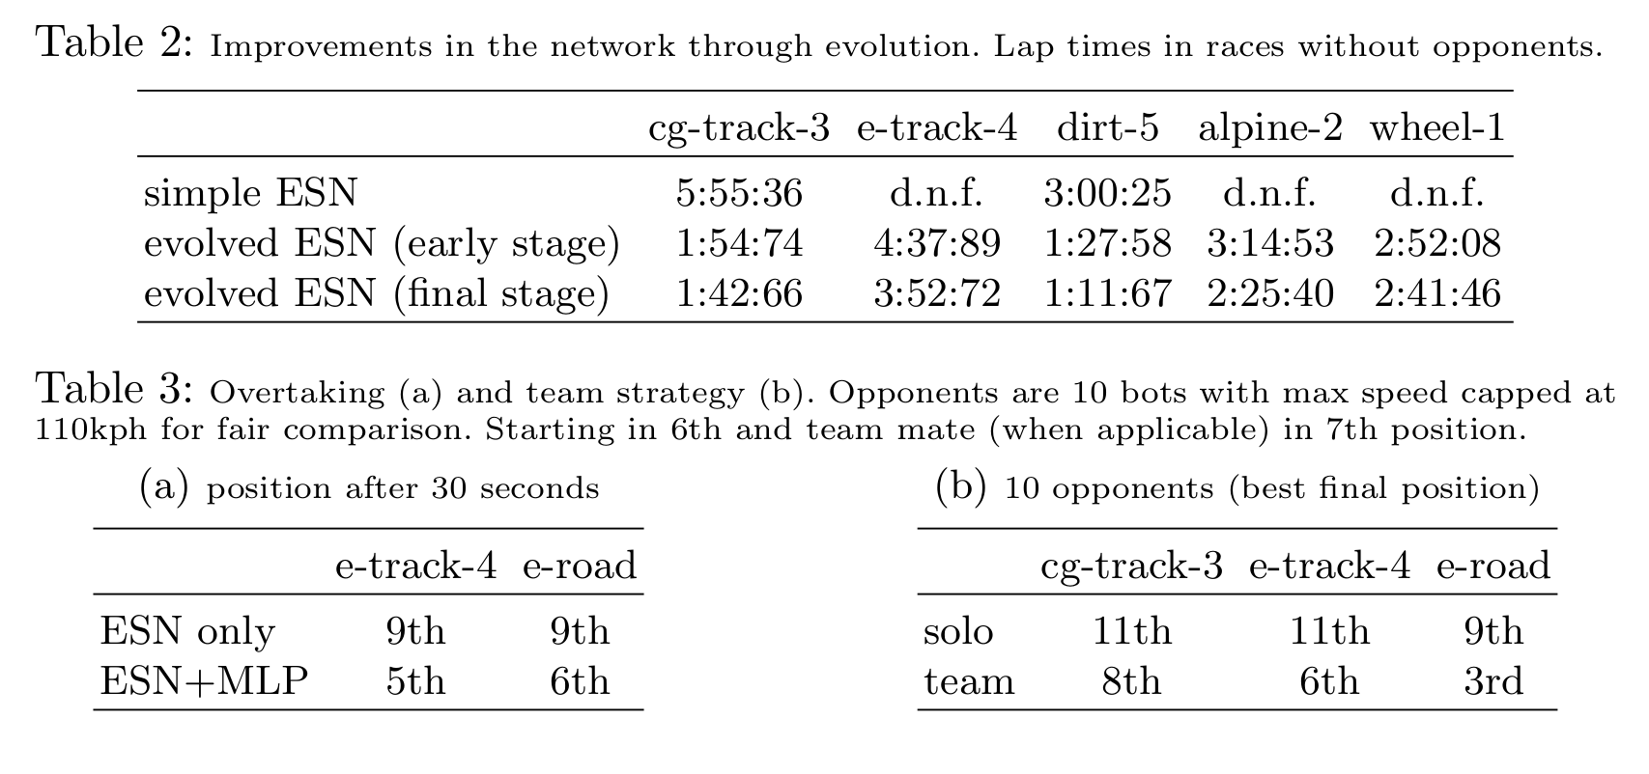
Results: Performance Estimation

