Slide 1
SP
SourcePilot
Spend the money. Prove the limit.
A procurement agent that spends company money inside a limit its owner signed cryptographically — enforced on-chain, revocable in one transaction.
Rain × Monad · NYC
rain-agentic-sourcepilot.vercel.app
Monad Testnet · 10143
Notes:
Ten seconds. Name it, then go straight to the problem. Do not read the URL aloud.

Slide 2
THE PROBLEM
Give an agent a corporate card and you have two bad options
Hand over the card number
Approve every purchase
The agent holds a 16-digit credential valid at every merchant on earth, for years.
You cannot say “these three suppliers, $1,840, ninety days.”
Now you don’t have an agent. You have a form with extra steps.
Every payment waits on a human who isn’t in the room.
The credential can express that an account exists — not what the agent is allowed to do.
That gap is the whole problem. SourcePilot closes it with a signature.
Notes:
Twenty-five seconds. Say it as a scene, not a market claim. The lime line is the thesis — pause after it.

Slide 3
HOW IT WORKS
One signature. Checked on-chain, every payment.
THE SIGNED MANDATE
EVERY PAYMENT TAKES THIS PATH
Cumulative ceiling
$1,840.00
1
Off-chain sourcing checks
Autonomous threshold
$200.00
lead time · spec match · completeness
Deposit cap
30% of PO value
2
MandateRegistry.record() on Monad
ceiling · payee scope · window · revocation · deposit cap
Approved payees
3 suppliers
Validity window
90 days
3
Payment processor
reached only if the contract did not revert
“What breaks if you delete the server’s call to the contract?” The payment loses its authorization and the ceiling stops decrementing.
Notes:
Fifty seconds. Step 2 is the slide. The contract is a gate, not a log. The quoted question is the Monad bounty question — answer it before it's asked.

Slide 4
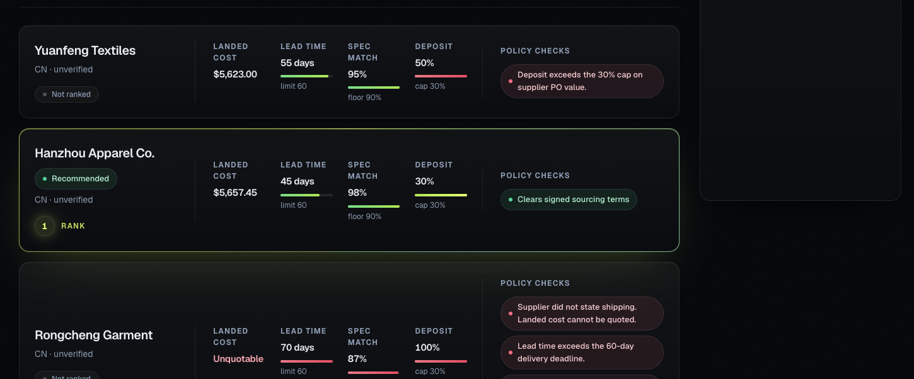
DEMO · 01
Compare suppliers
The agent ranks the complete terms — not just the lowest unit price.
Notes:
Click the slide title to open the live supplier comparison website. Live URL: https://rain-agentic-sourcepilot.vercel.app/compare
Keep the original screenshot on screen as a stable fallback during the demo.
[Sources]
- https://rain-agentic-sourcepilot.vercel.app/compare (live deployed route, accessed 2026-08-09)
[/Sources]

Slide 5
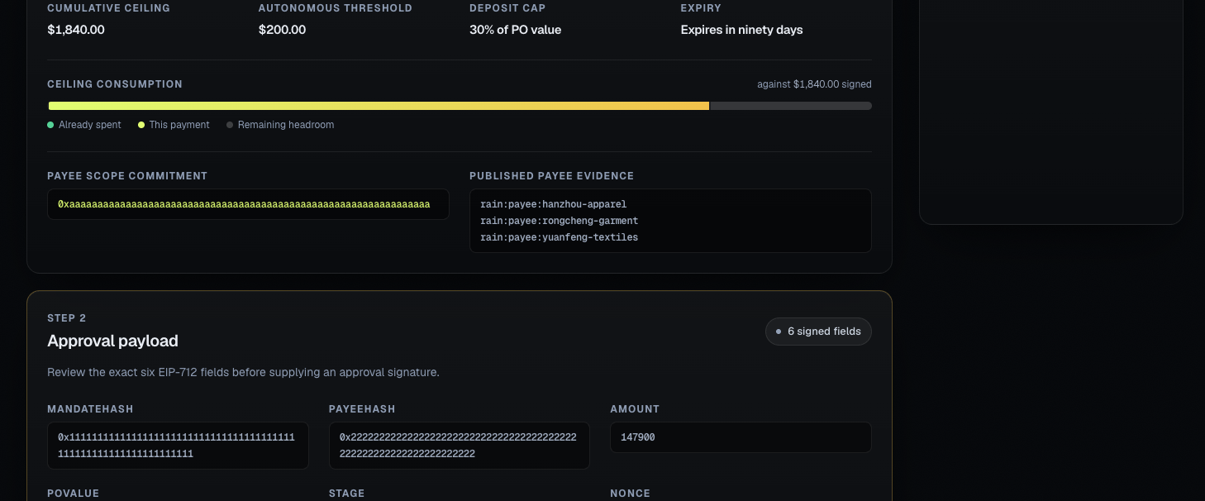
DEMO · 02
Stop at the approval boundary
The signed mandate makes the agent's authority explicit before any payment side effect.
Notes:
Click the slide title to open the live owner-approval website. Live URL: https://rain-agentic-sourcepilot.vercel.app/approve
Keep the original screenshot on screen as a stable fallback during the demo.
[Sources]
- https://rain-agentic-sourcepilot.vercel.app/approve (live deployed route, accessed 2026-08-09)
[/Sources]

Slide 6
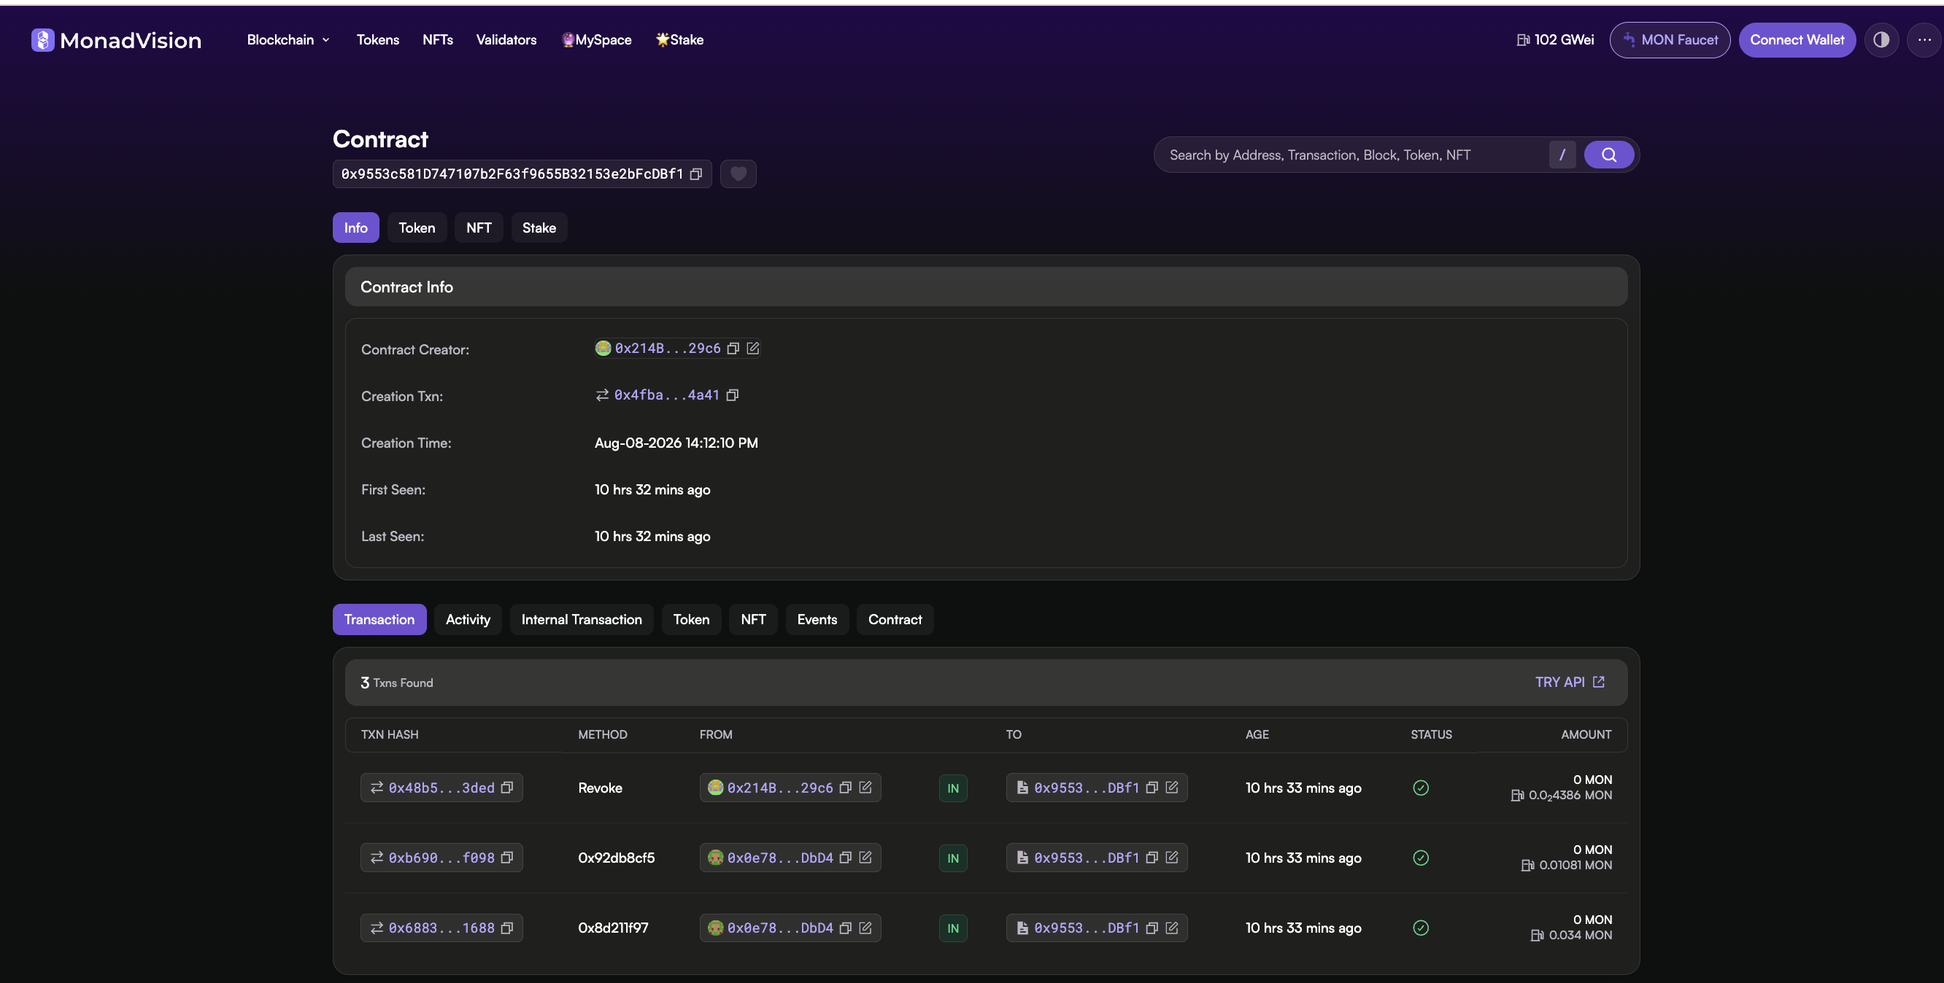
MONAD · 01
Public contract evidence
One Monad testnet registry, with creation, spend-recording, and revocation visible together.
Notes:
This is the public Monad testnet registry. The three successful interactions are mandate creation, spend recording, and revocation.
[Sources]
- /Users/yingzhou/Desktop/Screenshot 2026-08-09 at 12.45.16 AM.png (user-provided screenshot, captured 2026-08-09)
[/Sources]

Slide 7
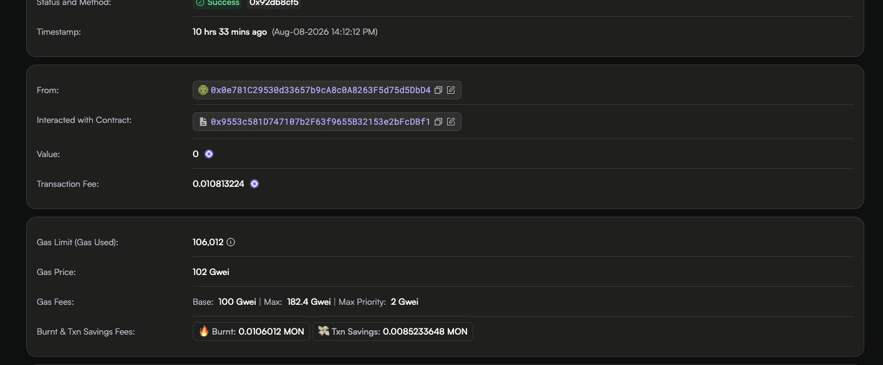
MONAD · 02
Spend recorded on-chain
The successful transaction is immutable evidence that the mandate's remaining ceiling changed.
Notes:
Transaction 0xb690…f098 is the successful spend record. The contract interaction is public and independently inspectable.
[Sources]
- /Users/yingzhou/Desktop/Screenshot 2026-08-09 at 12.46.07 AM.png (user-provided screenshot, captured 2026-08-09)
[/Sources]

Slide 8
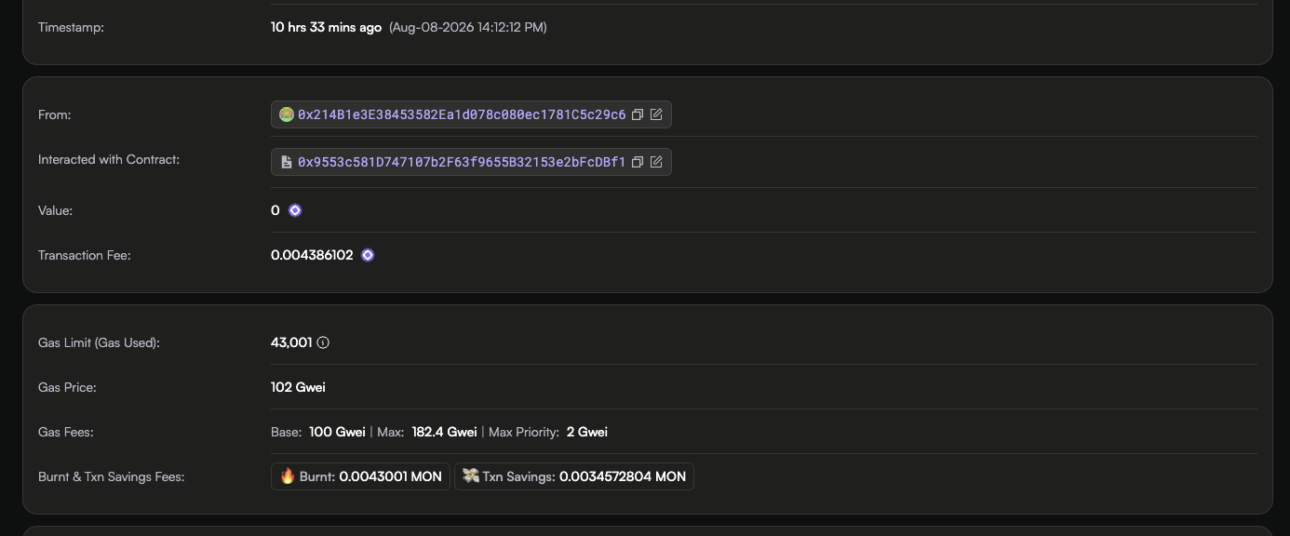
MONAD · 03
Authority revoked on-chain
Revocation is a state transition, not an application toggle — later authorization attempts fail.
Notes:
Transaction 0x48b5…3ded revokes the mandate. After this state transition, later attempts cannot reuse the authority.
[Sources]
- /Users/yingzhou/Desktop/Screenshot 2026-08-09 at 12.46.19 AM.png (user-provided screenshot, captured 2026-08-09)
[/Sources]

Slide 9
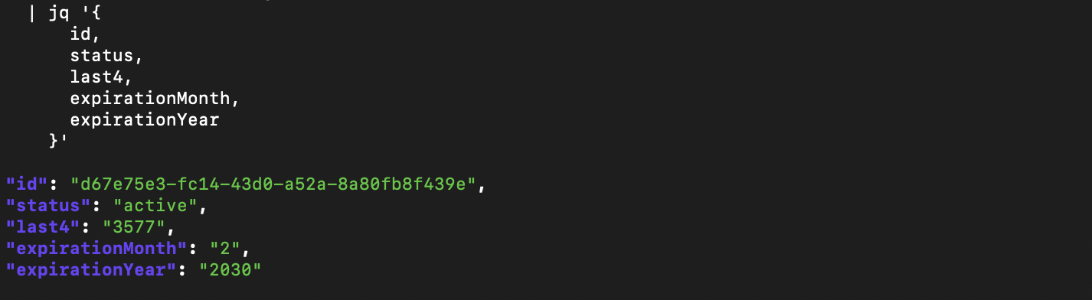
RAIN · SANDBOX
Live Rain scoped card
A live authenticated API read returns an active sandbox card; payment execution remains mocked.
Notes:
Show only the successful result: the active Rain sandbox card, last four digits, and expiry. Never display the API key, session secret, PAN, CVC, or authentication header.
[Sources]
- /Users/yingzhou/Desktop/Screenshot 2026-08-09 at 9.48.13 AM.png (user-provided screenshot, captured 2026-08-09)
[/Sources]

Slide 10
PROOF
Not a diagram. Four public transactions.
Registry deployed
208
0x4fba…4a41
tests passing
block 52019868
Mandate created
0x6883…1688
digest recomputed on-chain from 12 signed fields
24
Foundry contract tests
$180 sample recorded
0xb690…f098
spent 18000 → remaining 166000
0
processor calls when blocked
Mandate revoked
0x48b5…3ded
every later payment reverts Revoked
REGISTRY
Every figure re-checkable: pnpm verify:claims · output/monad/deployment.json
0x9553c5…dbf1
Notes:
Forty seconds. Open one of these in the explorer if the room is engaged. The remaining-166000 line is the ceiling actually decrementing — that is the claim.

Slide 11
THE BOUNDARY
What we enforce — and what we don’t
ENFORCED BY THE CONTRACT
NOT ENFORCED — AND WE SAY SO
Cumulative spending ceiling
Whether the signed PO value matches the real invoice. No contract can.
Approved-payee scope
Supplier verification. Out of scope, and we don’t claim it.
Validity window
Revocation
Rain sandbox authentication is live. No live issuance or settlement.
Deposit cap, via an approval signature verified on-chain
Live Rain GET: HTTP 200. For blocked payments, MockRainAdapter.calls = 0 — Monad remains the gate before mock execution.
Notes:
Twenty-five seconds, and do not rush it. Naming the seam before judges find it is the strongest move in the deck. Four Rain employees are in the room; the simulated line must come from you first.

