Slide 1
Introduction to Caret (a Classification Lens)
Fiona Lodge
RLadies Meetup

Slide 2
Motivation
This presentation will go through main functions of the caret package, which includes the following: CreateDataPartition, PreProcess, trainControl and train. We will focus on aspects of classifications problems for model training and tuning, and the predictors in these problems will be only numeric. The focus on this presentation is to demonstrate the processes of caret, not to talk about the mathematics of models.
I was motivated to learn caret because I am working through the book, Applied Predictive Modeling (Kuhn, 2016) to improve my statistical modeling skills. This book contains modeling problems and examples done in R, along with statistical explanations. Although the book does not exclusively rely on caret, you could work through the problems with caret.
I was also motivated to learn caret because my work flow tends to switch between R to Python. I find the EDA process to be more suited to using R and the modeling (sci-kit learn) to more suited to using Python. In terms of ease, uniformity, and the ability to run multiple models easily, the caret package seems comparable.

Slide 3
My BACKGROUND
Data science internship at Securian Financial. Seeking employment for June or thereafter.
Received a master’s (P.S.M) in Applied and Industrial Mathematics from the University of Stout.
Former life includes seven years as a high school math teacher, and still currently a high school softball coach.
I enjoy mathematics for its depth, there are always ‘new things to learn’, or ‘new ways to learn old things’!
What I’ve learned from caret has come from about a 1-2 months of practice, so I hoping to get some questions I can’t answer today! This will mostly get your toes wet with and I recommend reading the vignette and the Applied Predictive Modeling for more practice. Kuhn also lists more recommendations in the introduction of the caret vignette.
https://www.linkedin.com/in/fionarlodge/

Slide 4
Description of Caret
Caret is a predictive modeling package created by Max Kuhn and is an acronym for Classification And REgression Training. The functions in the caret package focus on the following main aspects of model development:
data splitting
pre-processing
feature selection
model tuning using resampling
variable importance estimation
(Kuhn, 2019)

Slide 5
Why Caret
Model functions in R vary in syntax, resampling methods, and tuning parameters. Compare the differences between some of the available inputs of a randomForest and gbm model, which are both tree-based models that can be used for both classification and regression.
 | randomForest | gbm
form | x , y | y ~ x
resampling | oob | cv.folds
sample tuning parameter | ntrees | n.trees

Slide 6
How CARET STREAMLINES Modeling
Having to work through all of these varying syntaxes (and also functions) can significantly slow down the modeling process.
The caret package streamlines this in many ways:
Pre-Processing, resampling, and tuning all have their own specific functions. This allows you to quickly work and change paths if required.
The Pre-Processing functions are built to aid in specific development of your training set.
There are a lot of models tags available, and you should be able to run at least a few different models for any given problem. There are also tools available for choosing the best model between many models.
The functionality in this package is very deep, and there are a variety of ways to tune the models that you build.
Lastly, uniform interface for any model!

Slide 7
Other Benefits to Caret
I have found the error messages are helpful. I actually learned a few things about the modeling process from them.
The package will ask you to install package dependencies, instead of stopping its processes and asking you to start over. This also means that you only need to load caret to be able to access a many different modeling libraries!
Kuhn has included many options for customization, including with preprocessing and models not included in the tagged list.
It is easy to find tuning parameters (as opposed to sorting through a long list of model inputs).
The package contains some datasets to practice on.
I found it refreshing to work through a book written by the author of the package. I got a better understanding of the package structure, functions, and motivation.

Slide 8
The Generated Dataset
For most of the examples today, I generated a random dataset in Python using the datasets.make_classification command in sci-kit learn.
X, y = make_classification(500, n_features= 5, n_informative = 3, n_redundant = 0, n_classes = 3, weights = [0.6, 0.3, 0.1])
I also manually added a few missing values. Below is the head of the dataset, and in the code, the dataset is (creatively) referred to as dat.
X0 X1 X2 X3 X4 y 1 -1.4588104 -0.08047330 -0.6332306 2.4122099 1.2415181 B 2 0.6027192 0.36260468 1.4755119 -1.6016240 1.2016910 A 3 -2.7398292 0.09769184 1.5173355 -0.5655078 -2.0879155 B 4 -1.3368162 0.69000199 2.2298045 -1.1350876 -1.8826160 B 5 0.3215398 -0.08808579 0.9228054 0.7519209 0.6560173 A 6 -0.2997237 -0.40722466 -1.4362178 -1.8426319 0.7878204 B

Slide 9
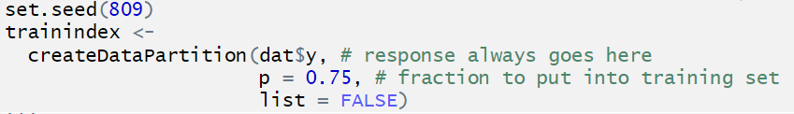

Data Splitting (Train/Test)
The data splitting function, CreateDataPartition, creates a list (or matrix) of indices for your training data. Below is a sample command for the dataset that use 75% of its data for training.
Some imputation methods require the format of x = x and y = y, so that is what I have chosen here, but this may not always be necessary.

Slide 10
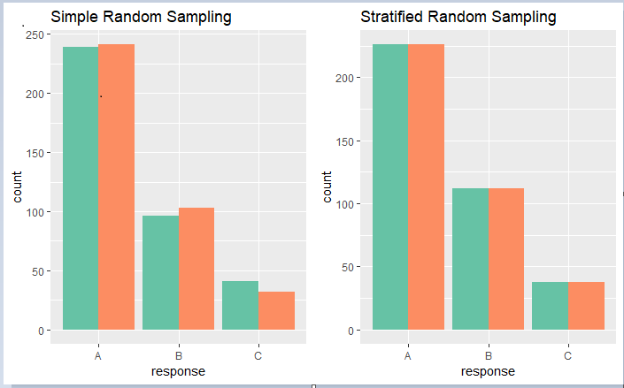
Data Splitting 2
The createDataPartition command uses stratified (proportional) random sampling to find its splits. The plots below compare this method to using the sample method in R. Stratified random sampling is preferred for classification problems.
(Kuhn, 2016)

Slide 11

Pre-processing
The preProcess function has many abilities. This includes data transformation, imputation, and even predictor removal. The function itself is descriptive in nature, while predict.preProcess will produce the new dataframe. The function, preProcess is also available in the train function, which will be covered later.
## Created from 369 samples and 5 variables ## Pre-processing: ## - centered (5) ## - ignored (0) ## - 5 nearest neighbor imputation (5) ## - scaled (5)

Slide 12
Pre-processing: Linear Dependencies
caret has a variety of functions available to assess the quality of your data. For example, if a dataset contains linear combinations of predictors, this can cause misleading results (in short, repetitive information). See the quick example below, where city and zip are often represented by the same vector. Imagine if you were to only have these data points, it would be hard to pick out a functional signal for your model!
## city zip beds baths sqft type price latitude longitude ## 1 SACRAMENTO z95838 2 1 836 Residential 59222 38.63191 -121.4349 ## 2 SACRAMENTO z95823 3 1 1167 Residential 68212 38.47890 -121.4310 ## 3 SACRAMENTO z95815 2 1 796 Residential 68880 38.61830 -121.4438 ## 4 SACRAMENTO z95815 2 1 852 Residential 69307 38.61684 -121.4391 ## 5 SACRAMENTO z95824 2 1 797 Residential 81900 38.51947 -121.4358 ## 6 SACRAMENTO z95841 3 1 1122 Condo 89921 38.66260 -121.3278

Slide 13

Pre-processing: Linear Dependencies
The findLinearCombos function will provide you with a recommendation of predictor columns to remove.
## [1] 38 40 41 42 43 45 46 47 48 49 50 51 52 53 54 55 57 ## [18] 58 59 61 64 65 66 67 68 69 70 71 72 73 75 76 77 103 ## [35] 104

Slide 14
Your Turn: Explore the preprocessing technique of nearZeroVar
Install and load caret. Look up ?nearZeroVar to get an understanding of what the function does.
Load the dataset German credit with data("GermanCredit"). The response variable is Class.
Split the data into a train/test split with createDataPartition.
Explore the proportional distribution of the predictors in the training set using the nearZeroVar command. Note that this could also be done with the preProcess command with method = "nzv".
(Kuhn, 2019)
(Hoffman)

Slide 15
Other Preprocessing techniques
There are quite a few other preprocessing techniques available:
The dummyVars function creates dummy variables. R seems to have a few different formulas to create model matrix type data, and I recommend reading before you go!
The plethora of available methods in preProcess:
BoxCox, YeoJohnson,
expoTrans, center, scale, range,
knnImpute, bagImpute, medianImpute,
pca, ica, spatialSign, corr,
zv, nzv, conditionalX

Slide 16
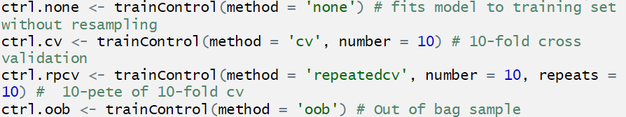
Training Parameters
Training parameters and resampling procedures are set up in the trainControl function. Below are some of the more well known methods, none, k-fold, repeated k-fold, and out-of-bag.
For dat, we will use ctrl.rpcv.

Slide 17
The gbm model and its tuning parameters
The gbm model is a stochastic gradient boosting model that minimizes a loss function to a certain distribution. You do not need to understand it for the purposes of this presentation, but you should know that interaction.depth, n.trees, and shrinkage have the most affect on the accuracy of your model. Note that choosing a small shrinkage should positively affect results, but also significantly slow done processing time.
## model parameter label ## 1 gbm n.trees # Boosting Iterations ## 2 gbm interaction.depth Max Tree Depth ## 3 gbm shrinkage Shrinkage ## 4 gbm n.minobsinnode Min. Terminal Node Size

Slide 18
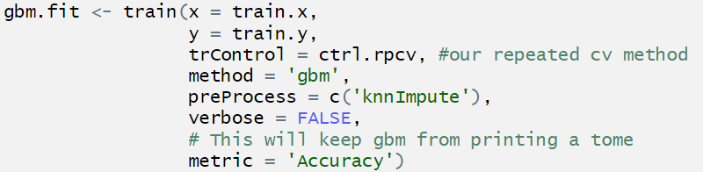
A First Look at Train
The train function is the heart of caret, and this is where everything comes together (pre-processing, training parameters, and tuning). This is the function where your model gets trained.

Slide 19
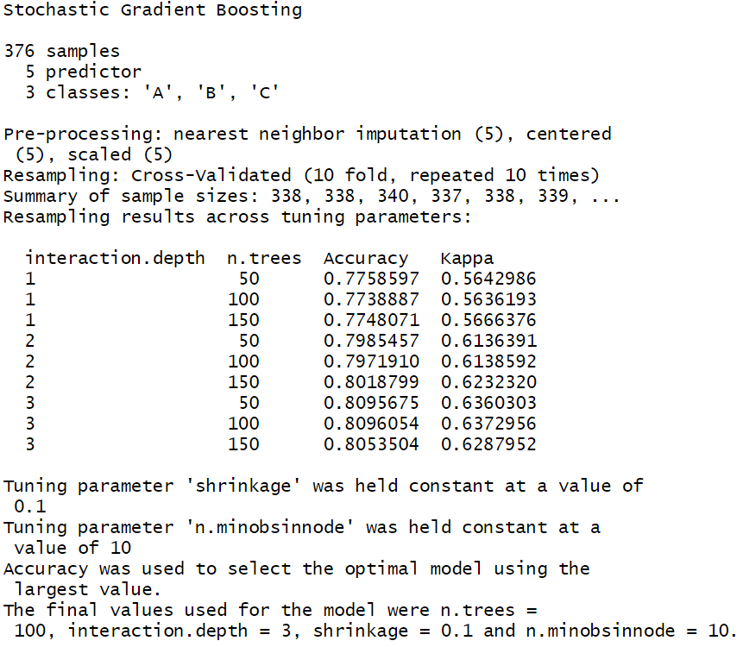
Results oF train

Slide 20
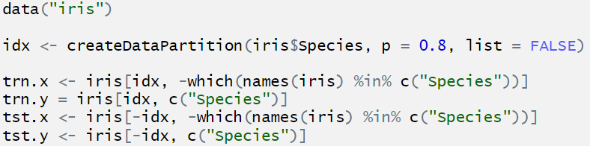
Your Turn with Train
We will run a random forest model on the popular Iris (Fisher, 1936) dataset. The method = "rf" is actually the default in train. The only tuning parameter in the randomForest tagged model is mtry, which is the number of randomly selected predictors.
Below is a reminder of how to set up a train/test set, but feel free to do your own!
Set up a 5-fold cross validation method, center and scale the data, and train a randomForest model.

Slide 21
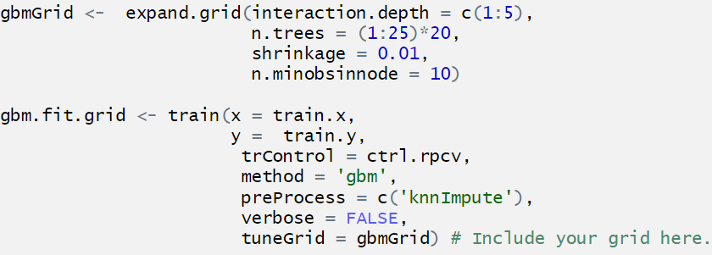
Training with Customized Grid
You can set up a customized grid that sets up your own tuning parameters in the tuneGrid section of the train command.
Note that there is one more way to train – by using a random search, search = "random", and setting the tuneLength.

Slide 22
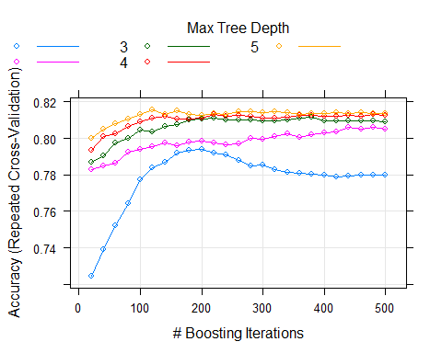
Tools for working with the train results
The results across tuning parameters are available for plotting with the plot.train function.

Slide 23
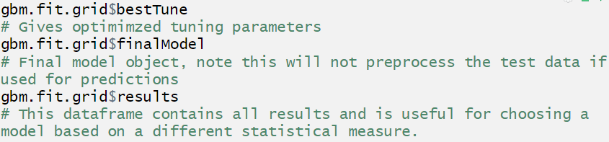
Tools for working with the train results
The default is for caret is to determine the best model by the metric given and there are a variety of ways to view this optimized model.

Slide 24

Getting predictions from your model
The function, predict.train can be used to get predictions from the optimized model.
## test.y ## preds A B C ## A 67 12 0 ## B 7 23 3 ## C 1 2 9
An additional function, extractPrediction which will output a dataframe full of information concerning your predictions (obs, pred, model, object, dataType). Note that this function can also be applied to a list of different models.

Slide 25
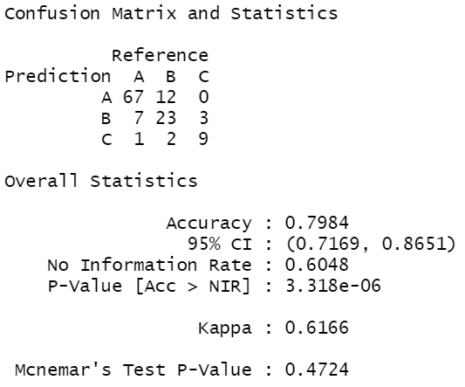
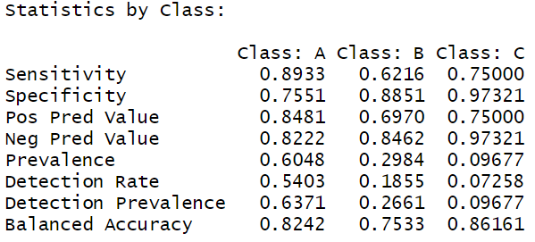
Confusion Matrix
Accuracy is not the only metric to analyze a classification model with. The confusionMatrix command provides several other associated statistics, below is a sample of the output.

Slide 26
Your Turn: Practice with the IRIS model
Plot the results of the random forest model. If you want to try a different tuning method, feel free! (Hint: you will have to adjust the mtry parameter).
Build predictions on the test set.
Print a confusion matrix.

Slide 27

Sampling methods to deal with class imbalance
The distribution of the response class in my dataset is unbalanced, which can affect the results of model training. | ## train.y ## A B C ## 226 112 38
There are a variety of rebalancing methods in caret to handle this, and we will try upSample. In essence, this randomly samples from the unbalanced classes until we reach equal proportions. | ## Class n ## 1 A 226 ## 2 B 226 ## 3 C 226

Slide 28
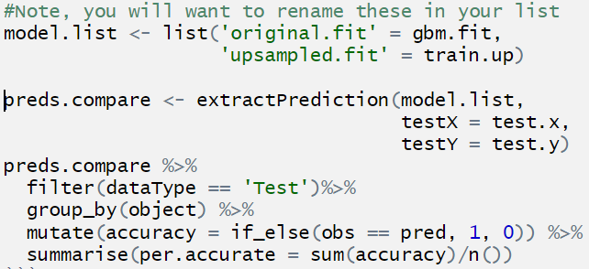
Training on the Upsampled Data
This might (or not) improve a fit, but let’s compare it to our original gbm.fit object. Both results are similar, but this example also shows us how we can use ExtractPrediction to compare models.
## object per.accurate ## 1 original.fit 0.831 ## 2 upsampled.fit 0.806

Slide 29
Your Turn
Fatty acids were measured in different oil types (coded as A), sunﬂower (B), peanut (C), olive (D), soybean (E), rapeseed (F) and corn (G). The variable FattyAcids contains the predictors, whilst the variable, oilType contains the response.
1. By plot or count, view the distribution of the response variable and start to think about how this might affect the model results.
2. Split the data into a train/test split.
3. Train a classification model of your choice. There shouldn’t be much pre-processing required.
4. Your choice from here! Run predictions on your test set, go back and tune your model…
(Brodnjak-Vonina et al. (2005))
(Kuhn, 2016)

Slide 30
Going Further with Caret
Several feature selection tools available. For the gbm model we could have used recursive feature selection.
Tools available for analysis of classification problems with two classes.
A variety of visualization tools available, specifically geared towards analysis of EDA required for the modeling processes.
The ability to create recipes in train for customized pre-processing methods.
Parallel processing methods.
And….SO much more…we only made it through chapter 5 and a bit more of the caret vignette.

Slide 31
Bibliography
Kuhn, M., & Johnson, K. (2016). Applied predictive modeling. New York: Springer.
Kuhn, M. (2019, March 27). The caret Package. Retrieved from http://topepo.github.io/caret/
Datasets
Fisher, R. A. (1936) The use of multiple measurements in taxonomic problems. Annals of Eugenics, 7, Part II, 179–188
Sacramento Data. (n.d.). Retrieved from https://support.spatialkey.com/spatialkey-sample-csv-data/
Hofman, D. (n.d.). Retrieved from https://archive.ics.uci.edu/ml/datasets/statlog (german credit data)
Brodnjak-Voncina et al. (2005). Multivariate data analysis in classification of vegetable oils characterized by the content of fatty acids, Chemometrics and Intelligent Laboratory Systems, Vol. 75:31-45

