Slide 1
Introduction to Caret (a Classification Lens)
Fiona Lodge
RLadies Meetup

Slide 2
Motivation
This presentation will go through main functions of the caret package. We will focus on aspects of classifications problems for model training and tuning. The focus on this presentation is to demonstrate the processes of caret, not to talk about the mathematics of predictive modeling, although I did my best to include some background information.
I was motivated to learn caret because I am working through the book, Applied Predictive Modeling (Kuhn, 2016). This book contains modeling problems and examples done in R, along with statistical explanations. Although the book does not exclusively rely on caret, you could work through the problems with caret.
I was also motivated to learn caret because my work flow tends to switch between R to Python. I find the EDA process to be more suited to using R and the modeling (sci-kit learn) to more suited to using Python. In terms of ease, uniformity, and the ability to run multiple models easily, the caret package seems comparable.

Slide 3
My BACKGROUND
Current analytics intern at the Korn Ferry Institute. Working on enablement materials and building QA materials for Shiny apps.
Co – organizer of new WiMLDS (Women in Machine Learning and Data Science) MeetUp group. Check us out here! https://www.meetup.com/minneapolis-wimlds/
Received a master’s (P.S.M) in Applied and Industrial Mathematics from the University of Stout.
Former life includes seven years as a high school math teacher, and still currently a high school softball coach.
I enjoy mathematics for its depth, there are always ‘new things to learn’, or ‘new ways to learn old things’!

Slide 4
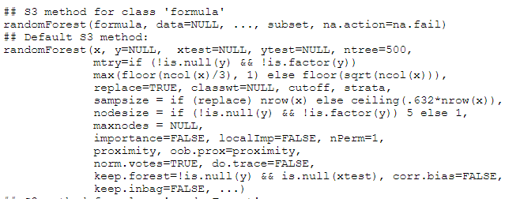
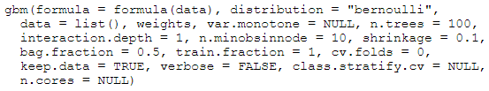
Starting with a question mark What’s Important?
?randomForest
?gbm

Slide 5
Why Caret
Model functions in R vary in syntax, resampling methods, and tuning parameters. You would need to pick out these differences in the formula, and code what’s not there on your own.
 | randomForest | gbm
form | x , y | y ~ x
resampling | oob | cv.folds
sample tuning parameter | ntrees | n.trees

Slide 6
Description of Caret
Kuhn has recognized that the modeling process is composed of similar tasks. The functions in the caret package focus on the following main aspects of model development:
data splitting
pre-processing
feature selection
model tuning using resampling
variable importance estimation
Caret is a predictive modeling package and is an acronym for Classification And REgression Training.
(Kuhn, 2019)

Slide 7
Other Benefits to Caret
I have found the error messages to be (mostly) helpful. I actually learned a few things about the modeling process from them.
The package will ask you to install package dependencies, instead of stopping its processes and asking you to start over. This also means that you only need to load caret to be able to access a many different modeling libraries.
Kuhn has included many options for customization.
It is easy to find tuning parameters (as opposed to sorting through a long list of model inputs).
The package contains some datasets to practice on.
I found it refreshing to work through a book written by the author of the package. I got a better understanding of the package structure, functions, and motivation.
Uniform interface.

Slide 8
Preprocessing techniques
The preProcess function has many methods available for preparing a dataset for modeling. This includes data transformation, imputation, and even predictor removal.
The function itself is descriptive in nature, while predict.preProcess will produce the new dataframe.
There are quite a few preprocessing techniques available:
The dummyVars function creates dummy variables.
The plethora of available methods in preProcess:
BoxCox, YeoJohnson
expoTrans, center, scale, range,
knnImpute, bagImpute, medianImpute,
pca, ica, spatialSign, corr,
zv, nzv, conditionalX
Although not discussed here, there are also options to build your own preprocessing techniques.

Slide 9

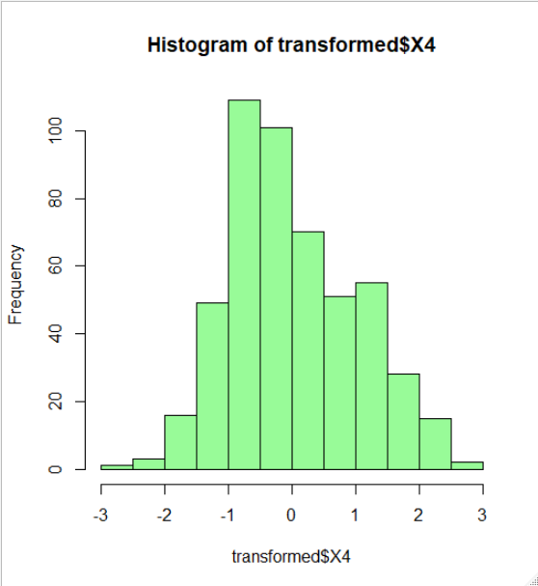
Example of Pre-processing
## Created from 376 samples and 5 variables ## Pre-processing: ## - centered (5) ## - ignored (0) ## - scaled (5)
The example below centers and scales the data to fit the standard parameters of a normal distribution.
This creates a new dataframe.

Slide 10
Pre-processing: Linear Dependencies
The data below is taken from the Sacramento dataset, which provides information about houses in the Sacramento area. All columns are shown below.
As we can see, city and zip are often represented by the same information.
Caret has a function to identify this repetitive information, FindLinearCombos.
## city zip beds baths sqft type price latitude longitude ## 1 SACRAMENTO z95838 2 1 836 Residential 59222 38.63191 -121.4349 ## 2 SACRAMENTO z95823 3 1 1167 Residential 68212 38.47890 -121.4310 ## 3 SACRAMENTO z95815 2 1 796 Residential 68880 38.61830 -121.4438 ## 4 SACRAMENTO z95815 2 1 852 Residential 69307 38.61684 -121.4391 ## 5 SACRAMENTO z95824 2 1 797 Residential 81900 38.51947 -121.4358 ## 6 SACRAMENTO z95841 3 1 1122 Condo 89921 38.66260 -121.3278

Slide 11

Pre-processing: Linear Dependencies
The findLinearCombos function will provide you with a recommendation of predictor columns to remove. After getting this list, it may be necessary to investigate further as these are the columns taken after creation of a model matrix.
## [1] 38 40 41 42 43 45 46 47 48 49 50 51 52 53 54 55 57 ## [18] 58 59 61 64 65 66 67 68 69 70 71 72 73 75 76 77 103 ## [35] 104

Slide 12
Your Turn: preprocessing THE GERMANCREDIT DATASET
Install and load caret. Look up ?nearZeroVar to get an understanding of what the function does.
Load the dataset German credit with data("GermanCredit"). The response variable is Class. Find out more about the dataset using ?GermanCredit or at the UCI site: https://archive.ics.uci.edu/ml/datasets/statlog+(german+credit+data)
Explore the proportional distribution of the predictors in the training set using the nearZeroVar command. Note that this could also be done with the preProcess command with method = "nzv".
Use findLinearCombos to determine if there are any linear dependencies in the columns. Alternatively, explore the column names to determine if there are any that may be repeat the same information.
(Kuhn, 2019)
(Hoffman)

Slide 13

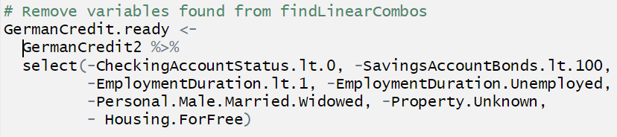
Final Preprocessing Steps
Now that we’ve explore the preprocessing steps, here is the code you can use to get a final prepped data set for modeling. Hold onto GermanCredit.ready for later.
Kuhn (2019)

Slide 14
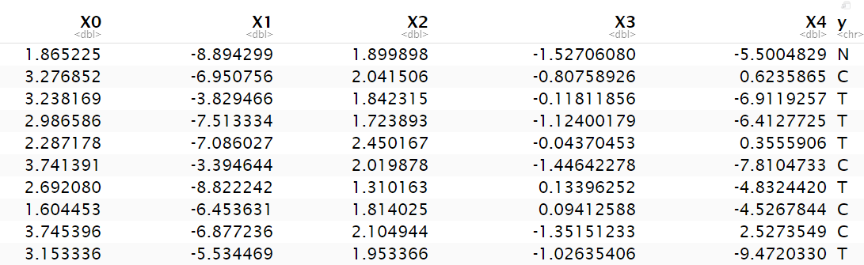
example Dataset for Modeling
For most of the examples today, I generated a random dataset in Python using the datasets.make_classification command in sci-kit learn.
The dimensions are (500, 6) with y as a response variable.
Below is the head of the dataset, and in the code, the dataset is (creatively) referred to as dat.

Slide 15
Model Syntax
Although caret will take both forms of models that R typically uses, some preprocessing steps may be easier using the x,y format, specifically imputation (filling in of missing values). This is because the model frame format has its own default method for imputation.
 | Explicit Inputs | Model Frame
Model Form | x = train.x, y = train.y | y ~ x, data = train.data
What training data might look like. | train.x = dat[index,(-y)] train.y = dat[index, ‘y’] | train.data = dat[index,]
What testing data might look like. | test.x = dat[-index, (-y)] test.y = dat[-index, ‘y’] *(-y) is just a placeholder and not proper R syntax | test.data = dat[-index,]

Slide 16
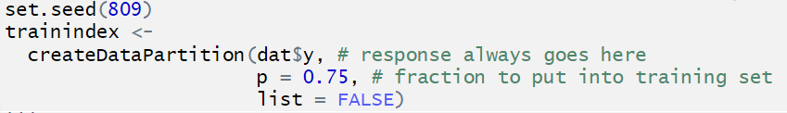
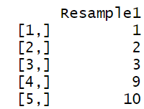
Creating Indices for Data Splitting
The data splitting function, CreateDataPartition, creates a list (or matrix) of indices for your training data. Below is a sample command for the dataset that use 75% of its data for training.
The results of CreateDataPartition.

Slide 17
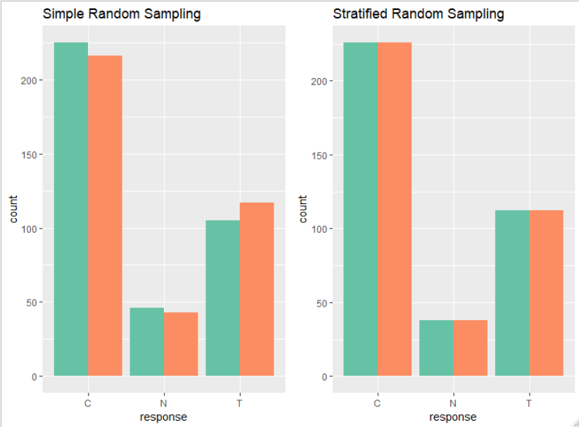
Data Splitting
The createDataPartition command uses stratified (proportional) random sampling to find its splits for a train/test set. The plots below compare this method to using the sample method in R for two training set samples. Stratified random sampling is preferred for classification problems.
(Kuhn, 2016)

Slide 18

Train/Test Set SPLIT
Below is the train/test split of our data from CreateDataPartition. Since there is no missing values in the data, we will use the model frame method.
Model Frame Method (y~.) ~ x)

Slide 19
Your Turn SPLIT the GERMANCREDIT DAtaset
Use CreateDataPartition to set up the indices for the split in your GermanCredit.ready dataset, use p = 0.8.
Set up two datasets, a training (train.dat) dataset and a testing (test.dat) dataset.

Slide 20
The Heart of Caret: The Train FUnction
The train function is the really the heart of the caret package, and is what simplifies the modeling process. In essence, it can sets up all training parameters in one function!
Here is an exoskeleton of train.
train( data input,
preprocess methods for the training data,
resample method(s) – cv, oob, etc..,
tuning parameters for the model,
model metrics)

Slide 21
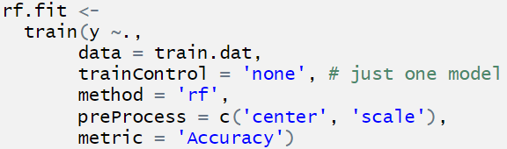
A First Look at Train
The random forest model is actually the default in train.

Slide 22
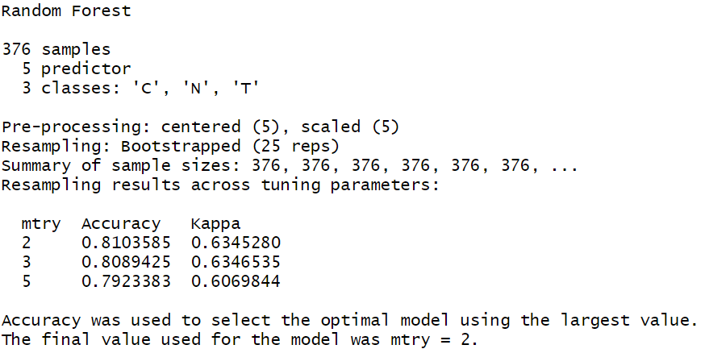
A First Look at Train - Results

Slide 23
Model Lookup (GBM)
You do not need to understand gbm (gradient boosting model) for the purposes of this presentation, but for any model you can look up tuning parameters in using modelLookup.
## model parameter label ## 1 gbm n.trees # Boosting Iterations ## 2 gbm interaction.depth Max Tree Depth ## 3 gbm shrinkage Shrinkage ## 4 gbm n.minobsinnode Min. Terminal Node Size
Note that choosing a small shrinkage should positively affect results, but also will significantly slow done processing time.

Slide 24
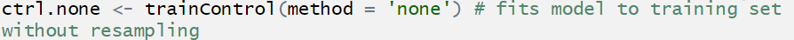
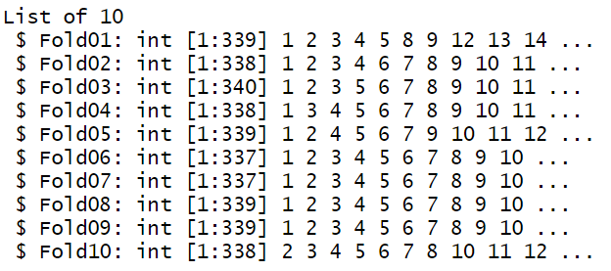
Training Parameters for resampling
Resampling procedures are set up in the trainControl function.
For cross validation, we will use a repeat k-fold cross validation. First, we can visualize what these folds look like with the CreateFolds. Each fold represents a subset of the training set, which the model will be run on. Around 36-38 data points have been held out to assess performance on that set.
Set up the resampling process in an object.

Slide 25
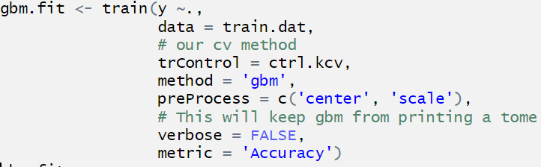
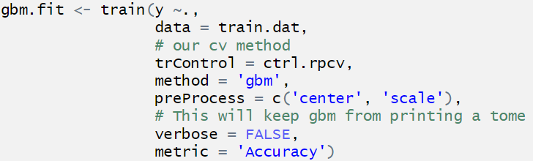
A Second Look at Train with GBM
Here is a model with a resampling method other than ‘none’.

Slide 26
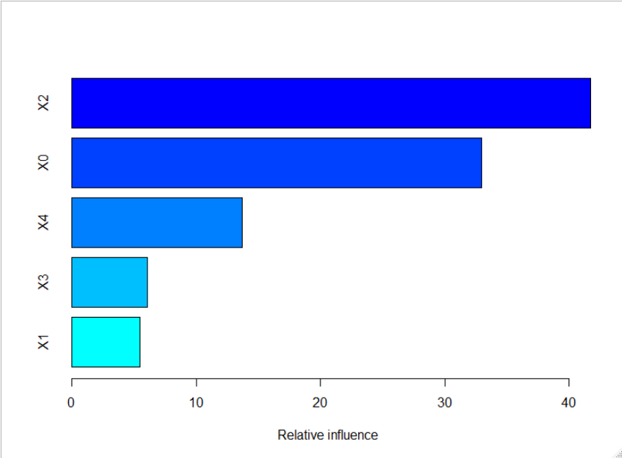
Tools for working with the train results – Variable Importance Plots
I was able to find the variable importance plot using summary(gbm.fit).

Slide 27
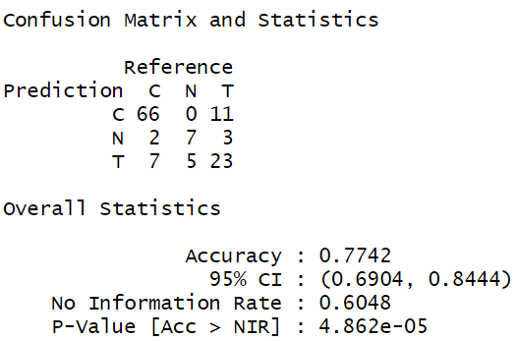
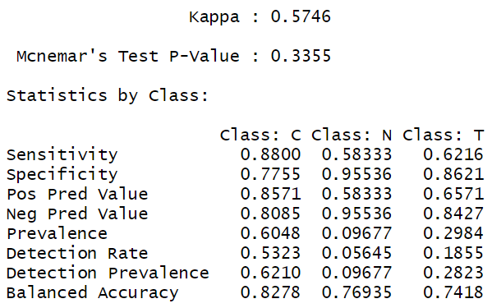
Confusion Matrix
Accuracy is not the only metric to analyze a classification model with. The confusionMatrix command provides several other associated statistics, below is a sample of the output for the gbm model.

Slide 28
Your Turn with Train
Run a ‘gbm’ or ‘rf’ model using the training dataset that you have set up for the GermanCredit data.
Print the model and summary of the model.
Do the model look up for method = ‘svmRadial’ and find the tuning parameters. How many are there? What type of modeling processes can this model be used for?

Slide 29
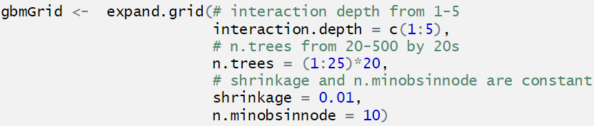
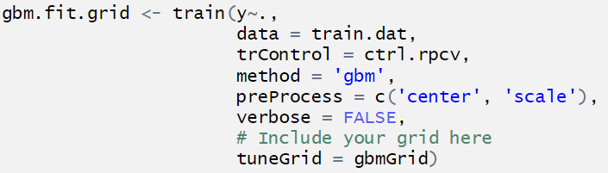
Training with A Customized Grid
You can set up a customized grid that sets up your own tuning parameters in the tuneGrid section of the train command.
Note that there are many more ways to train – by using a random search, search = "random", setting the tuneLength, etc… The great thing about caret is that there is a lot of room for customization.

Slide 30
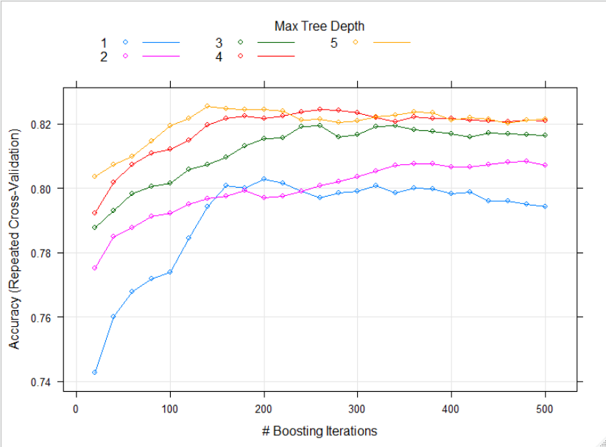
Tools for working with the train results – Plotting Results
The results across tuning parameters are available for plotting with plot(gbm.fit.grid).

Slide 31
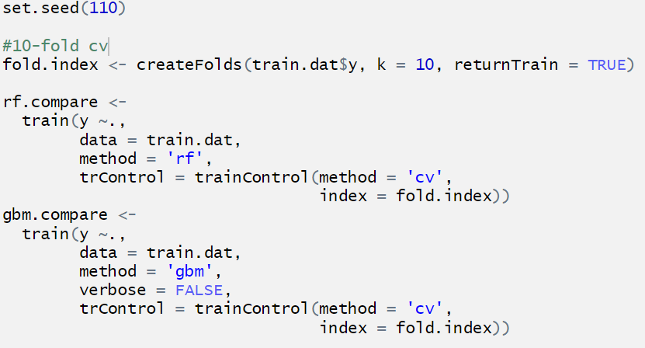
Comparing Models
There are a variety of functions for comparing models, you just have to make sure that the samples are created from the same index.

Slide 32
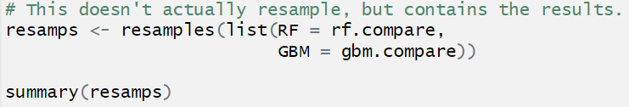
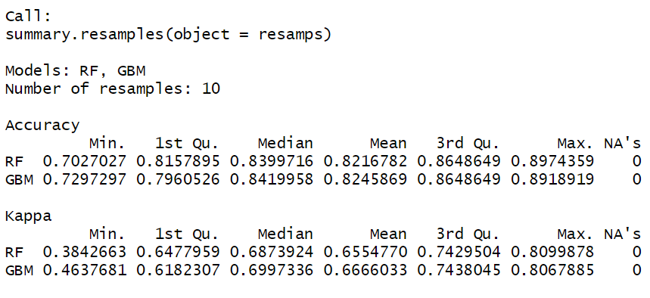
Comparing Models 2
The resamples command contains methods and graphics for comparing models.

Slide 33

Upsampling Example
The distribution of the response class in my dataset is unbalanced, which can affect the results of model training. | ## train.y ## A B C ## 226 112 38
There are a variety of rebalancing methods in caret to handle this, and we will try upSample. In essence, this randomly samples from the unbalanced classes until we reach equal proportions. | ## Class n ## 1 A 226 ## 2 B 226 ## 3 C 226

Slide 34
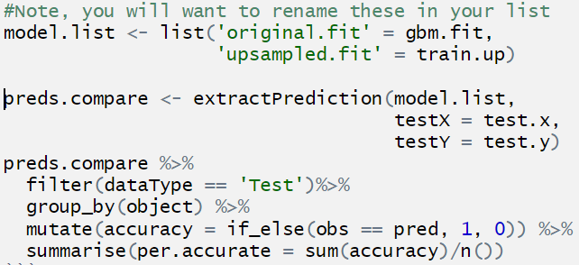
Training on the Upsampled Data
This might (or not) improve a fit, but let’s compare it to our original gbm.fit object. Both results are similar, but this example also shows us how we can use ExtractPrediction to compare models.
## object per.accurate ## 1 original.fit 0.831 ## 2 upsampled.fit 0.806

Slide 35
Going Further with Caret
Several feature selection tools available. For the gbm model we could have used recursive feature selection.
Tools available for analysis of classification problems with two classes.
A variety of visualization tools available, specifically geared towards analysis of EDA required for the modeling processes.
The ability to create recipes in train for customization of (everything?).

Slide 36
Bibliography
Kuhn, M., & Johnson, K. (2016). Applied predictive modeling. New York: Springer.
Kuhn, M. (2019, March 27). The caret Package. Retrieved from http://topepo.github.io/caret/
Datasets
Fisher, R. A. (1936) The use of multiple measurements in taxonomic problems. Annals of Eugenics, 7, Part II, 179–188
Sacramento Data. (n.d.). Retrieved from https://support.spatialkey.com/spatialkey-sample-csv-data/
Hofman, D. (n.d.). Retrieved from https://archive.ics.uci.edu/ml/datasets/statlog (german credit data)
Brodnjak-Voncina et al. (2005). Multivariate data analysis in classification of vegetable oils characterized by the content of fatty acids, Chemometrics and Intelligent Laboratory Systems, Vol. 75:31-45

