Slide 1







new study site = i
Year = j
Site = i, Year = j

Slide 2






Slide 3
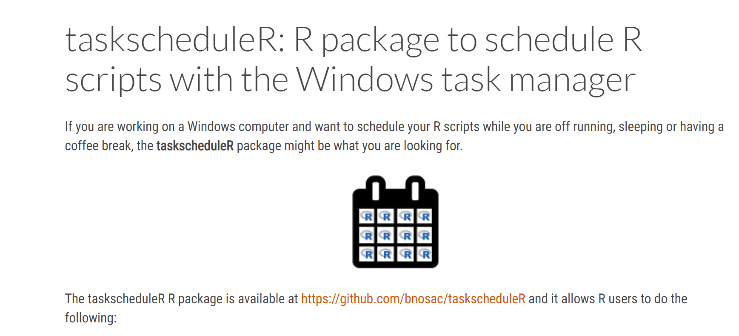

Slide 4
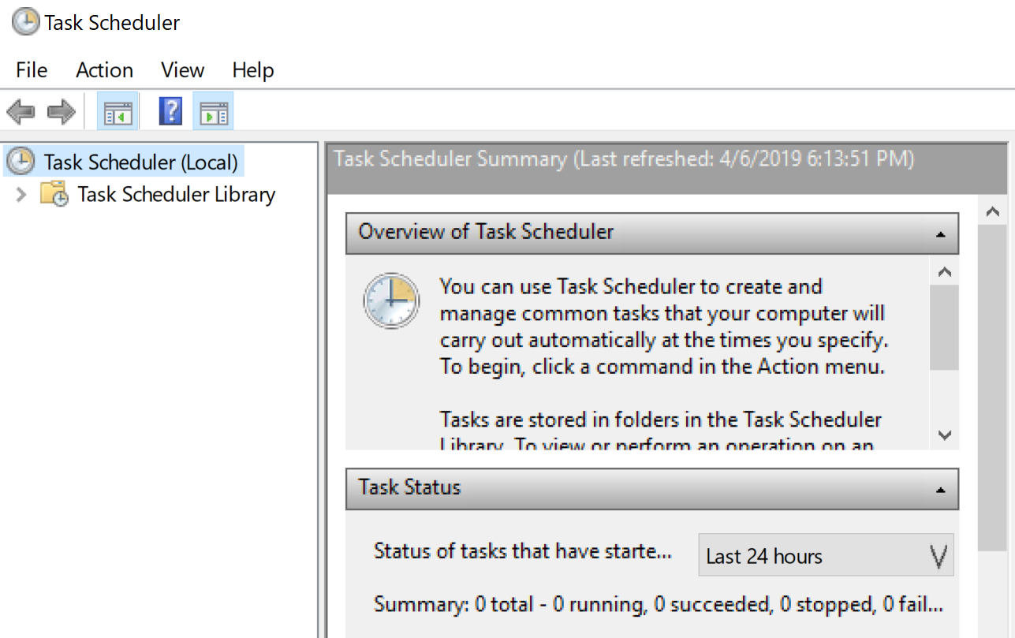
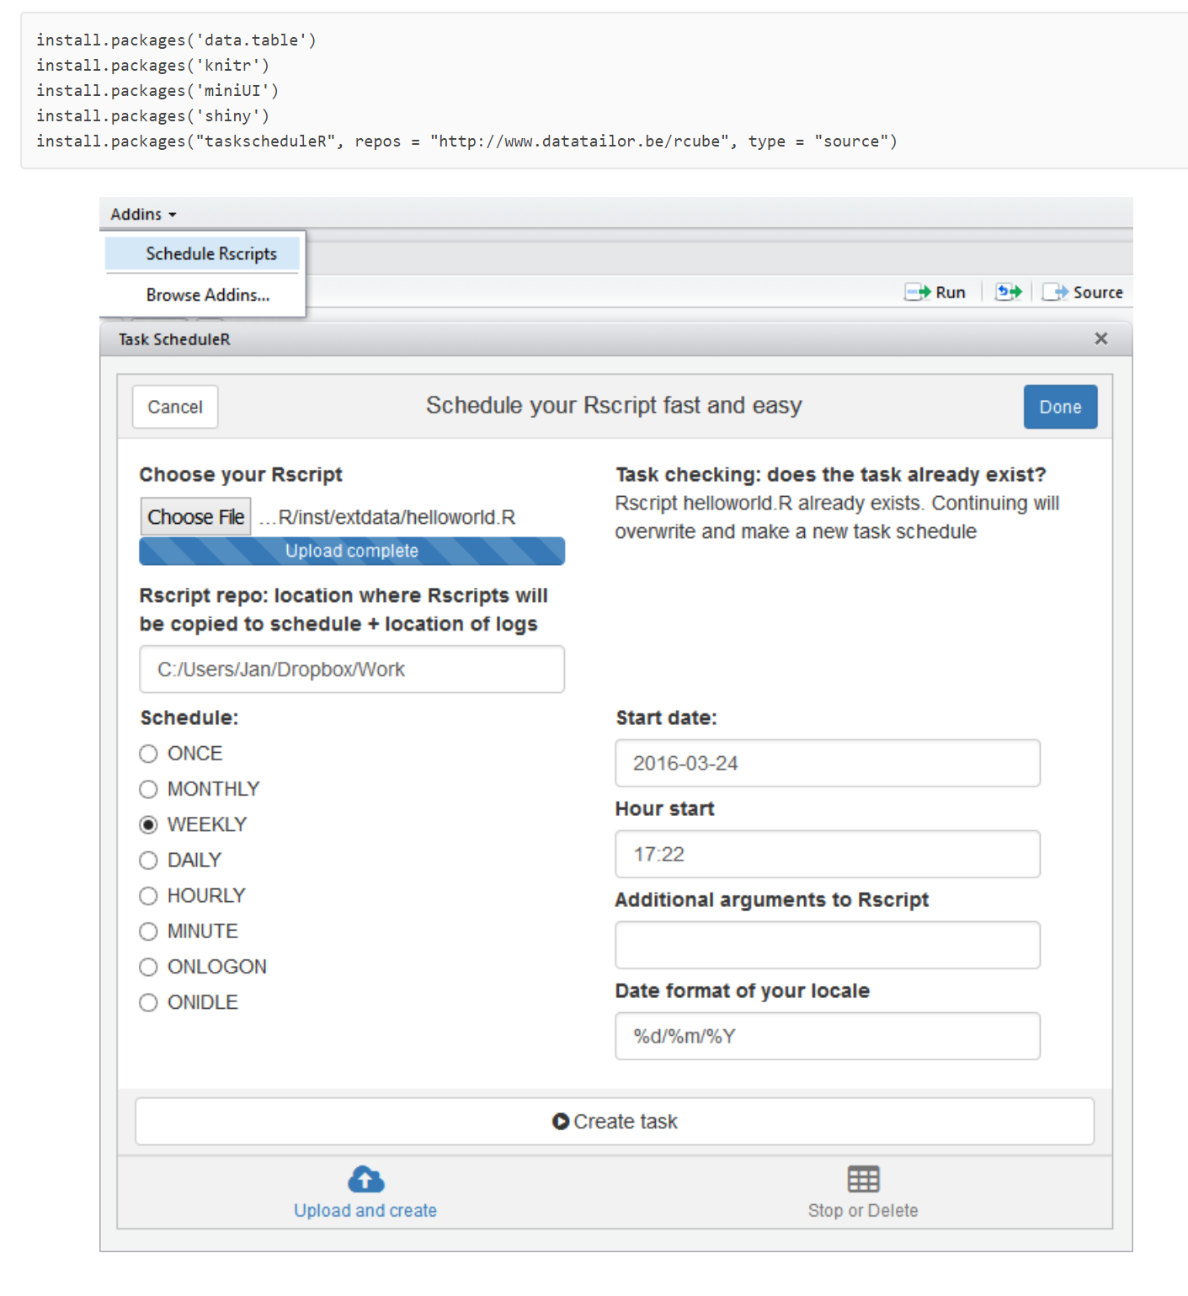
Windows OS
taskscheduleR

Slide 5
Site = i, Year = j

Slide 6
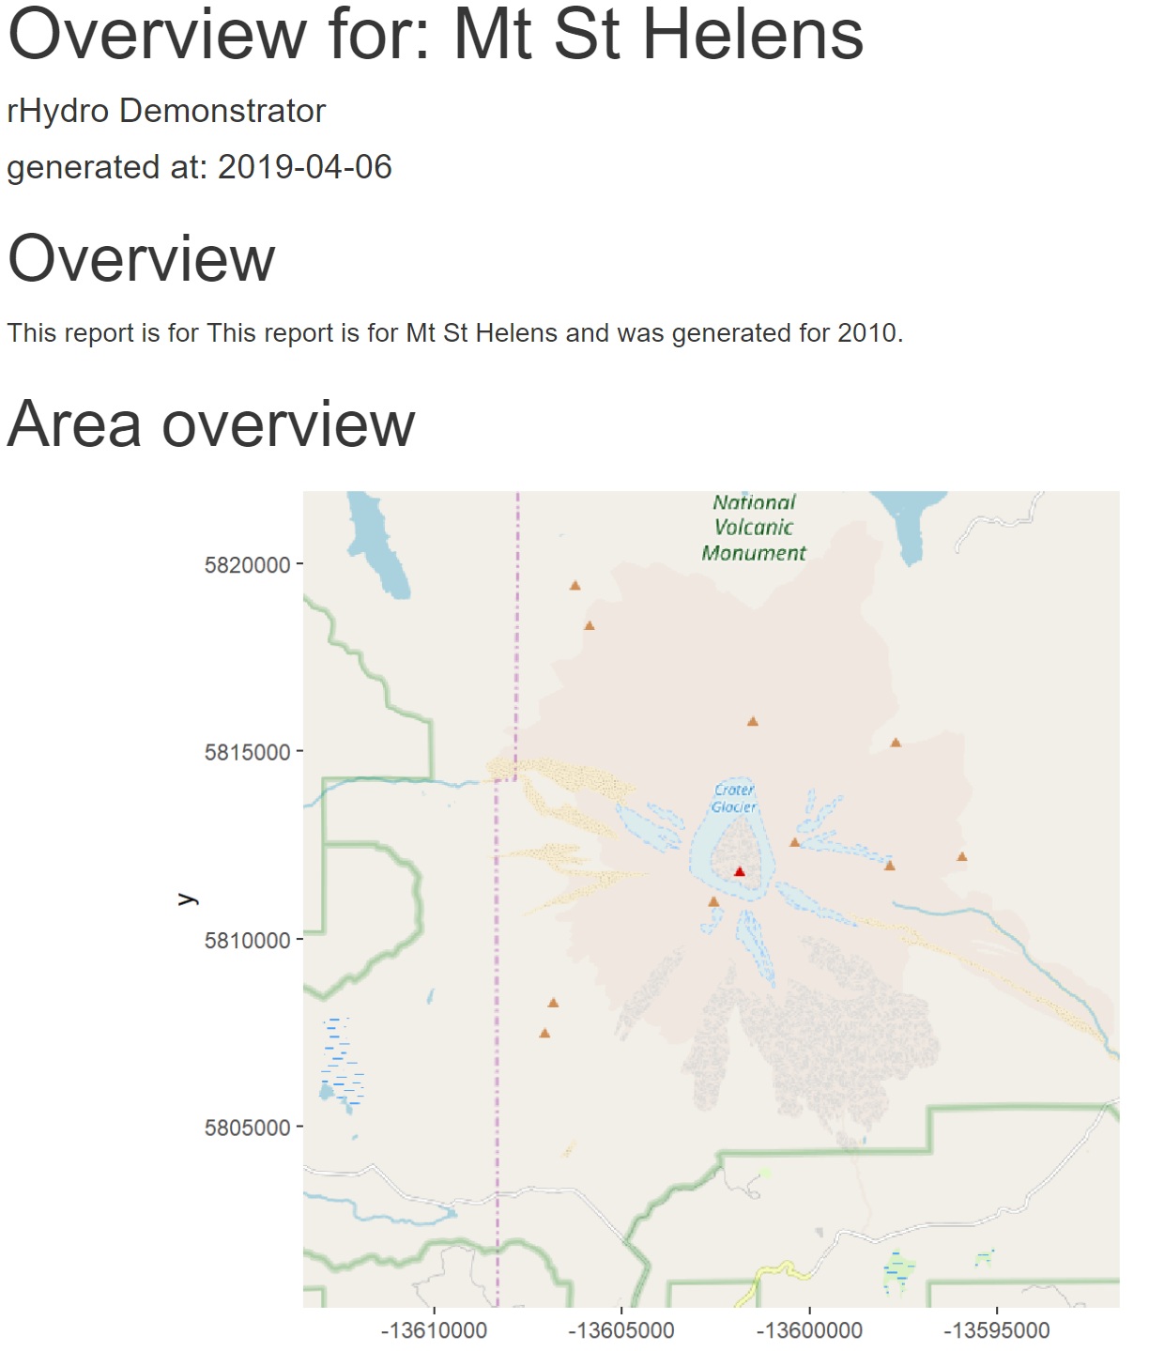

Slide 7
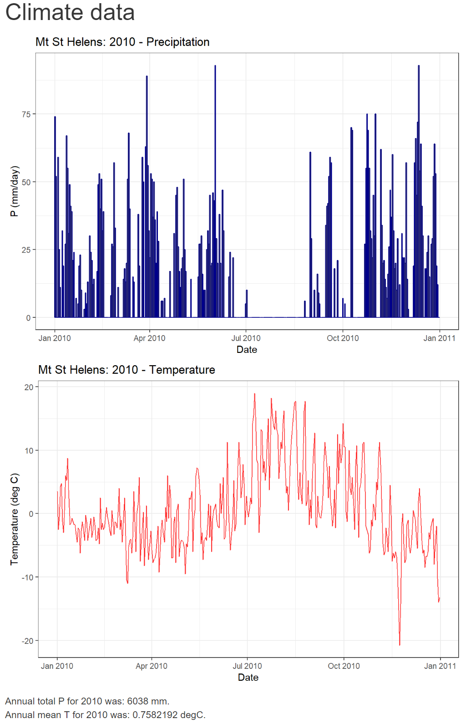

Slide 8


Slide 9


Slide 10
GitHub
sites.csv
code.R

Slide 11

GitHub
sites.csv
code.R

Slide 12
Travis Continuous Integration
GitHub
sites.csv
code.R

Slide 13

Travis Continuous Integration
GitHub
sites.csv
code.R
.travis.yml

Slide 14
Travis Continuous Integration
GitHub
sites.csv
code.R
Install R
Run scripts
Deliver back
.travis.yml

Slide 15
Travis Continuous Integration
GitHub
sites.csv
code.R
R
Install R
Run scripts
Deliver back
.travis.yml

Slide 16
Travis Continuous Integration
GitHub
sites.csv
code.R
R
Install R
Run scripts
Deliver back
sites.csv
report_j.html
.travis.yml

Slide 17
Travis Continuous Integration
GitHub
sites.csv
code.R
R
Install R
Run scripts
Deliver back
sites.csv
report_j.html
.travis.yml

Slide 18
GitHub
sites.csv
code.R
reports
.travis.yml

Slide 19
sites.csv
report_j.html

