Slide 1
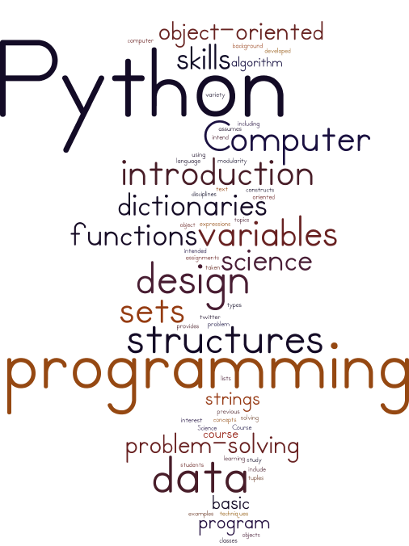
Notes:
When you think of the word Python what comes to mind?

Slide 2
TA Office Hours
The location is MC 4A
Meng Tuesday 2:30 – 3:30
Neda Wednesday 3 – 4 and Thursday 2:30 – 3:30

Slide 3
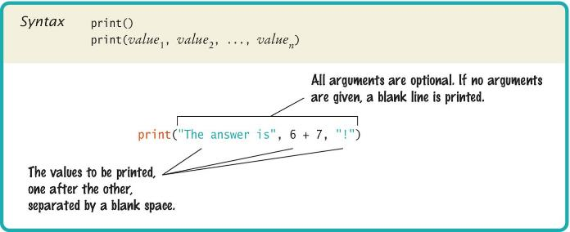
Basic Python Syntax: Print
Using the Python ‘print()’ function.
A function is a collection of programming instructions that carry out a particular task (in this case to print a value onscreen).
It’s code that somebody else wrote for you!

Slide 4
Our Second Program (Page 12, printtest.py)
##
# Sample Program that demonstrates the print function
#
# Prints 7
print(3 + 4)
# Print Hello World! on two lines
print(“Hello”)
print(“World!”)
# Print multiple values with a single print function call
print(“My favorite number are”, 3 + 4, “and”, 3 + 10)
# Print Hello World! on two lines
print(“Goodbye”)
print()
print(“Hope to see you again”)

Slide 5
Recap
Write a python program that displays your name, favorite desert, and favorite movie to the screen.

Slide 6
Chapter Two
Programming with numbers and strings

Slide 7
Introduction
Numbers and character strings are important data types in any Python program
These are the fundamental building blocks we use to build more complex data structures
In this chapter, you will learn how to work with numbers and text. We will write several simple programs that use them

Slide 8
The Pseudocode: Choosing a Car
For each Car, compute the total cost
Annual fuel consumed = annual miles driven / fuel efficiency
Annual fuel cost = price per gallon * annual fuel consumed
Operating cost = Length of time * annual fuel cost
Total cost = purchase price + operating cost
If total cost1 < total cost2
Chose Car1
Else
Choose Car2

Slide 9
Chapter Goals
To declare and initialize variables and constants
To understand the properties and limitations of integers and floating-point numbers
To appreciate the importance of comments and good code layout
To write arithmetic expressions and assignment statements
To create programs that read, and process inputs, and display the results
To learn how to use Python strings
To create simple graphics programs using basic shapes and text

Slide 10
Contents
2.1 Variables
2.2 Arithmetic
2.3 Problem Solving: First Do It By Hand
2.4 Strings
2.5 Input and Output
2.6 Graphics: Simple Drawings

Slide 11
2.1 Variables

Slide 12
Variables
A variable is a named storage location in a computer program
There are many different types of variables, each type used to store different things
You ‘define’ a variable by telling the compiler:
What name you will use to refer to it
The initial value of the variable
You use an assignment statement to place a value into a variable

Slide 13
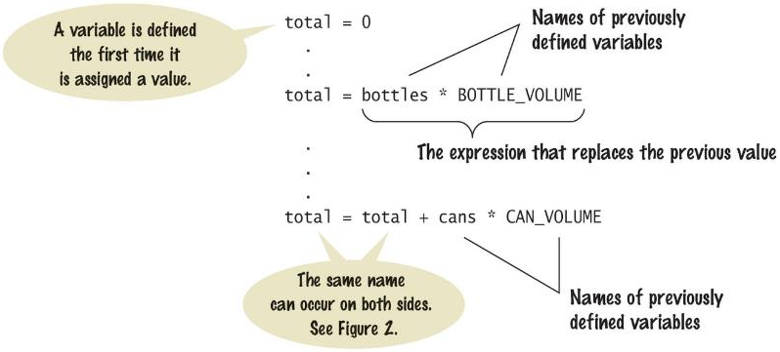
Variable Definition
To define a variable, you must specify an initial value.

Slide 14
The assignment statement
Use the assignment statement '=' to place a new value into a variable
cansPerPack = 6 # define & initializes the variable cansPerPack
Beware: The “=“ sign is NOT used for comparison:
It copies the value on the right side into the variable on the left side
You will learn about the comparison operator in the next chapter

Slide 15

Assignment syntax
The value on the right of the '=' sign is assigned to the variable on the left

Slide 16
An example: soda deal
Soft drinks are sold in cans and bottles. A store offers a six-pack of 12-ounce cans for the same price as a two-liter bottle. Which should you buy? (12 fluid ounces equal approximately 0.355 liters.)
List of variables:
Number of cans per pack
Ounces per can
Ounces per bottle
Type of Number
Whole number
Whole number
Number with fraction

Slide 17
Why different types?
There are three different types of data that we will use in this chapter:
A whole number (no fractional part) 7 (integer or int)
A number with a fraction part 8.88 (float)
A sequence of characters “Bob” (string)
The data type is associated with the value, not the variable:
cansPerPack = 6 # int
canVolume = 12.0 # float

Slide 18
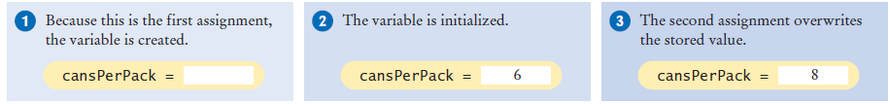
Updating a Variable (assigning a value)
If an existing variable is assigned a new value, that value replaces the previous contents of the variable.
For example:
cansPerPack = 6
cansPerPack = 8

Slide 19
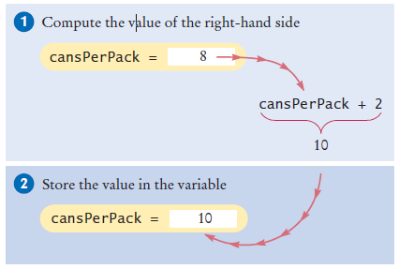
Updating a Variable (computed)
Executing the Assignment:
cansPerPack = cansPerPack + 2
Step by Step:
Step 1: Calculate the right hand side of the assignment. Find the value of cansPerPack, and add 2 to it.
Step 2: Store the result in the variable named on the left side of the assignment operator

Slide 20
A Warning…
Since the data type is associated with the value and not the variable:
A variable can be assigned different values at different places in a program
taxRate = 5 # an int
Then later…
taxRate = 5.5 # a float
And then
taxRate = “Non- taxable” # a string
If you use a variable and it has an unexpected type an error will occur in your program

Slide 21
Our First Program of the Day…
Open your IDE and create a new file
type in the following
save the file as typetest.py
Run the program
# Testing different types in the same variable
taxRate = 5 # int
print(taxRate)
taxRate = 5.5 # float
print(taxRate)
taxRate = "Non-taxable" # string
print(taxRate)
print(taxRate + 5)
So…
Once you have initialized a variable with a value of a particular type you should take great care to keep storing values of the same type in the variable

Slide 22
A Minor Change
Change line 8 to read:
print(taxRate + “??”)
Save your changes
Run the program
What is the result?
When you use the “+” operator with strings the second argument is concatenated to the end of the first
We’ll cover string operations in more detail later in this chapter

Slide 23
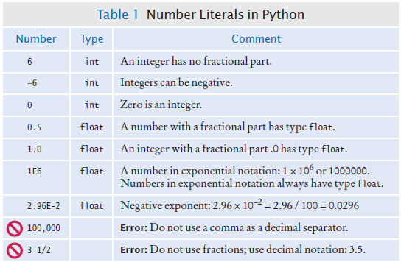
Table 1: Number Literals in Python

Slide 24
Naming variables
Variable names should describe the purpose of the variable
‘canVolume’ is better than ‘cv’
Use These Simple Rules
Variable names must start with a letter or the underscore ( _ ) character
Continue with letters (upper or lower case), digits or the underscore
You cannot use other symbols (? or %...) and spaces are not permitted
Separate words with ‘camelCase’ notation
Use upper case letters to signify word boundaries
Don’t use ‘reserved’ Python words (see Appendix C, pages A6 and A7)

Slide 25
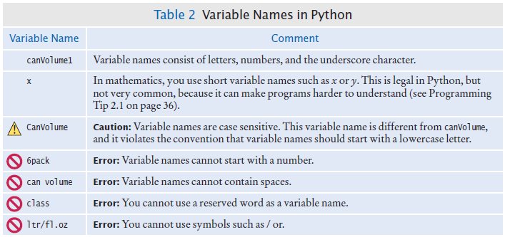
Table 2: Variable Names in Python

Slide 26
Think-Pair-Share: Naming Variables
Which of the following is not a valid variable name in Python
Fuel_efficiency
#OfMiles
carCost1
Which of the following is a valid variable name in Python
1table
SecondCar
Operating Cost

Slide 27
Programming Tip: Use Descriptive Variable Names
Choose descriptive variable names
Which variable name is more self descriptive?
canVolume = 0.35
cv = 0.355
This is particularly important when programs are written by more than one person.

Slide 28
constants
In Python a constant is a variable whose value should not be changed after it’s assigned an initial value.
It is a good practice to use all caps when naming constants
BOTTLE_VOLUME = 2.0
It is good style to use named constants to explain numerical values to be used in calculations
Which is clearer?
totalVolume = bottles * 2
totalVolume = bottles * BOTTLE_VOLUME
A programmer reading the first statement may not understand the significance of the “2”
Python will let you change the value of a constant
Just because you can do it, doesn’t mean you should do it

Slide 29
Constants: Naming & Style
It is customary to use all UPPER_CASE letters for constants to distinguish them from variables.
It is a nice visual way cue
BOTTLE_VOLUME = 2 # Constant
MAX_SIZE = 100 # Constant
taxRate = 5 # Variable

Slide 30
Python comments
Use comments at the beginning of each program, and to clarify details of the code
Comments are a courtesy to others and a way to document your thinking
Comments to add explanations for humans who read your code.
The compiler ignores comments.

Slide 31
Commenting Code: 1st Style
##
# This program computes the volume (in liters) of a six-pack of soda
# cans and the total volume of a six-pack and a two-liter bottle
#
# Liters in a 12-ounce can
CAN_VOLUME = 0.355
# Liters in a two-liter bottle.
BOTTLE_VOLUME = 2
# Number of cans per pack.
cansPerPack = 6
# Calculate total volume in the cans.
totalVolume = cansPerPack * CAN_VOLUME
print("A six-pack of 12-ounce cans contains", totalVolume, "liters.")
# Calculate total volume in the cans and a 2-liter bottle.
totalVolume = totalVolume + BOTTLE_VOLUME
print("A six-pack and a two-liter bottle contain", totalVolume, "liters.")

Slide 32
Commenting Code: 2nd Style
##
# This program computes the volume (in liters) of a six-pack of soda
# cans and the total volume of a six-pack and a two-liter bottle
#
## CONSTANTS ##
CAN_VOLUME = 0.355 # Liters in a 12-ounce can
BOTTLE_VOLUME = 2 # Liters in a two-liter bottle
# Number of cans per pack.
cansPerPack = 6
# Calculate total volume in the cans.
totalVolume = cansPerPack * CAN_VOLUME
print("A six-pack of 12-ounce cans contains", totalVolume, "liters.")
# Calculate total volume in the cans and a 2-liter bottle.
totalVolume = totalVolume + BOTTLE_VOLUME
print("A six-pack and a two-liter bottle contain", totalVolume, "liters.")

Slide 33
Undefined Variables
You must define a variable before you use it: (i.e. it must be defined somewhere above the line of code where you first use the variable)
canVolume = 12 * literPerOunce
literPerOunce = 0.0296
The correct order for the statements is:
literPerOunce = 0.0296
canVolume = 12 * literPerOunce

Slide 34
Quick Review
Declare a variable, give it any name you want and store the value 10 in the variable.
num = 10
Declare a variable, give it any name you want and store the value 0.2 in it.
value = 0.2
Print the first variable to the screen
print(num)
Write a comment with your name in it.
#Oluwakemi Ola-Mudzengi
Add 0.3 to the 2nd variable you created and store the result in the 1st variable you created.
num = value + 0.3
Create a constant and store the number 1000 in it.
THOUS =1000

Slide 36
Notes:
When you think of the word Python what comes to mind?

Slide 37
Additional Resources for Learning
https://www.python.org/
https://www.lynda.com/
PyCharm Courses

Slide 38
Access to SourceCode
Wiley WEBSITE
http://bcs.wiley.com/he-bcs/Books?action=resource&bcsId=10000&itemId=1119056551&resourceId=39930

Slide 39
Contents
2.1 Variables
2.2 Arithmetic
2.3 Problem Solving: First Do It By Hand
2.4 Strings
2.5 Input and Output
2.6 Graphics: Simple Drawings

Slide 40
2.2 Arithmetic

Slide 41


Basic Arithmetic Operations
Python supports all of the basic arithmetic operations:
Addition “+”
Subtraction “-”
Multiplication “*”
Division “/”
You write your expressions a bit differently

Slide 42
Precedence
Precedence is similar to Algebra:
PEMDAS
Parenthesis, Exponent, Multiply/Divide, Add/Subtract

Slide 43
Mixing numeric types
If you mix integer and floating-point values in an arithmetic expression, the result is a floating-point value.
7 + 4.0 # Yields the floating value 11.0
Remember from our earlier example:
If you mix stings with integer or floating point values the result is an error

Slide 44
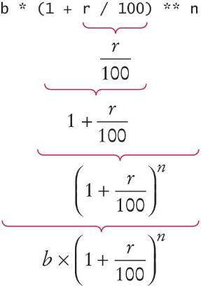
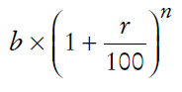
Powers
Double stars ** are used to calculate an exponent
Analyzing the expression:
Becomes:
b * ((1 + r / 100) ** n)

Slide 45
Floor division
When you divide two integers with the / operator, you get a floating-point value. For example,
7 / 4
Yields 1.75
We can also perform floor division using the // operator.
The “//” operator computes the quotient and discards the fractional part
7 // 4
Evaluates to 1 because 7 divided by 4 is 1.75 with a fractional part of 0.75, which is discarded.

Slide 46
Calculating a remainder
If you are interested in the remainder of dividing two integers, use the “%” operator (called modulus):
remainder = 7 % 4
The value of remainder will be 3
Sometimes called modulo divide

Slide 47
A Simple Example:
Open a new file in the PyCharm IDE:
Type in the following:
# Convert pennies to dollars and cents
pennies = 1729
dollars = pennies // 100 # Calculates the number of dollars
cents = pennies % 100 # Calculates the number of pennies
print("I have", dollars, "and", cents, "cents")
Save the file
Run the file
What is the result?

Slide 48
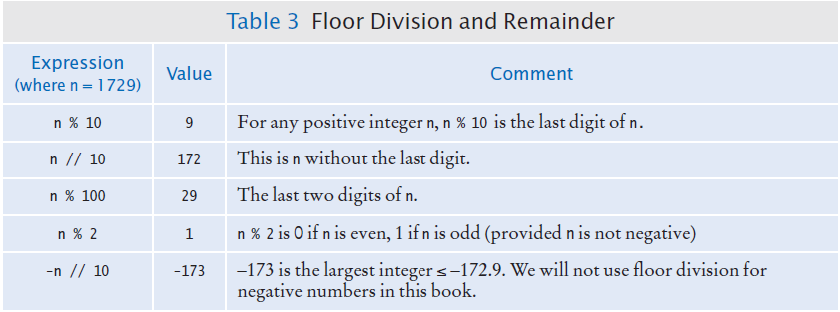
Integer Division and Remainder Examples
Handy to use for making change:
pennies = 1729
dollars = pennies / 100 # 17
cents = pennies % 100 # 29

Slide 49
Calling functions
Recall that a function is a collection of programming instructions that carry out a particular task.
The print() function can display information, but there are many other functions available in Python.
When calling a function you must provide the correct number of arguments
The program will generate an error message if you don’t

Slide 50
Calling functions that return a value
Most functions return a value. That is, when the function completes its task, it passes a value back to the point where the function was called.
For example:
The call abs(-173) returns the value 173.
The value returned by a function can be stored in a variable:
distance = abs(x)
You can use a function call as an argument to the print function
For instance:
print(abs(-173))

Slide 51
Built-in Functions
Built-in functions are a small set of functions that are defined as a part of the Python language
They can be used without importing any modules
For example, Floating-point to integer conversion
You can use the function int() and float() to convert between integer and floating point values:
balance = total + tax # balance: float
dollars = int (balance) # dollars: integer
You lose the fractional part of the floating-point value (no rounding occurs)
So int(10.6) and int(10.3) both return 10

Slide 52
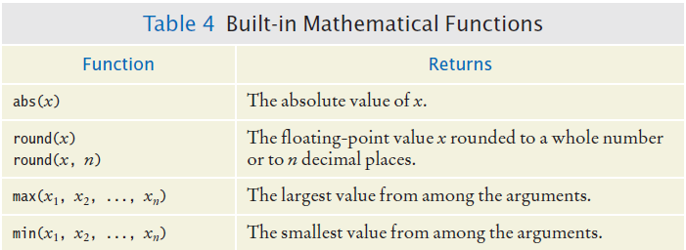
Built in Mathematical Functions

Slide 53
Python libraries (modules)
A library is a collection of code, written and compiled by someone else, that is ready for you to use in your program
A standard library is a library that is considered part of the language and must be included with any Python system.
Python’s standard library is organized into modules.
Related functions and data types are grouped into the same module.
Functions defined in a module must be explicitly loaded into your program before they can be used.

Slide 54
Using functions from the Math Module
For example, to use the sqrt() function, which computes the square root of its argument:
# First include this statement at the top of your
# program file.
from math import sqrt
# Then you can simply call the function as
y = sqrt(x)

Slide 55
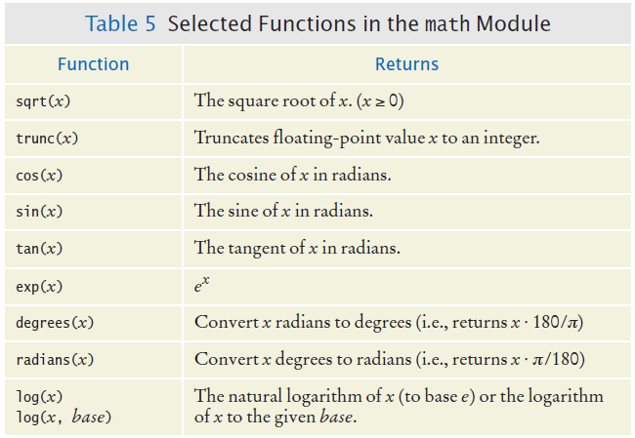
Functions from the Math Module

Slide 56
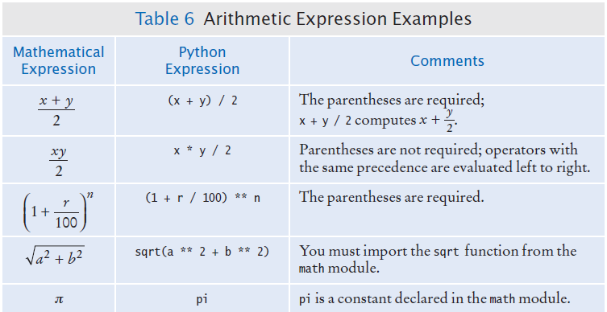
Arithmetic Expressions

Slide 57
ERRORS ☹

Slide 58
Roundoff Errors
Floating point values are not exact
This is a limitation of binary values; not all floating point numbers have an exact representation
Open PyCharm, open a new file and type in:
price = 4.35
quantity = 100
total = price * quantity
# Should be 100 * 4.35 = 435.00
print(total)
You can deal with roundoff errors by
rounding to the nearest integer (see Section 2.2.4)
or by displaying a fixed number of digits after the decimal separator (see Section 2.5.3).

Slide 59
Unbalanced Parentheses
Consider the expression
((a + b) * t / 2 * (1 - t)
What is wrong with the expression?
Now consider this expression.
(a + b) * t) / (2 * (1 - t)
This expression has three “(“ and three “)”, but it still is not correct
At any point in an expression the count of “(“ must be greater than or equal to the count of “)”
At the end of the expression the two counts must be the same

Slide 60
Additional Programming Tips
Use Spaces in expressions
totalCans = fullCans + emptyCans
Is easier to read than
totalCans=fullCans+emptyCans
Other ways to import modules:
From math import, sqrt, sin, cos # imports the functions listed
From math import * # imports all functions from the module
Import math # imports all functions from the module
If you use the last style you have to add the module name and a “.” before each function call
y = math.sqrt(x)

Slide 61
Quick Review
What is the value stored in the variable?
X = 10 / 4
X= 2.5
Y = 11 // 4
Y = 2
Z = 11 % 4
Z = 3
A = abs (10 * -2 + 4)
16

Slide 62
2.3 Problem Solving
Develop the algorithm first, then write the Python

Slide 63
Activity
You want to decide whether you should drive to class or take the bus. You know the one-way distance from your home to campus, and the fuel efficiency of your car (in km per litre). You also know the one-way price of a bus ticket, $3. Let’s assume the cost of gas is $1 per litre, and car maintenance is 5 cents per km, and parking on campus is $5 per day. Write an algorithm to decide which commute is cheaper. Assume you come to campus 50 days for the semester.

Slide 64
What are the major steps
Determine how much it cost for taking public transport
Calculate the cost for using your car.
Choose the one that is less.
Pseudocode

Slide 65
Calculate the cost of taking your car.
Gas cost = km to campus * numOfTrips * price per litre / fuel efficiency
Maintenance cost = maintenance cost * km to campus * numOfTrips
Total cost for the day = Gas cost + parking cost + maintenance cost
SemesterCar = 50 * totalCostPerDay
Calculate the cost of taking the bus
Total cost for a day = bus ticket * numOfTrips
SemesterBus = 50 * totalCostPerDay
If semesterBus < semesterCar
‘Take the bus’
Else
‘Drive your car’

Slide 66
5-minute Break

Slide 67
0
0
5
4
3
2
1
0
0
9
8
7
6
5
4
3
2
1
0
9
8
7
6
5
4
3
2
1
0
9
8
7
6
5
4
3
2
1
0
9
8
7
6
5
4
3
2
1
0
9
8
7
6
5
4
3
2
1
0
9
8
7
6
5
4
3
2
1
0
0
5
0
4
Hours
Minutes
Seconds

Slide 68
0
0
5
4
3
2
1
0
0
9
8
7
6
5
4
3
2
1
0
9
8
7
6
5
4
3
2
1
0
9
8
7
6
5
4
3
2
1
0
9
8
7
6
5
4
3
2
1
0
9
8
7
6
5
4
3
2
1
0
9
8
7
6
5
4
3
2
1
0
0
4
0
3
Hours
Minutes
Seconds

Slide 69
0
0
5
4
3
2
1
0
0
9
8
7
6
5
4
3
2
1
0
9
8
7
6
5
4
3
2
1
0
9
8
7
6
5
4
3
2
1
0
9
8
7
6
5
4
3
2
1
0
9
8
7
6
5
4
3
2
1
0
9
8
7
6
5
4
3
2
1
0
0
3
0
2
Hours
Minutes
Seconds

Slide 70
0
0
5
4
3
2
1
0
0
9
8
7
6
5
4
3
2
1
0
9
8
7
6
5
4
3
2
1
0
9
8
7
6
5
4
3
2
1
0
9
8
7
6
5
4
3
2
1
0
9
8
7
6
5
4
3
2
1
0
9
8
7
6
5
4
3
2
1
0
0
2
0
1
Hours
Minutes
Seconds

Slide 71
0
0
5
4
3
2
1
0
0
9
8
7
6
5
4
3
2
1
0
9
8
7
6
5
4
3
2
1
0
9
8
7
6
5
4
3
2
1
0
9
8
7
6
5
4
3
2
1
0
9
8
7
6
5
4
3
2
1
0
9
8
7
6
5
4
3
2
1
0
0
1
0
0
Hours
Minutes
Seconds

Slide 72
0
0
5
4
3
2
1
0
0
9
8
7
6
5
4
3
2
1
0
9
8
7
6
5
4
3
2
1
0
9
8
7
6
5
4
3
2
1
0
9
8
7
6
5
4
3
2
1
0
9
8
7
6
5
4
3
2
1
0
9
8
7
6
5
4
3
2
1
0
0
1
0
0
Hours
Minutes
Seconds

Slide 73
2.4 Strings

Slide 74
Strings
Start with some simple definitions:
Text consists of characters
Characters are letters, numbers, punctuation marks, spaces, ….
A string is a sequence of characters
In Python, string literals are specified by enclosing a sequence of characters within a matching pair of either single or double quotes.
print("This is a string.", 'So is this.')
By allowing both types of delimiters, Python makes it easy to include an apostrophe or quotation mark within a string.
message = 'He said "Hello"‘
Remember to use matching pairs of quotes, single with single, double with double

Slide 75
String Length
The number of characters in a string is called the length of the string. (For example, the length of "Harry" is 5).
You can compute the length of a string using Python’s len() function:
length = len("World!") # length is 6
A string of length 0 is called the empty string. It contains no characters and is written as "" or ''.

Slide 76
String Concatenation (“+”)
You can ‘add’ one String onto the end of another
firstName = "Harry"
lastName = "Morgan"
name = firstName + lastName # HarryMorgan
print(“my name is:”, name)
You wanted a space in between the two names?
name = firstName + " " + lastName # Harry Morgan
Using “+” to concatenate strings is an example of a concept called operator overloading. The “+” operator performs different functions of variables of different types

Slide 77
String repetition (“*”)
You can also produce a string that is the result of repeating a string multiple times.
Suppose you need to print a dashed line.
Instead of specifying a literal string with 50 dashes, you can use the * operator to create a string that is comprised of the string "-" repeated 50 times.
dashes = "-" * 50
results in the string
"-------------------------------------------------“
The “*” operator is also overloaded.

Slide 78
Converting Numbers to Strings
Use the str() function to convert between numbers and strings.
Open PyCharm, then open a new file and type in:
balance = 888.88
dollars = 888
balanceAsString = str(balance)
dollarsAsString = str(dollars)
print(balanceAsString)
print(dollarsAsString)
To turn a string containing a number into a numerical value, we use the int() and float() functions:
id = int("1729")
price = float("17.29")
print(id)
print(price)
This conversion is important when the strings come from user input.

Slide 79
Strings and Characters
strings are sequences of characters
Python uses Unicode characters
Unicode defines over 100,000 characters
Unicode was designed to be able to encode text in essentially all written languages
Characters are stored as integer values
See the ASCII subset on Unicode chart in Appendix A
For example, the letter ‘H’ has a value of 72

Slide 80
Copying a character from a String
Each char inside a String has an index number:
0 | 1 | 2 | 3 | 4 | 5 | 6 | 7 | 8 | 9
c | h | a | r | s |  | h | e | r | e
The first char is index zero (0)
The [] operator returns a char at a given index inside a String:
name = "Harry”
start = name[0]
last = name[4]
0 | 1 | 2 | 3 | 4
H | a | r | r | y

Slide 81
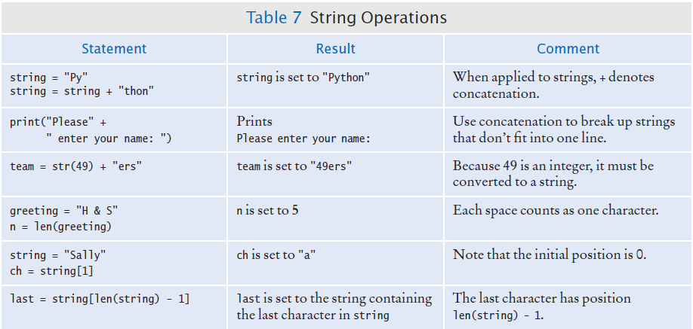
String Operations

Slide 82
Methods
In computer programming, an object is a software entity that represents a value with certain behavior.
The value can be simple, such as a string, or complex, like a graphical window or data file.
The behavior of an object is given through its methods.
A method is a collection of programming instructions to carry out a specific task – similar to a function
But unlike a function, which is a standalone operation, a method can only be applied to an object of the type for which it was defined.
Methods are specific to a type of object
Functions are general and can accept arguments of different types
You can apply the upper() method to any string, like this:
name = "John Smith"
# Sets uppercaseName to "JOHN SMITH"
uppercaseName = name.upper()

Slide 83
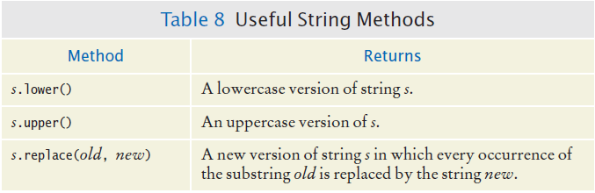
Some Useful String Methods

Slide 84
String Escape Sequences
How would you print a double quote?
Preface the " with a “\” inside the double quoted String
print("He said \"Hello\"")
OK, then how do you print a backslash?
Preface the \ with another \
System.out.print("“C:\\Temp\\Secret.txt“")
Special characters inside Strings
Output a newline with a ‘\n’
print("*\n**\n***\n")
*
**
***

Slide 85
Practice Problems
What are the values of the following expressions? In each line, assume that s = "Hello" t = "World"
len(s) + len(t)
s[1] + s[2]
s[len(s) // 2]
s + t
t + s
s * 2
s.upper()
t.toLower()
10
el
l
HelloWorld
WorldHello
HelloHello
HELLO

Slide 86
2.5 Input and Output

Slide 87
Input and Output
You can read a String from the console with the input() function:
name = input("Please enter your name")
Converting a String variable to a number can be used if numeric (rather than string input) is needed
age = int(input("Please enter age: "))
The above is equivalent to doing it two steps (getting the input and then converting it to a number):
aString = input("Please enter age: ") # String input
age = int(aString) # Converted to int

Slide 88
Formatted output
Outputting floating point values can look strange:
Price per liter: 1.21997
To control the output appearance of numeric variables, use formatted output tools such as:
print("Price per liter %.2f" %(price))
Price per liter: 1.22
print("Price per liter %10.2f" %(price))
Price per liter: 1.22
The %10.2f is called a format specifier
10 spaces
2 spaces

Slide 89
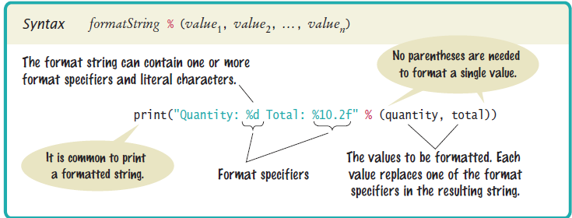
Syntax: formatting strings

Slide 90
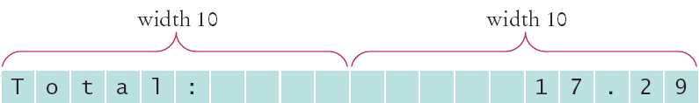


Format flag examples
Left Justify a String:
print("%-10s" %("Total:"))
Right justify a number with two decimal places
print("%10.2f" %(price))
And you can print multiple values:
print("%-10s%10.2f" %("Total: ", price))

Slide 91
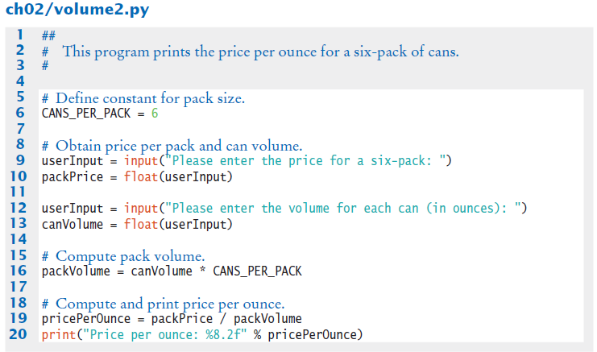
Volume2.py

Slide 92
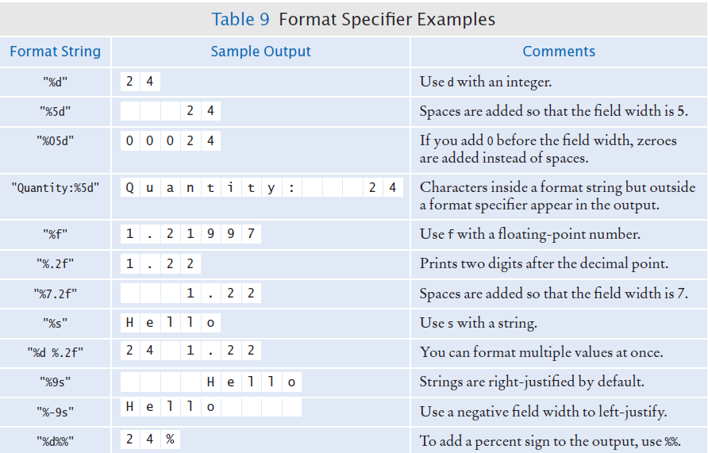
Format Specifier Examples

Slide 93
Calculate the cost of taking your car.
Gas cost = km to campus * numOfTrips * price per litre / fuel efficiency
Maintenance cost = maintenance cost * km to campus * numOfTrips
Total cost for the day = Gas cost + parking cost + maintenance cost
SemesterCar = 50 * totalCostPerDay
Calculate the cost of taking the bus
Total cost for a day = bus ticket * numOfTrips
SemesterBus = 50 * totalCostPerDay
If semesterBus < semesterCar
‘Take the bus’
Else
‘Drive your car’

Slide 94
Peer Programming
Write a program that asks the user for their first, middle and last name and then create a monogram based on the first letter of each word.
For instance if the person inputs paul for first name, adam for middle name and jain for last name. Your program should output PAJ

Slide 95
Write the code
First create variables and constants
Then get input from the user
Perform calculations
Output the cost for both options.

Slide 96
Suggested Next Steps
Read Chapter 2: Sections 1 – 5 Practice and when you get tired Practice some more.
Self Check Questions
8, 16, 26
Review Questions
3, 6 , 7, 9 , 14, 20
Programming Exercises
1, 4, 10, 17
Read Chpt 3.1 – 3.4 in preparation for next week

Slide 97
Summary: variables
A variable is a storage location with a name.
When defining a variable, you must specify an initial value.
By convention, variable names should start with a lower case letter.
An assignment statement stores a new value in a variable, replacing the previously stored value.

Slide 98
Summary: operators
The assignment operator = does not denote mathematical equality.
Variables whose initial value should not change are typically capitalized by convention.
The / operator performs a division yielding a value that may have a fractional value.
The // operator performs a division, the remainder is discarded.
The % operator computes the remainder of a floor division.

Slide 99
Summary: python overview
The Python library declares many mathematical functions, such as sqrt() and abs()
You can convert between integers, floats and strings using the respective functions: int(), float(), str()
Python libraries are grouped into modules. Use the import statement to use methods from a module.
Use the input() function to read keyboard input in a console window.

Slide 100
Summary: python overview
Use the format specifiers to specify how values should be formatted.

Slide 101
Summary: Strings
Strings are sequences of characters.
The len() function yields the number of characters in a String.
Use the + operator to concatenate Strings; that is, to put them together to yield a longer String.
In order to perform a concatenation, the + operator requires both arguments to be strings. Numbers must be converted to strings using the str() function.
String index numbers are counted starting with 0.

Slide 102
Summary: Strings
Use the [ ] operator to extract the elements of a String.

