Slide 1
Chapter 6: Lists

Slide 2
Chapter Goals
To collect elements using lists
To use the for loop for traversing lists
To learn common algorithms for processing lists
To use lists with functions
To work with tables of data

Slide 3
Contents
Basic Properties of Lists
List Operations
Common List Algorithms
Using Lists with Functions
Problem Solving: Adapting Algorithms
Problem Solving: Discovering Algorithms by Manipulating Physical Objects
Tables

Slide 4
Basic Properties of Lists
Section 6.1

Slide 5
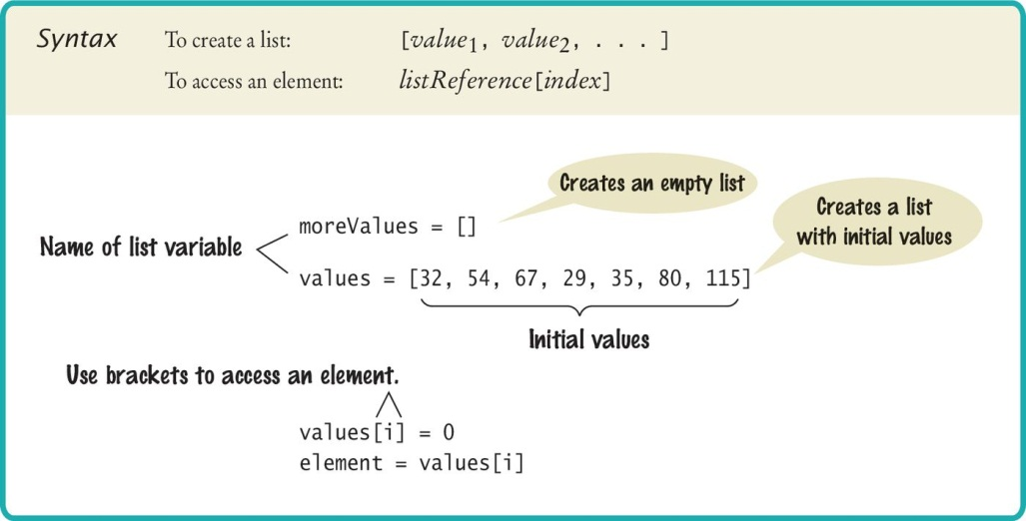
Creating a List
Specify a list variable with the subscript operator []

Slide 6
Accessing List Elements
A list is a sequence of elements, each of which has an integer position or index
To access a list element, you specify which index you want to use. That is done with the subscript operator in the same way that you access individual characters in a string
Accessing list elements
Replacing list elements
print(values[5])
values[5] = 87

Slide 7
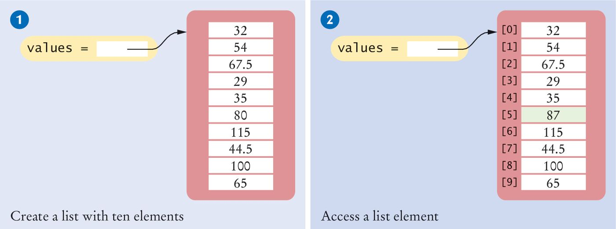
Creating Lists/Accessing Elements
# 1: Creating a list
values = [32, 54, 67.5, 29, 35, 80, 115, 44.5, 100, 65]
# 2: Accessing a list element
values[5] = 87

Slide 8
Lists Vs. Strings
Both lists and strings are sequences, and the [] operator is used to access an element in any sequence
There are two differences between lists and strings:
Lists can hold values of any type, whereas strings are sequences of characters
Moreover:
strings are immutable— you cannot change the characters in the sequence
Lists are mutable

Slide 9
Out of Range Errors
Out-of-Range Errors:
Perhaps the most common error in using lists is accessing a nonexistent element
If your program accesses a list through an out-of-range index, the program will generate an exception at run time
values = [2.3, 4.5, 7.2, 1.0, 12.2, 9.0, 15.2, 0.5]
values[8] = 5.4
# Error––values has 8 elements,
# and the index can range from 0 to 7

Slide 10
Determining List Length
You can use the len() function to obtain the length of the list; that is, the number of elements:
numElements = len(values)

Slide 11
Using The Square Brackets
Note that there are two distinct uses of the square brackets. When the square brackets immediately follow a variable name, they are treated as the subscript operator:
values[4]
When the square brackets follow an “=“ they create a list:
values = [4]

Slide 12
Loop Over the Index Values
Given the values list that contains 10 elements, we will want to set a variable, say i, to 0, 1, 2, and so on, up to 9
# First version (list index used)
for i in range(10) :
print(i, values[i])
# Better version (list index used)
for i in range(len(values)) :
print(i, values[i])
# Third version: index values not needed (traverse
# list elements)
for element in values :
print(element)

Slide 13

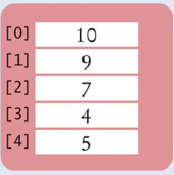
List References
Make sure you see the difference between the:
List variable: The named ‘alias’ or pointer to the list
List contents: Memory where the values are stored
values = [32, 54, 67.5, 29, 35, 80, 115, 44.5, 100, 65]
List variable
List contents
Reference
A list variable contains a reference to the list contents. The reference is the location of the list contents (in memory).
Values

Slide 14
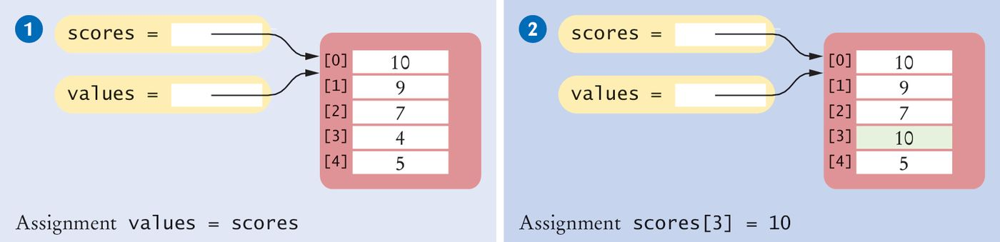
List Aliases
When you copy a list variable into another, both variables refer to the same list
The second variable is an alias for the first because both variables reference the same list
scores = [10, 9, 7, 4, 5]
values = scores # Copying list reference
List contents
A list variable specifies the location of a list. Copying the reference yields a second reference to the same list.
References

Slide 15
Modifying Aliased Lists
You can modify the list through either of the variables:
scores[3] = 10
print(values[3]) # Prints 10

Slide 16
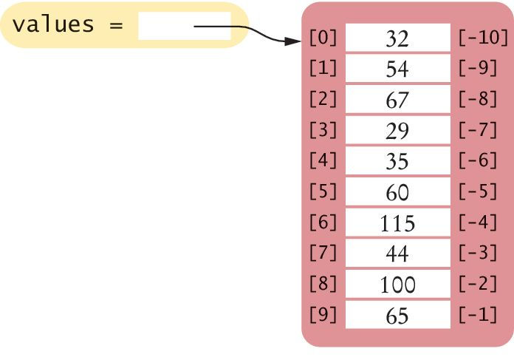
Reverse Subscripts
Python, unlike other languages, uses negative subscripts to provide access to the list elements in reverse order.
For example, a subscript of –1 provides access to the last element in the list:
Similarly, values[-2] is the second-to-last element.
Just because you can do this, does not mean you should…
last = values[-1]
print("The last element in the list is", last)

Slide 17
List Operations
Section 6.2

Slide 18
List Operations
Appending Elements
Inserting an Element
Finding an Element
Removing an Element
Concatenation
Equality / Inequality Testing
Sum, Maximum, Minimum, and Sorting
Copying Lists

Slide 19
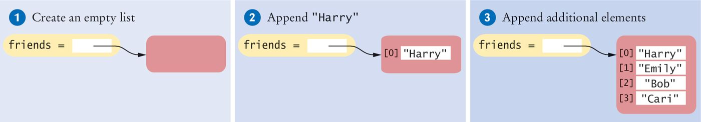
Appending Elements
Sometimes we may not know the values that will be contained in the list when it’s created
In this case, we can create an empty list and add elements to the end as needed
#1
friends = []
#2
friends.append("Harry")
#3
friends.append("Emily")
friends.append("Bob")
friends.append("Cari")

Slide 20
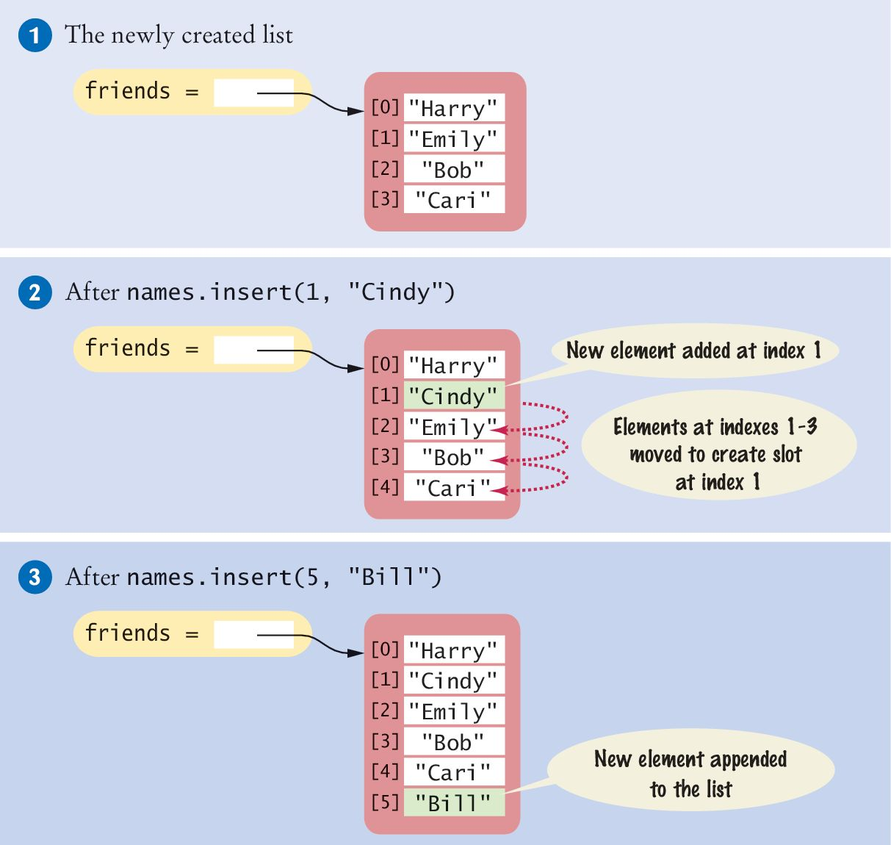
Inserting an Element
Sometimes the order in which elements are added to a list is important
A new element has to be inserted at a specific position in the list
#1
friends = ["Harry", "Emily", "Bob", "Cari"]
#2
friends.insert(1, "Cindy")

Slide 21
Finding an Element
If you simply want to know whether an element is present in a list, use the in operator:
if "Cindy" in friends :
print("She's a friend")
Often, you want to know the position at which an element occurs
The index() method yields the index of the first match
friends = ["Harry", "Emily", "Bob", "Cari", "Emily"]
n = friends.index("Emily") # Sets n to 1

Slide 22
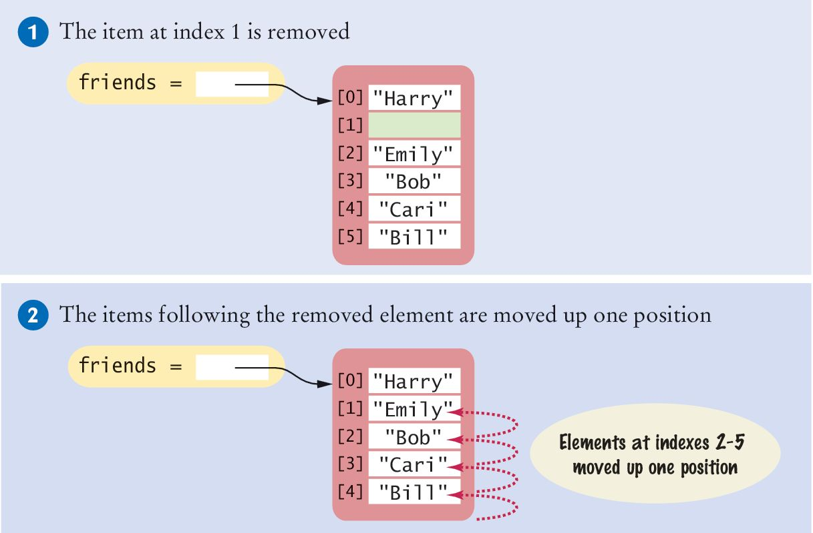
Removing an Element
The pop() method removes the element at a given position
friends = ["Harry", "Cindy", "Emily", "Bob", "Cari","Bill"]
friends.pop(1)
All of the elements following the removed element are moved up one position to close the gap
The length of the list is reduced by 1

Slide 23
Concatenation
The concatenation of two lists is a new list that contains the elements of the first list, followed by the elements of the second
myFriends = ["Fritz", "Cindy"]
yourFriends = ["Lee", "Pat", "Phuong"]
Two lists can be concatenated by using the plus (+) operator:
ourFriends = myFriends + yourFriends
# Sets ourFriends to ["Fritz", "Cindy", "Lee", "Pat","Phuong"]

Slide 24
Replication
As with string replication of two lists is a new list that contains the elements of the first list, followed by the elements of the second
monthInQuarter = [ 1, 2, 3] * 4
Results in the list [1, 2, 3, 1, 2, 3, 1, 2, 3, 1, 2 ,3]
You can place the integer on either side of the “*” operator
The integer specifies how many copies of the list should be concatenated
One common use of replication is to initialize a list with a fixed value
monthlyScores = [0] * 12

Slide 25
Equality / Inequality Testing
You can use the == operator to compare whether two lists have the same elements, in the same order.
[1, 4, 9] == [1, 4, 9] # True
[1, 4, 9 ] == [4, 1, 9] # False.
The opposite of == is !=.
[1, 4, 9] != [4, 9] # True.

Slide 26
Sum, Maximum, Minimum
If you have a list of numbers, the sum() function yields the sum of all values in the list.
sum([1, 4, 9, 16]) # Yields 30
For a list of numbers or strings, the max() and min() functions return the largest and smallest value:
max([1, 16, 9, 4]) # Yields 16
min("Fred", "Ann", "Sue") # Yields "Ann"

Slide 27
Sorting
The sort() method sorts a list of numbers or strings.
values = [1, 16, 9, 4]
values.sort() # Now values is [1, 4 , 9, 16]

Slide 28
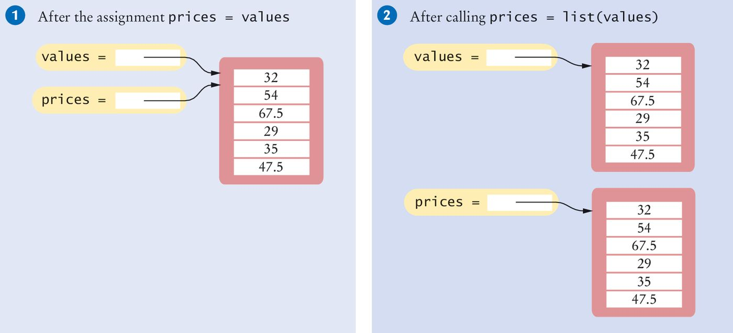
Copying Lists
As discussed, list variables do not themselves hold list elements
They hold a reference to the actual list
If you copy the reference, you get another reference to the same list:
prices = values

Slide 29
Copying Lists (2)
Sometimes, you want to make a copy of a list; that is, a new list that has the same elements in the same order as a given list
Use the list() function:
prices = list(values)

Slide 30
Slices of a List Special Topic 6.2 (HW)
Sometimes you want to look at a part of a list. Suppose you are given a list of temperatures, one per month:
temperatures = [18, 21, 24, 33, 39, 40, 39, 36, 30, 22, 18]
You are only interested in the temperatures for the third quarter, with index values 6, 7, and 8
You can use the slice operator to obtain them:
thirdQuarter = temperatures[6 : 9]
The arguments are the first element to include, and the first to exclude
So in our example we get elements 6, 7, and 8

Slide 31
Slices (2)
Both indexes used with the slice operator are optional
If the first index is omitted, all elements from the first are included
The slice
temperatures[ : 6]
Includes all elements up to, but not including, position 6
The slice
temperatures[6 : ]
Includes all elements starting at position 6 to the end of the list
You can assign values to a slice:
temperatures[6 : 9] = [45, 44, 40]
Replaces the values in elements 6, 7, and 8

Slide 32
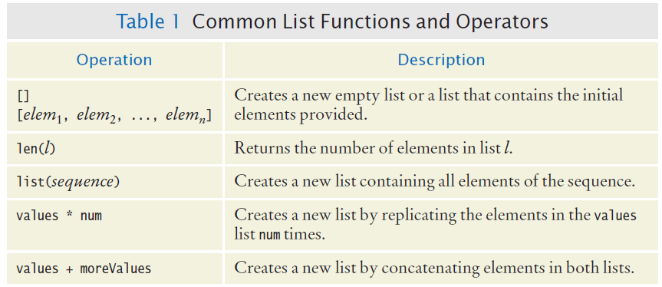
Common List Functions And Operators

Slide 33
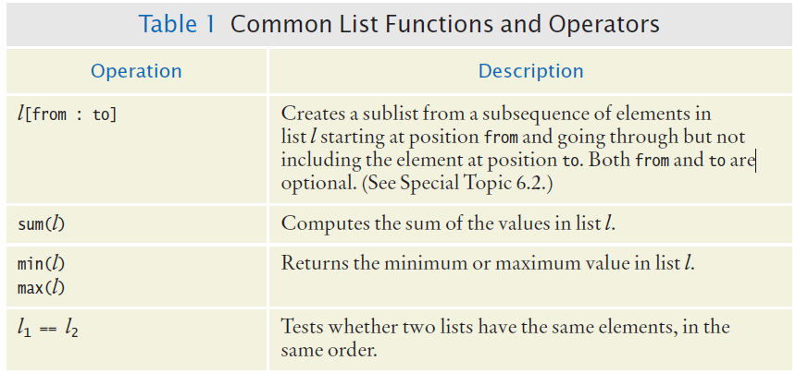
Common List Functions And Operators (2)

Slide 34
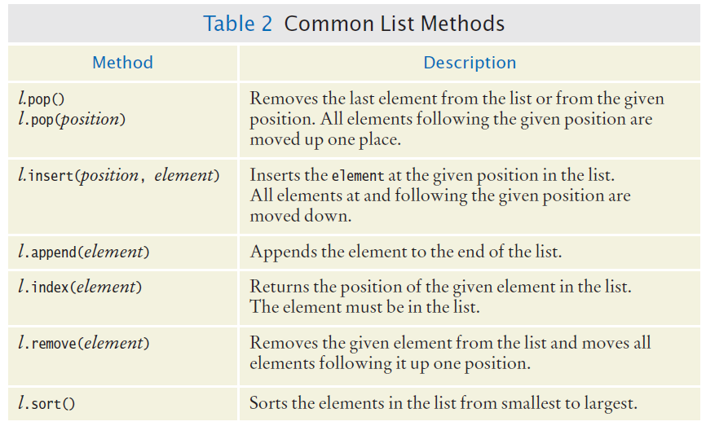
Common List Methods

Slide 35
Zybooks Demos
8.1.6: List indexing.
8.2.1: In-place modification using list methods.

Slide 36
Activity
short_names = ['Gertrude', 'Sam', 'Ann', 'Joseph']
Modify short_names by deleting the first element and changing the last element to Joe.
Sample output from given program:['Sam', 'Ann', 'Joe']

Slide 37
Common List Algorithms
Section 6.3

Slide 38
Common List Algorithms
Filling a List
Combining List Elements
Element Separators
Maximum and Minimum
Linear Search
Collecting and Counting Matches
Removing Matches
Swapping Elements
Reading Input

Slide 39
Filling a List
This loop creates and fills a list with squares (0, 1, 4, 9, 16, ...)
values = []
for i in range(n) :
values.append(i * i)

Slide 40
Combining List Elements
Here is how to compute a sum of numbers:
result = 0.0
for element in values :
result = result + element
To concatenate strings, you only need to change the initial value:
result = ""
for element in names :
result = result + element

Slide 41
Element Separators
When you display the elements of a list, you usually want to separate them, often with commas or vertical lines, like this:
Harry, Emily, Bob

Slide 42
Element Separators (2)
Add the separator before each element (there’s one fewer separator than there are numbers) in the sequence except the initial one (with index 0), like this:
for i in range(len(names)) :
if i > 0 :
result = result + ", "
result = result + names[i]

Slide 43
Element Separators (3)
If you want to print values without adding them to a string:
for i in range(len(values)) :
if i > 0 :
print(" | ", end="")
print(values[i], end="")
print()

Slide 44
Maximum and Minimum
Here is the implementation of the max algorithm (already covered in Chapter 4, this one is just specific to a list):
largest = values[0]
for i in range(1, len(values)) :
if values[i] > largest :
largest = values[i]
smallest = values[0]
for i in range(1, len(values)) :
if values[i] < smallest :
smallest = values[i]

Slide 45
Linear Search
Finding the first value that is > 100. You need to visit all elements until you have found a match or you have come to the end of the list:
limit = 100
pos = 0
found = False
while pos < len(values) and not found :
if values[pos] > limit :
found = True
else :
pos = pos + 1
if found :
print("Found at position:", pos)
else :
print("Not found")
A linear search
inspects elements
in sequence until a
match is found.

Slide 46
Collecting and Counting Matches
Collecting all matches
limit = 100
result = []
for element in values :
if (element > limit) :
result.append(element)
Counting matches
limit = 100
counter = 0
for element in values :
if (element > limit) :
counter = counter + 1

Slide 47
Removing Matches
Remove all elements that match a particular condition
Example: remove all strings of length < 4 from a list
i = 0
while i < len(words) :
word = words[i]
if len(word) < 4 :
words.pop(i)
else :
i = i + 1

Slide 48

Swapping Elements
For example, you can sort a list by repeatedly swapping elements that are not in order
Swap the elements at positions i and j of a list values
We’d like to set values[i] to values[j]. But that overwrites the value that is currently stored in values[i], so we want to save that first:
Before moving a new value into a location (say blue) copy blue’s value elsewhere and then move black’s value into blue. Then move the temporary value (originally in blue) into black.

Slide 49
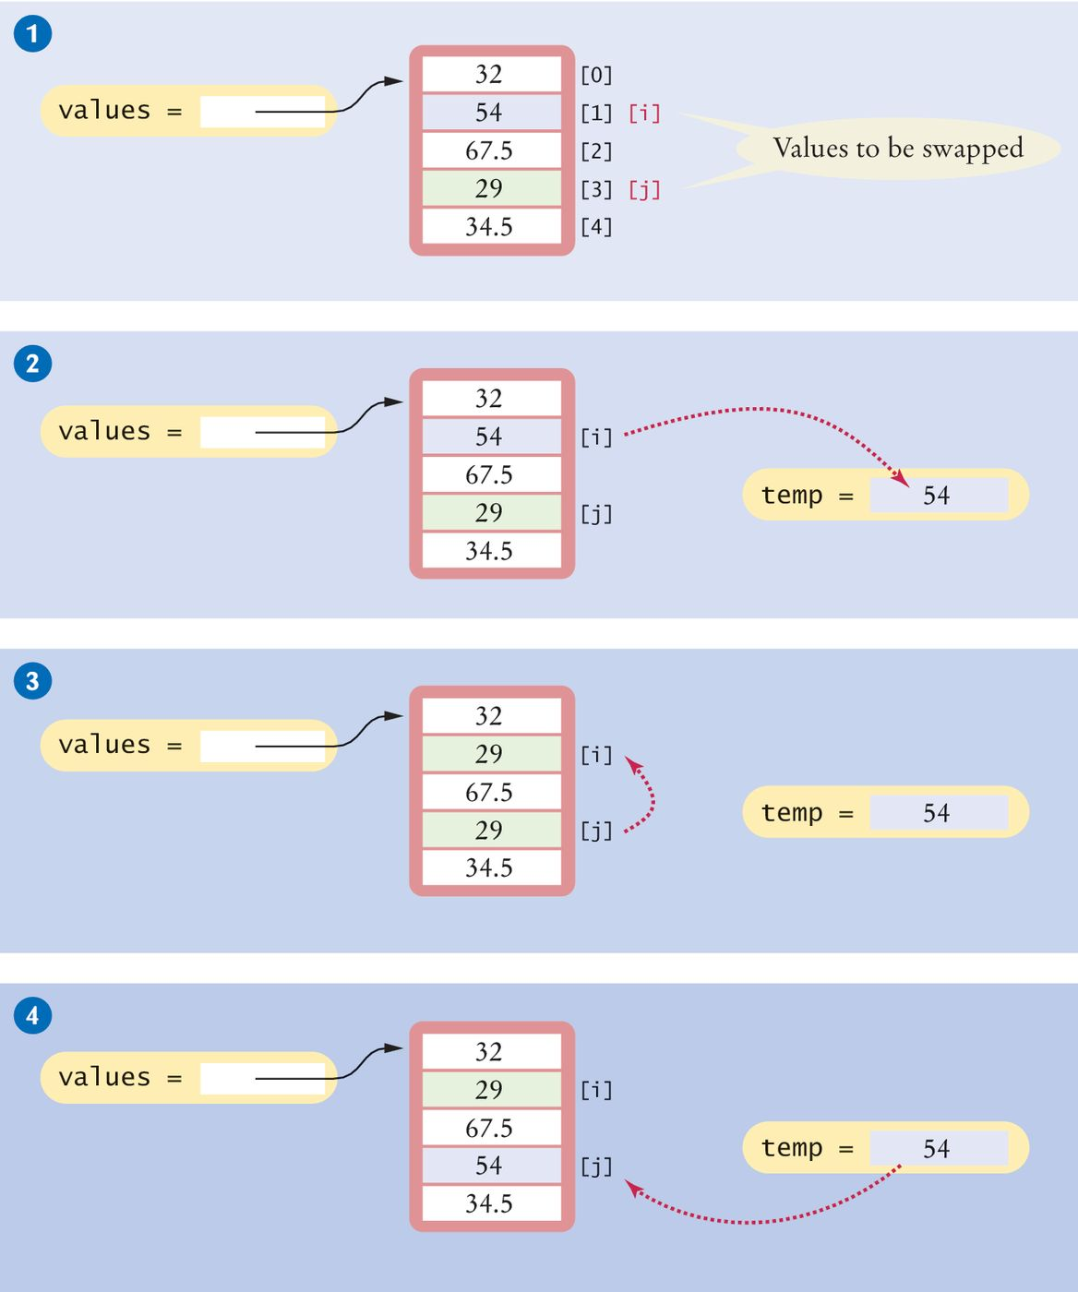
Swapping Elements (2)
Swapping elements [1] and [3]
This sets up the scenario for the actual code that will follows

Slide 50
Swapping Elements (3)
# Step 2
temp = values[i]
# Step 3
values[i] = values[j]

Slide 51
Swapping Elements (4)
# Step 4
# temp contains values[i]
values[j] = temp

Slide 52
Reading Input
It is very common to read input from a user and store it in a list for later processing.
values = []
print("Please enter values, Q to quit:")
userInput = input("")
while userInput.upper() != "Q" :
values.append(float(userInput))
userInput = input("")
Please enter values, Q to quit:
32
29
67.5
Q
Program execution

Slide 53
Built-In Operations For Lists
Use the insert() method to insert a new element at any position in a list
The in operator tests whether an element is contained in a list
Use the pop() method to remove an element from any position in a list
Use the remove() method to remove an element from a list by value
Two lists can be concatenated using the plus (+) operator
Use the list() function to copy lists

Slide 54
Built-In Operations For Lists
Use the slice operator (:) to extract a sublist or substrings

Slide 55
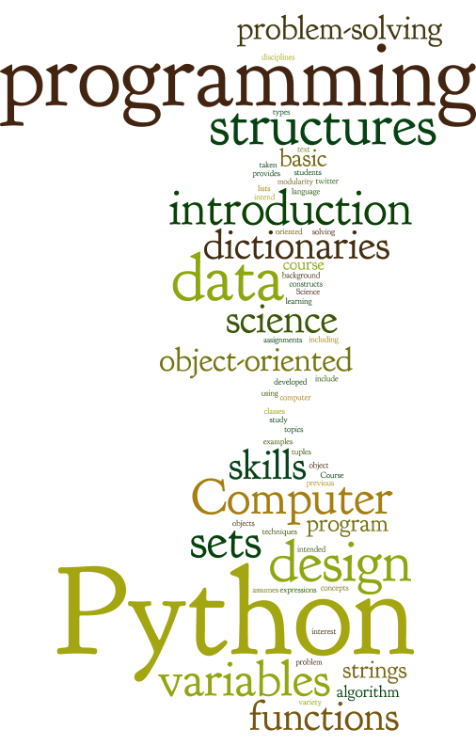

Slide 56
Using Lists With Functions
Section 6.4

Slide 57
Using Lists With Functions
A function can accept a list as an argument
The following function visits the list elements, but it does not modify them
def sum(values) :
total = 0
for element in values :
total = total + element
return total

Slide 58
Modifying List Elements
The following function multiplies all elements of a list by a given factor:
def multiply(values, factor) :
for i in range(len(values)) :
values[i] = values[i] * factor

Slide 59
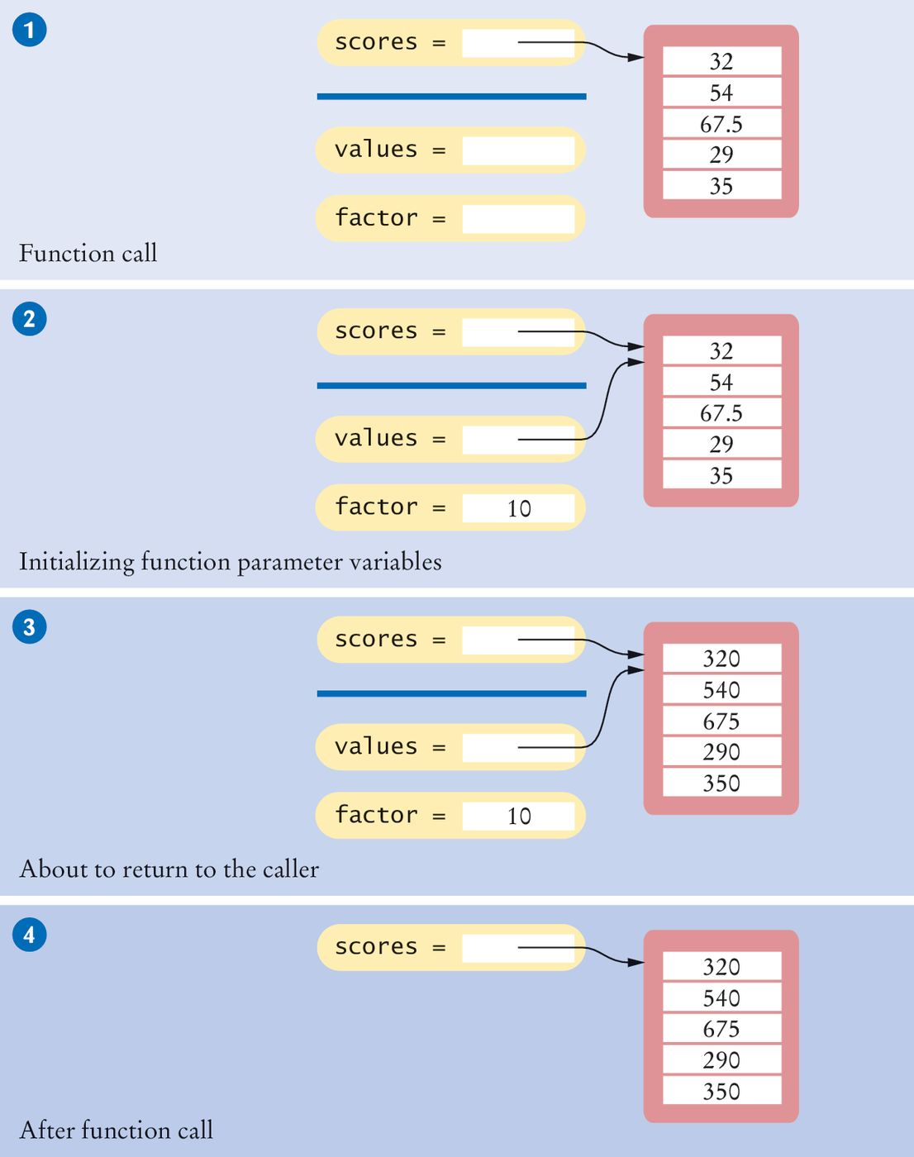
Example: Step 1
The parameter variables values and factor are created

Slide 60
Example: Step 2
The parameter variables are initialized with the arguments that are passed in the call
In our case, values is set to scores and factor is set to 10
Note that values and scores are references to the same list
# Function call
multiply(scores, 10)

Slide 61
Example: Step 3
The function multiplies all list elements by 10
def multiply(values, factor) :
for i in range(len(values)) :
values[i] = values[i] * factor

Slide 62
Example: Step 4
The function returns. Its parameter variables are removed
However, scores still refers to the list with the modified elements

Slide 63
Returning Lists From Functions
Simply build up the result in the function and return it
In this example, the squares() function returns a list of squares from 0² up to (n – 1)²:
def squares(n) :
result = []
for i in range(n) :
result.append(i * i)
return result

Slide 64
Call By: Value Vs. Reference
Call by value:
When the contents of a variable that was passed to a function can never be changed by that function
Call by reference:
Function can change the arguments of a method call
A Python method can mutate the contents of a list when it receives an reference to

Slide 65
Group Activity
Create a function that reads in a list and then do the following
Create two local lists
Put all the even numbers in one list and the odd numbers in another list
Print both lists.
Return the summation of the minimum of listOfOdds with the maximum of listOfEvens
Call the function X = myListMaster([4,5,7,5,4,3,2,2,3,4,5]) print(X)

Slide 66
Example One
Open the file reverse.py
This program reads values from the user, multiplies them by 10, and prints them in reverse order
The readFloats function returns a list
The multiply function has a list argument, it modifies the list elements
The printReversed function has a list argument, but it does not modify the list elements

Slide 67
def main() : numbers = readFloats(5) multiply(numbers, 10) printReversed(numbers) def readFloats(numberOfInputs) : print("Enter", numberOfInputs, "numbers:") inputs = [] for i in range(numberOfInputs) : value = float(input("")) inputs.append(value) return inputs def multiply(values, factor) : for i in range(len(values)) : values[i] = values[i] * factor def printReversed(values) : # Traverse the list in reverse order, starting with the last element i = len(values) - 1 while i >= 0 : print(values[i], end=" ") i = i - 1 print() # Start the program. main()

Slide 68
## # This program reads, scales and reverses a sequence of numbers. # def main() : numbers = readFloats(5) multiply(numbers, 10) printReversed(numbers)

Slide 69
## Reads a sequence of floating-point numbers. # @param numberOfInputs the number of inputs to read # @return a list containing the input values # def readFloats(numberOfInputs) : print("Enter", numberOfInputs, "numbers:") inputs = [] for i in range(numberOfInputs) : value = float(input("")) inputs.append(value) return inputs

Slide 70
## Multiplies all elements of a list by a factor. # @param values a list of numbers # @param factor the value with which element is multiplied # def multiply(values, factor) : for i in range(len(values)) : values[i] = values[i] * factor ## Prints a list in reverse order. # @param values a list of numbers # def printReversed(values) : # Traverse the list in reverse order, starting with the last element i = len(values) - 1 while i >= 0 : print(values[i], end=" ") i = i - 1 print() # Start the program. main()

Slide 71
HW to read: Tuples
A tuple is similar to a list, but once created, its contents cannot be modified (a tuple is an immutable version of a list).
A tuple is created by specifying its contents as a comma-separated sequence. You can enclose the sequence in parentheses:
triple = (5, 10, 15)
If you prefer, you can omit the parentheses:
triple = 5, 10, 15

Slide 72
Tables
Section 6.7

Slide 73
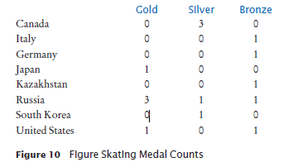
Tables
Lists can be used to store data in two dimensions (2D) like a spreadsheet
Rows and Columns
Also known as a ‘matrix’

Slide 74
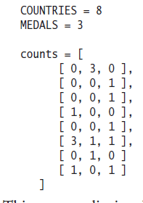
Creating Tables
Here is the code for creating a table that contains 8 rows and 3 columns, which is suitable for holding our medal count data:

Slide 75
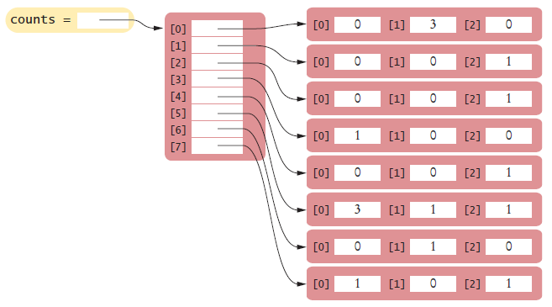
Creating Tables (2)
This creates a list in which each element is itself another list:

Slide 76
Creating Tables (3)
Sometimes, you may need to create a table with a size that is too large to initialize with literal values
First, create a list that will be used to store the individual rows
table = []

Slide 77
Creating Tables (4)
Then create a new list using replication (with the number of columns as the size) for each row in the table and append it to the list of rows:
ROWS = 5
COLUMNS = 20
for i in range(ROWS) :
row = [0] * COLUMNS
table.append(row)
The result is a table that consists of 5 rows and 20 columns

Slide 78
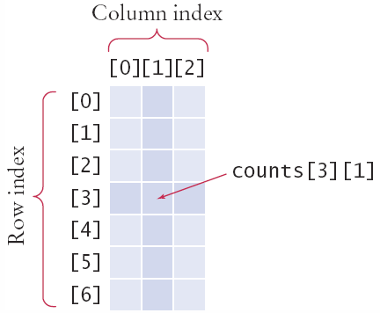
Accessing Elements
Use two index values:
Row then column
medalCount = counts[3][1]
To print
Use nested for loops
Outer row(i) , inner column(j) :
for i in range(COUNTRIES):
# Process the ith row
for j in range(MEDALS) :
# Process the jth column in the ith row
print("%8d" % counts[i][j], end="")
print() # Start a new line at the end of the row

Slide 79
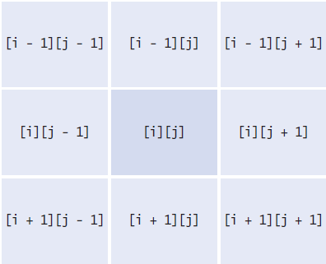
Locating Neighboring Elements
Some programs that work with two-dimensional lists need to locate the elements that are adjacent to an element
This task is particularly common in games
You are at loc i, j
Watch out for edges!
No negative indexes!
Not off the ‘board’

Slide 80
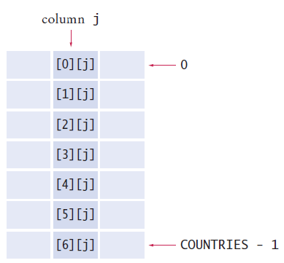
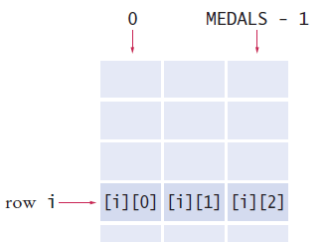
Adding Rows and Columns
Rows (x) Columns (y)
total = 0
for j in range(MEDALS):
total = total + counts[i][j]
total = 0
for i in range(MEDALS):
total = total + counts[i][j]

Slide 81
Using Tables With Functions
When you pass a table to a function, you will want to recover the dimensions of the table. If values is a table, then:
len(values) is the number of rows
len(values[0]) is the number of columns
For example, the following function computes the sum of all elements in a table:
def sum(values) :
total = 0
for i in range(len(values)) :
for j in range(len(values[0])) :
total = total + values[i][j]
return total

Slide 82
Example
Open the file medals.py

Slide 83
Problem Solving
Section 6.5: Adapting Algorithms

Slide 84
In Class Programming
Write a program that initializes a list with ten random integers between 0 and 100 and then create four functions to print each of the following tasks.
•Every element at an even index.
•Every even element.
•All elements in reverse order.
•Only the first and last element.

Slide 85
Summary

Slide 86
Summary: Lists
A list is a container that stores a sequence of values
Each individual element in a list is accessed by an integer index i, using the notation list[i]
A list index must be at least zero and less than the number of elements in the list
An out-of-range error, which occurs if you supply an invalid list index, can cause your program to terminate
You can iterate over the index values or the elements of a list

Slide 87
Summary: Lists
A list reference specifies the location of a list. Copying the reference yields a second reference to the same list
A linear search inspects elements in sequence until a match is found
Use a temporary variable when swapping elements
Lists can occur as function parameters and return values

Slide 88
Summary: Lists
When calling a function with a list argument, the function receives a list reference, not a copy of the list
A tuple is created as a comma-separated sequence enclosed in parentheses
By combining fundamental algorithms, you can solve complex programming tasks
You should be familiar with the implementation of fundamental algorithms so that you can adapt them

Slide 89
Summary: Lists
Use a two-dimensional list to store tabular data
Individual elements in a two-dimensional list are accessed by using two index values, table[i][j]

Slide 90
Built-In Operations For Lists
Use the insert() method to insert a new element at any position in a list
The in operator tests whether an element is contained in a list
Use the pop() method to remove an element from any position in a list
Use the remove() method to remove an element from a list by value
Two lists can be concatenated using the plus (+) operator
Use the list() function to copy lists

Slide 91
Built-In Operations For Lists
Use the slice operator (:) to extract a sublist or substrings

