Slide 1
Chapter Seven
FILES AND EXCEPTIONS

Slide 2
Announcements
Exams will be handed back on Thursday
Preliminary Date for Final: Monday April 24th 7pm

Slide 3
Chapter Goals
To read and write text files
To process collections of data
To process command line arguments
To raise and handle exceptions
In this chapter, you will learn how to write programs that manipulate files

Slide 4
Contents
Reading and Writing Text Files
Text Input and Output

Slide 5
Reading and Writing Text Files
Section 7.1

Slide 6
Reading and Writing Text Files
Text files are very commonly used to store information
They are the most ‘portable’ types of data files
Examples of text files include files that are created with a simple text editor, such as Windows Notepad, and Python source code and HTML files

Slide 7
Opening Files: Reading
To access a file, you must first open it
Suppose you want to read data from a file named input.txt, located in the same directory as the program
To open a file for reading, you must provide the name of the file as the first argument to the open function and the string "r" as the second argument:
infile = open("input.txt", "r")

Slide 8
Opening Files: Reading (2)
Important things to keep in mind:
When opening a file for reading, the file must exist (and otherwise be accessible) or an exception occurs
The file object returned by the open function must be saved in a variable
All operations for accessing a file are made via the file object

Slide 9
Opening Files: Writing
To open a file for writing, you provide the name of the file as the first argument to the open function and the string "w" as the second argument:
outfile = open("output.txt", "w")
If the output file already exists, it is emptied before the new data is written into it
If the file does not exist, an empty file is created

Slide 10
Closing Files: Important
When you are done processing a file, be sure to close the file using the close() method:
infile.close()
outfile.close()
If your program exits without closing a file that was opened for writing, some of the output may not be written to the disk file

Slide 11
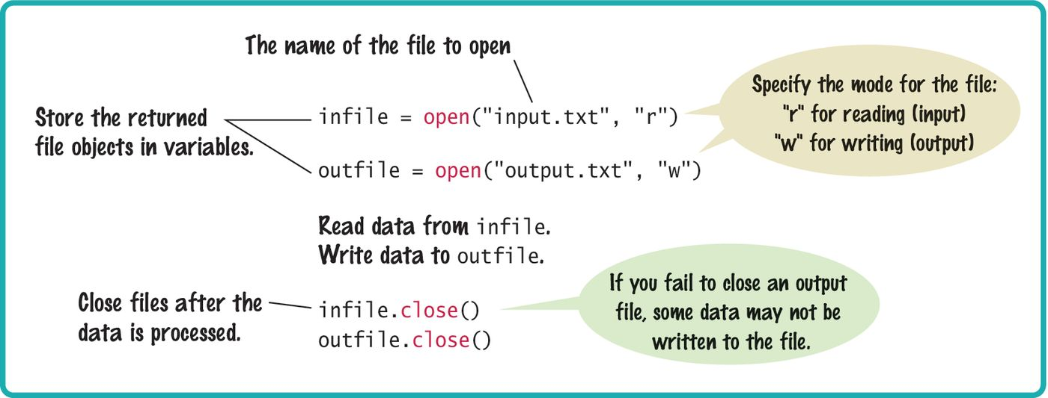
Syntax: Opening And Closing Files

Slide 12
Reading From a File
To read a line of text from a file, call the readline() method with the file object that was returned when you opened the file:
line = infile.readline()
When a file is opened, an input marker is positioned at the beginning of the file
The readline() method reads the text, starting at the current position and continuing until the end of the line is encountered
The input marker is then moved to the next line

Slide 13
Reading From a File (2)
For example, suppose input.txt contains the lines
flying
circus
The first call to readline() returns the string "flying\n"
Recall that \n denotes the newline character that indicates the end of the line
If you call readline() a second time, it returns the string "circus\n"

Slide 14
Reading From a File (3)
Calling readline() again yields the empty string "" because you have reached the end of the file
If the file contains a blank line, then readline() returns a string containing only the newline character "\n"

Slide 15
Reading Multiple Lines From a File
You repeatedly read a line of text and process it until the sentinel value is reached:
The sentinel value is an empty string, which is returned by the readline() method after the end of file has been reached
line = infile.readline()
while line != "" :
# Process the line.
line = infile.readline()

Slide 16
Converting File Input
As with the input function, the readline() method can only return strings
If the file contains numerical data, the strings must be converted to the numerical value using the int() or float() function:
value = float(line)
The newline character at the end of the line is ignored when the string is converted to a numerical value

Slide 17
Writing To A File
For example, we can write the string "Hello, World!" to our output file using the statement:
outfile.write("Hello, World!\n")
Unlike print() when writing text to an output file, you must explicitly write the newline character to start a new line
You can also write formatted strings to a file with the write method:
outfile.write("Number of entries: %d\nTotal: %8.2f\n"
% (count, total))

Slide 18
Demos
Read from a file.
Write to a file

Slide 19
Example: File Reading/Writing
Suppose you are given a text file that contains a sequence of floating-point values, stored one value per line
You need to read the values and write them to a new output file, aligned in a column and followed by their total and average value
If the input file has the contents
32.0
54.0
67.5
80.25
115.0

Slide 20
Example: File Reading/Writing (2)
The output file will contain
32.00
54.00
67.50
80.25
115.00
--------
Total: 348.75
Average: 69.75

Slide 21
inputFileName = input("Input file name: ") outputFileName = input("Output file name: ") # Open the input and output files. infile = open(inputFileName, "r") outfile = open(outputFileName, "w") # Read the input and write the output. total = 0.0 count = 0 line = infile.readline() while line != "" : value = float(line) outfile.write("%15.2f\n" % value) total = total + value count = count + 1 line = infile.readline() # Output the total and average. outfile.write("%15s\n" % "--------") outfile.write("Total: %8.2f\n" % total) avg = total / count outfile.write("Average: %6.2f\n" % avg) # Close the files. infile.close() outfile.close()

Slide 22
Text Input and Output
Section 7.2

Slide 23
Text Input and Output
In the following sections, you will learn how to process text with complex contents, and you will learn how to cope with challenges that often occur with real data
Reading Words Example:
Mary had a little lamb
input
for line in inputFile :
line = line.rsplit()
output
Mary
had
a
little
lamb

Slide 24
Processing Text Input
There are times when you want to read input by:
Each word
Each line
A single character
Python provides methods such: read(), split() and strip() for these tasks
Processing text input is required for almost all types of programs that interact with the user

Slide 25
Text Input and Output
Python can treat an input file as though it were a container of strings in which each line comprises an individual string
For example, the following loop reads all lines from a file and prints them:
for line in infile :
print(line)
At the beginning of each iteration, the loop variable line is assigned the value of a string that contains the next line of text in the file
There is a critical difference between a file and a container:
Once you read the file you must close it before you can iterate over it again

Slide 26
An Example of Reading a File
We have a file that contains a collection of words; one per line:
spam
and
eggs

Slide 27

Removing The Newline (1)
Recall that each input line ends with a newline (\n) character
Generally, the newline character must be removed before the input string is used
When the first line of the text file is read, the string line contains

Slide 28

Removing The Newline (2)
To remove the newline character, apply the rstrip() method to the string:
line = line.rstrip()
This results in the string:

Slide 29
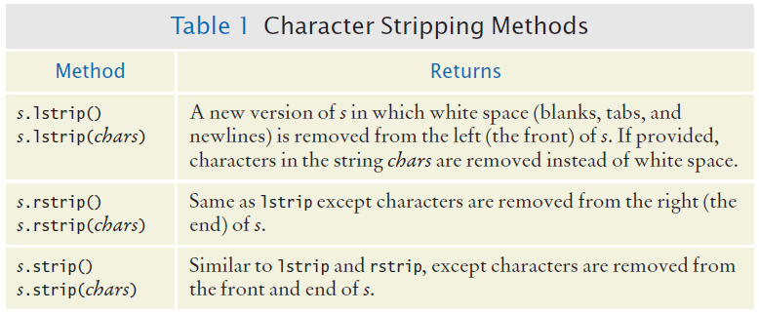
Character Strip Methods

Slide 30
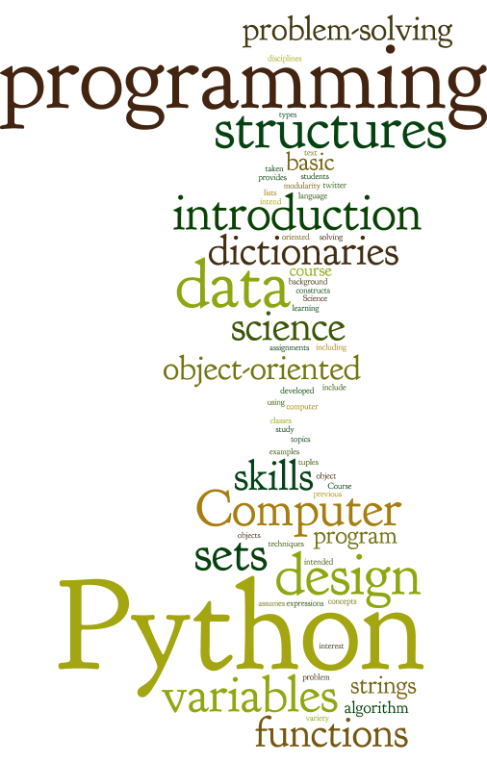

Slide 31
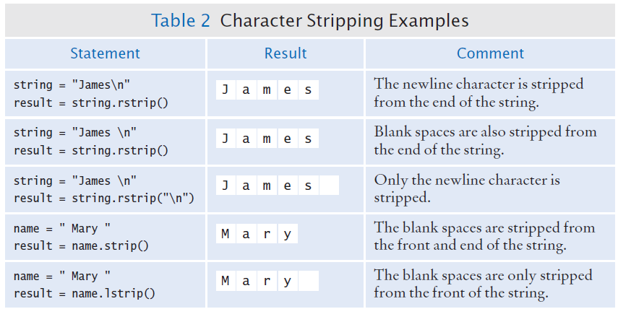
Character Strip Examples

Slide 32
Reading Words
Sometimes you may need to read the individual words from a text file
For example, suppose our input file contains two lines of text
Mary had a little lamb,
whose fleece was white as snow

Slide 33
Reading Words (2)
We would like to print to the terminal, one word per line
Mary
had
a
little
. . .
Because there is no method for reading a word from a file, you must first read a line and then split it into individual words
line = line.rstrip()
wordlist = line.split()

Slide 34
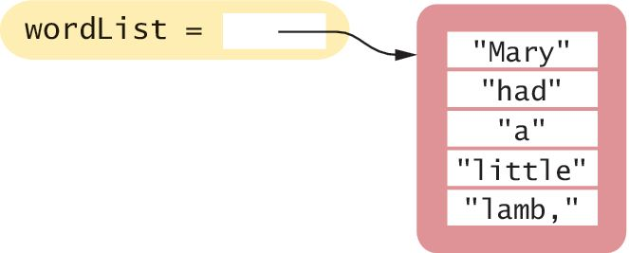
Reading Words (3)
The split method returns the list of substrings that results from splitting the string at each blank space
For example, if line contains the string:
It will be split into 5 substrings that are stored in a list in the same order in which they occur in the string:

Slide 35
Reading Words (4)
Notice that the last word in the line contains a comma
If we only want to print the words contained in the file without punctuation marks, we can strip those from the substrings using the rstrip() method introduced in the previous section:
word = word.rstrip(".,?!")

Slide 36
Reading Words: Complete Example
inputFile = open("lyrics.txt", "r")
for line in inputFile :
line = line.rstrip()
wordList = line.split()
for word in wordList :
word = word.rstrip(".,?!")
print(word)
inputFile.close()

Slide 37
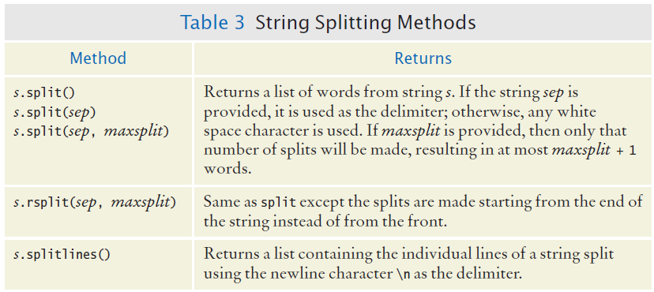
Additional String Splitting Methods

Slide 38
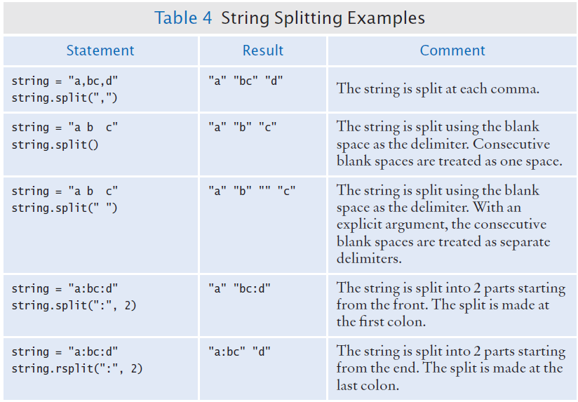
Additional String Splitting Examples

Slide 39
Example Two
Open the file lyrics.py

Slide 40
Reading Characters
The read() method takes a single argument that specifies the number of characters to read
The method returns a string containing the characters
When supplied with an argument of 1, the read() method returns a string consisting of the next character in the file
char = inputFile.read(1)
If the end of the file is reached, it returns an empty string ""

Slide 41
Algorithm: Reading Characters
while char != "" :
Process character
char = inputFile.read(1)

Slide 42
Reading Records
A text file can contain a collection of data records in which each record consists of multiple fields
For example, a file containing student data may consist of records composed of an identification number, full name, address, and class year
When working with text files that contain data records, you generally have to read the entire record before you can process it:
For each record in the file
Read the entire record
Process the record

Slide 43
Reading Options
After opening the file and creating a file object, there are three ways you can iterate through a file.
readline
read
for a in fileObj:
line = infile.readline() while line != "" : Process the line. line = infile.readline()
line = infile.read(1) while line != "" : Process the line. line = infile.read (1)
for line in infile: Process the line.

Slide 44
Example
Write a program that prompts the user for an input file name, check to see if the file name ends with .txt if it doesn’t add it and then read a collection of integer values from a text file, and determines how many of the values are negative. Assume the values are stored in the file one per line.
fileName = input('Please enter the file name') if not fileName.endswith('.txt'): fileName = fileName + '.txt' infile = open(fileName, 'r') count = 0 for line in infile: if int(line) < 0: count = count + 1 print('There are ', count, "number of negative numbers in the file")
line = infile.readline() while line != "": if int(line) < 0: count = count + 1 line=infile.readline()
line = infile.read() numbersInFile = line.split("\n") for num in numbersInFile: if int(num) < 0: count +=1

Slide 45
Writing options
After opening the file you want to write to, there are two ways to write to the file
outfile.write("Number of entries: %d\nTotal: %8.2f\n" % (count, total))
print("Total: ", end=“”,file=outfile)

Slide 46
Recap Exercise
Write a short program that generates 10 random numbers between 100 and 200 and stores the values in an file named “out.txt”. The numbers should all appear on the same line and should be separated by a comma and space
e.g 110, 120, 130
from random import randint outfile = open("out.txt", "w") for i in range(20): print(randint(100,200), end=", ", file=outfile) outfile.write(str(randint(100,200))+ ", ") outfile.write("%d, "%(randint(100,200)))

Slide 47
Read and Write
To read and write to the same file (not advisable for novices), you use
multiFile = open("filename", "r+")
fileName = input('Please enter the file name') if not fileName.endswith('.txt'): fileName = fileName + '.txt' infile = open(fileName, 'r+') count = 0 line = infile.read() numbersInFile = line.split("\n") for num in numbersInFile: if int(num) < 0: count +=1 print('There are ', count, "number of negative numbers in the file", file=infile)

Slide 48
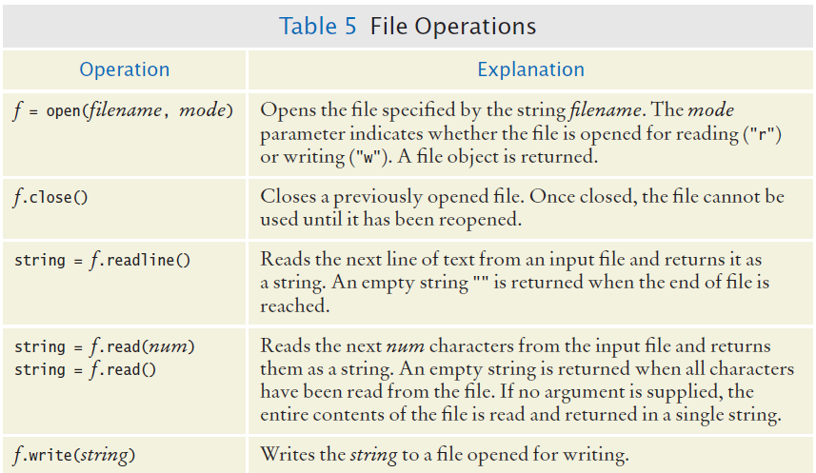
File Operations

Slide 49
Stripping and Splitting
Use strip methods when you want to remove characters from strings
Use split when you want to split a string into an array of parts

Slide 50
Rstrip vs Lstrip vs Strip
Strip removes characters from both ends
Rstrip only removes the characters from the end
Lstrip only removes the characters from the front
x = "%43%45%" print(x.rstrip('%')) print(x.lstrip('%')) print(x.strip('%'))
%43%45
43%45%
43%45

Slide 51
Record Formats: Example
The organization or format of the records can vary, however, making some formats easier to read than others
A typical format for such data is to store each field on a separate line of the file with all fields of a single record on consecutive lines:
China
1330044605
India
1147995898
United States
303824646
. . .

Slide 52
Record Formats: Example
Reading the data in this format is rather easy
Because each record consists of two fields, we read two lines from the file for each record
line = infile.readline()
while line != "" :
countryName = line.rstrip()
line = infile.readline()
population = int(line)
Process data record
line = infile.readline()

Slide 53
Record Formats: Example 2
Another common format stores each data record on a single line
If the record’s fields are separated by a specific delimiter “:” you can extract the fields by splitting the line with the split() method
China:1330044605
India:1147995898
United States:303824646
. . .

Slide 54
Record Formats: Example 2
line = infile.readline()
while line != "" :
lines = line.rstrip().split(‘:’)
countryName = lines[0]
population = int(lines[1])
Process data record
line = infile.readline()

Slide 55
Record Formats: Example 3
But what if the fields are not separated by a delimiter?
China 1330044605
India 1147995898
United States 303824646
. . .
Because some country names have more than one word, we cannot simply use a blank space as the delimiter because multi-word names would be split incorrectly
Can we use rsplit in this case?
inputString = "United States 303824646"
result = inputString.rsplit(" ",1)
print(result)

Slide 56
Record Formats: Example 3
One approach for reading records in this format is to read the line, then search for the first digit in the string returned by readline():
i = 0
char = line[0]
while not line[0].isdigit() :
i = i + 1
You can then extract the country name and population as substrings using the slice operator:
countryName = line[0 : i - 1]
population = int(line[i : ])

Slide 57
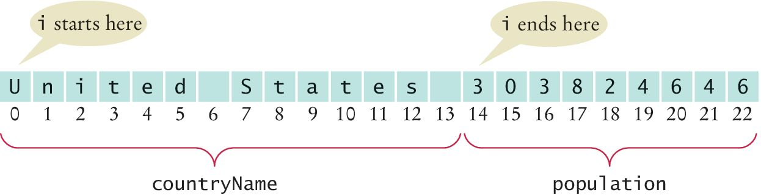
Record Formats: Example 3
‘Slicing’ the string read from file

Slide 58
Peer Programming (10 minutes)
Consider the text file with the following format, using lists, write a short program to find the average cost of all items in list. Print the result as shown below. Average is the sum of all items cost divided by the total number of items purchased.
$45.00,biscuits,5 $34.34,table salt,3 $1,245.00,ipad,2 $434.34,fitbit,3
The average cost of 13 items is $135.28

Slide 59
#$34.34,table salt,3 #$1,245.00,ipad,2 inf = open('Example3.txt', 'r') itemList = [] costList = [] for line in inf: elements = line.rsplit(',',2) itemList.append(int(elements[2])) elements[0] = elements[0].lstrip('$').replace(',', '') print(elements[0]) costList.append(float(elements[0])) average = sum(costList)/sum(itemList) print("The average cost of ",sum(itemList) , " items is" ,"$"+str(round(average,2)))

Slide 60
0
0
5
4
3
2
1
0
0
9
8
7
6
5
4
3
2
1
0
9
8
7
6
5
4
3
2
1
0
9
8
7
6
5
4
3
2
1
0
9
8
7
6
5
4
3
2
1
0
9
8
7
6
5
4
3
2
1
0
9
8
7
6
5
4
3
2
1
0
0
5
0
4
Hours
Minutes
Seconds

Slide 61
0
0
5
4
3
2
1
0
0
9
8
7
6
5
4
3
2
1
0
9
8
7
6
5
4
3
2
1
0
9
8
7
6
5
4
3
2
1
0
9
8
7
6
5
4
3
2
1
0
9
8
7
6
5
4
3
2
1
0
9
8
7
6
5
4
3
2
1
0
0
4
0
3
Hours
Minutes
Seconds

Slide 62
0
0
5
4
3
2
1
0
0
9
8
7
6
5
4
3
2
1
0
9
8
7
6
5
4
3
2
1
0
9
8
7
6
5
4
3
2
1
0
9
8
7
6
5
4
3
2
1
0
9
8
7
6
5
4
3
2
1
0
9
8
7
6
5
4
3
2
1
0
0
3
0
2
Hours
Minutes
Seconds

Slide 63
0
0
5
4
3
2
1
0
0
9
8
7
6
5
4
3
2
1
0
9
8
7
6
5
4
3
2
1
0
9
8
7
6
5
4
3
2
1
0
9
8
7
6
5
4
3
2
1
0
9
8
7
6
5
4
3
2
1
0
9
8
7
6
5
4
3
2
1
0
0
2
0
1
Hours
Minutes
Seconds

Slide 64
0
0
5
4
3
2
1
0
0
9
8
7
6
5
4
3
2
1
0
9
8
7
6
5
4
3
2
1
0
9
8
7
6
5
4
3
2
1
0
9
8
7
6
5
4
3
2
1
0
9
8
7
6
5
4
3
2
1
0
9
8
7
6
5
4
3
2
1
0
0
1
0
0
Hours
Minutes
Seconds

Slide 65
Processing Text Files Example
Page 360

Slide 66
Steps to Processing Text Files
Problem Statement:
Read two country data files, worldpop.txt and worldarea.txt
Write a file world_pop_density.txt that contains country names and population densities with the country names aligned left and the numbers aligned right
Afghanistan 50.56
Akrotiri 127.64
Albania 125.91
Algria 14.18
American Samoa 288.92
. . .

Slide 67
Six Steps to Processing Text Files
Understand the Processing Task
Process the data “on the go” or store data and then process?
Determine which files you need to read and write
Choose a mechanism for obtaining the file names
Choose between iterating over the file or reading individual lines
If all data is on one line, normally use line input
With line-oriented input, extract required data
Examine the line and plan for whitespace, delimiters…
Use functions to factor out common tasks

Slide 68
Processing Text Files: Pseudocode
Step 1: Understand the Task
While there are more lines to be read
Read a line from each file
Extract the country name
population = number following the country name in the line from the first file
area = number following the country name in the line from the second file
If area != 0
density = population / area
Print country name and density
Afghanistan 50.56
Akrotiri 127.64
Albania 125.91
Algria 14.18
American Samoa 288.92

Slide 69
Step Two
Determine the file you need to read and write
There are two input files:
worldpop.txt
worldarea.txt
There is one output file:
world_pop_density.txt

Slide 70
Step Three
Choose a mechanism for obtaining the file names
We have three options:
Hardcode the filename as a constant
Prompt the user
Use a command line argument
We will use hard-coded files names
The file names are constant in this example

Slide 71
Step Four
Choose between iterating over the file or reading individual lines
Generally if the data is grouped on lines we iterate over the file
If the data is spread over several line, we read the individual lines
In this example we will read individual lines since we are reading from two input files

Slide 72
Step Five
Extract the data into the individual fields
Use spilt or rsplit to extract the data elements

Slide 73
Step Six
Use functions to factor out common tasks
Find the repetitive tasks and develop functions to handle them

Slide 74
Example Code
Open the file population.py

Slide 75
def main() : # Open the files. popFile = open(POPULATION_FILE, "r") #TRUNCATED # Read the first population data record. popData = extractDataRecord(popFile) while len(popData) == 2 : # Read the next area data record. areaData = extractDataRecord(areaFile) # Extract the data components from the two lists. country = popData[0] population = popData[1] area = areaData[1] # Compute and print the population density. density = 0.0 if area > 0 : # Protect against division by zero. density = population / area reportFile.write("%-40s%15.2f\n" % (country, density)) # Read the next population data record. popData = extractDataRecord(popFile) popFile.close() areaFile.close() reportFile.close()

Slide 76
def extractDataRecord(infile) : line = infile.readline() if line == "" : return [] else : parts = line.rsplit(" ", 1) parts[1] = int(parts[1]) return parts # Start the program. main()

Slide 77
Exception Handling
Section 7.5

Slide 78
Exception Handling
There are two aspects to dealing with run-time program errors:
Detecting Errors
Handling Errors
The open function can detect an attempt to read from a non-existent file
The open function cannot handle the error
There are multiple alternatives, the function does not know which is the correct choice
The function reports the error to another part of the program to be handled
Exception handling provides a flexible mechanism for passing control from the point of the error to a handler that can deal with the error

Slide 79
Detecting Errors
What do you do if someone tries to withdraw too much money from a bank account?
You can raise an exception
When you raise an exception, execution does not continue with the next statement
It transfers to the exception handler
Use the raise statement to signal an exception
if amount > balance :
raise ValueError("Amount exceeds balance")

Slide 80
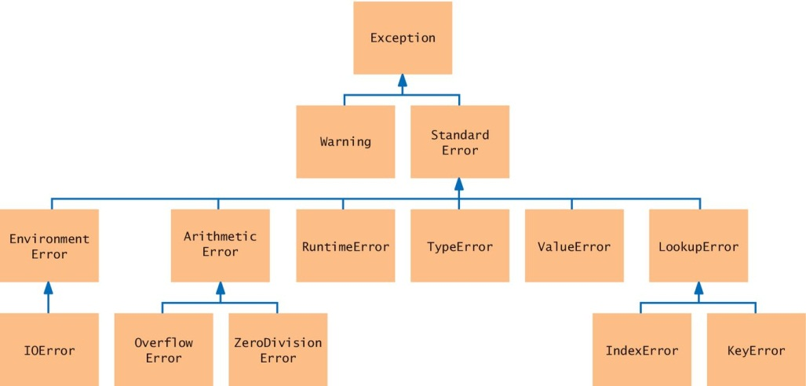
Exception Classes (a subset)
Look for an appropriate exception

Slide 81
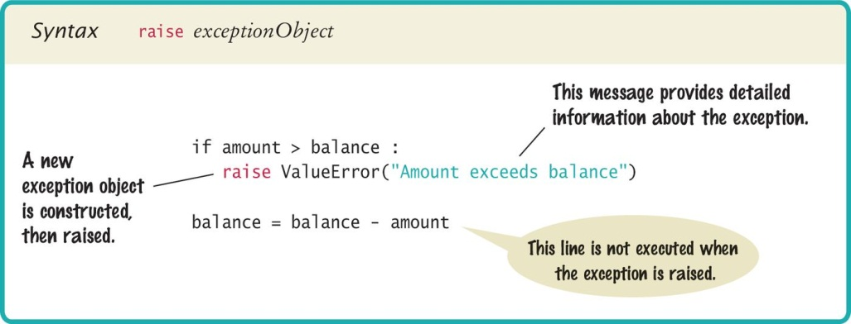
Syntax: Raising an Exception

Slide 82
Handling Exceptions
Every exception should be handled somewhere in the program
This is a complex problem
You need to handle each possible exception and react to it appropriately
Handling recoverable errors can be done:
Simply: exit the program
User-friendly: Ask the user to correct the error

Slide 83
Handling Exceptions: Try-Except
You handle exceptions with the try/except statement
Place the statement into a location of your program that knows how to handle a particular exception
The try block contains one or more statements that may cause an exception of the kind that you are willing to handle
Each except clause contains the handler for an exception type

Slide 84
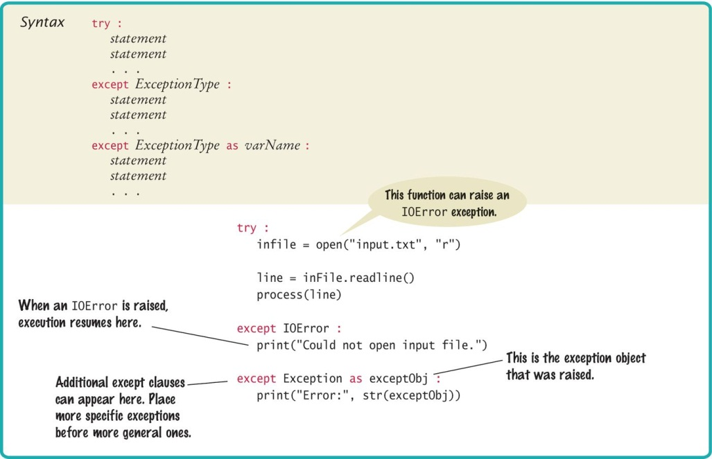
Syntax: Try-Except

Slide 85
Try-Except: An Example
try :
filename = input("Enter filename: ")
infile = open(filename, "r")
line = infile.readline()
value = int(line)
. . .
except IOError :
print("Error: file not found.")
except ValueError as exception :
print("Error:", str(exception))
open() can raise an IOError exception
int() can raise a ValueError exception
Execution transfers here if file cannot be opened
Execution transfers here if the string cannot be converted to an int
If either of these exceptions is raised, the rest of the instructions in the try block are skipped

Slide 86
Example
If an IOError exception is raised, the except clause for the IOError exception is executed
If a ValueError exception occurs, then second except clause is executed
If any other exception is raised it will not be handled by any of the except blocks

Slide 87
Output Messages
When the body of this handler is executed, it prints the message included with the exception
except ValueError as exception :
print("Error:", str(exception))
For example, if the string passed to the int() function was "35x2", then the message included with the exception will be:
invalid literal for int() with base 10: '35x2'

Slide 88
Output Messages (2)
To obtain the message, we must have access to the exception object itself
You can store the exception object in a variable with the as syntax:
except ValueError as exception :
When the handler for ValueError is executed, exception is set to the exception object. In our code, we then obtain the message string by calling str(exception)

Slide 89
Source of Output Messages
When you raise an exception, you can provide your own message string. For example, when you call
raise ValueError("Amount exceeds balance")
The message of the exception, "Amount exceeds balance", is the string provided as the argument to the constructor

Slide 90
The finally Clause
The finally clause is used when you need to take some action whether or not an exception is raised
Here is a typical situation
It is important to always close an output file whether or not an exception was raised (to ensure that all output is written to the file)
Place the call to close() inside a finally clause:
outfile = open(filename, "w")
try :
writeData(outfile)
finally :
outfile.close()

Slide 91
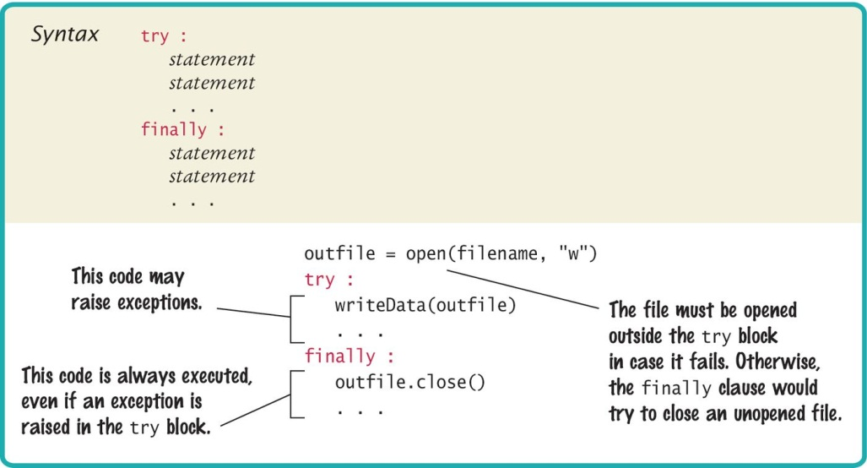
Syntax: The Finally Clause

Slide 92
Programming Tip
Throw exceptions early
When a method detects a problem that it cannot solve, it is better to throw an exception rather than try to come up with an imperfect fix
Catch exceptions late
Conversely, a method should only catch an exception if it can really remedy the situation
Otherwise, the best remedy is simply to have the exception propagate to its caller, allowing it to be caught by a competent handler

Slide 93
Programming Tip
Do not use except and finally in the same try block
The finally clause is executed whenever the try block is exited in any of three ways:
1. After completing the last statement of the try block
2. After completing the last statement of a except clause, if this try block caught an exception
3. When an exception was raised in the try block and not handled
try
except
finally

Slide 94
Programming Tip
It is better to use two (nested) try clauses to control the flow
try
try :
outfile = open(filename, "w")
try :
# Write output to outfile
finally :
out.close() # Close resources
except IOError :
# Handle exception
try
finally
except

Slide 95
The With Statement
Because a try/finally statement for opening and closing files is so common, Python has a special shortcut:
with open(filename, "w") as outfile :
Write output to outfile
This with statement opens the file with the given name, sets outfile to the file object, and closes the file object when the end of the statement has been reached or an exception is raised

Slide 97

A Little on Graphics
SIMPLE GRAPHICS

Slide 98

Drawing Simple Graphics
There is a graphics module included with the book that is a simplified version of Python’s more complex graphics library module. The module code is available via the course web site.

Slide 99
Using the graphics module (1)
To create a graphical application using the graphics module, carry out the following at the top of your program:
from graphics import GraphicsWindow
Create a graphics window (640 x 480 pixels):
win = GraphicsWindow(640, 480)
Access the canvas contained in the graphics window:
canvas = win.canvas()

Slide 100
Using the graphics module (2)
Create your drawing.
canvas.drawRect(15, 10, 20, 30)
Have the program wait for the user to close the window (by clicking the close button). Without this statement, the program would terminate immediately and the graphics window would disappear, leaving no time for you to see your drawing.
win.wait()

Slide 101
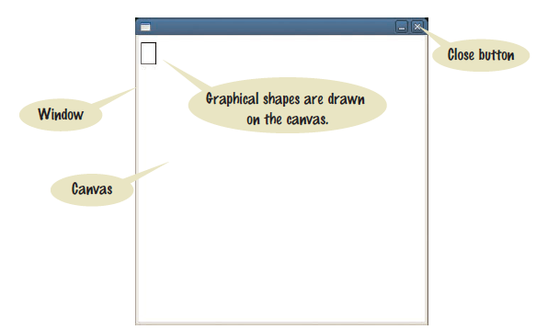
A graphics window

Slide 102
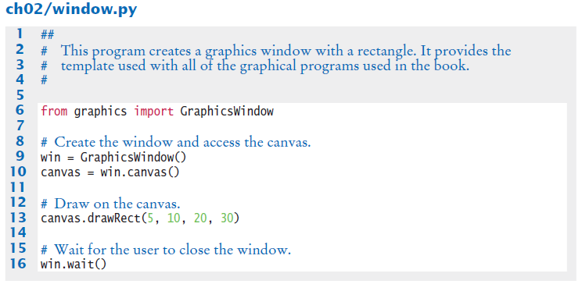
A complete drawing example

Slide 103
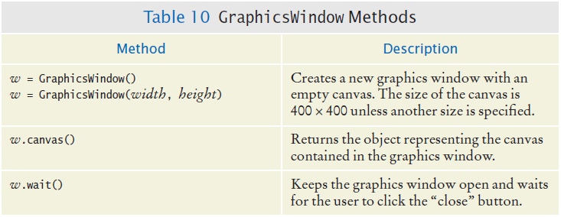
Table 10: GraphicsWindow Methods

Slide 104
Drawing shapes
Basic shapes have 4 properties: x coordinate, y coordinate, width and height.
Example:
canvas.drawRect(15, 10, 20, 30)
This statement draws a rectangle with the upper top left corner at point (15,10) in the window with a height of 20 and a width of 30.
Common shapes that can be drawn include: rectangles, squares, circles and ovals.

Slide 105
Drawing lines
Lines require 4 slightly different properties than drawing shapes:
Point 1(x coordinate, y coordinate)
Point 2(x coordinate, y coordinate)

Slide 106
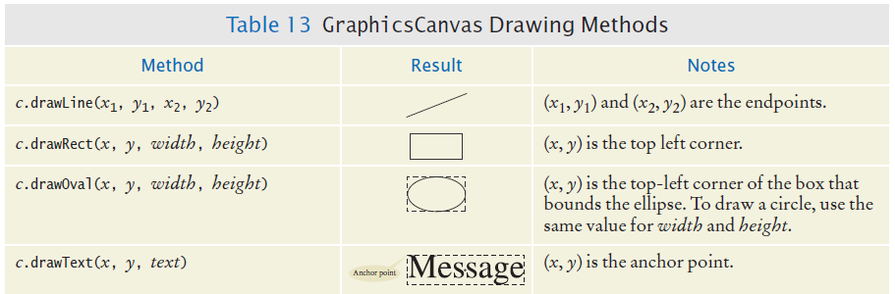
Table 13: Common Shapes, Lines and Text

Slide 107
The canvas and shapes can be colored
If you use the default setting (not changing the fill or outline), shapes are outlined in black and there is no fill color.
The fill color and outline can be set to different colors with the method calls:
setFill(<color name>)
OR
setFill(<red level>, <green level>, <blue level>)
setOutline(<color name>)
OR
setOutline(<red level>, <green level>, <blue level>)

Slide 108

Example of setting color
The following statements draw a rectangle that is outlined in black and filled with green.
canvas.setOutline("black")
canvas.setFill(0, 255, 0)
canvas.drawRect(10, 20, 100, 50)

Slide 109
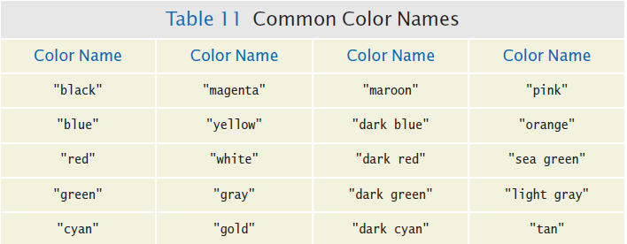
Table 11: Common Color Names

Slide 110
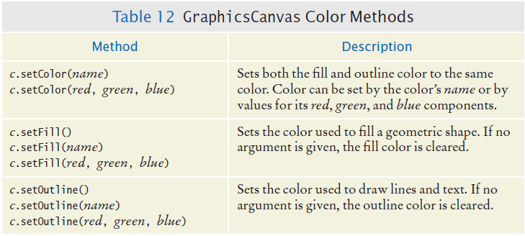
Table 12: GraphicsCanvas Color Methods

Slide 111
Demo of Graphics

