Slide 1
CS 2212B
Introduction to Software Engineering
Kostas Kontogiannis
Lecture 16: Architecture Styles (Chapter 5)

Slide 2
Overview
Context
What is software architecture?
Example: Mobile Robotics
Architectural styles and patterns
Data flow
Call-and-return
Interacting processes
Data-oriented repository
Data-sharing
Hierarchical
Other
Heterogeneous architectures

Slide 3
Call-and-return
Main program/subroutines
Information hiding
ADT, object, naive client/server

Slide 4
Main Program + Subroutine Architecture
Classic style since 60s - pre-OO.
Hierarchical decomposition into subroutines (Components) each solving a well defined task/function.
Data passed around as parameters.
Main driver provides a control loop for sequencing through subroutines.

Slide 5
Data Abstraction / Object Oriented
Widely used architectural style
Components:
Objects or abstract data types
Connections:
Messages or function/procedure invocations
Key aspects:
Object preserves integrity of representation - no direct access
Representation is hidden from objects
Variations:
Objects as concurrent tasks
Multiple interfaces for objects for objects (Java !)
Note that Data Abstraction is different from Object-Oriented - no inheritance.

Slide 6
Object-Oriented Strengths/Weaknesses
Strengths:
Change implementation without affecting clients (assuming interface doesn’t change)
Can break problems into interacting agents (distributed across multiple machine / networks).
Weaknesses:
To interact objects must know each other’s identity (in contrast to Pipe and Filter).
When identity changes, objects that explicitly invoke it must change (Java interfaces help though).
Side effect problems: if A uses B and C uses B, then C effects on B can be unexpected to A (and vice-versa).
Complex dynamic interactions – distributed functionality.

Slide 7
Overview
Context
What is software architecture?
Example: Mobile Robotics
Architectural styles and patterns
Data flow
Call-and-return
Interacting processes
Data-oriented repository
Data-sharing
Hierarchical
Other
Heterogeneous architectures

Slide 8
Interacting processes
Communicating processes
LW processes, distributed objects, …
Event systems
implicit invocation, pure events, …

Slide 9
Event-Based, Implicit Invocation
This architectural style (pattern) is characterised by the style of communication between components:
Rather than invoking a procedure directly or sending a message a component announces, or broadcasts, one or more events.
Basically, components communicate using a generalised Observer Design Pattern style of communication.
BUT this is a different architectural style from Object-Oriented
Communications are broadcast-based and components are not necessarily objects.

Slide 10
Implicit Invocation Example
Components register interest in an event by associating a procedure with the event.
When the event is announced the system implicitly invokes all procedures that have been registered for the event.
Common style for integrating tools in a shared environment, e.g.,
Tools communicate by broadcasting interesting events
Other tools register patterns that indicate which events should be routed to them and which method/procedure should be invoked when an event matches that pattern.
Pattern matcher responsible for invoking appropriate methods when each event is announced.

Slide 11
Implicit Invocation Example
Examples:
Editor announces it has finished editing a module, compiler registers for such announcements and automatically re-compiles module.
Debugger announces it has reached a breakpoint, editor registers interest in such announcements and automatically scrolls to relevant source line.

Slide 12
Implicit Invocation
Components
Modules whose interfaces provide a collection of procedures/methods and a set of events that it may announce
Connectors
Bindings between event announcements and procedure/method calls
Traditional procedure/method calls (to bypass implicit invocation)

Slide 13
Implicit Invocation
Invariants
Announcers of events do not know which components will be affected by those events
Components cannot make assumptions about ordering of processing, or what processing will occur as a result of their events
Common Examples (Shaw and Garlan textbook)
Programming environment tool integration
User interfaces - Model-View-Controller
Syntax-directed editors to support incremental semantic checking

Slide 14
Implicit Invocation
Strengths
Strong support for reuse - plug in new components by registering it for events
Maintenance - add and replace components with minimum affect on other components in the system.

Slide 15
Implicit Invocation
Weaknesses
Loss of control
when a component announces an event, it has no idea what components will respond to it
cannot rely on order that these components will be invoked
cannot tell when they are finished
Ensuring correctness is difficult because it depends on context in which invoked. Unpredictable interactions.
Sharing data - see the Observer Design Pattern
Hence explicit invocation is usually provided as well as implicit invocation. In practice architectural styles are combined.

Slide 16
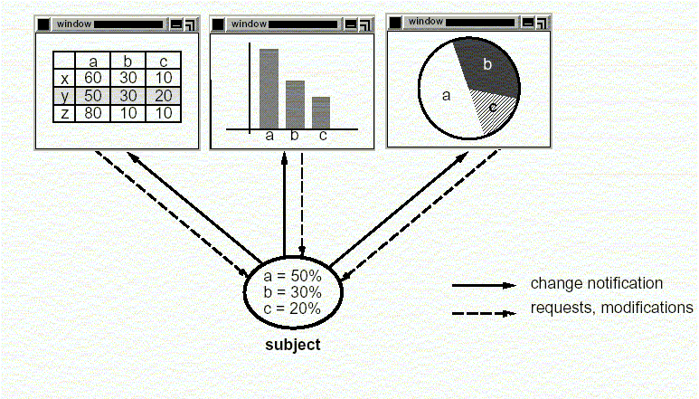
Model-View-Controller

Slide 17
Model-View-Controller
A decomposition of an interactive system into three components:
A model containing the core functionality and data,
One or more views displaying information to the user, and
One or more controllers that handle user input.
A change-propagation mechanism (i.e., observer) ensures consistency between user interface and model, e.g.,
If the user changes the model through the controller of one view, the other views will be updated automatically
Sometimes the need for the controller to operate in the context of a given view may mandate combining the view and the controller into one component
The division into the MVC components improves maintainability

Slide 18
Model-View-Controller
view1
controller1
view2
controller2
view3
model

Slide 19
Model/View/Controller (MVC)
In this architecture under the style of implicit invocation there are three different typed of components:
Model Components: Denote and implement the domain application data
Viewer Components: Denote and implement the different ways data are presented to the user or to other systems
Controller Components: Implement software logic that alter the data in the model (i.e. in the Model Components)
Controller
initiator
*
1
repository
Model
1
notifier
View
subscriber
*

Slide 20
Communication Diagram MVC
2.User types new filename
:Controller
3. Request name change in model
1. Views subscribe to event
:Model
5. Updated views
:InfoView
4. Notify subscribers
:FolderView

Slide 21
RMI
Communication
modules
Proxy for A
A’s client stubs
A’s skeleton
A server stubs
dispatcher
X
A
B
C
ROID
modules

Slide 22
CORBA Architecture
- Manufacturing:
- Electronic Commerce:
- Healthcare:
-Telecommunications:
- Finance
-Transportation
- …..
- Architecture guide and roadmap
- Working on Internet facilities.
Domains Interfaces
Common Facilities
Application Interfaces
Common Object Request Broker
- Naming
- Security (...ICL)
- Transactions (..Bull)
- Query Service
- Persistence
- Lifecycle
- ORBIX - IONA
- Obj Broker BEA
- VisiBroker Borland
- Omni Orb Olivetti
- Component Broker IBM
Object Services
Notes:
The ORB, through which objects intercommunicate
Object Services, which define system-level services that are added to the ORB, Examples of these services are naming, security, persistence, and transaction.
Common Facilitates, which define application-level service. Examples of these service are components, compound documents, and other vertical facilities.

Slide 23
Overview
Context
What is software architecture?
Example: Mobile Robotics
Architectural styles and patterns
Data flow
Call-and-return
Interacting processes
Data-oriented repository
Data-sharing
Hierarchical
Other
Heterogeneous architectures

Slide 24
Data-Oriented Repository
Transactional databases
True client/server
Blackboard
Modern compiler

Slide 25
Repositories / Data Centred
Characterised by a central data store component representing systems state and a collection of independent components that operate on the data store.
Connections between data store and external components vary considerably in this style:
Transactional databases: Incoming stream of transactions trigger processes to act on data store. Passive.
Blackboard architecture: Current state of data store triggers processes. Active.

Slide 26
Blackboard
Characteristics: cooperating ‘partial solution solvers’ collaborating but not following a pre-defined strategy.
Current state of the solution stored in the blackboard.
Processing triggered by the state of the blackboard.
Knowledge
Source 1
Knowledge
Source 6
Knowledge
Source 2
Blackboard
(shared data)
Knowledge
Source 5
Knowledge
Source 3
Knowledge
Source 4

Slide 27
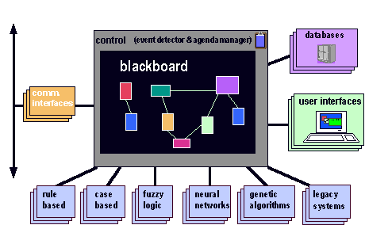
Blackboard Architectural Style Example
…………….
Knowledge Sources /
Problem Solving Strategies
http://www.nb.net/~javadoug/bb.htm

Slide 28
Examples of Blackboard Architectures
Problems for which no deterministic solution strategy is known, but many different approaches (often alternative ones) exist and are used to build a partial or approximate solution.
AI: vision, speech and pattern recognition
Modern compilers act on shared data: symbol table, abstract syntax tree

Slide 29
Overview
Context
What is software architecture?
Example: Mobile Robotics
Architectural styles and patterns
Data flow
Call-and-return
Interacting processes
Data-oriented repository
Data-sharing
Hierarchical
Other
Heterogeneous architectures

Slide 30
Data-sharing
Compound documents
Hypertext
Fortran COMMON
LW processes

Slide 31
Overview
Context
What is software architecture?
Example: Mobile Robotics
Architectural styles and patterns
Data flow
Call-and-return
Interacting processes
Data-oriented repository
Data-sharing
Hierarchical
Other
Heterogeneous architectures

Slide 32
Hierarchical
Layered
Interpreter
Tiered

Slide 33
Layered Systems
“A layered system is organised hierarchically, each layer providing service to the layer above it and serving as a client to the layer below.” (Garlan and Shaw)
Each layer collects services at a particular level of abstraction.
In a pure layered system: Layers are hidden to all except adjacent layers.

Slide 34
Layered Systems
“Onion Skin model”…
corresponds to a stack of layers.
Components
Composites of
various elements
Useful Systems
Basic Utilities
Core
Level
Connectors
Usually
procedure
calls
Useful Systems
Basic Utilities
Core Level

Slide 35
Hierarchical systems
Hierarchical systems can be tree-like in general

Slide 36
Layered Systems
Applicability
A large system that is characterised by a mix of high and low level issues, where high level issues depend on lower level ones.
Components
Group of subtasks which implement a ‘virtual machine’ at some layer in the hierarchy
Connectors
Protocols / interface that define how the layers will interact

Slide 37
Layered Systems
Invariants
Limit layer (component) interactions to adjacent layers (in practice this may be relaxed for efficiency reasons)
Typical variant relaxing the pure style
A layer may access services of all layers below it
Common Examples
Communication protocols: each level supports communication at a level of abstraction, lower levels provide lower levels of communication, the lowest level being hardware communications.

Slide 38
Layered System Examples
Example 1: ISO defined the OSI 7-layer architectural model with layers: Application, Presentation, …, Data, Physical.
Protocol specifies behaviour at each level of abstraction (layer).
Each layer deals with specific level of communication and uses services of the next lower level.
Example 2: TCP/IP is the basic communications protocol used on the internet. POSA book describes 4 layers: ftp, tcp, ip, Ethernet. The same layers in a network communicate ‘virtually’.
Example 3: Operating systems e.g. hardware layer, …, kernel, resource management, … user level “Onion Skin model”.
...

Slide 39
Layered Systems
Strengths
Increasing levels of abstraction as we move up through layers – partitions complex problems
Maintenance - in theory, a layer only interacts with layers above and below. Change has minimum effect.
Reuse - different implementations of the same level can be interchanged
Standardisation based on layers e.g. OSI

Slide 40
Layered Systems
Weaknesses
Not all systems are easily structured in layers (e.g., mobile robotics)
Performance - communicating down through layers and back up, hence bypassing may occur for efficiency reasons
Similar strengths to data abstraction / OO but with multiple levels of abstraction (e.g. well-defined interfaces, implementation hidden).
Similar to pipelines, e.g., communication with at most one component at either side, but with richer form of communication.
A layer can be viewed as aka “virtual machine” providing a standardized interface to the one above it

Slide 41
Interpreter
Architecture is based on a virtual machine produced in software.
Special kind of a layered architecture where a layer is implemented as a true language interpreter.
Components are ‘program’ being executed, its data, the interpretation engine and its state.
Example: Java Virtual Machine. Java code translated to platform independent bytecodes. JVM is platform specific and interprets (or compiles - JIT) the bytecodes.

Slide 42
Tiered Architectures
Special kind of layered architecture for enterprise applications
Evolution
Two Tier
Three Tier
Multi Tier

Slide 43
Two Tier Client Server Architecture Design
Developed in the 1980s to decouple (typically form/based) user interface from the storage of data.
Improved maintainability (changes to UI and database can be made independently); Scales up to 100 users
See http://www.sei.cmu.edu/str/descriptions/twotier.html#512860
Client tier
User System Interface
+ Some Processing
Management
Server tier
Database Management
+ Some Processing
Management

Slide 44
Three Tier Client Server Architecture Design
Emerged in the 1990s to overcome the limitations of the two tier architecture by adding an additional middle tier.
This middle tier provides process management where business logic and rules are executed and can accommodate hundreds of users by providing generic services such as queuing, application execution, and database staging.
An effective distributed client/server design that provides increased performance, flexibility, maintainability, reusability, and scalability, while hiding the complexity of distributed processing from the user.
See http://www.sei.cmu.edu/str/descriptions/threetier.html

Slide 45
Three Tier Client Server Architecture Design
User System Interface
Processing Management
Database Management

Slide 46
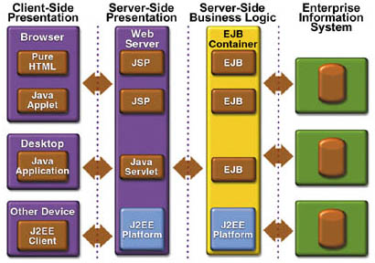
Example of a Multi Tier Architecture: Java 2 Platform, Enterprise Edition (J2EE)

Slide 47
Overview
Context
What is software architecture?
Example: Mobile Robotics
Architectural styles and patterns
Data flow
Call-and-return
Interacting processes
Data-oriented repository
Data-sharing
Hierarchical
Other
Heterogeneous architectures

Slide 48
Heterogeneous Architectures
In practice the architecture of large-scale system is a combination of architectural styles:
(‘Hierarchical heterogeneous’) A Component in one style may have an internal style developed in a completely different style (e.g, pipe component developed in OO style, implicit invocation module with a layered internal structure, etc.)
(‘Locational heterogeneous’) Overall architecture at same level is a combination of different styles (e.g., repository (database) and mainprogram-subroutine, etc.) Here individual components may connect using a mixture of architectural connectors - message invocation and implicit invocation.
(‘Perspective heterogeneous’) Different architecture in different perspectives (e.g., structure of the logical view, structure of the physical view, etc.)

Slide 49
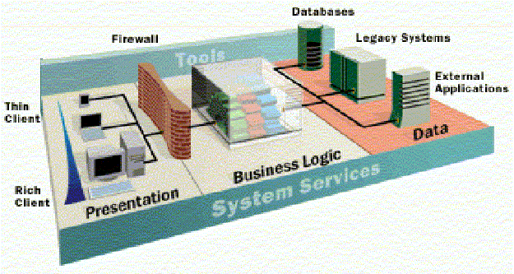
Example of Heterogeneous Architectures: Enterprise Architectures
Multi tier (at the highest level), distributed (including broker pattern), transactional databases, event-based communication, implicit invocation, object-oriented, MVC (e.g., for presentation in the client), dataflow for workflow, etc.

Slide 50
Links to Supporting Material
https://en.wikipedia.org/wiki/Software_architecture
https://en.wikipedia.org/wiki/List_of_software_architecture_styles_and_patterns
https://herbertograca.com/2017/07/28/architectural-styles-vs-architectural-patterns-vs-design-patterns/
https://www.win.tue.nl/~aserebre/2IW80/2013-2014/A3%20-%20Arch%20Styles.pdf
https://www.sciencedirect.com/science/article/pii/S187705091503183X
http://csse.usc.edu/classes/cs578_2013/Styles.ppt

