Slide 1
CS 2212B
Introduction to Software Engineering
Kostas Kontogiannis
Lecture 17: Life Cycle Models – Cost Estimation

Slide 2
Software Life-Cycle Models
Life-cycle model (also, process model)
The software development and operation activities and their ordering
Requirements elicitation
Specification
Design
Implementation
Integration
Maintenance phase
Retirement
…

Slide 3
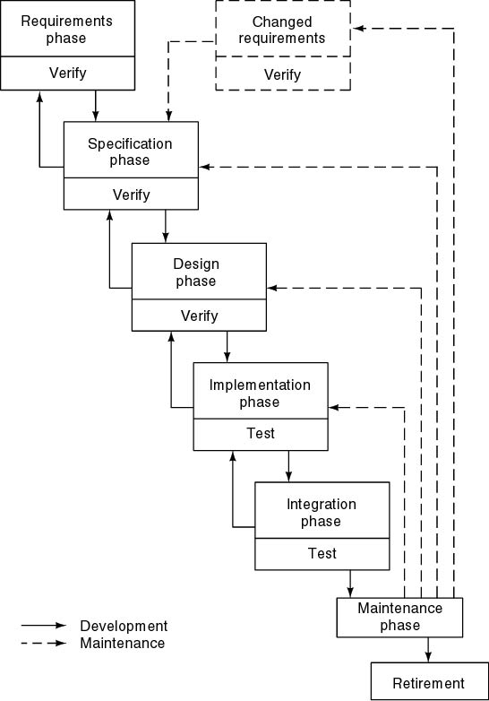
Waterfall Model
Characterized by
Sequential steps (phases)
Feedback loops (between two phases in development)
Documentation-driven
Advantages
Documentation
Maintenance easier
Disadvantages
Complete and frozen specification document up-front often not feasible in practice
Customer involvement in the first phase only
Sequential and complete execution of phases often not desirable
Process difficult to control
The product becomes available very late in the process

Slide 4
Incremental
Release 1
Design
Coding
Test
Deployment
Release 2
Requirements
Design
Coding
Test
Deployment
Release 3
Design
Coding
Test
Deployment
Each release adds more functionality, i.e., a new increment
(Some call it iterative)

Slide 5
Evolutionary
Version 1
Requirements
Design
Coding
Test
Deployment
Version 2
Requirements
Design
Coding
Test
Deployment
Version 3
Feedback
Requirements
Design
Coding
Test
Deployment
New versions implement new and evolving requirements
(Some call it iterative)

Slide 6
Spiral model

Slide 7
The four variables of a Project
The main four variables of a project
Development cost
Time
Quality
Scope
Development cost, time and quality are bad control variables
The number of developers can only be incrementally increased (negative effects beyond the optimal count)
Deadlines are often predetermined externally (e.g., market window, important presentation)
Low quality upsets customers and developers
Scope is the only real control variable

Slide 8
Function Points
The idea of function point was first proposed by Albrecht in 1979.
The function point of a system is a measure of the “functionality” of the system.
Steps
Counting the information domain – counting FPs
Assessing complexity of the software – adjusting FPs
Applying an empirical relationship to come up with LOC or P-months based on the adjusted FPs
This method cannot be performed automatically
©Ian Sommerville 1995

Slide 9
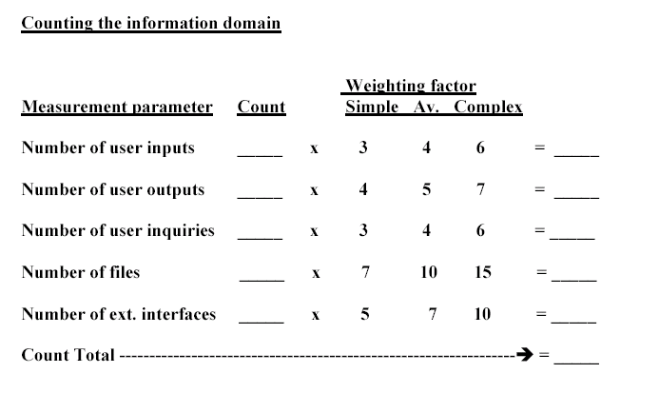
Counting Function Points

Slide 10
Counting Function Points
User inputs. Each user input that provides distinct application oriented data to the software is counted.
User outputs. Each user output that provides application oriented information to the user is counted. Individual data items within a report are not counted separately.
User inquiries. This is an on-line input that results in the generation of some response.
Files. Each master file is counted.
External interfaces. Each interface that is used to transmit information to another system is counted.

Slide 11
Adjusting Function Points
Answer the following questions using a scale of [0-5]: 0 not important; 5 absolutely essential. We call them influence factors (F_{i}).
1. Does the system require reliable backup and recovery?
2. Are data communications required?
3. Are there distributed processing functions?
4. Is performance critical?
5. Will the system run in an existing, heavily utilized operational env.?
6. Does the system require on-line data entry?

Slide 12
Adjusting Function Points
7. Does the on-line data entry require the input transaction to be built over multiple screens or operations (user efficiency)?
8. Are the master files updated on-line?
9. Are the inputs, outputs, files, or inquiries complex?
10. Is the internal processing complex?
11. Is the code designed to be reusable?
12. Is installation included in the design?
13. Is the system designed for multiple installations?
14. Is the application designed to facilitate change and ease of use by the user?

Slide 13
Map FPs to LOC
Use an empirical relationship
Function point = count total × [0.65 + 0.01 × (sum of the 14 F_{i})]
Companies may want to refine their own version
According to a 1989 study, implementing a function point in a given programming language requires the following number of lines of code
Assembly 320
C 128
COBOL 106
C++ 64
Visual Basic 32
SQL 12
See www.ifpug.org for more information on FP

Slide 14
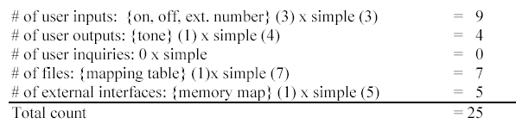
Example: Project

Slide 15
Example: Project
Total of FPs = 25
F₄ = 4, F₁₀ = 4, other F_{i}’s are set to 0. Sum of all F_{i}’s = 8.
FP = 25 x (0.65 + 0.01 x 8) = 18.25
Lines of code in C = 18.25 x 128 LOC = 2336 LOC
In the past, students have implemented their projects using about 2500 LOC.

Slide 16
Basic COCOMO Formula
Organic mode: PM = 2.4 (KDSI) ^{1.05}
Semi-detached mode: PM = 3 (KDSI) ^{1.12}
Embedded mode: PM = 3.6 (KDSI) ^{1.2}
KDSI = Kilo Delivered Source Instructions
©Ian Sommerville 1995

Slide 17
COCOMO examples
Organic mode project, 32KLOC
PM = 2.4 (32) ^{1.05} = 91 person months
TDEV = 2.5 (91) ^{0.38} = 14 months
N = 91/15 = 6.5 people
Embedded mode project, 128KLOC
PM = 3.6 (128)^{1.2} = 1216 person-months
TDEV = 2.5 (1216)^{0.32} = 24 months
N = 1216/24 = 51
©Ian Sommerville 1995

