Slide 1
CS 2212B
Introduction to Software Engineering
Kostas Kontogiannis
Cohesion examples

Slide 2
Cohesion Types
1. Coincidental Cohesion
2. Logical cohesion
3. Temporal cohesion
4. Procedural cohesion
5. Communicational cohesion
6. Sequential cohesion
7. Functional cohesion
8. Informational cohesion
Low Cohesion - Bad
High Cohesion - Good

Slide 3
Coincidental cohesion
Elements contribute to activities with no meaningful relationship to one another
Similar to logical cohesion, except the activities may not even be the same type
Difficult to understand and maintain, with strong possibilities of causing ‘side effects’ every time the module is modified
Example of Coincidental Cohesion
module miscellaneous functions
use customer record
display customer record
calculate total sales
read transaction record
return transaction record
end module
https://www.avatto.com/study-material/software-engineering-cohesion

Slide 4
Examples of Logical Cohesion
void function(param1, param2, param3, ..., paramN)
{
variable declarations....
code common to all cases... [A]
if ( param1 == 1 ) [B]
...
else if ( param1 == 2 )
...
else if ( param1 == n )
...
end if
code common to all cases... [C]
if ( param == 1) [D]
...
else if ( param1 == 5 )
...
end if
code common to all cases... [E]
if ( param1 == 7 )
...
}
module display record
use record-type, record
if record-type is student then
display student record
else if record-type is staff then
display staff record
end module
https://www.avatto.com/study-material/software-engineering-cohesion

Slide 5
Example of Temporal Cohesion
module initialise
set counter to 0
open student file
clear error message variable
initialise array
end module
https://www.avatto.com/study-material/software-engineering-cohesion

Slide 6
Example of Procedural Cohesion
Module A
Module B
operationA()
{ readData(data,filename1);
processAData(data);
storeData(data,filename2);
}
operationB()
{ readData(data,filename1);
processBData(data);
storeData(data,filename2);
}
readData(data,filename)
{ f := openfile(filename);
readrecords(f, data);
closefile(f);
}
storeData(data,filename)
{...}
processAData(data)
{...}
readData(data,filename)
{ f := openfile(filename);
readrecords(f, data);
closefile(f);
}
storeData(data,filename)
{...}
processBData(data)
{...}

Slide 7
Example of Procedural Cohesion
module write read and edit something
use out record
write out record
read in record
pad numeric fields with zeros
return in record
end module
https://www.avatto.com/study-material/software-engineering-cohesion

Slide 8
Example of Communicational Cohesion
module determine customer details
use customer account no
find customer name
find customer loan balance
return customer name, loan balance
end module
https://www.avatto.com/study-material/software-engineering-cohesion

Slide 9
Example of Sequential Cohesion
module format and cross-validate record
use raw record
format raw record
cross-validate fields in raw record
return formatted cross-validated record
end module
https://www.avatto.com/study-material/software-engineering-cohesion

Slide 10
Functional Cohesion
Module with functional cohesion focuses on exactly one goal or “function”
(in the sense of purpose, not a programming language “function”).
Module performing a well-defined operation is more reusable, e.g.,
modules such as: read_file, or draw_graph are more likely to be applicable to another project than one called initialize_data.
Another advantage of is fault isolation, e.g.,
If the data is not being read from the file correctly, there is a good chance the error lies in the read_file module/function.​
Examples of functional cohesive modules:
Compute cosine of angle
Read transaction record
Assign seat to airline passenger
https://www.avatto.com/study-material/software-engineering-cohesion

Slide 11
Informational Cohesion
Informational cohesion describes a module as performing a number of actions, each with a unique entry point, independent code for each action, and all operations are performed on the same data.
In informational cohesion, each function in a module can perform exactly one action.
It corresponds to the definition of an ADT (abstract data type) or object in an object-oriented language.
Thus, the object-oriented approach naturally produces designs with informational cohesion.
Each object is generally defined in its own source file/module, and all the data definitions and member functions of that object are defined inside that source file (or perhaps one other source file, in the case of a .hpp/.cpp combination).

Slide 12
Examples of Cohesion
Function A
Function A
Function A’
Function A’’
Time t₀
Time t₀ + X
Time t₀ + 2X
Function
B
Function
C
logic
Function
D
Function
E
Coincidental
Parts unrelated
Logical
Similar functions
Temporal
Related by time
Function A
Function B
Function C
Procedural
Related by order of functions
12

Slide 13
Examples of Cohesion (Cont.)
Function A
Function B
Function C
Function A
Function B
Function C
Communicational
Access same data
Sequential
Output of one is input to another
Function A part 1
Function A part 2
Function A part 3
Functional
Sequential with complete, related functions
13

Slide 14
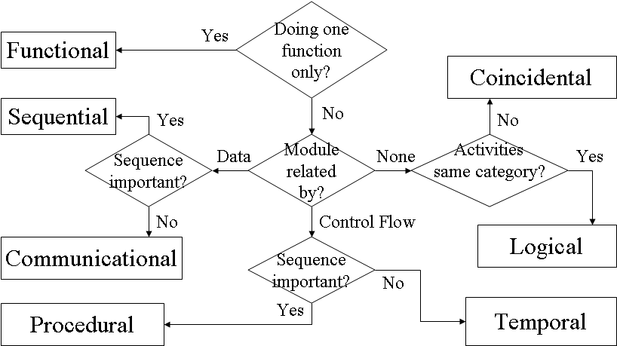
Determining Module Cohesion
https://www.avatto.com/study-material/software-engineering-cohesion

Slide 15
Links to Supporting Material
https://en.wikipedia.org/wiki/Cohesion_(computer_science)
https://stackoverflow.com/questions/3085285/cohesion-coupling
https://www.coursera.org/learn/software-processes/lecture/LWhWM/software-design-cohesion
https://en.wikipedia.org/wiki/Coupling_(computer_programming)
https://www.tutorialspoint.com/software_engineering/software_design_basics.htm
https://www.coursera.org/learn/software-processes/lecture/BNSI0/software-design-coupling
https://www.avatto.com/study-material/software-engineering-cohesion

