Slide 1
CS 2212B
Introduction to Software Engineering
Kostas Kontogiannis
Lecture 2: Requirements Engineering (Chapter 4)

Slide 2
What we will cover
General Concepts
Type of Requirements
Characteristics
Requirements Specification Process
Requirements Specification Cell
Requirements Modeling
Classic Techniques
Data Flow Diagrams
Entity-Relation Diagrams
State Diagrams
Unified Modeling Techniques
Use Case Diagrams
Sequence Diagrams
Collaboration Diagrams

Slide 3
Requirements Engineering
A systematic approach to eliciting, organizing, and documenting the requirements of the system (i.e. what the system is supposed to do), and
A process that establishes and maintains agreement between the customer and the project team on the changing requirements of the system. (Leffingwell & Widrig 1999)

Slide 4
Requirements Engineering
Idea of a new
product
(to solve some
problem in the
real world)
Requirements
development
(the process of
creating the
requirements
spec)
Requirements
specification
(the document that
describes what
has to be built,
not how)

Slide 5
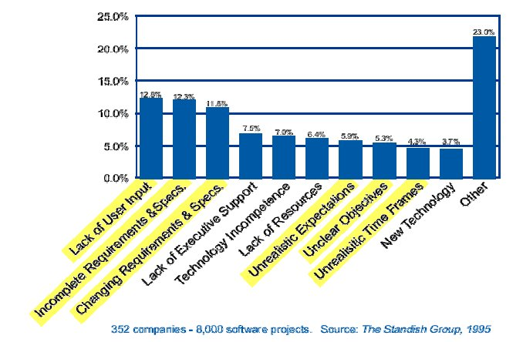
Why software projects fail?

Slide 6
What is a Requirement in a Software Product
Three basic types of requirements:
Functional requirements:
What the system is supposed to do – Its functionality
These requirements define the reasons a system should be built
Non-functional requirements:
What are the characteristics of the system – Quality characteristics, properties etc.
These requirements define the properties which we will examine to evaluate whetyer the system is successful or not
Constraints:
Requirements that have a global scope on the system and impose specific characteristics
In a nutshell requirements exist either because either
The type of the product requires them or
The user wants them

Slide 7
Requirements Elicitation
Very challenging activity
Requires collaboration of people with different backgrounds
Users
Developers
The gap between users and developers is bridged by:
Scenarios: Example of the use of the system in terms of a series of interactions with between the user and the system
Use cases: Abstraction that describes a class of related scenarios

Slide 8
Characteristics of Software Requirements
Clarity: The meaning and the significance of the requirement has to be clearly defined
Consistency: One requirement can not be inconsistent with another (it can be conflicting though)
Completeness: The requirement is fully defined (relates with clarity)
Verifiable: The requirement can be verified against the final implementation
Independence of technological and implementation factors: The requirement specification has to be independent of any preoccupations we may have towards specific design decisions we may favor or want to follow:
Requirement → What the system is supposed to do
Implementation → How the system satisfies its requirements

Slide 9
Requirements Validation
To check whether we have captured and modeled the right requirements (as opposed to check whether we have implemented the requirements right → requirements verification)
The criteria for requirements validation include:
Validation of Correctness: The requirements model is correct and denotes the idea the user/client has
Validation of Completeness: To ensure that all possible uses and scenarios of the system have been captured and modeled, and thee are nor inconsistencies among them
Realism: To ensure that the requirements can be implemented given the available technology and resources
Traceability: To ensure that each implementation part can be traced back to a requirement (i.e. this piece of code or this module implements requirement X)

Slide 10
Requirements Template
Unique ID
Requirement type
Code ID referring to corresponding use case
Brief outline
Rationale: Why the requirement is important
Sources: The stakeholders initiating/wanting the requirement
The structural properties of a requirement
E.g. Use case diagrams, sequence diagrams, collaboration diagram, domain model, state model, entity-relationship diagrams, data flow diagrams, i-star diagrams
Verification criteria: Criteria/metrics/properties by which we can verify that the final implementation indeed satisfies the requirement
Importance: The level by which the stakeholder wants the particular requirement and the level by which the stakeholder will be dissatisfied if the specific requirements does not get implemented
Relevance / Dependency with other requirements
Conflict with other requirements
Supporting material: pointer to supporting information
Historical information on how the requirement has been modified / altered over time

Slide 11
Requirements Engineering Process
Problem
Statement
Problem
Statement
Generation
Requirements
Elicitation
system
specification:
Model
Requirements
Analysis
analysis
(Activity Diagram)
model: Model

Slide 12
Requirements Elicitation Process
It is a tedious process that requires organization and consistency. There are different approaches for requirements elicitation.
The key stakeholders in this process are:
The users of the system they know the application domain
Software Engineers they know how to model problems and implement it as a software system
The objective of the requirements elicitation process is to bridge the sematic gap between system users and software engineers. This bridging is achieved by identifying usage scenarios and creating use cases:
Usage Scenario: Specific example of a system function/operation and how associates/affects other systems
Περίπτωση Χρήσης: Defines describes a group (class) of closely associated scenarios (scenario category)

Slide 13
System Specification Model vs Analysis Model
Both models focus on system requirements from the user’s perspective
The System Specification Model: Uses natural language and structured text to define and describe usage scenarios or use cases. This is a good model for the user to understand.
The Analysis Model: Uses a formalism or a modeling language to specify and denote the usage scenarios or the use cases. It is a good model for the software engineer). Examples of modeling languages include UML, i-star and, Goal Models)

Slide 14
Functional vs. non-functional requirements
Example: One of the functional requirements is to be able to provide a new flight time. This is a functional requirement.
Now let us say that a response has to be provided to the user within 1 minute. This is a performance requirement (i.e. a non-functional requirement)

Slide 15
Some types of non-functional requirements
Look and feel
Usability
Performance
speed, memory and other resources, accuracy, volumes, range of values, reliability, …
Operational
e.g., The product will be used by desktop, laptop and mobile users.
Maintainability
e.g., Readily portable to Linux.
Security
e.g., implements a specific type of security protocol or complies with a security regulation.
Cultural and political
Acceptable and unacceptable solutions, political correctness, spelling etc.

Slide 16
Functional requirements vs. technical requirements
Functional requirements are business requirements
Technical requirements are introduced during designing a solution for the functional requirements because of the implementation technology used

Slide 17
Models
A model is a representation of some aspect of a system being built
Models are abstract
they always leave out some system information
Systems are usually described by a set of models
different types
different levels of detail
different parts
different perspectives
Purpose of models
documentation, analysis, communication, simulation, ...

Slide 18
Types of Models
Mathematical
Descriptive
Graphical
Executable vs. non-executable

Slide 19
What needs to be modeled?
Events
Things and relations
States and state transitions
...

Slide 20
Events
Virtually all approaches to system development begin the modeling process with the concept of an event
An event occurs at
a specific time and place,
can be described, and
should be remembered by the system
Events trigger all processing that a system does
begin requirement analysis by asking what events occur that will affect the system and then analyze them

Slide 21
Types of Events
Temporal events
Occur as a result of reaching a point in time
Many information systems produce outputs at defined intervals, such as a payroll system producing paychecks at the end of each month
State events
Occur when something happens inside the system that triggers the need for processing
E.g., the share price of NT drops below a certain level and the system alerts a certain customer. Often state events occur as a result of external events

Slide 22
Event Table

Slide 23
Models of Things = Domain Model
Identify, understand, and model “things” relevant to a usage scenario.
Examples
Tangible things: telephone, switch, document, worksheet
Roles played: employee, customer, end user, system, administrator
Organizational units: division, department, section, task force
Devices: sensor, timer, controller, printer, keyboard
Incidents/events/interactions: logon, purchase order
Sites/locations: warehouse, branch office, factory, retail
For each thing identify its generalizations, associations, and dependencies, as well as their properties/characteristics and the events that impact them
The model that describes the “things” is referred to as the domain model

Slide 24
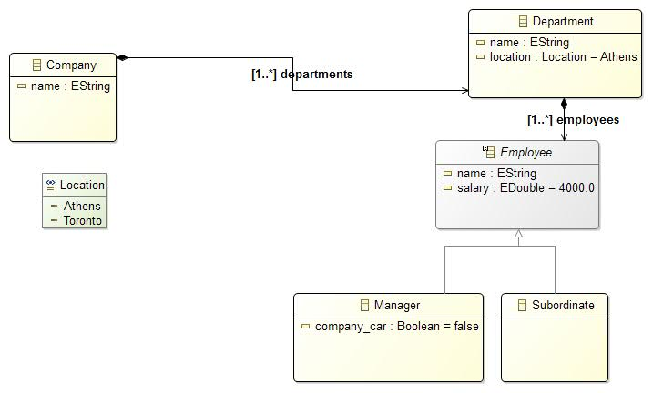
Example Domain Model

Slide 25
https://fenix.tecnico.ulisboa.pt/downloadFile/3779571242794/10-domain%20model.pdf

Slide 26
States and state transitions
Things may have states
e.g., payment has status (received, pending…)
Transitions between states are triggered by events

Slide 27
Notations
Traditional modeling approaches
Entity relationship diagrams
Data flow diagrams
State transition diagrams
Object-oriented modeling approaches
Class diagrams
Use case diagrams
Collaboration diagrams
Sequence diagrams
Statechart diagrams

Slide 28
Usage Scenarios for Requirements Elicitation
Usage Scenario: Description of a specific case of system use and its corresponding required functionality
Usage Scenario types :
Current: They describe the system functionality as needed/required for the current version of the system to be built
Future: They describe possible functionality we may want to add in future system versions or extensions
Evaluation: They describe functionality by which the system will be evaluated when it is implemented
Training: They describe the steps/process by which new users will be trained to use the system
Elicitation of Usage Scenarios from the user/client
We ask the user the following questions:
Which are the basic system operations?
What data they consume, produce, transform, or store and which are the “agents” involved ?
We observe how the users complete a task relevant to the system to be built
Meetings and brainstorming between system users, analysts, and software engineers

Slide 29
Use Cases
Use Case
It is a result of factoring / amalgamating several related usage scenarios
A use case defines and describes the interaction between
Actors (i.e. system users, stakeholders)
Specific parts of the application (i.e. system services)
That is a use case defines in a systematic and methodical way the functionality described by a collection of related scenarios
Many use cases finally cover the whole breadth of the desired system behavior and functionality
To compile use cases we consider normal scenarios (i.e. specify vanilla behavior), and pathological scenarios (i.e. specify extreme, alternative, or non-standard system behavior and state)

Slide 30
Use Case Example: Change of Airline Ticket Reservation
Actors: traveler, airline data base, airline reservation system
Preconditions:
The traveler has already logged-in in the system and has selected the “change booking” option
Base use case route:
The system retrieves information related to bookings of the user from its data base
The system prompts the user to select a specific flight; The traveler selects a specific flight
The system prompts the traveler to select a new departure time/date; the traveler provides the required information
If the flight has seats available ...
…
The system confirms the changes provides a summary of the changes.
Alternative use case route:
If the flight does not have seats available then …

Slide 31
Use Case Models
A use case model denotes a use case by employing a modeling language or formalism
Use case models denote functional requirements
As we will see later, in UML use case models are defined by Use Case Diagrams, Use Case Descriptions, Domain Model, State Diagrams, Sequence Diagrams, and Collaboration Diagrams
A Use Case Description is simply structured text that defines the steps (route) of a use case

Slide 32
Functional Requirements Modeling Techniques
Traditional Technique
The system is seen as a collection of interacting processes
Processes accept data as input and produce data as output
Processes interact with other (possibly external) processes
Object-Oriented Technique
A system is seen as a collection of entities (i.e. things or objects)
Entities interact with each other and with other entities external to the system
Entities can issue messages (i.e. events, requests) and respond to incoming messages (i.e. events and requests addressed to them)

Slide 33
Traditional Technique for Functional Requirements Modeling

Slide 34
Views
Process/functional view:
Use of Data Flow Diagrams
The objective is to provide a depiction of the processes involved for the specific requirement being modelled
Data-centric view:
Use of Entity-Relation Diagrams
The objective is to denote the data used/produced by the system, their properties, and their relationships
Behavior view:
Use of State machines
The objective is to denote a requirement be modeling its behavior of the as a collection of state changes

Slide 35
Data Flow Diagrams
Structural elements of DFDs:
External agents:
They interact with the system and produce and/or consu,e data and events
Example: External users, external applications
Processes:
They define system functionality
Data stores: They denote persistent storage elements
Data flows: They denote input/output streams to/from specific processes

Slide 36
Example DFD
Customer
order
Validate
Order
new_order
part_number
Orders
Stock

Slide 37
DFD: Abstraction Levels
DFDs are defined at different levels of abstraction
These are:
Level 0: The most abstract level. It defines the system as one big process blob that it interacts with external agents/systems. It is referred as context diagram
Level 1: The process denoted at Level 0 is analysed and denoted as a collection of sub-processes
Level 2: The processes denoted at Level 1 are analysed and denoted as a collection of sub-processes
…
Level n: The process denoted at Level n-1 ate analysed and denoted as a collection of sub-processes. In this level the processes are so simple which can be represented by psudocode, text, or decision tables.

Slide 38
Guidelines for Level 0
The guidelines for denoting a Level 0 DFD are:
We identify the entities that produce data to be used by the system
We identify the entities that consume data form the system
We identify data that affect or affected by the operation of the system

Slide 39
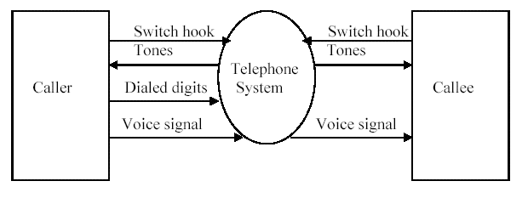
DFD Level 0

Slide 40
Guidelines for Level 1
We specify
The system in more detail (as far its processes and the data they internally exchange)
The external data used as input to the system
The processes that use the external data
The data that are produced as output by the system
The processes denoted at DFD Level 1 are a decomposition of the process at Level 0

Slide 41
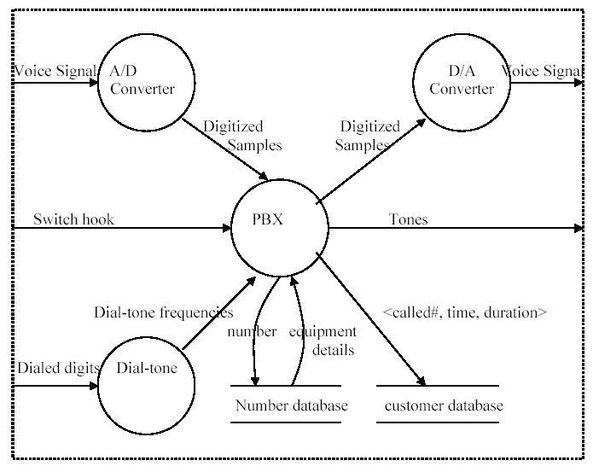
DFD Level 1

Slide 42
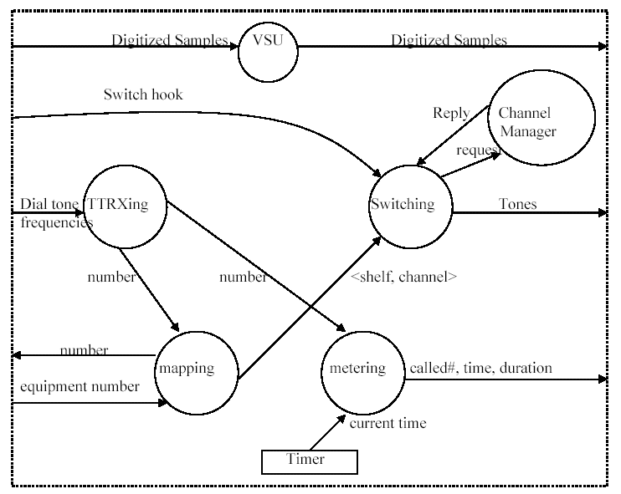
Further Decomposition of the PBX Process

Slide 43
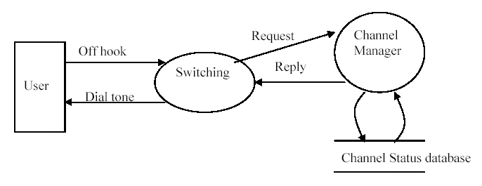
DFD Segment for the Switching Process and the “off hook” event

Slide 44
Example Psudocode
1. IF the dollar amount of the invoice times the number of weeks overdue is greater than $10,000 THEN:
a. Give a photocopy of the invoice to the appropriate salesperson who is to call the customer.
b. Log on the back of the invoice that a copy has been given to the salesperson, with the date on which it was done.
c. Refile the invoice in the file for examination two weeks from today.
2: OTHERWISE IF more than four overdue notices have been sent THEN:
a. Give a photocopy of the invoice to the appropriate salesperson to call the customer.
b. Log on the back of the invoice that a copy has been given to the salesperson, with the date on which it was done.
c. Refile the invoice in the file to be examined one week from today.
3: OTHERWISE (the situation has not yet reached serious proportions):
...

Slide 45
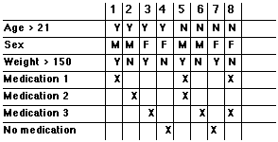
Decision Table Example

Slide 46
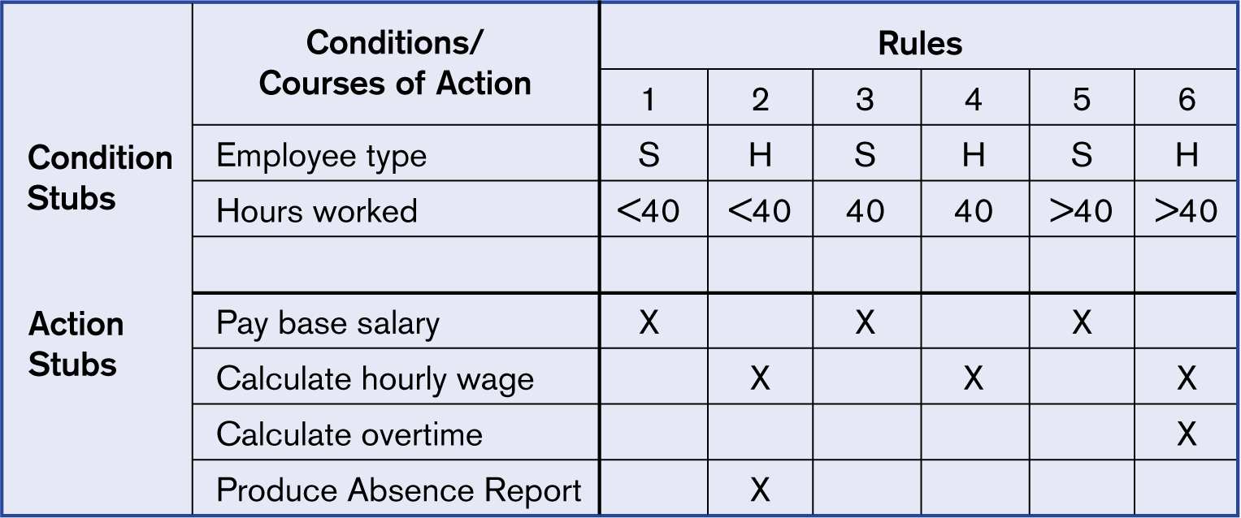
Decision Table Example

Slide 47
Entity-Relationship Diagram
E-R diagrams denote entities (usually data) and the relationship between them
E-R diagrams where proposed by P. Chen in 1976
They unify different methodologies for specifying data schemas in relational data bases
There are different E-R diagram notations but the concept is the same

Slide 48
Structural Elements of E-R Diagrams
Entities: Τhe prototypes of the system entities being modeled (e.g. traveler, airline reservation, departure time etc.).
Attributes: Characteristics of the entities (e.g. traveler name, airline reservation ID)
Atomic
Compound
Multi-valued
Derived
Key
Relationships:
Relationships between two or more entities (e.g. airline reservation relates to a traveler and a departure time)

Slide 49
E-R Diagram example
Entity
(or more precisely: entity set or type)
Student
Course
Name
attends
Title
Surname.
Description
ID.
Semester
Relation
attribute

Slide 50
Relations
How two or more entities are related (if at all…)
The relations can be:
1:1
1:N
N:M
Full Coverage
E.g. Every child has a mother
Partial Coverage
E.g. Not all people have children

Slide 51
E-R Semantics
Entities correspond
To Types
Bride
1
1
Groom
Relations are
implemented in
specific objects/
entites

Slide 52
1-Ν Relation
Mother
1
n
Children

Slide 53
Ν-Μ Relation
Grandfather
2
m
Grand
Children

Slide 54
Partial Relation
1

Slide 55
E-R Cardinality Notation
Entity
Relation
Exactly one
Many (zero or more)
Optional (zero or more)
+1
One or more
1-3,6
Specicif values

Slide 56
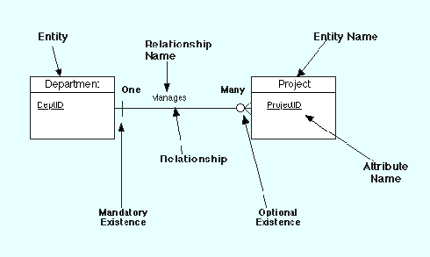
E-R Diagram Example

Slide 57
State Machines (Automata)
Input alphabet
Output alphabet
States
Set if possible actions
Set of transitions (State x Event → State x Action)
Initial state
Set of final states

Slide 58
State Machine Example
on
Lamp On
on
off
Lamp Off
off

Slide 59
Results and Actioms
As the automaton changes state it may produce results and invoke specific actions:
on
on
Lamp On
Lamp On
print(”on”)
on/print(”on”)
on
off
off
Lamp Off
off
Lamp Off
off
Autonaton Mealy
Automaton Moore

Slide 60
Extended State Machine
Use of variables
Lamp On
on
ctr : Integer
on/ctr := ctr + 1
off
Lamp Off
off

Slide 61
Guards
The transitions form one state to another are triggered by event but only when specific conditions (guards) are satisfied. Guards do not have side effects
bid [value < 100] /reject
Selling
bid [value >= 200] /sell
Happy
bid [(value >= 100) & (value < 200)] /sell
Unhappy

