Slide 1
CS 2212B
Introduction to Software Engineering
Kostas Kontogiannis
Lecture 5: Requirements Engineering (Chapter 4)

Slide 2
What we will cover
Requirements Specification Techniques
Classic Technique
Object Oriented Technique ←
Use Case Diagrams
Sequence Diagrams
Collaboration Diagrams
Class Diagrams

Slide 3
Modeling with UML
Requirements Modeling | Scenarios, Use Case Diagrams
Static Modeling | Class Diagrams Object Diagrams Component Diagrams Deployment Diagrams
Dynamic Modeling | Sequence Diagrams Collaboration Diagrams – Communication Diagrams στη UML 2.0
Modeling the behavior of specific objects/classes | State Diagrams
Modeling the execution of system process steps | Activity Diagrams
Modeling system
operation – user’s
view
System
Structure
Modeling
System
Behavior Modeling

Slide 4
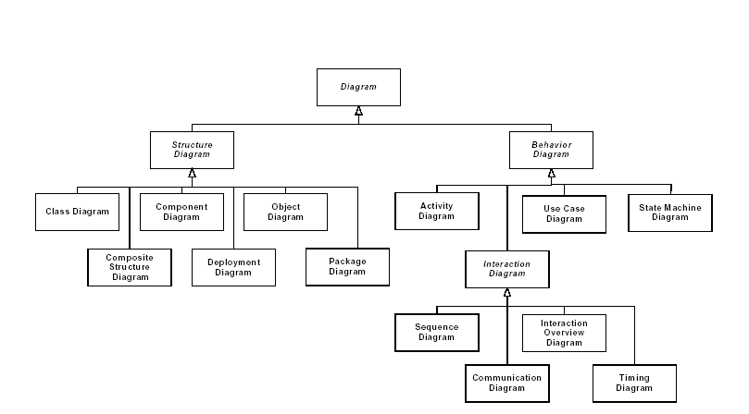
UML 2.0 Diagrams Structure

Slide 5
Structural Elements of Static Design Models

Slide 6
Structural Elements of Static Design Models
Class/Object Categories:
Initiators – external entities that start a process (initiators)
Handlers – active internal to the system entities that create objects,
destroy objects and start importrant system operations
Managed Entities – passive internal entities which offer services

Slide 7
Structural Elements of Relations in Static Design Models

Slide 8
Structural Elements of Relations in Static Design Models

Slide 9
Class
Window
class name)
origin
size
attributes
Open()
Close()
Move()
Display()
operations

Slide 10
Initiator or Active Classes
EventManager
Bold line
Suspend()
Flush()

Slide 11
Classifiers
A classifier is a UML mechanism that is used to denote the structural and behavioral characteristics of a system.
Eight basic classifiers
Classes, Interfaces, data types, event, components, nodes, use cases, sub-systems).

Slide 12
Scope of Class Attributes
Public scoping: (+).
Protected scoping: (#).
Private scoping: (-).
Toolbar
# currentSelection: Tool
# toolCount: Integer
+ pickItem(i: integer)
- compact()

Slide 13
Static Scoping
Frame
Header : FrameHeader
uniqueID : Long
(“static”
e.g. in Java)

Slide 14
Multiplicity
It denotes the multiplicity of the values a class attribute may obtain
NetworkController
1
consolePort [2..*] : Port
The attribute consolePort can take
2 or more values

Slide 15
Classes – Operation Body

Slide 16
Classes with more Information
The names of abstract classes and their operations are
Represented by italics

Slide 17
Relations
Window depends on (requires) Event
Window
dependency
Open()
Close()
HandleEvent()
Event
DialogBox is a subclass (specialization
of Window
generalization
association
ConsoleWindow
DialogBox
Control
DisplayPrompt()
…

Slide 18
Generalization - Specialization
Shape
Polygon
Ellipse
Spline
. . .
Shape
Polygon
Ellipse
Spline
. . .

Slide 19
Associations
Person
Works-for
Company
The name of the association defines its semantics. The arrow is how we
read the relation specified by this association
Person
employee
employer
Company
The Role denotes how a class is viewed through the association by the other
class (e.g. The Role of a Person in the above association is that of an employee).

Slide 20
Association Direction
Association Direction: We can add an arrow at one or both ends of an association
To signify the directionality of the relation, In this example below, a Company object
has or contains a reference to a Person object.
Works for
Person
Company

Slide 21
More about Associations
Multiplicity: Denotes how many objects can relate under the specific association.
1..*
*
Person
Company
employee
employer
Exactly one: 1
Zero or one: 0 .. 1
Zero or more: 0 ..*
Many: *
One or more: 1 .. *
Not shown ➔ unspecified or suppressed

Slide 22
Aggregation
It is a special type of association.
It denotes the relationship between the whole and its parts. The parts may still exist even if we delete the whole (i.e. the container).
The whole (i.e. the container)
Company
1
*
employee
Person
The part

Slide 23
Composition
Composition:
- It is a stronger type of Aggregation. The composing parts cannot exist on their
own if the container is deleted.
Window
The whole
1
*
Frame
The part

Slide 24
Association Classes
Association Classes – They denote and specify information and properties for
(a complex) association.
employer
employee
Company
Person
*
1..*
WorksFor
Description
Salary
StartDate

Slide 25
Constraints
Provide a UML extension mechanism in order to denote and specify pre-conditions,
post-condition, and constraints.
Portfolio
Corporation
{secure}
{or}
BankAccount
Person

Slide 26
Constraints and Comments
∗
Member-of
∗
Person
{subset}
Committee
Represents
an incorporated entity.
1
Chair-of
∗
employee
employer
∗
Person
∗
0..1
Company
0..1
boss
{Person.employer =
Person.boss.employer}

Slide 27
Inferred Association and Properties

Slide 28
Association Example

Slide 29
Association Example

Slide 30
Dependency
Class A depends (or requires Class B)

Slide 31
Realization (Implementation)
- A relation between two classifiers
The first classifier defines the operations and the second is implementing them.
In UML the Realization relation is occurring between:
- Interfaces (define the operations) and
classes/components (implement the operations)
- Use cases and use case implementations
- We use the following terminology:

Slide 32
How to Denote an Interface
I
I

Slide 33
Alternative (and more descriptive) Way of Denoting an Interface
I
I
The implementation link

Slide 34
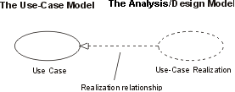
Realization in Use Case Diagrams
For each use case in the requirements, there can be a use-case realization in the
design with a realization relationship to the use case, as the following figure shows.
In UML, this is shown as a dashed arrow with an arrowhead,
like a generalization relationship, indicating that a realization is a kind of inheritance,
as well as a dependency (see the figure that follows).
http://www.utm.mx/~caff/doc/OpenUPWeb/openup/guidances/guidelines/uc_realizations_448DDA77.html

Slide 35
Class Diagram Example

Slide 36
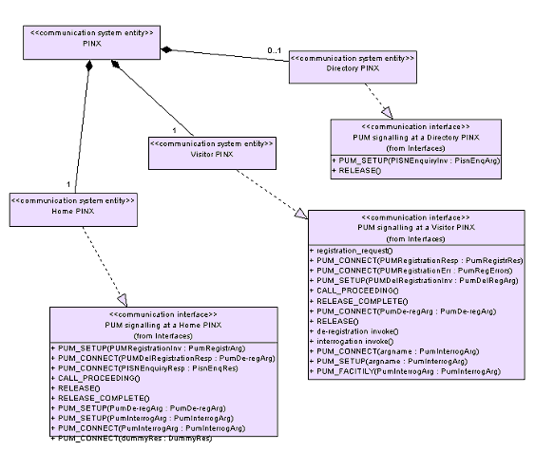
Class Diagram Example
http://portal.etsi.org/mbs/Languages/UML/uml_example.asp#Cd

Slide 37
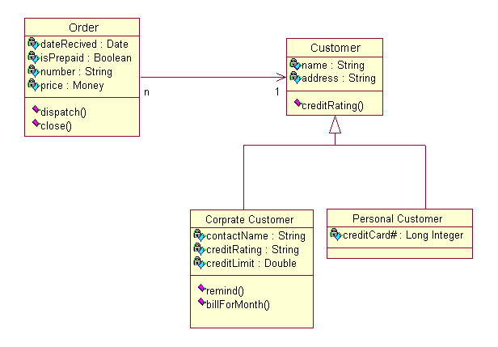
Class Diagram Example
http://pigseye.kennesaw.edu/~dbraun/csis4650/A&D/UML_tutorial/class.htm

Slide 38
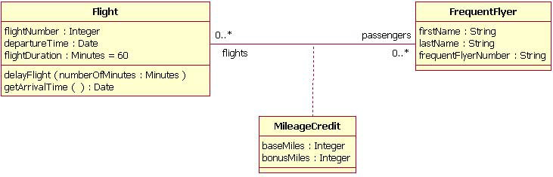
Class Diagram with Association Class
http://pigseye.kennesaw.edu/~dbraun/csis4650/A&D/UML_tutorial/class.htm

Slide 39
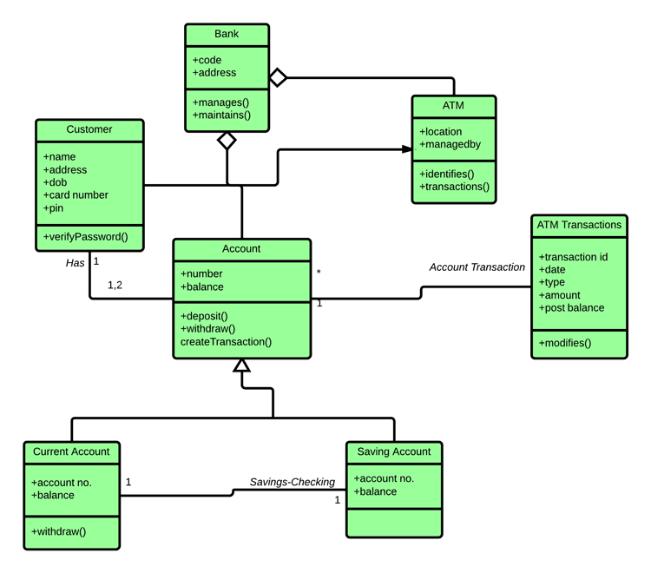
Class Diagram Example (ATM System)

Slide 40
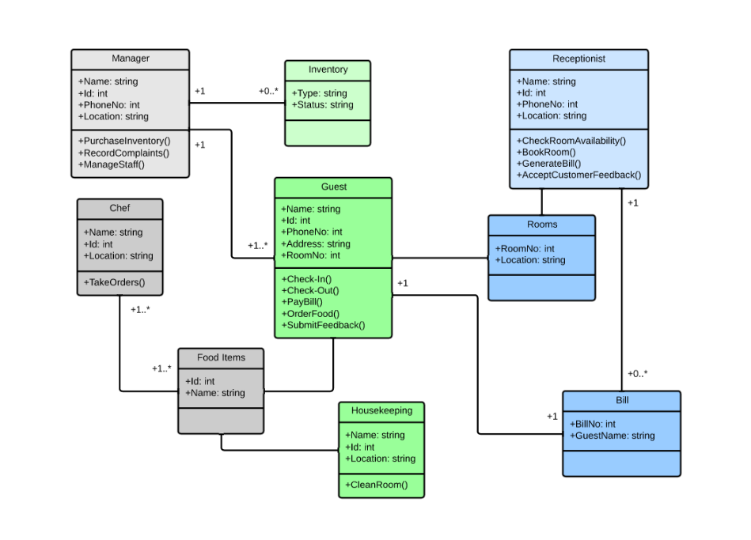
Class Diagram Example (Hotel Management System)

Slide 41
Class Diagrams Pros/Cons
Class diagrams are great for:
discovering related data and attributes
getting a quick picture of the important entities in a system
seeing whether you have too few/many classes
seeing whether the relationships between objects are too complex, too many in number, simple enough, etc.
spotting dependencies between one class/object and another
Not so great for:
discovering algorithmic (not data-driven) behavior
finding the flow of steps for objects to solve a given problem
understanding the app's overall control flow (event-driven? web-based? sequential? etc.)
https://courses.cs.washington.edu/courses/cse403/11sp/lectures/lecture08-uml1.pdf

Slide 42
Instances
Denotes a specific implementation of an abstract entity (e.g. of a class)
All objects are instances of their class
Some instances are not objects (the instance if an association is a specific relation between two specific objects)
In order to denote instances we underline the names of the classes

Slide 43
Examples of Objects (named, anonymous, multiple)
t: Transaction
named
myCustomer
:Multimedia::AudioStream
anonymous
multiobject
:keyCode

Slide 44
The State of an Object
myCustomer
Attributes with specific values
Id : SSN = “432 …..”
Active = true
Object in a specific state
c: Phone
The state of object c which
Is of type Phone is
[WaitForAnswer]
[WaitingForAnswer]

Slide 45
Object Diagrams
They denote instances of entities that appear in the corresponding class diagrams
They represent specific objects and relations between them for a specific case or point of time.

Slide 46
Object Diagram Example
c:Company
d1: Dept
d2: Dept
name = “Sales”
name = “R&D”
Objects, links, notes, constraints
d3: Dept
Name = ….
p: Person
: ContactInfo
Name = “jk”
Address=“200 Univ. Av.”

Slide 47
Composite Objects
Fig. 3-39, UML Notation Guide

Slide 48
Links to Supporting Material
https://www.ibm.com/developerworks/rational/library/content/RationalEdge/sep04/bell/
https://www.tutorialspoint.com/uml/uml_class_diagram.htm
https://www.lucidchart.com/pages/uml-class-diagram
https://www.uml-diagrams.org/class-diagrams-overview.html
https://courses.cs.washington.edu/courses/cse403/11sp/lectures/lecture08-uml1.pdf

