Slide 1
CS 2212B
Introduction to Software Engineering
Kostas Kontogiannis
Lecture 7: Requirements Engineering

Slide 2
What we will cover
Requirements Specification Techniques
Classic Technique
Object Oriented Technique ←
Use Case Diagrams
Sequence Diagrams
Collaboration Diagrams
Class Diagrams
Activity Diagrams / State Diagrams

Slide 3
Modeling with UML
Requirements Modeling | Scenarios, Use Case Diagrams
Static Modeling | Class Diagrams Object Diagrams Component Diagrams Deployment Diagrams
Dynamic Modeling | Sequence Diagrams Collaboration Diagrams – Communication Diagrams στη UML 2.0
Modeling the behavior of specific objects/classes | State Diagrams
Modeling the execution of system process steps | Activity Diagrams
Modeling system
operation – user’s
view
System
Structure
Modeling
System
Behavior Modeling

Slide 4
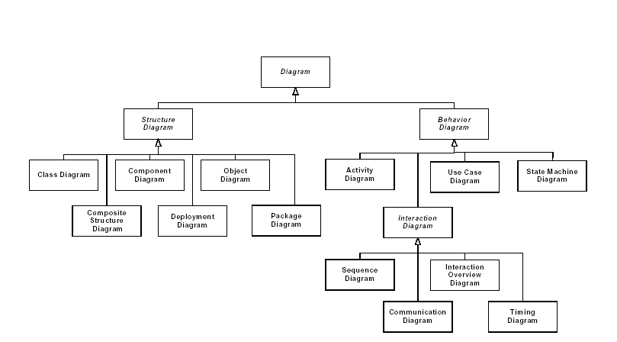
UML 2.0 Diagrams Structure

Slide 5
Specification of Static Structure
As we have mentioned already the Structural Model (Object Model) of a system denotes and specifies the static structure of the system and of the subsystems as a collection of interelated classes, objects and other entities
To create the Structural Model of the system we use:
Diagrams that focus on the static structure of the detailed design
Class Diagrams
Object Diagrams
Diagrams that focus on the deployment of the system
Component Diagrams
Deployment Diagrams and
Package Diagrams

Slide 6
Component Diagrams
These diagrams model the structure of the system as a collection of components which interact using specific interfaces and exchange messages through these interfaces
A Component is:
A system unit that offers specific functionality and services and obeys to specific communication protocols with other components
A component is referred to by a mnemonic name and hide their implementation details. They only expose interfaces
A good design has components with high cohesion and low coupling

Slide 7
Hierarchy of Units
Systems
Subsystem
Component
Composite Component
Class
System
Subsystem
1
*
1
*
Component
*
Class
Composite Components
1

Slide 8
Component Diagram Example in UML 1.x

Slide 9
Component Types
Domain components
Application components
Infrastructure components

Slide 10
How Do We Identify Components?
Step 1. Define classes which are relevant to the application domain Προσδιορισμός κλάσεων σχετικών με το πεδίο και το αντικείμενο του συστήματος. These are referred to as domain classes
Step 2. Grouping of domain classes in cohesive domain components. The grouping is based on the concept that the methods of the classes being grouped should be relevant with each other so that high cohesion is maintained

Slide 11
How Do We Identify Components?
Step 3. Identification and grouping of classes that implement functionality that is specific to the system’s requirements. These components are signified by the stereotype <<application>>
Step 4. Association of user interface classes (or cohesiive groups thereof) which implement input/output operations with application components
Step 5. Identification and grouping of classes that implement low level system operations (e.g. security services, interoperability services, middleware services). These components are signified by the stereotype <<infrastructure>>
Step 6. Identification of interfaces between components (i.e. component interfaces)

Slide 12
How Do We Identify Components?
Step 7. Grouping of classes that have a generalization/specialization relation or a composition/aggregation relation, to the same component
Step 8. Classes that only offer specific types of services are referred to as server classes and are recipients of service requests from other components
Step 9. Classes which generate requests are referred to as client classes and most probably belong to application components and not in domain components. The classes in the domain components they usually receive messages and initiate processes and services

Slide 13
How Do We Identify Components?
Step 10. Classes with high cohesion or classes that exchange many messages belong to the same component
Step 11. Regrouping and fine tuning of the design to achieve the minimization of messages exchanged between components

Slide 14
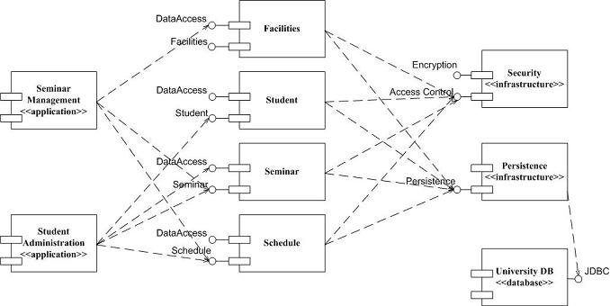
Component Diagram Example in UML 1.x
http://www.agilemodeling.com/artifacts/componentDiagram.htm

Slide 15
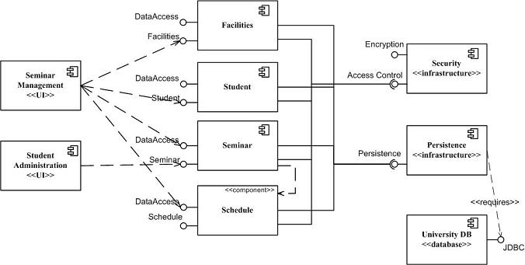
Component Diagram Example in UML 2.x
http://www.agilemodeling.com/artifacts/componentDiagram.htm

Slide 16
Deployment Diagrams
They denote and specify how the components will be physically deployed
Deployment diagrams show in which computational nodes (i.e. servers, data centers etc.) the different components or subsystems run and execute
In other words, these diagrams show how the system will have to be deployed in a specific hardware infrastructure

Slide 17
Example of Deployment Diagram
:Client
<<browser>>
:OpenSourceBrowser
videoStoreServer:AppServer
<<Container>>
VideoStoreApplication
<<Session>>
<<Entity>>
ShoppingSession
Catalog
<<Focus>>
<<Focus>>
ShoppingSession
Catalog
<<Entity>>
ShoppingCart
<<Focus>>
ShoppingCart
:DBServer
<<database>>
:VideoStore
DB

Slide 18
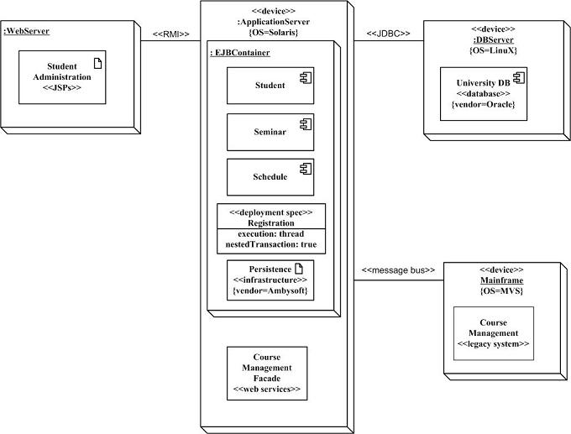
Deployment Diagram Example (UML 2.0)
http://www.agilemodeling.com/artifacts/deploymentDiagram.htm

Slide 19
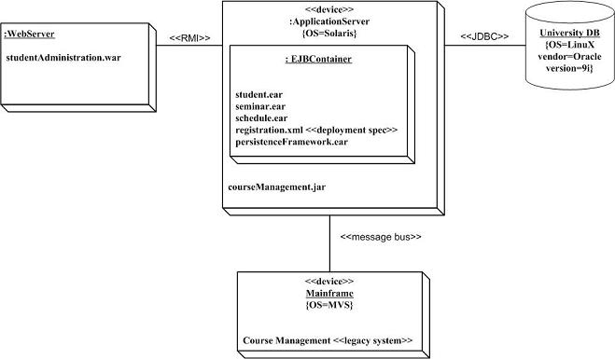
Deployment Diagram Example (UML 2.0)
http://www.agilemodeling.com/artifacts/deploymentDiagram.htm

Slide 20
Package Diagrams
They allow for grouping of classifiers in order to facilitate the easier comprehension of the system’s structure
The packaging is a way to facilitate grouping of related units and many times also reflects basic design decisions

Slide 21
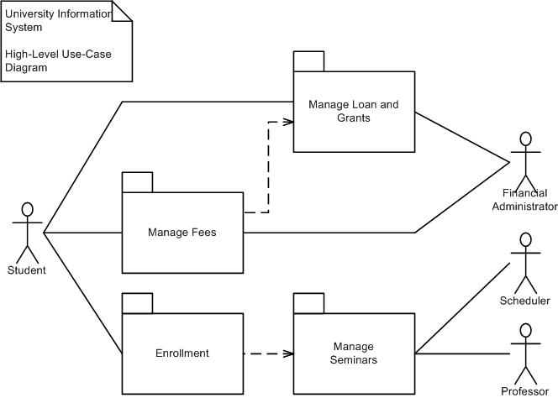
Package Diagram Example
http://www.agilemodeling.com/artifacts/packageDiagram.htm

Slide 22
Links to Supporting Material
https://www.ibm.com/developerworks/rational/library/dec04/bell/index.html
http://agilemodeling.com/artifacts/componentDiagram.htm
https://www.uml-diagrams.org/component-diagrams-examples.html
https://www.tutorialspoint.com/uml/uml_component_diagram.htm
https://www.uml-diagrams.org/package-diagrams-overview.html
http://www.agilemodeling.com/artifacts/packageDiagram.htm

