Slide 1
CS 2212B
Introduction to Software Engineering
Kostas Kontogiannis
Lecture 14: Design Patterns

Slide 2
Adapter Design Pattern
The Adapter Design Pattern allows for client code to access an object which has different interface from the interface the client code expects the object to have, and all these without the need to change neither the object or the client code.
This design pattern is useful when we want:
1) To replace a class A with another one (say B) which has a different interface than class A, without changing the clients using the class A
2) To implement a class that interacts with other classes for which we do not know yet the final design of their interfaces (e.g. during the system design phase)

Slide 3
Structural Elements of the Adapter Design Pattern
Participating classes. The classes that implement the pattern are:
The class Target
The class that defines the interface which the client code expects. It is the interface the client code invokes.
The class Adaptee
The class which defines the interface which is actually used
The class Adapter
The class that adapts the interace of the class Adaptee to the interface of the class Target
The class Client
The class that contains the client code that uses the Target class

Slide 4
Adapter – Construction / Use
We first design and implement the class Target that defines the methods which implement the interface expected by the client code
Then, we design and implement the class Adapter which defines the interface that is required to access the interface of the class Adaptee. The class Adapter inherits from the class Target and provides a transformation of the calls initiated from the client code to calls that are compatible with the interface of the class Adaptee. The class Adapter overrides the methods of the class Target and implements them in a way that are compatible with the Adaptee inerface.
This design pattern is very useful as it allows for the client code to remain the same even though the classes that are actually used may change. This pattern is particularly useful during the design of very large systems where the interfaces of several modules may need to change.

Slide 5
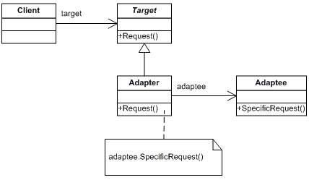
Adapter Design Pattern – Class Diagram

Slide 6
Adapter - Example
// "Target" class Target { public virtual void Request() { Console.WriteLine("Called Target Request()"); } }
class Adapter : Target { private Adaptee adaptee = new Adaptee(); public override void Request() { // Possibly do some other work // and then call SpecificRequest adaptee.SpecificRequest(); } }
// "Adaptee" class Adaptee { public void SpecificRequest() { Console.WriteLine("Called SpecificRequest()"); } } }
// Client
class MainApp { static void Main() { // Create adapter and place a request Target target = new Adapter(); target.Request(); // Wait for user Console.Read(); } }
Output
Called SpecificRequest()

Slide 7
Bridge Design Pattern
By using subclassing of an abstract base class to provide alternative implementations locks in compile-time binding between interface and implementation. The abstraction and implementation cannot be independently extended or composed.
Decouple an abstraction from its implementation so that the two can vary independently.
Publish interface in an inheritance hierarchy, and bury implementation in its own inheritance hierarchy.
This design pattern can be used for implementing layered architectures. It can also be used in conjunction with the Abstract Factory Design pattern, where the Bridge pattern can use the Abstract Factory in order to decide which implementation to be used for which abstraction.

Slide 8
Structural Elements of the Bridge Design Pattern
The Class Abstraction (Abstract class)
Defines the interface of the abstraction model
Keeps a reference to an implementation object
The Class RefinedAbstraction
Extends the interface defined in the class Abstraction
The Class Implementor (Abstract Class)
Defines the interface for the implementation classes. This interface is not necessarily the same as in the one in the abstraction model. In fact the interface of the class Implementor defines specific detailed operations, while the interface of the class Abstraction defines high level operations that are implemented by the operations of the class Implementor
The Class ConcreteImplementor
Implements concrete operations of the class Implementor

Slide 9
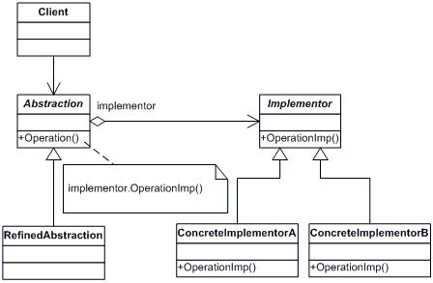
Bridge Design Pattern – Class Diagram

Slide 10
Bridge - Example
// "Abstraction" class Abstraction { protected Implementor implementor; // Property
public Implementor Implementor { set{ implementor = value; } } public virtual void Operation() { implementor.Operation(); } }
// "Implementor" abstract class Implementor { public abstract void Operation(); }
// "RefinedAbstraction" class RefinedAbstraction : Abstraction { public override void Operation() { implementor.Operation(); } }

Slide 11
Bridge - Example
// "ConcreteImplementorA" class ConcreteImplementorA : Implementor { public override void Operation() { Console.WriteLine("ConcreteImplementorA Operation"); } } // "ConcreteImplementorB" class ConcreteImplementorB : Implementor { public override void Operation() { Console.WriteLine("ConcreteImplementorB Operation"); } }

Slide 12
Bridge – Client Code
class MainApp { static void Main() { Abstraction ab = new RefinedAbstraction(); // Set implementation and call ab.implementor = new ConcreteImplementorA(); ab.Operation(); // Change implemention and call ab.implementor = new ConcreteImplementorB(); ab.Operation(); // Wait for user Console.Read(); } }
Output
ConcreteImplementorA Operation ConcreteImplementorB Operation

Slide 13
Composite Design Pattern
Problem
Application needs to manipulate a hierarchical collection of "primitive" and "composite" objects. Processing of a primitive object is handled one way, and processing of a composite object is handled differently. Having to query the "type" of each object before attempting to process it is not desirable.
Intent
The key concept is that you can manipulate a single instance of the object just as you would manipulate a group of them.
Compose objects into tree structures to represent whole-part hierarchies. Composite lets clients treat individual objects and compositions of objects uniformly.
Recursive composition

Slide 14
Composite Design Pattern – Class Diagram

Slide 15
Composite Design Pattern – Comments
Επακόλουθα
Ομοιομορφία: Όλα τα αντικείμενα σε κάποια σύνθετη κατασκευη τα διαχειριζόμαστε με τον ίδιο τρόπο
Επεκτασιμότητα: Μπορούμε να κατασκευάσουμε νέες συνθέσεις από υπάρχοντα αντικείμενα
– Λειτουργικό κόστος: Για τη κατασκευή ενός σύνθετου αντικειμένου μπορεί να χρειαστούμε πολλά άλλα αντικείμενα
Σχόλια Υλοποίησης
Τα συνιστώντα μέρη γνωρίζουν το αντικείμενο που περιγράφει τη σύνθεση (Do Components know their parents)?
Κοινή διαπροσωπία για τα απλά και τα σύνθετα αντικείμενα?
Τα σύνθετα αντικείμενα περιέχουν μια αναφορά (reference) για κάθε ένα από τα συνιστώντα αντικείμενα (δεν χρειάζεται να δεσμεύσουμε μνήμη στο σύνθετο αντικείμενο για τα μέρη του)
Που και ποιο αντικείμενο έχει την ευθύνη για τη διαγραφή των συνιστώντων αντικειμένων

Slide 16
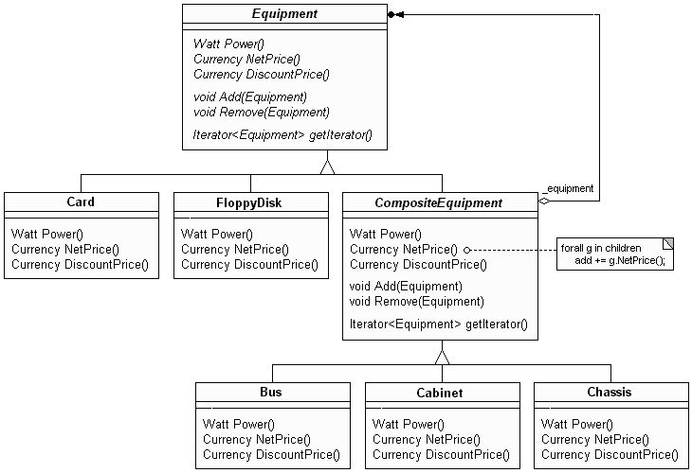
Composite - Example

Slide 17
Composite – Client Code
Currency CompositeEquipment::NetPrice() { Iterator<Equipment*>* i = getIterator(); Currency total = 0;
for (i->First(); !i->IsDone(); i->Next()) total += i->CurrentItem()->NetPrice();
delete i; return total; }
// and in the client code … (e.g. in main)
Cabinet* cabinet = new Cabinet("PC Cabinet");
Chassis* chassis = new Chassis("PC Chassis");
cabinet->Add( chassis );
Bus* bus = new Bus ("MCA Bus");
bus ->Add( new Card("16Mbs Token Ring") );
chassis->Add( bus );
chassis->Add( new FloppyDisk("3.5 floppy") );
cout << cabinet->NetPrice() << endl;

Slide 18
Façade Design Pattern
Façade

Slide 19
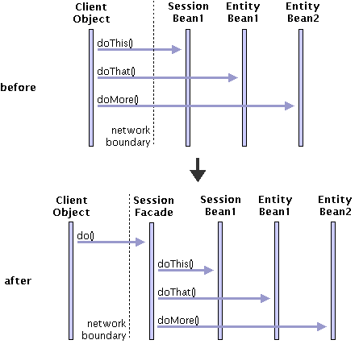
Façade

Slide 20
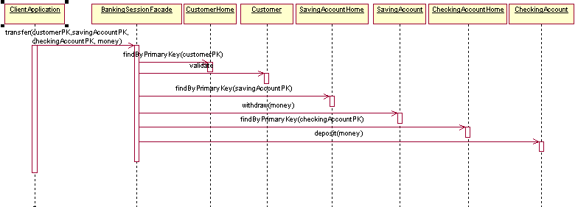
Façade - Example

Slide 21
Proxy Design Pattern
This Design Pattern allows the creation of a "substitute" object that holds a reference for an object, and this "substitute" controls the access to the object for which it acts as a "substitute"
This pattern is useful when a function takes a lot of time to execute, the "substitute" object can send messages about the progress of the function back to the client code
The "substitute" object can also provide complementary functions on behalf of the object for which it acts as a "substitute". For example, the "substitute" object can provide additional functions related to security, access control, RPC,

Slide 22
Structural Elements of the Proxy Design Pattern
The Class Proxy
It keeps a reference to the "real" object and controls access to this "real" object.
It provides an interface that is similar to that of the object acting as a substitute
Controls access to the object and may be responsible for creating and destroying it
It provides complementary functions depending on what type of "substitute" is.
We can define three basic types of substitute objects:
remote proxies are responsible for receiving a call and then encoding it and sending it to the "real" object that is located in another computer system or address space
virtual proxies maintain information about the status of the actual object so that they are able to postpone as much as possible access to the actual object
protection proxies check whether the caller has the appropriate credentials to invoke the actual object and the features it offers
The Class Subject
Specifies a common interface for Proxy and RealSubject class so that the Proxy class can be used where the RealSubject class can be used
The Class RealSubject
It defines the "real" object that will eventually be accessed and will provide the corresponding services

Slide 23
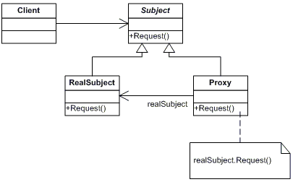
Proxy Design Pattern – Class Diagram

Slide 24
Proxy Design Pattern- Example
// "Subject" abstract class Subject { public abstract void Request(); }
// "RealSubject" class RealSubject : Subject { public override void Request() { Console.WriteLine("Called
RealSubject.Request()"); } }
// "Proxy" class Proxy : Subject { RealSubject realSubject; public override void Request() { // Use 'lazy initialization' if (realSubject == null) { realSubject = new RealSubject(); } realSubject.Request(); } }

Slide 25
Proxy Design Pattern – Client Code
class MainApp { static void Main() { // Create proxy and request a service
Proxy proxy = new Proxy(); proxy.Request(); // Wait for user Console.Read(); } }
Αποτέλεσμα:
Called RealSubject.Request()

Slide 26
Decorator Design Pattern
Intent
Add new features to the methods of a single object
Application
When it is not practical to extend the functions of an object using inheritance (sub-classes)
When we want to dynamically expand the functionality delivered by a single object and be able to remove them if needed

Slide 27
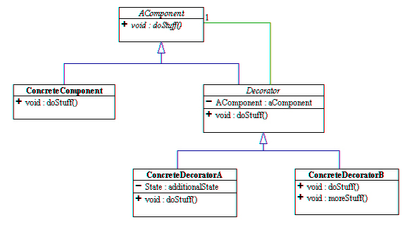
Decorator – Class Diagram

Slide 28
Decorator – General Comments
Decorator design pattern is also known as Wrapper. The structure of this pattern is based on the use of an object (Decorator) that has the same interfaces with the object for which we want to expand its functions. When we call a Decorator method, this call is forwarded to the object that Decorator “wraps". In the process of this call, the Decorator method can add new functionality which is applied either before or after calling the archetypal method of the “wrapped" object.
The usefulness of this Design Pattern is that we can augment the functions of specific objects instead of all the objects that can be derived from a class.
By using this design pattern we can augment the functions of a single object, leaving all other objects of the same class unchanged.
By just using sub-classes, without applying this design pattern, would lead to the problem that we could not upgrade only specific objects in the class

Slide 29
Decorator - Comments
This Design Pattern provides enough design flexibility because we can change the behavior of a Decorator during the program execution and we do not need to re-compile the program
As the Decorator class has the same interface with the object it wraps, an object of this type of Decorator presents to any client code the same view that would present the object that is “wrapped" by the Decorator.
It is interesting to note that we can “wrap" a Decorator with other Decorators and any other object in the program would not see any difference in the interface. This gives us a great deal of functionality adaptability even on specific objects.

Slide 30
Decorator – Comments
Consequences
Functions to a single object can be added / removed during system operation
Avoid using multiple sub-classes
Recursive use and encapsulation allows the functionality to be adjusted as we want
Restrictions on the definition of interfaces
Identity crisis (what finally this object does?)
Implementation
We need to support the same interface
Use abstract base class for the original Decorator class
When we have large base classes (with many methods), the use of the Strategy Pattern may be more appropriate

Slide 31
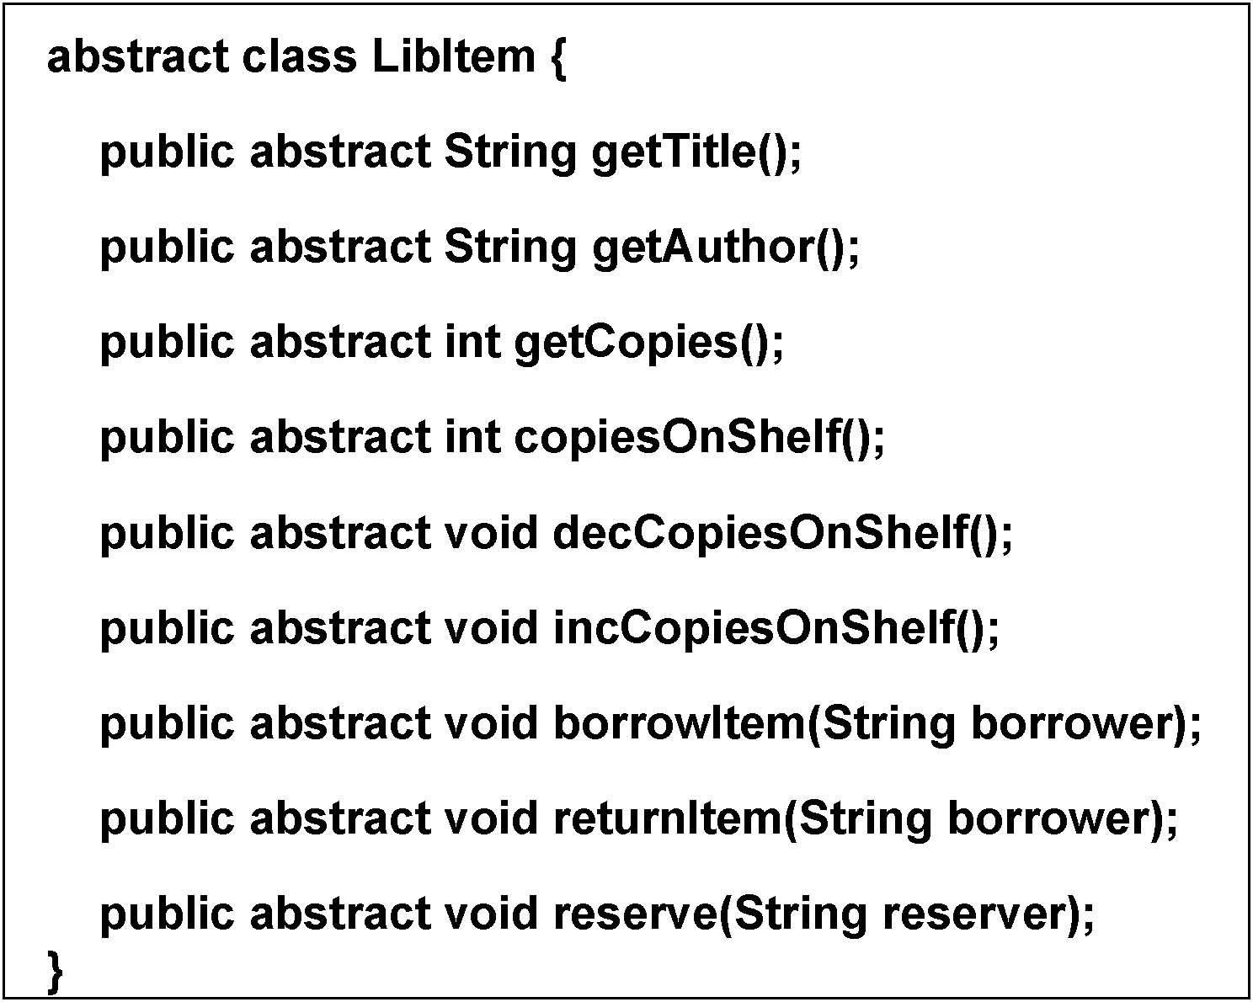
Decorator - Example

Slide 32
Decorator – Example
class Book extends LibItem{
String author;
int noCopies;
int onShelf;
String title;
public Book(String t, String a, int c){
title = t;
noCopies= c;
author = a;
onShelf= c;
}
public String getTitle() {
return title;
}
public int getCopies() {
return noCopies;
}
public int copiesOnShelf() {
return onShelf;
}
public void decCopiesOnShelf() {
onShelf--;
}
public void incCopiesOnShelf() {
onShelf++;
}
public String getAuthor() {
return author;
}
public void borrowItem(String borrower) {
System.out.println("borrow–in Book");
}
public void returnItem(String borrower) { }
public void reserve(String reserver) { }
} /* End class Book */

Slide 33
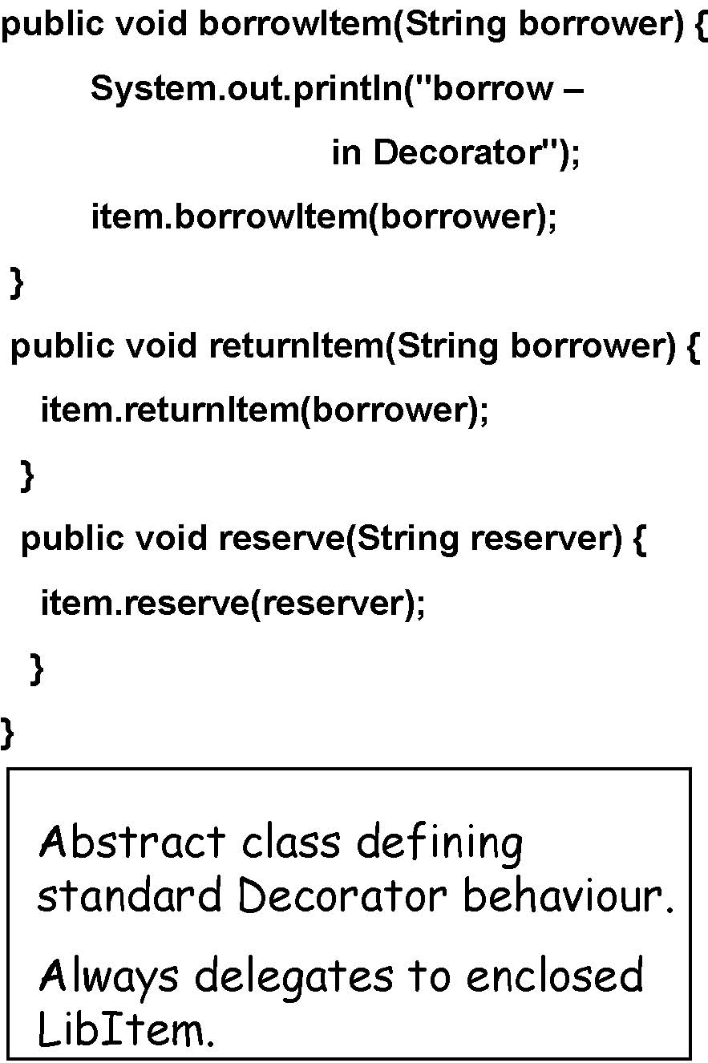
Decorator - Example
abstract class Decorator extends LibItem{
LibItem item;
public Decorator(LibItem li) {
item = li;
}
public String getTitle() {
return item.getTitle();
}
// Following methods are
// similarly implemented
public String getAuthor() {...
public int getCopies() { ...
public int copiesOnShelf() { ...
public void decCopiesOnShelf() {
item.decCopiesOnShelf();
}
// and similarly...
public void incCopiesOnShelf() {...

Slide 34
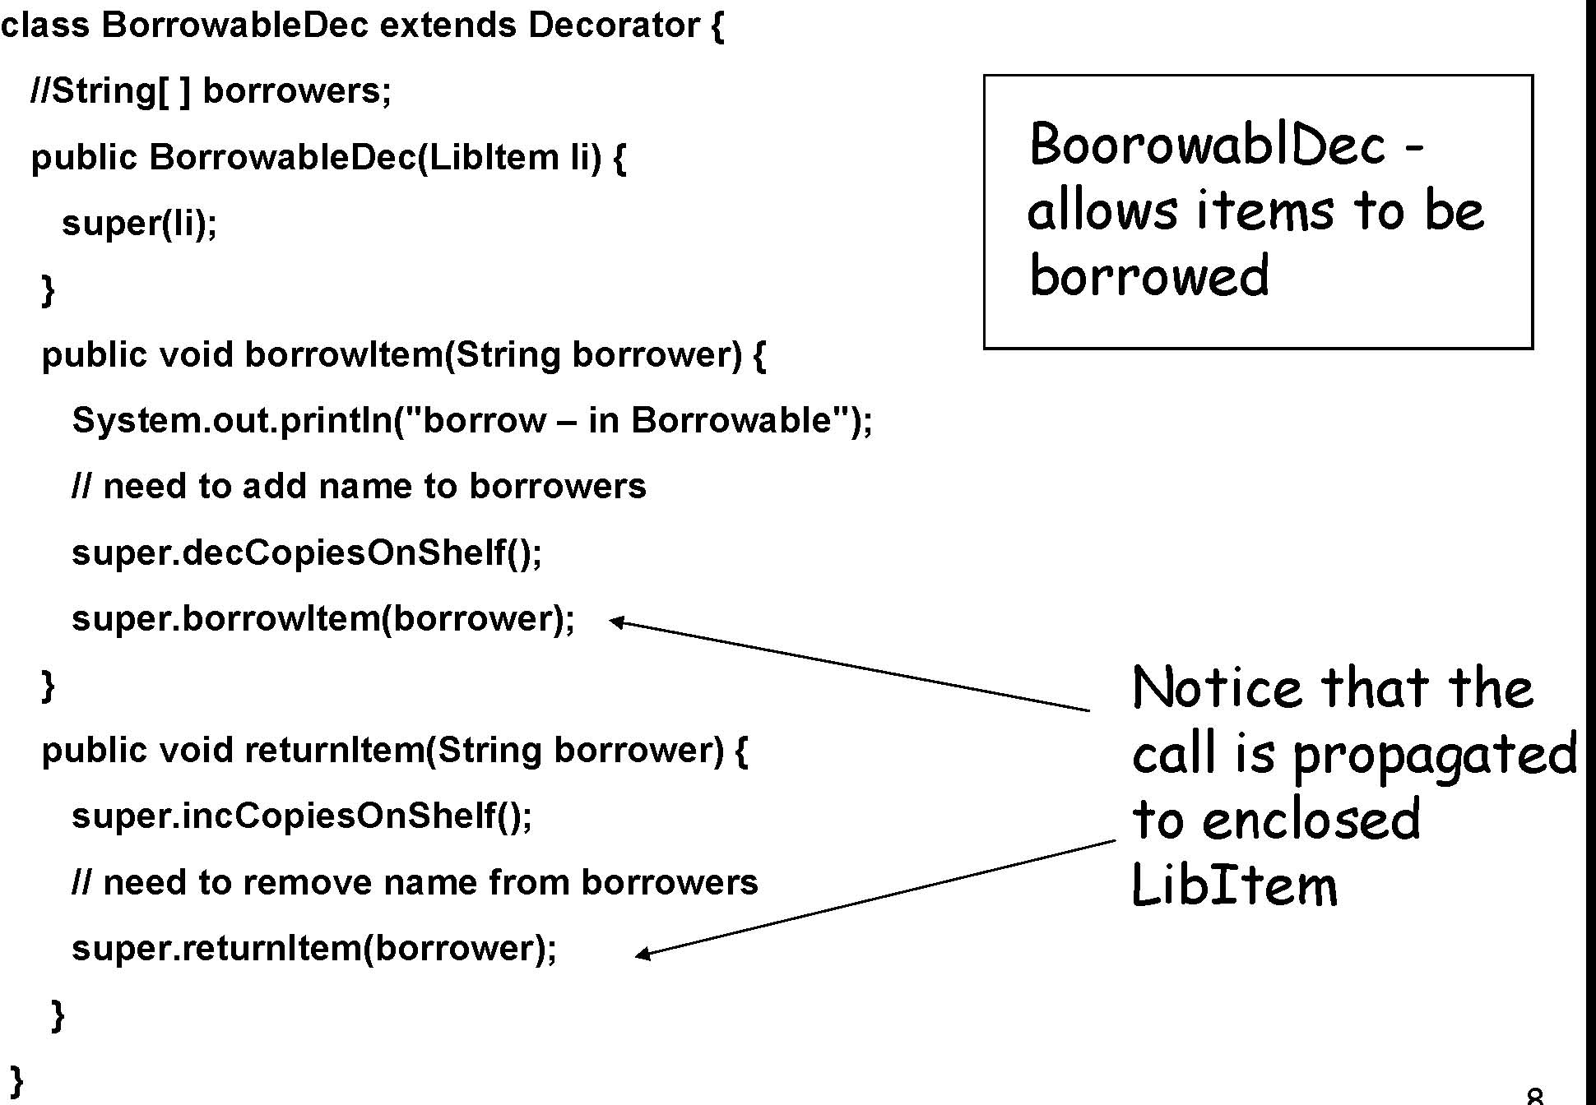
Decorator – Example

Slide 35
Decorator – Client Code
// Non borrowable, non reservablebook
LibItem b1 = new Book("A", "B", 1);
// Borrowablevideo
LibItem v1 = new BorrowableDec(new Video("V", 3));
// borrow unborrowableitem -copies should stay 1
b1.borrowItem("Bob");
System.out.println("Copiesof book = " +b1.copiesOnShelf());
// borrow video -copies decremented to 2
v1.borrowItem("Fred");
System.out.println("Copiesof video = " +v1.copiesOnShelf());
//make book borrowable and borrow it -copies = 0
LibItem b2 = new BorrowableDec(b1);
b2.borrowItem("Bob");
System.out.println("Copiesof book = " +b2.copiesOnShelf());
// make book reservable
LibItem b3 = new ReservableDec(b2);
b3.reserve("Alice");
b3.returnItem("Bob");
// book returned -back to 1 copy
System.out.println("Copiesof book = " +b3.copiesOnShelf());
// Not reserved for Jane -still 1 copy
b3.borrowItem("Jane");
System.out.println("Copiesof book = " +b3.copiesOnShelf());
// Okay Alice can borrow -down to 0
b3.borrowItem("Alice");
System.out.println("Copiesof book = " +b3.copiesOnShelf());

Slide 36
Links to Supporting Material
https://sourcemaking.com/design_patterns/
https://www.youtube.com/playlist?list=PLF206E906175C7E07
http://www.netobjectives.com/resources/books/design-patterns-explained/review-questions

