Slide 1
CS 2212B
Introduction to Software Engineering
Kostas Kontogiannis
Lecture 17: Software Reliability

Slide 2
Software Reliability
What Is Software Reliability?
Defn.: Probability(failure-free op, specified time, given environment) ➔ P(t)
Affected by development process—not ageing/ manufacturing
Uses
Criterion for technology evaluation: expensive
Project management: ready to release? More test?
Size of change: change decreases reliability

Slide 3
Basic Concepts
Failure and fault
Failure: departure of external results of program operation
Fault: cause of failure (localized or not)
Time
Execution time (τ)
Calendar time (t): meaningful to managers
Characterizing failure occurrence in time
Time of failure: instant
Time interval between failures
Cumulative failures up to a given time
Failures in a time interval

Slide 4
Terminology
It is in the code... (bug)
Fault
May cause
The system goes into an
internal state different than
specified
Error
May cause
It is observed
Failure

Slide 5
Reliability and Availability
A simple measure of reliability is:
MTBF = MTTF + MTTR , where
MTBF Total average time between two consecutive failures
MTTF Average time between two consecutive failures
MTTR Average time to repair a fault
MTBF is a better reliability estimator than “faults/KLOC”

Slide 6
Reliability and Availability
Availability is defined as the probability that the system will behave according to its specifications when it is requested to operate at a certain point in time.
In general, the metric of availability is also a better estimator of the maintenability of a system than the MTTR metric

Slide 7
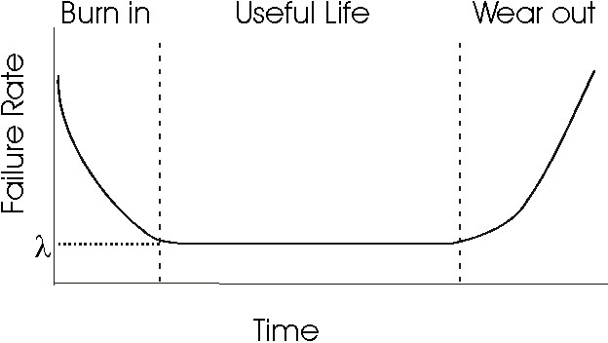
Failure Intensity in “Physical” systems and structures
http://www.ece.cmu.edu/~koopman/des_s99/sw_reliability/

Slide 8
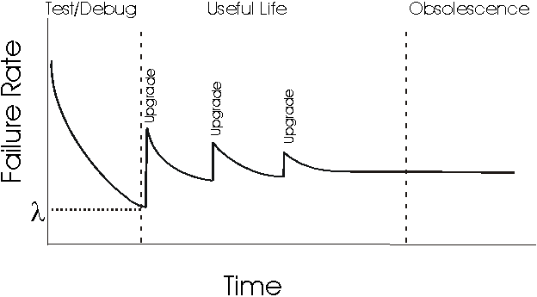
Failure Intensity in Software Systems
http://www.ece.cmu.edu/~koopman/des_s99/sw_reliability/

Slide 9
Methodologies for Calculating Software Reliability
The most well-known models / methodologies for calculating reliability of software systems fall into two main groups:
Error Seeding Models
Growth reliability models
error seeding - It is a method of calculating the number of defects found in the code. In this methodology defects fall into two categories - those in the code and those we deliberately put (and of course we know how many are). The number of defects found in the code is calculated by the (assumed stable) ratio of the number of the two types of defects as they are discovered during the system test.

Slide 10
Reliability Growth Models
Reliability Growth Models
These models calculate the improvement of a system's reliability, as defects are discovered and corrected as a result of the testing process, using a growth function.
The free variable (input variables) is time and the bound variables (result) are reliability, the system failure rate, or the cumulative number of defects that have been detected up to a point in time

Slide 11
Reliability Measurements in Reliability Growth Models
A typical measurement to calculate the reliability of a system (number of failures in the time unit) is the rate of failure defined by:
where τ = CPU time (in a multitasking machine), or real time in an embedded system).

Slide 12
Reliability Models (of Musa)
Assumptions
Two models
Basic
Logarithmic
Diff: Change in failure intensity per failure seen
Basic: decrement is constant
Logarithmic: decrement reduces

Slide 13
Basic Assumptions
Faults are independent.
Execution time between failures is large with respect to instruction execution time.
Potential ‘test space’ covers its ‘use space’.
Inputs per test run (test or operational) are randomly selected.
All failures are observed.
The error causing the failure is immediately fixed or else its re-occurrence is not counted again.

Slide 14
Musa’s Basic Model
Failure Intensity - (FI) is defined as the number of failures in the unit of time.
The Musa’s Basic Model considers that the rate of reduction of the Fault Intensity (derivative in relation to the total number of faults μ), is constant.
This means that Fault Intensity is a linear function of the average total number of failures we have observed up to a certain time (CPU time or calendar time).
Reference: Musa, Iannino, Okumoto, “Software Reliability: Measurement, Prediction, Application”, McGraw-Hill, 1987.

Slide 15
Musa’s Basic Model
In the Basic model failure intensity is defined as:
Where λ₀ is the Failure intensity at the initial at the start of the system (before any defect correction is made)
μ is the (average) total number of failures up to a certain time
v₀ is the total number of failures we expect to have in the unlimited run time of the program. Also:

Slide 16
Example
Let's assume that a program will have 100 failures throughout its lifetime (v₀), and that so far we have noticed 50 failures (μ), and that the initial failure rate is 10 failures per CPU hour (λ₀).
Then the estimated present failure intensity is:
The (average) total number of failures after 10 cpu hours will be:
And for 100 CPU hours of operation

Slide 17
Musa’s Logarithmic Model
The rate by which the failure intensity drops is getting lower, as defects in the code are discovered and corrected
In this model
λ(μ) = λ₀ e^{(-θμ)}
where θ is a Faιlure Intensity reduction parameters
Accordingly, the (average) total number of failures at a time t is:

Slide 18
Example: Let us assume λ₀ = 10 failures/cpu hour, θ = 0.02/failure, and that up until now we have observed 50 failures.
Then:
In 10 cpu hours:
(less total number of
failures than the basic model)
and in 100 cpu hours:
(more total number of
failures than the basic model)

Slide 19
Reliability Models
Basic model
Logarithmic model
λ(μ) = λ₀[1 - μ/v₀]
λ(μ) = λ₀exp(−θμ)
θ: failure intensity decay
Initial failure intensity, λ₀
λ: failure intensity
Basic
Log.
v₀
λ: pronounced lamda
θ: pronounced theta
μ: Mean failures exp.

Slide 20
Reliability Models
Basic model
Logarithmic model
μ(τ) = v₀[1 – exp(−λ₀τ/v₀)]
μ(τ) = (1/θ).ln(λ₀θτ + 1)
λ(τ) = λ₀exp(−λ₀τ/v₀)
λ(τ) = λ₀/(λ₀θτ + 1)
λ
μ
Log.
Log.
v₀
Basic
Basic
τ
τ

Slide 21
Example Use of Reliability Models
Example: Assume that a program will experience 100 failures in infinite time.
The initial failure intensity was 10 failures/CPU-hr, the
present failure intensity is 3.68 failures/CPU-hour and our
objective intensity is 0.000454 failure/CPU-hr.
Predict the additional testing time to achieve the stated objective.
Ans.: We know that λ(τ) = λ₀exp(−λ₀τ/v₀)
At time τ₁, λ(τ₁) = λ₀exp(−λ₀τ₁/v₀) = λ_{p}
At time τ₂, λ(τ₂) = λ₀exp(−λ₀τ₂/v₀) = λ_{f}
τ₂ - τ₁ = (v₀/ λ₀).ln(λ_{p}/ λ_{f})
v₀ = 100 faults, λ₀ = 10 failures/CPU-hr
λ_{p} = 3.68 failures/CPU-hr, λ_{f} = 0.000454 failure/CPU-hr
Τesting time = (τ₂ - τ₁ ) = 90 CPU-hr

Slide 22
System Operation in Calendar Time
The calendar time of system operation is computed by knowing the ratio:
and the time of system operation in CPU hours.
Calendar time is useful for generalizing the project plan to deliver the system to its users (e.g., Calculate the date on which we will have reached a certain Failure Intensity value).

Slide 23
In its more complex form, the computation of calendar time is based on the process used for correcting the defects as well as the following parameters:
The available computational resources and;
The rate a resource is used

Slide 24
For example, at the beginning of the testing process, we observe many failures at short intervals between them;
Then, testing stops so that we can first correct the errors in the code
As the testing process proceeds:
The time intervals between to consecutive failures are getting larger
In the mean time the personnel who are assigned to correct errors is not doing something
Here, the testing team creates a “bottleneck”
At the end the computational resources are the key factor that determines the throughput of the whole process.

Slide 25
Resource Usage
Musa showed that the use of resources is linearly proportional to the running time of the system, and the average total number of failures.
if we consider that the variable χ_{r} denotes the usage of a resource r, then
Where θ_{r} is the time the resource r is used per CPU hour; and μ_{r} is the time the resource r is used per failure

Slide 26
In summary we have:
Resources | Use per CPU hour | Use per failure | Available resources | Resource utilization
Personnel for locating errors
Personnel for fixing errors
Computational resources

Slide 27
Example:
A software testing process runs for 10 CPU hours and recognizes 34 failures. If the testing effort for every hour of system run time (operation) is 5 person hours, and each failure requires 2 person hours to locate the corresponding defect, then.
Then, the total time for of finding an error is: :
= 5(10) + 2(34)
= 118 person hr

Slide 28
Operational Phase of the System
When the system goes into its released phase, and there is no change in the code, the failure intensity remains constant.
Both models we have seen will follow a Poisson process with the Reliability Intensity parameter λ to calculate the reliability of the system.

Slide 29
Reliability and Failure Intensity
Reliability R and Failure Intensity λ are related by the equation:
R(τ) = exp( −λτ)
As expected, the probability that we will not observe a failure on a given time (reliability), is lower for larger system operation time intervals

Slide 30
Software Reliability (Parallel Systems)
Let us assume that we have Q_{P}-many subsystems / components each with a fixed failure intensity, and their reliability is calculated in a common calendar time. We also assume that for the system to work properly, all (parallel) subsystems should work properly. Then the Total Failure Intensity is:
Where λ_{k} is the failure intensity of each subsystem.

Slide 31
Αξιοπιστία Συστημάτων (Παράλληλα Συστήματα)
As we have seen R(τ) = exp( −λτ).
So in CPU time we have:
If the average usage of the computational resources
In the computer for the specific system is ρ_{c} then:
In calendar time

Slide 32
Overall, the reliability if the system in calendar time is:
And the failure intensity is

Slide 33
It is also possible in the above models to assume that the system running on the computer 1 having the execution rate r₁, is transferred to the computer 2 having a r₂ execution rate
Then, the failure intensity of the system running in computer 2 is:

