Slide 1

NEGAT
Online Ticket purchasing Website

Slide 2
What is Negat?
Negat is an Ethiopian based startup company founded by two Bahirdar university students. It currently has over 250,000 active users with 50+ daily event handles.
Developers:
Firaol Tolessa(CTO)
Gizachew Tsega(Chief Brand Manager)
Negat.net is free to use under Creative Commons Attribution license based in Ethiopia,Bahirdar. Negat is licened through: Negat©TM

Slide 3

Why Negat?
As the sunrises with new hope entangled with a sprit of joy, Negat has with in its root a sense of HOPE and belongingness. It is a means of creating a new and connected Ethiopia.

Slide 4
The problem that initiated us to develop this website:
We faced some problems around the stadium ,when we tried to enjoy the match between Fasil kenema football club and Ethiopian Coffee fc.

Slide 5
OBJECTIVES
General Objective
The primary objective of the website:
solving the problems that occure during ticket selling and purchasing for football matches and concerts.
Specific Objective
Developing the habit of online purchasing. And Reducing physical existence for searching tickets.

Slide 6

Wake up with Negat!!!
Negat makes life easy for football funs and art lovers!!!

Slide 7
There are a lot of tickets sold online
There are a lot of options available for purchase methods
Will get rid of the traffic for ticket purchasing
Will increase the security of ticketing

Slide 8


Big concept
Reduce the ticket waiting lines we observe at stadium ticket center.

Slide 9
Problems encountered along the way:
When we tried to use presenter’s photo for tickets ,it requires copy right and restricts us to use their photo.
Because of this we have understand how much deep is Google security.
.

Slide 10
Methdology
Identify objectives
Design general layout of website
Collect some important information needed to develop our website
Implementation through hard code

Slide 11
To explain our ideas graphically:
Tickets
Football Matches
Concert
Friendly
Comptetive
music
theatre

Slide 12
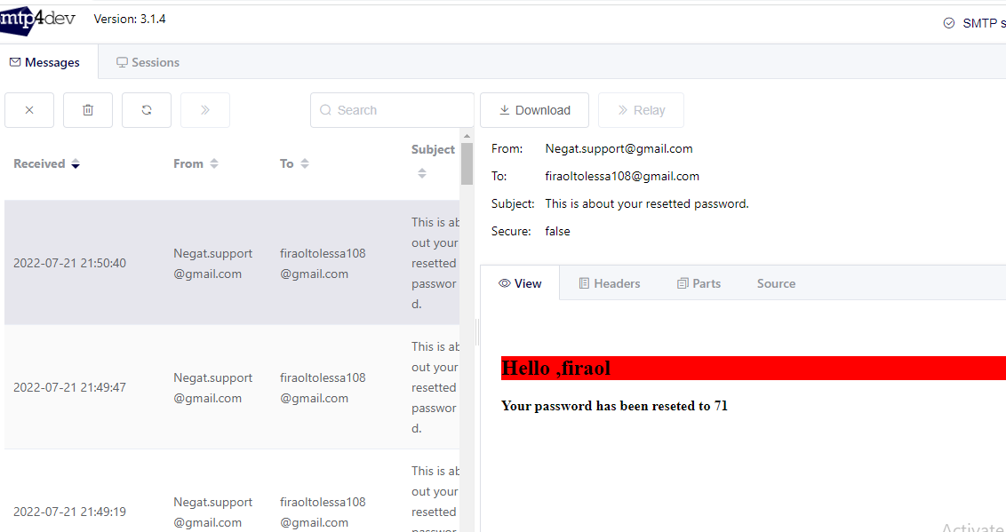
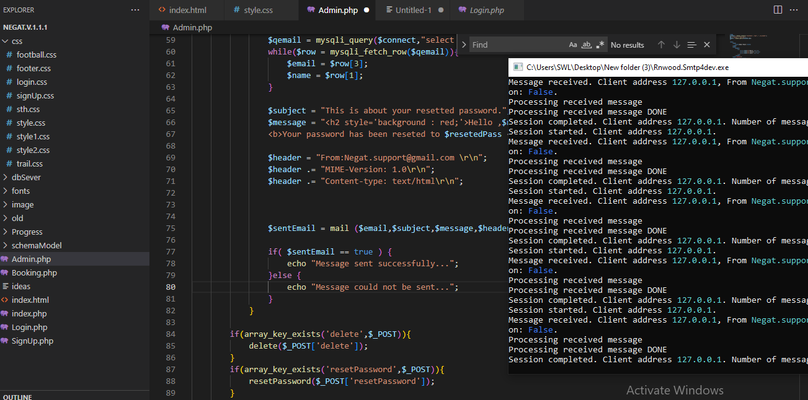
Special features
We have Added QR code generator for security issue and related phenomena We have Added SMPT server to reset user password and to send mail text to the user

Slide 13
What Our Platform Gives
Access Of Online Tickets
You can get ticket for concert and football matches ontime !!!
Access of some detail info about football clubs and Artists
In this website there are short and precise informations about Ethiopian football clus and artists that contribute in different aspects for us and for our country!!!
1
2

Slide 14
4000
3000
2000
1000
0
We plan to be the #1 ticket selling site in Ethiopia

Slide 15
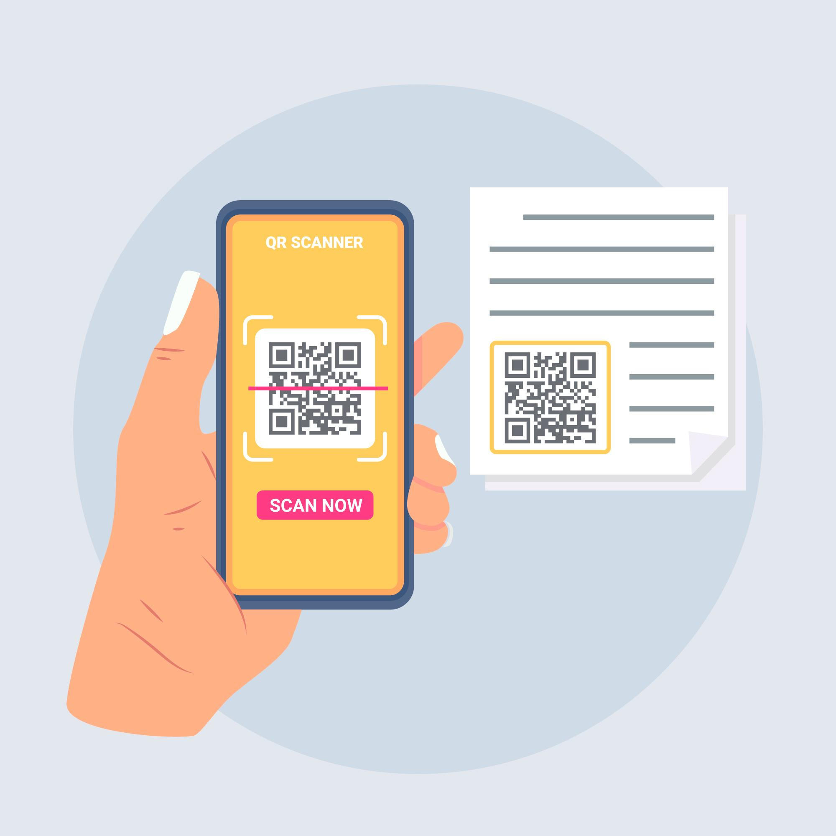

Future App project
We are planning to incoperate an android application that can scan the QR code generated on the ticket for security.

Slide 16
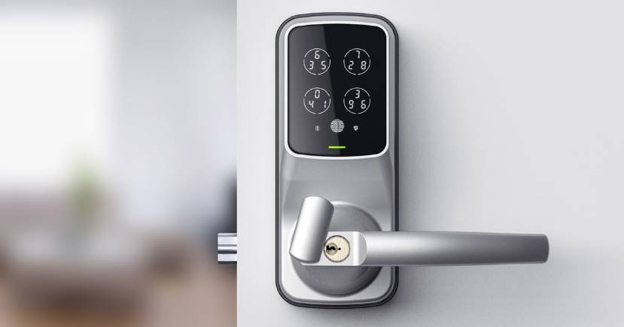
Future Digital Project
We are planning to mogernize the gates of stadiums and cinemas that can sense the coming person is legal or illegal.

Slide 17
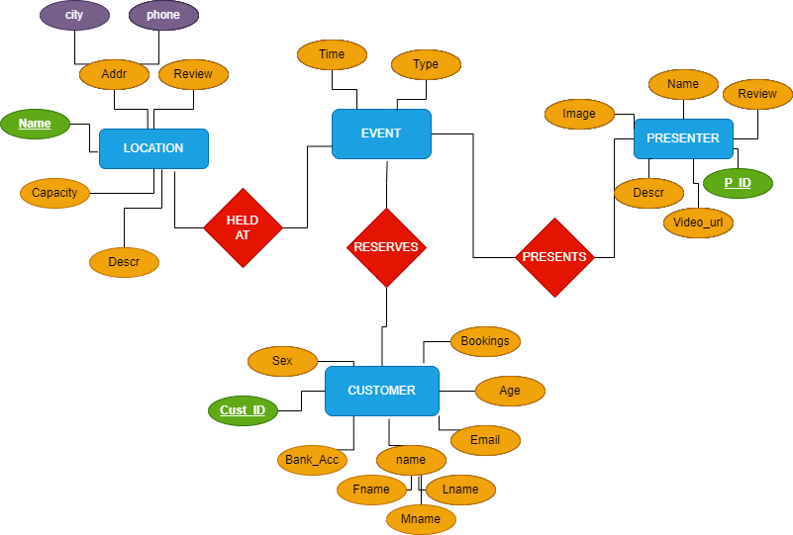

Slide 18
Funnel
CONCEPT
We made a plan for what the website should include
RESEARCH
Searched websites in Ethiopia that give such services.
IMPLEMENTATION
We used HTML,CSS,PHP,JAVASCRIPT
TESTED
Tested it out like a pro!
FEATURES
QR CODE SCANNER,
LOCAL SMTP MAIL SERVER
DEPLOY
Made ready for deployment

Slide 19

REACH THE HEIGHT WITH US! Thank YOU!

