Slide 1
Capstone Presentation
U.S. Accidents Dataset (2016–2023) , Traffic Accident Predicting
U.S. Accidents Dataset (2016–2023) • Capstone 2

Slide 2
Project Overview
Goal: Predict traffic accident severity using environmental, temporal, and roadway-related features.
Dataset: U.S. Accidents (2016–2023) crash records across the United States.
Approach: Data wrangling → feature engineering → EDA → model training & evaluation.
Models compared: Logistic Regression, KNN, Random Forest, Gradient Boosting.
Best model: Gradient Boosting (Accuracy 0.82; ROC-AUC 0.90).
U.S. Accidents Dataset (2016–2023) • Capstone 2

Slide 3
1) Problem Identification
Traffic accidents are a major public safety issue with significant injuries and fatalities.
Understanding contributing factors can inform policy, road safety, and emergency response.
Objective: Predict severity based on weather, time of day, and location/road factors.
Target variable: Severity (categorical levels 1–4).
U.S. Accidents Dataset (2016–2023) • Capstone 2

Slide 4
2) Data Description
Source: U.S. Department of Transportation–related portals and Kaggle U.S. Accidents dataset.
Typical fields: Date/time, city/state/coordinates, weather conditions, road & traffic indicators.
Task: Classification to predict Severity (1–4).
Key challenges: Large, high-dimensional data with missing values and class imbalance.
U.S. Accidents Dataset (2016–2023) • Capstone 2

Slide 5
3) Methods — Data Wrangling
Inspected dataset shape, feature data types, duplicates, and missing-value percentages.
Removed duplicates to avoid biased training.
Handled missing data:
• Numerical: median (skewed) or mean (normal) imputation.
• Categorical: 'Unknown' or mode imputation.
Dropped columns with excessive missingness and low relevance.
Converted types: date/time → datetime; booleans → 0/1; Severity treated as target label.
U.S. Accidents Dataset (2016–2023) • Capstone 2

Slide 6
3) Methods — Feature Engineering
Derived time-based predictors to capture traffic behavior patterns:
• Hour of day • Day of week • Month • Year
• Weekend indicator • Night vs Day indicator
Rationale: Rush hours, weekend travel, and nighttime visibility/fatigue affect severity.
U.S. Accidents Dataset (2016–2023) • Capstone 2

Slide 7
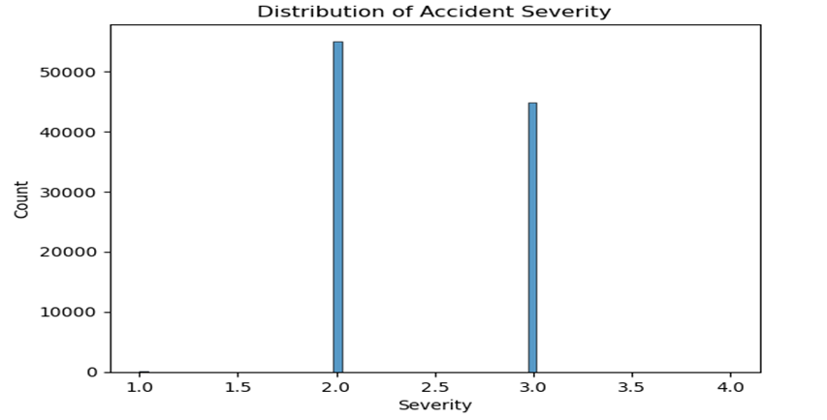
4) Exploratory Data Analysis (EDA) — Highlights
Severity distribution: Most crashes are lower severity; severe classes are rarer (class imbalance).
U.S. Accidents Dataset (2016–2023) • Capstone 2

Slide 8
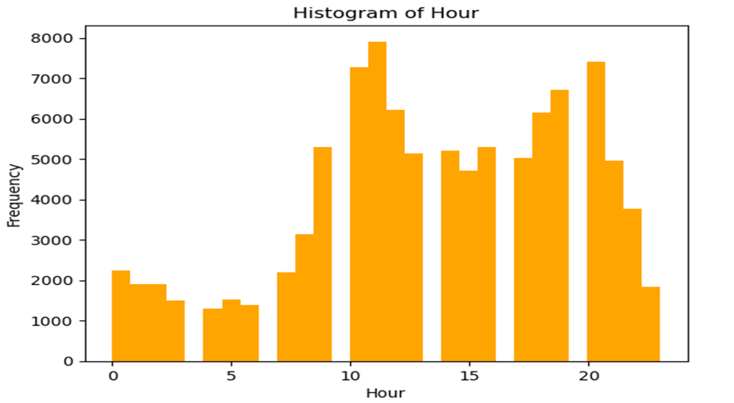
4) Exploratory Data Analysis (EDA) — Highlights
Accidents by hour: Peaks during morning/evening rush hours; fewer late at night.
U.S. Accidents Dataset (2016–2023) • Capstone 2

Slide 9
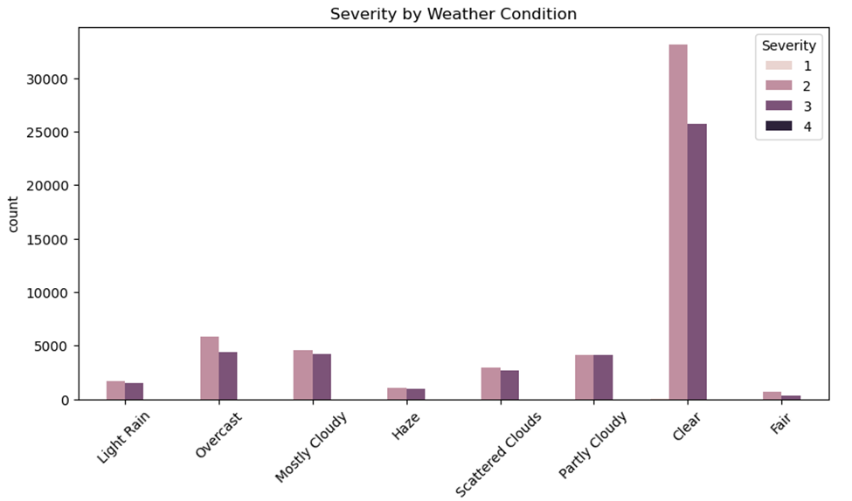
4) Exploratory Data Analysis (EDA) — Highlights
Weather vs severity: Rain/snow/fog associated with higher severity; clear weather has many crashes due to volume.
U.S. Accidents Dataset (2016–2023) • Capstone 2

Slide 10
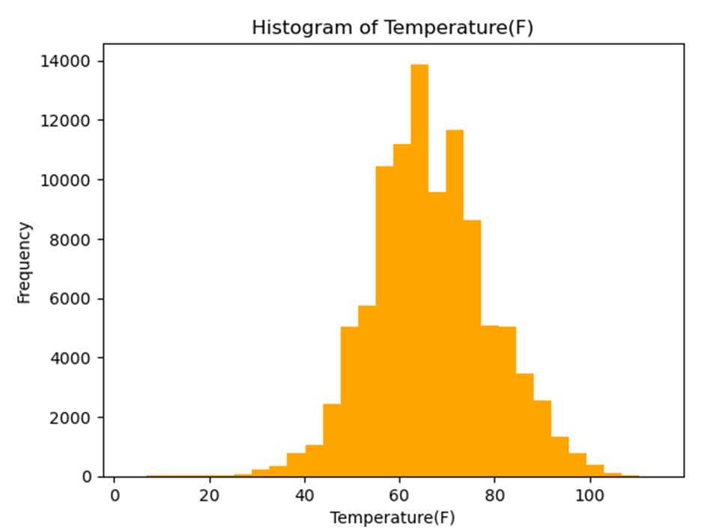
4) Exploratory Data Analysis (EDA) — Highlights
Visibility & temperature: Low visibility and extreme temperatures indicate increased risk.
U.S. Accidents Dataset (2016–2023) • Capstone 2

Slide 11
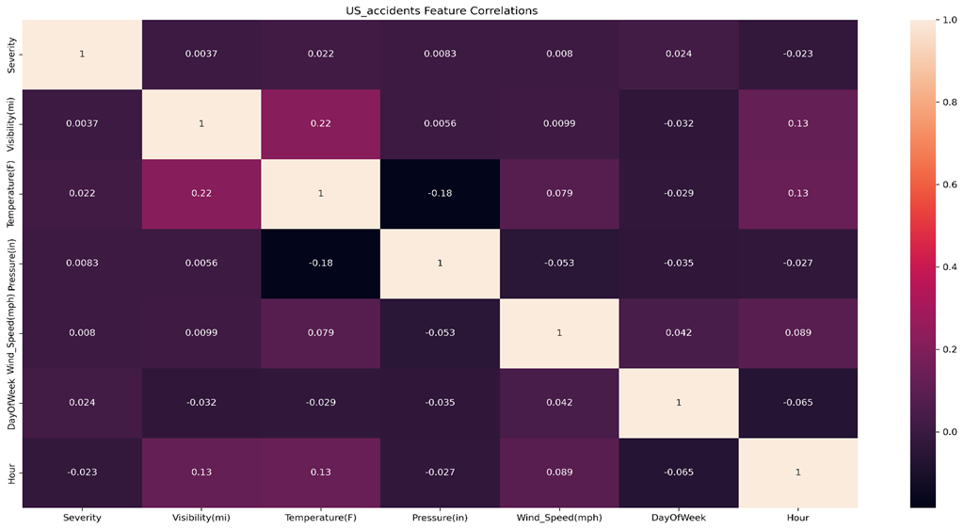
4) Exploratory Data Analysis (EDA) — Highlights
Correlations: Negative correlation between visibility and severity; weak–moderate for some weather variables.
U.S. Accidents Dataset (2016–2023) • Capstone 2

Slide 12
5) Preprocessing & Training Data Development
Split: 70% training, 15% validation, 15% test (stratified where applicable).
Feature types:
• Numerical: impute + standardize (mean 0, std 1).
• Categorical: one-hot encoding; handle unknowns; drop first category.
Used ColumnTransformer + Pipeline to ensure reproducibility and avoid data leakage.
Post-preprocessing training shape reported as (70000, 879), Validation set shape as(15000, 879)
U.S. Accidents Dataset (2016–2023) • Capstone 2

Slide 13
Baseline Model — Logistic Regression
Purpose: Fast, interpretable baseline before trying more complex models.
Accuracy: 0.765 (train), 0.761 (validation), 0.756 (test) — close values suggest good generalization.
Confusion matrix analysis: Strong on common classes; most errors between adjacent severity levels.
Limitations: Linear decision boundary; weaker recall/F1 for minority classes under imbalance.
U.S. Accidents Dataset (2016–2023) • Capstone 2

Slide 14
Model Development & Comparison
Model | Accuracy | Precision (W) | Recall (W) | F1 (W) | ROC-AUC
Logistic Regression | 0.62 | 0.78 | 0.62 | 0.68 | —
KNN | 0.74 | 0.74 | 0.74 | 0.74 | 0.82
Random Forest | 0.81 | 0.81 | 0.81 | 0.81 | —
Gradient Boosting | 0.82 | 0.82 | 0.82 | 0.82 | 0.90
Ensemble tree models (Random Forest, Gradient Boosting) performed best on nonlinear structure and imbalance.
Gradient Boosting delivered the highest accuracy and ROC-AUC.
U.S. Accidents Dataset (2016–2023) • Capstone 2

Slide 15
Final Model Selection — Gradient Boosting
Selected because it consistently provided the best overall predictive performance.
Top results: Accuracy 0.82 and ROC-AUC 0.90.
Why it worked well: Captures complex nonlinear relationships and feature interactions (weather × road × time).
Observed challenge: Severe class imbalance (Classes 1 and 4) reduced macro-average metrics.
Evaluation visuals referenced: Confusion matrix, ROC curves, Precision–Recall curves.
U.S. Accidents Dataset (2016–2023) • Capstone 2

Slide 16
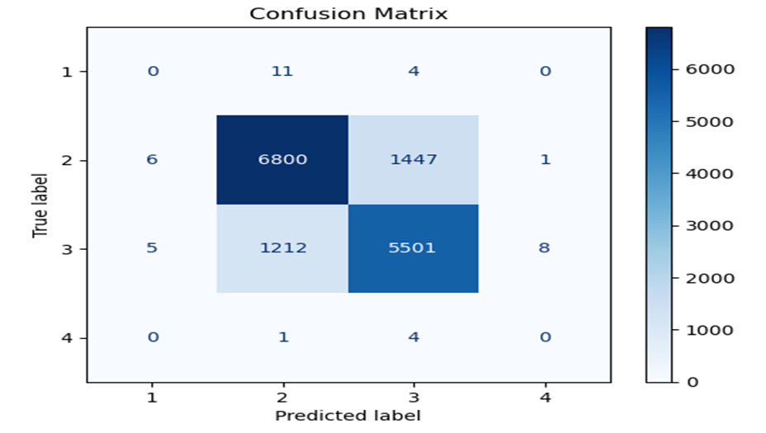
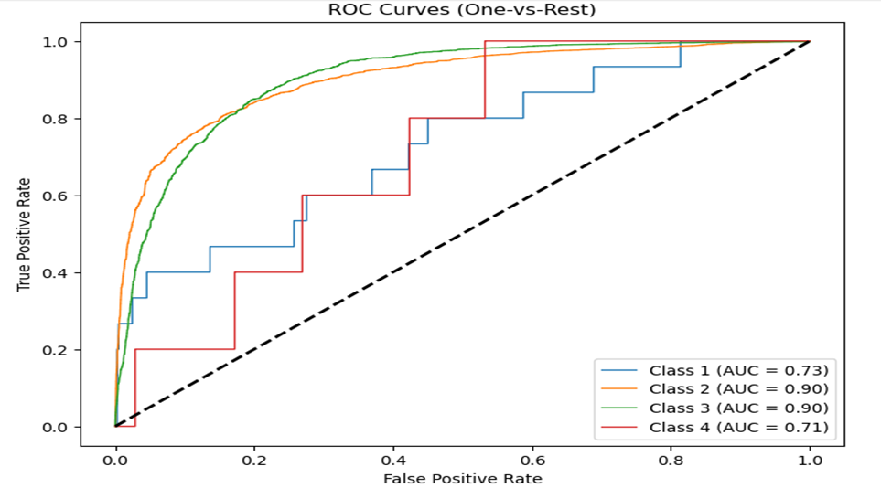
Final Model Selection — Gradient Boosting
Evaluation visuals referenced: Confusion matrix, ROC curves, Precision–Recall curves.
U.S. Accidents Dataset (2016–2023) • Capstone 2

Slide 17
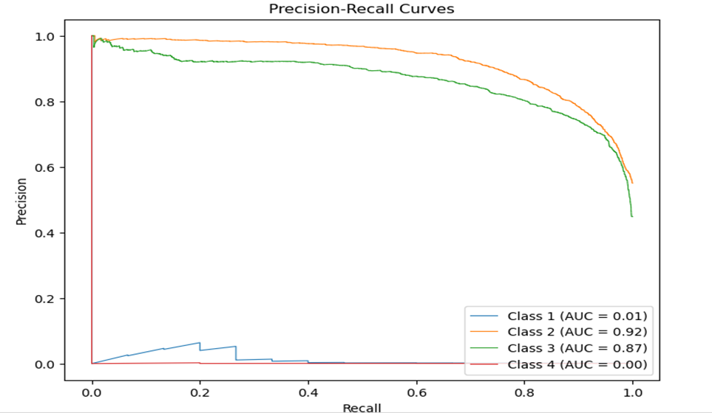
Final Model Selection — Gradient Boosting
Evaluation visuals referenced: Confusion matrix, ROC curves, Precision–Recall curves.
U.S. Accidents Dataset (2016–2023) • Capstone 2

Slide 18
Conclusion & Future Work
End-to-end workflow completed: cleaning → EDA → preprocessing → modeling → evaluation.
Impact: Supports identifying high-risk conditions, safety planning, and emergency response prioritization.
Recommended improvements:
• Address imbalance (SMOTE/resampling, class weighting).
• Try advanced models (XGBoost, deep neural networks).
• Add geographic clustering for spatial insights.
• Deploy as a real-time prediction tool.
References: Kaggle U.S. Accidents Dataset (2016–2023) • Capstone 2

