Slide 1
UNISPHERE
Empowering Universities and Students Through Data-Driven Insights
Team T4
Youcef Abdelhalim
Riad Kadri
Kiram Firas Mohammed El Amine
Ahmed Marouane djouama
Product vision
2025

Slide 2
Introduction
In an increasingly digital world, the education sector still suffers from fragmented and inconsistent data especially across Algerian universities. From missing faculty profiles to outdated department records and unstructured news, students, educators, and institutions face a lack of transparency and insights that limits growth, and innovation.
Product vision
2022

Slide 3
01
Problem Statement
The Challenge in Academia
Product vision
2022

Slide 4
Challenges
Fragmented Information: Universities (especially Algerian ones) have inconsistent, incomplete information (faculty names, departments, specialities, and event details).
Limited Insights: Lack of standardized data impedes comparative analysis with universities globally.
Unstructured Reviews: Campus news, user posts, and reviews are scattered and unclassified, leaving sentiment and trends unexplored.
Opportunities Missed: Students struggle to find curated resources and a standardized marketplace for Modules Summaries.
Product vision
2025

Slide 5
114
Number of universities in Algeria
Product vision
2025

Slide 6
02
Our Solution
Introducing UNISPHERE
Product vision
2022

Slide 7
Proposal
Unified Data Platform: Aggregates detailed university information (faculty, departments, specialties, events, and news).
AI Integration:
Use of ML/DL Methods to Analyse user feedback and reviews (Sentiment Analysis)
cluster and lable abstract topics of the reviews (Topic Modelling),
Comparative Analytics , generate knowledge maps of analysed scientific topics to compare knowledge and information gaps in Algerian universities to global peers.
Marketplace for Students: A dedicated section where students can sell their resumes using curated modules and templates.
Product vision
2025

Slide 8
Around 1.5 Million
Algerian university Students that can benefit from our soloution
Product vision
2025

Slide 9
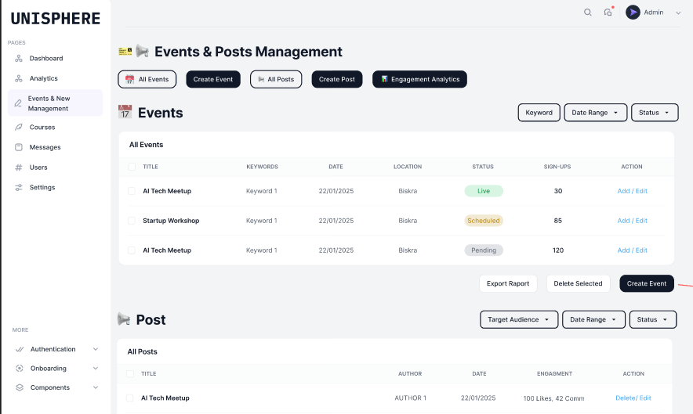
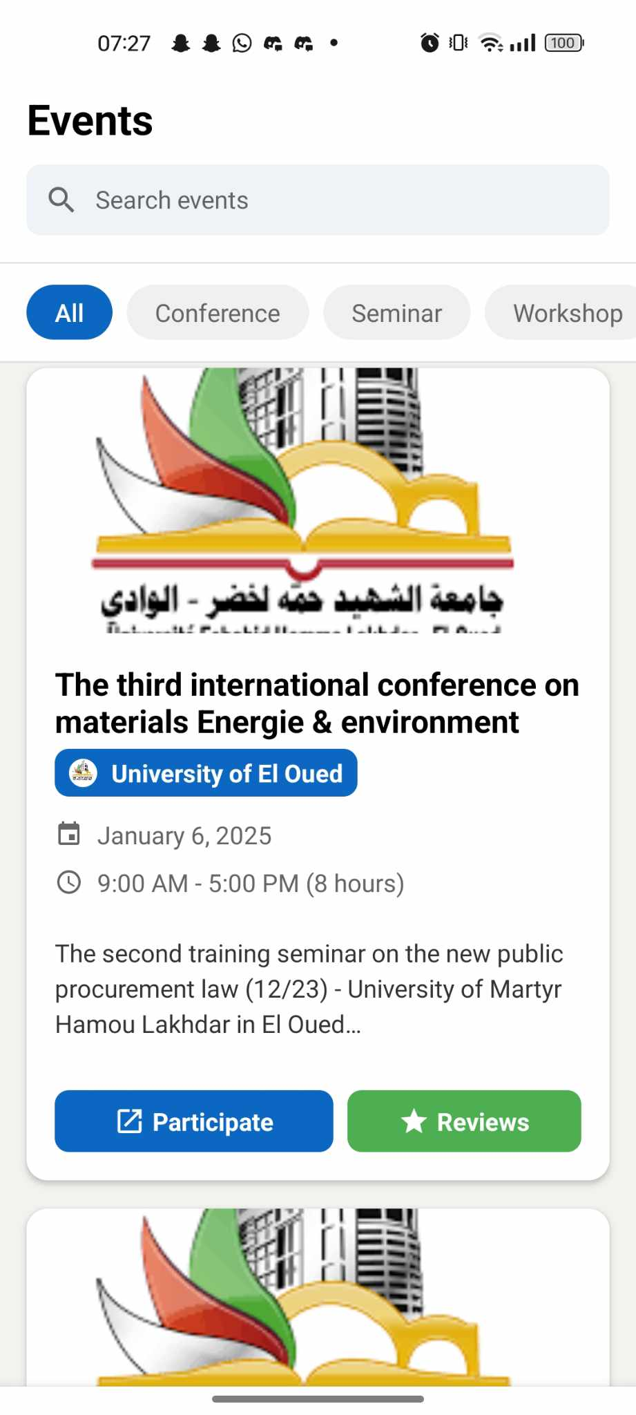
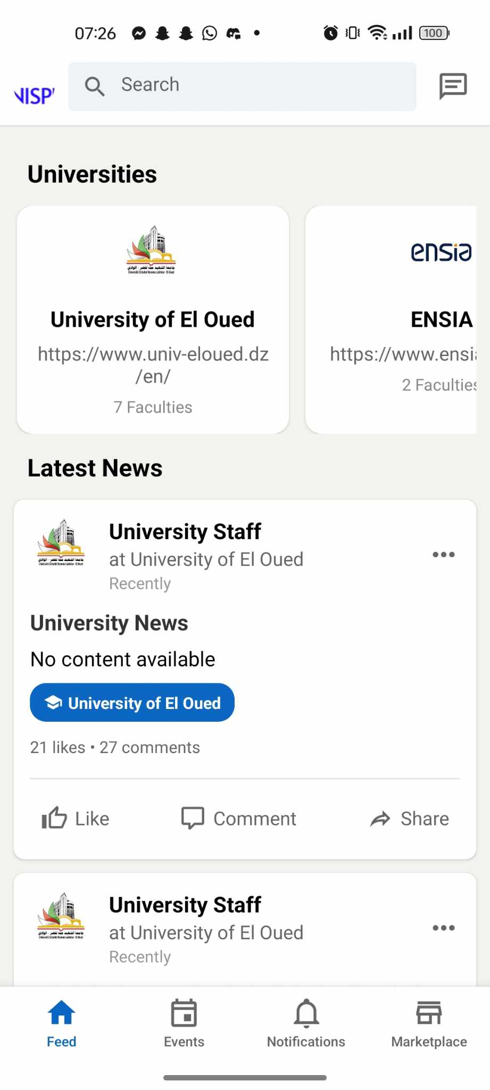
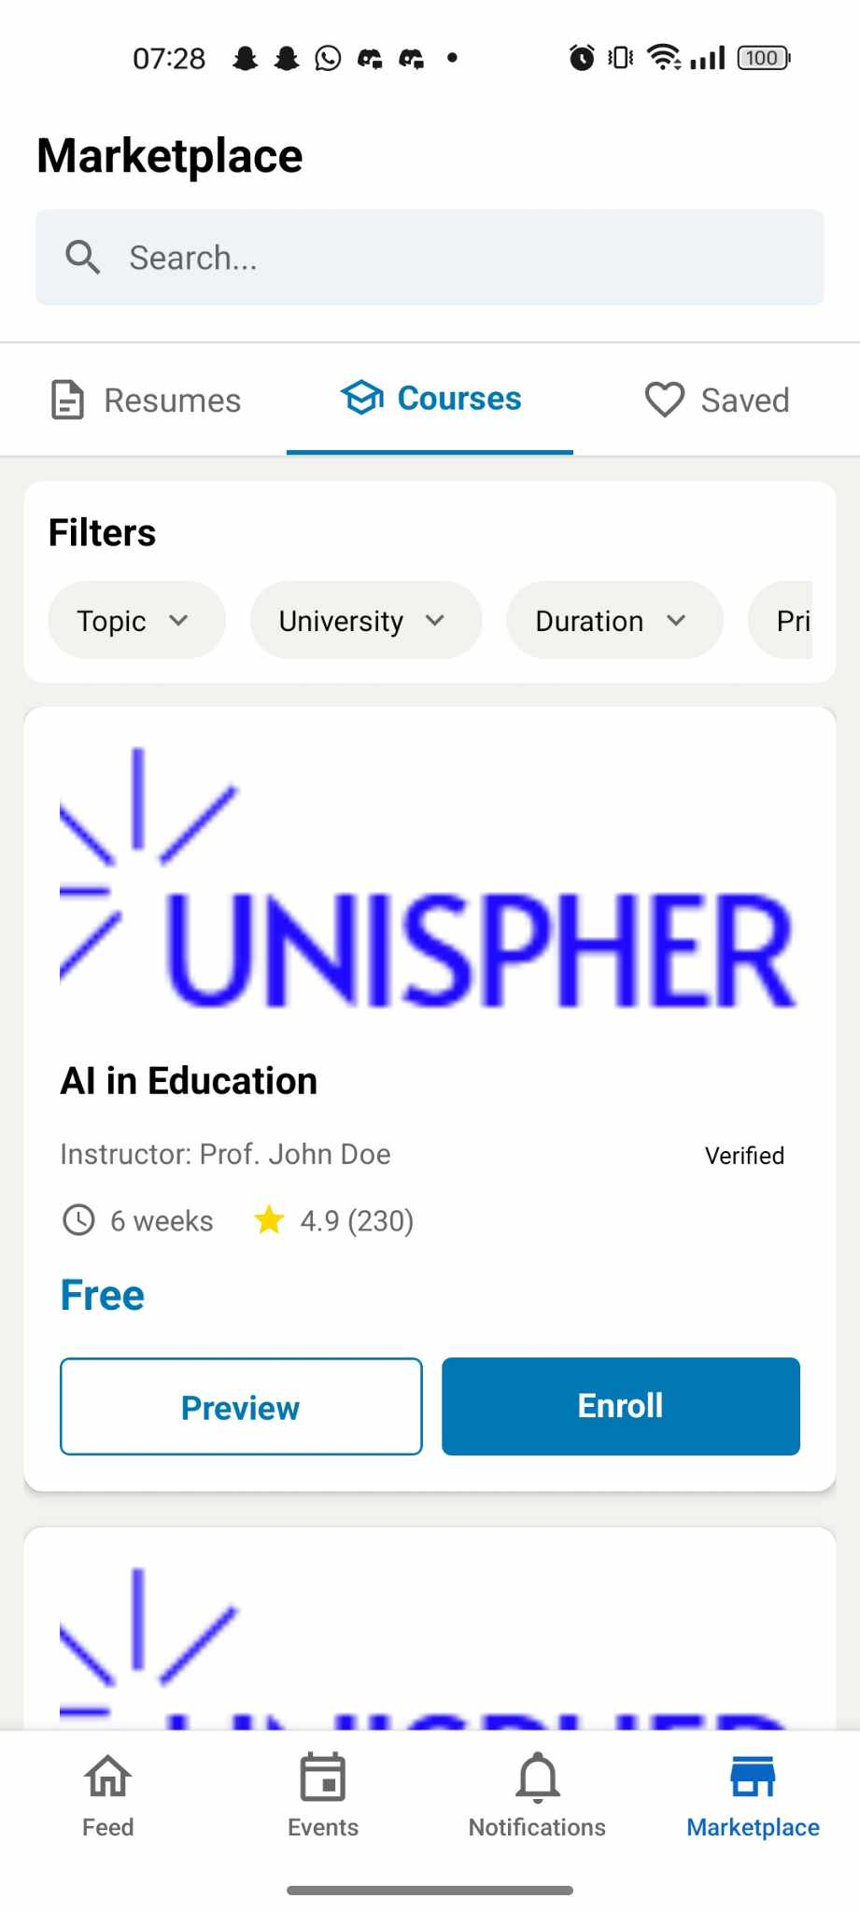
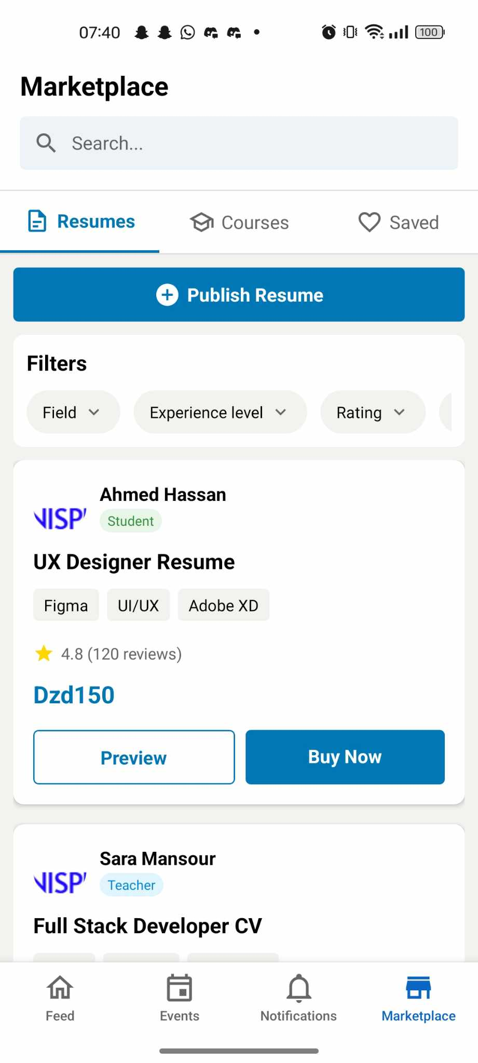
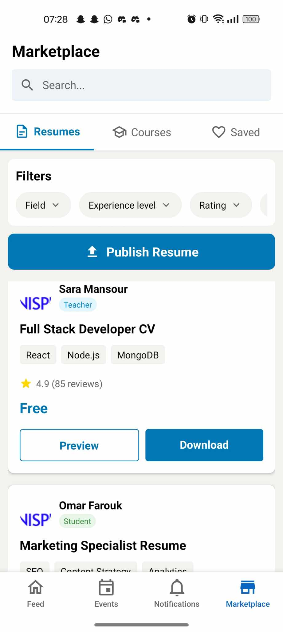
APP Presentation
Product vision
2025

Slide 10
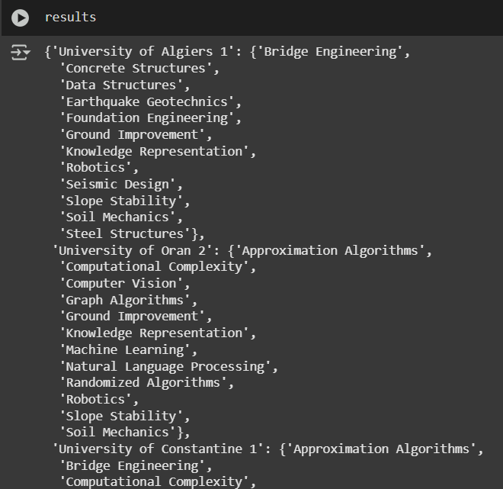
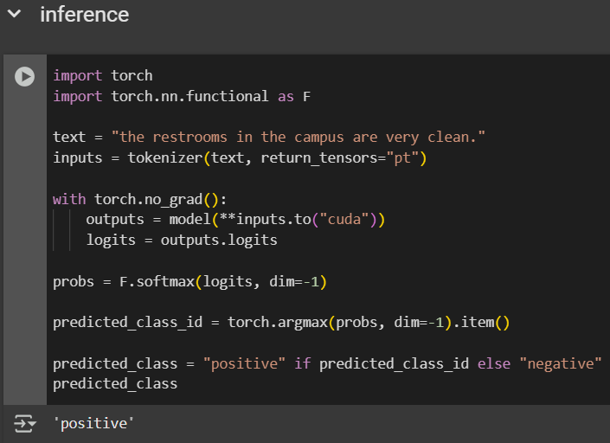
AI Models Results
Knowledge Map
Sentiment Analysis
Product vision
2025

Slide 11
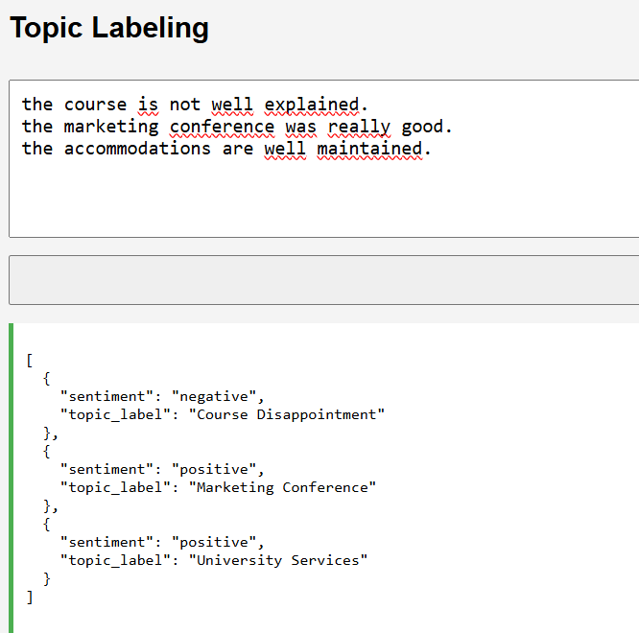
AI Models Results
Topic Modelling
Product vision
2025

Slide 12
03
Financial Assesment
How are we goint to generate income ?
Product vision
2025

Slide 13
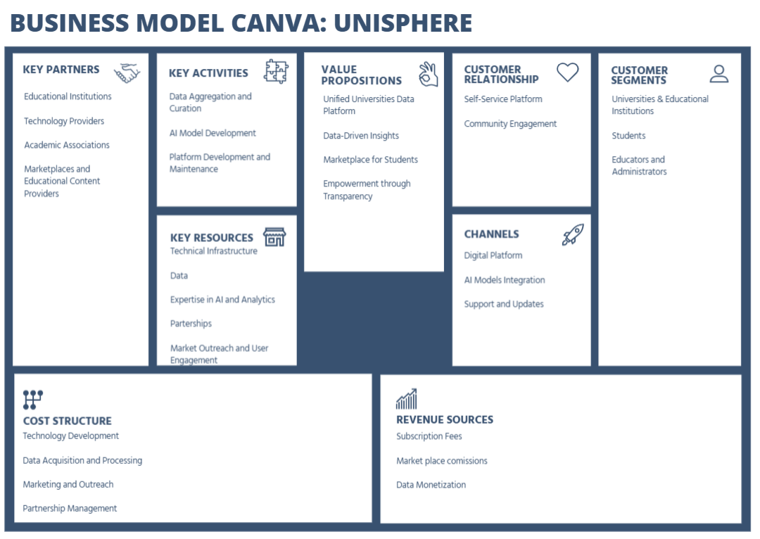
Product vision
2025

Slide 14
Thank you for your attention!
Product vision
2025

