Slide 1

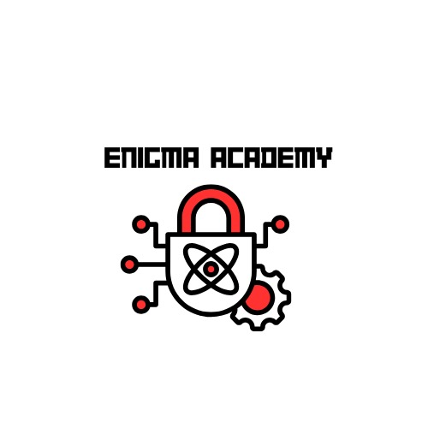
Braude College of Engineering Software Engineering Department
Advisor:
PhD. Moshe Sulamy
Students :
Abed Ellateef Zoabi
Firas Amaria
Capstone Project Phase A
Enigma Academy
25-1-D-8

Slide 2

The Problem
Cryptography is complex and difficult to learn through traditional methods.

Slide 3

The Solution
Enigma Academy - an interactive, puzzle-based game to teach cryptography in an engaging way.
game stimulation
visual representation
hands on approach
Notes:
we plan to use the stimulation of games and the visual use of cryptography tools to help student understand the basics of cryptography to ease the way for the more complex lessons in the future

Slide 4
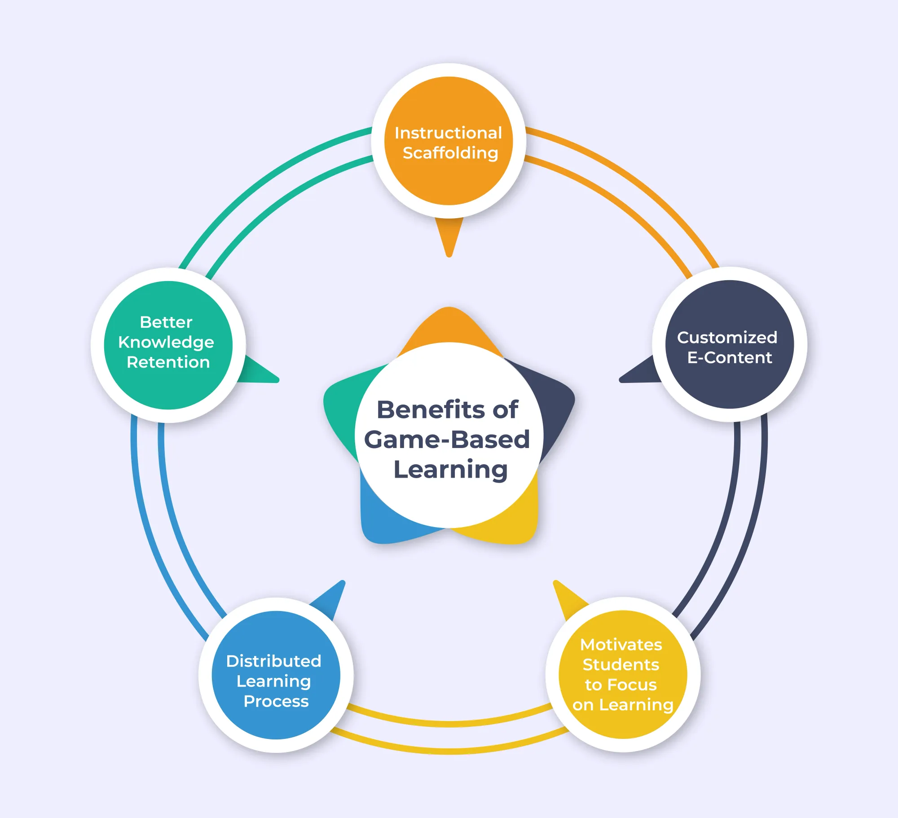
Game-Based Learning

Slide 5
Game | Game-Based Learning
Games are just for fun, and may or may not have defined rules or objective | Games have defined learning objective
Winning and losing is a part of the game | Losing may or may not be possible because the goal is to motivate people to action and learn as an end result.
Game play comes first, rewards are secondary | Sometime just okaying the game is intrinsically rewarding
Games are usually hard and expensive to build | Are usually hard and expensive to build
Story and scenes are part of the game | Content is usually morphed to fit the learning objective of the game

Slide 6
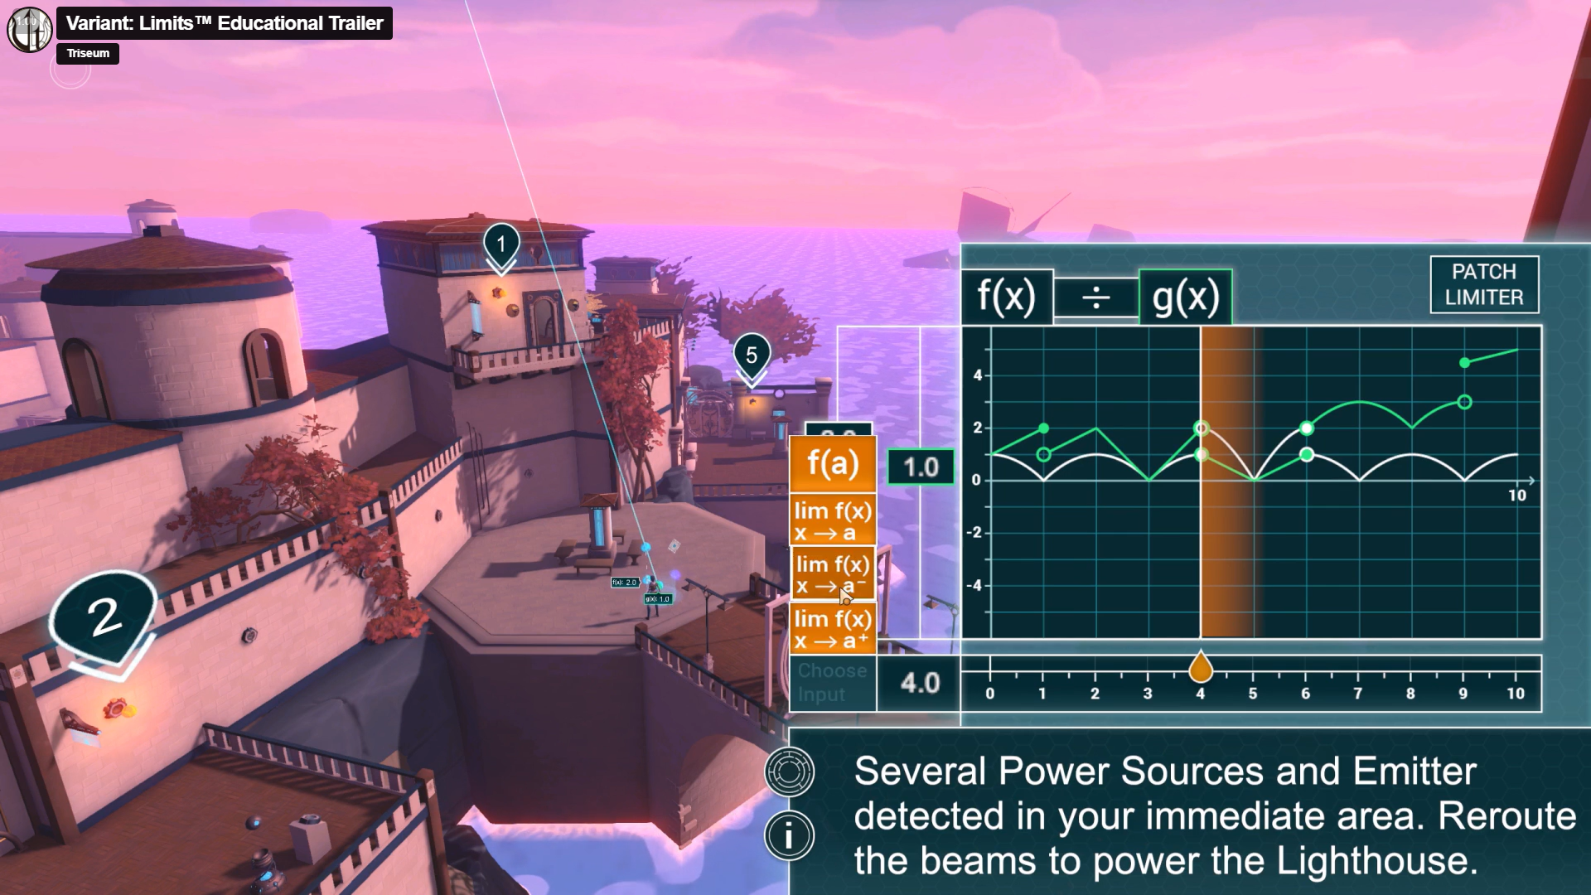
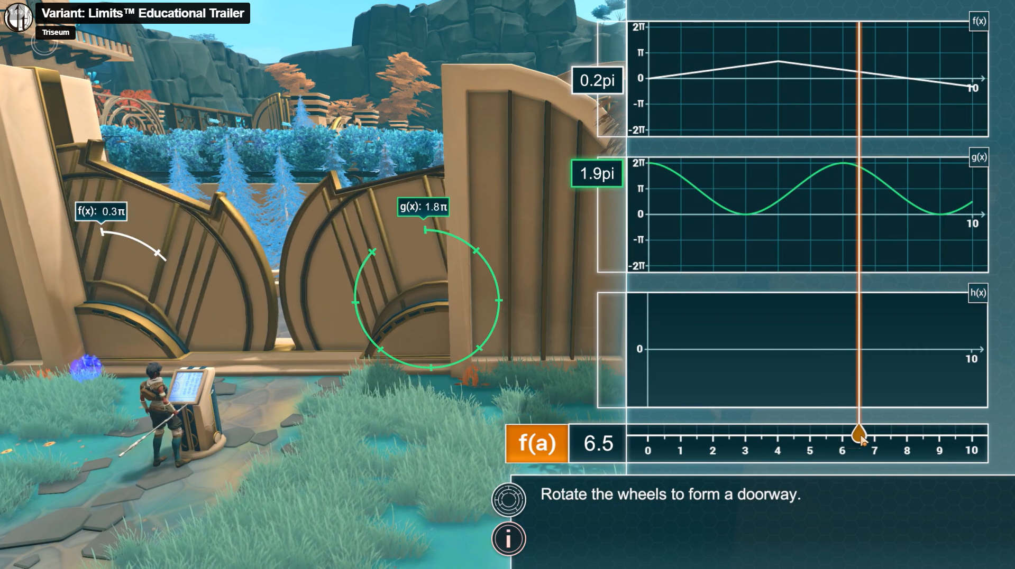
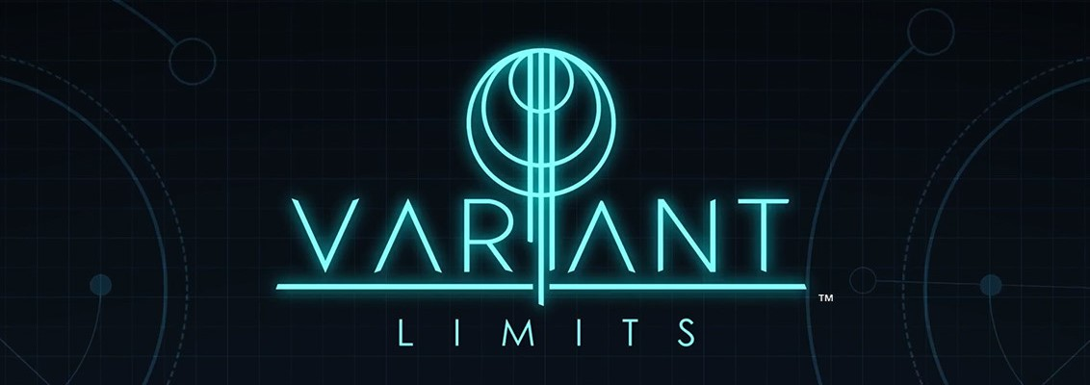
Example of GBL

Slide 7
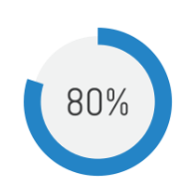


GBL Effect

Slide 8
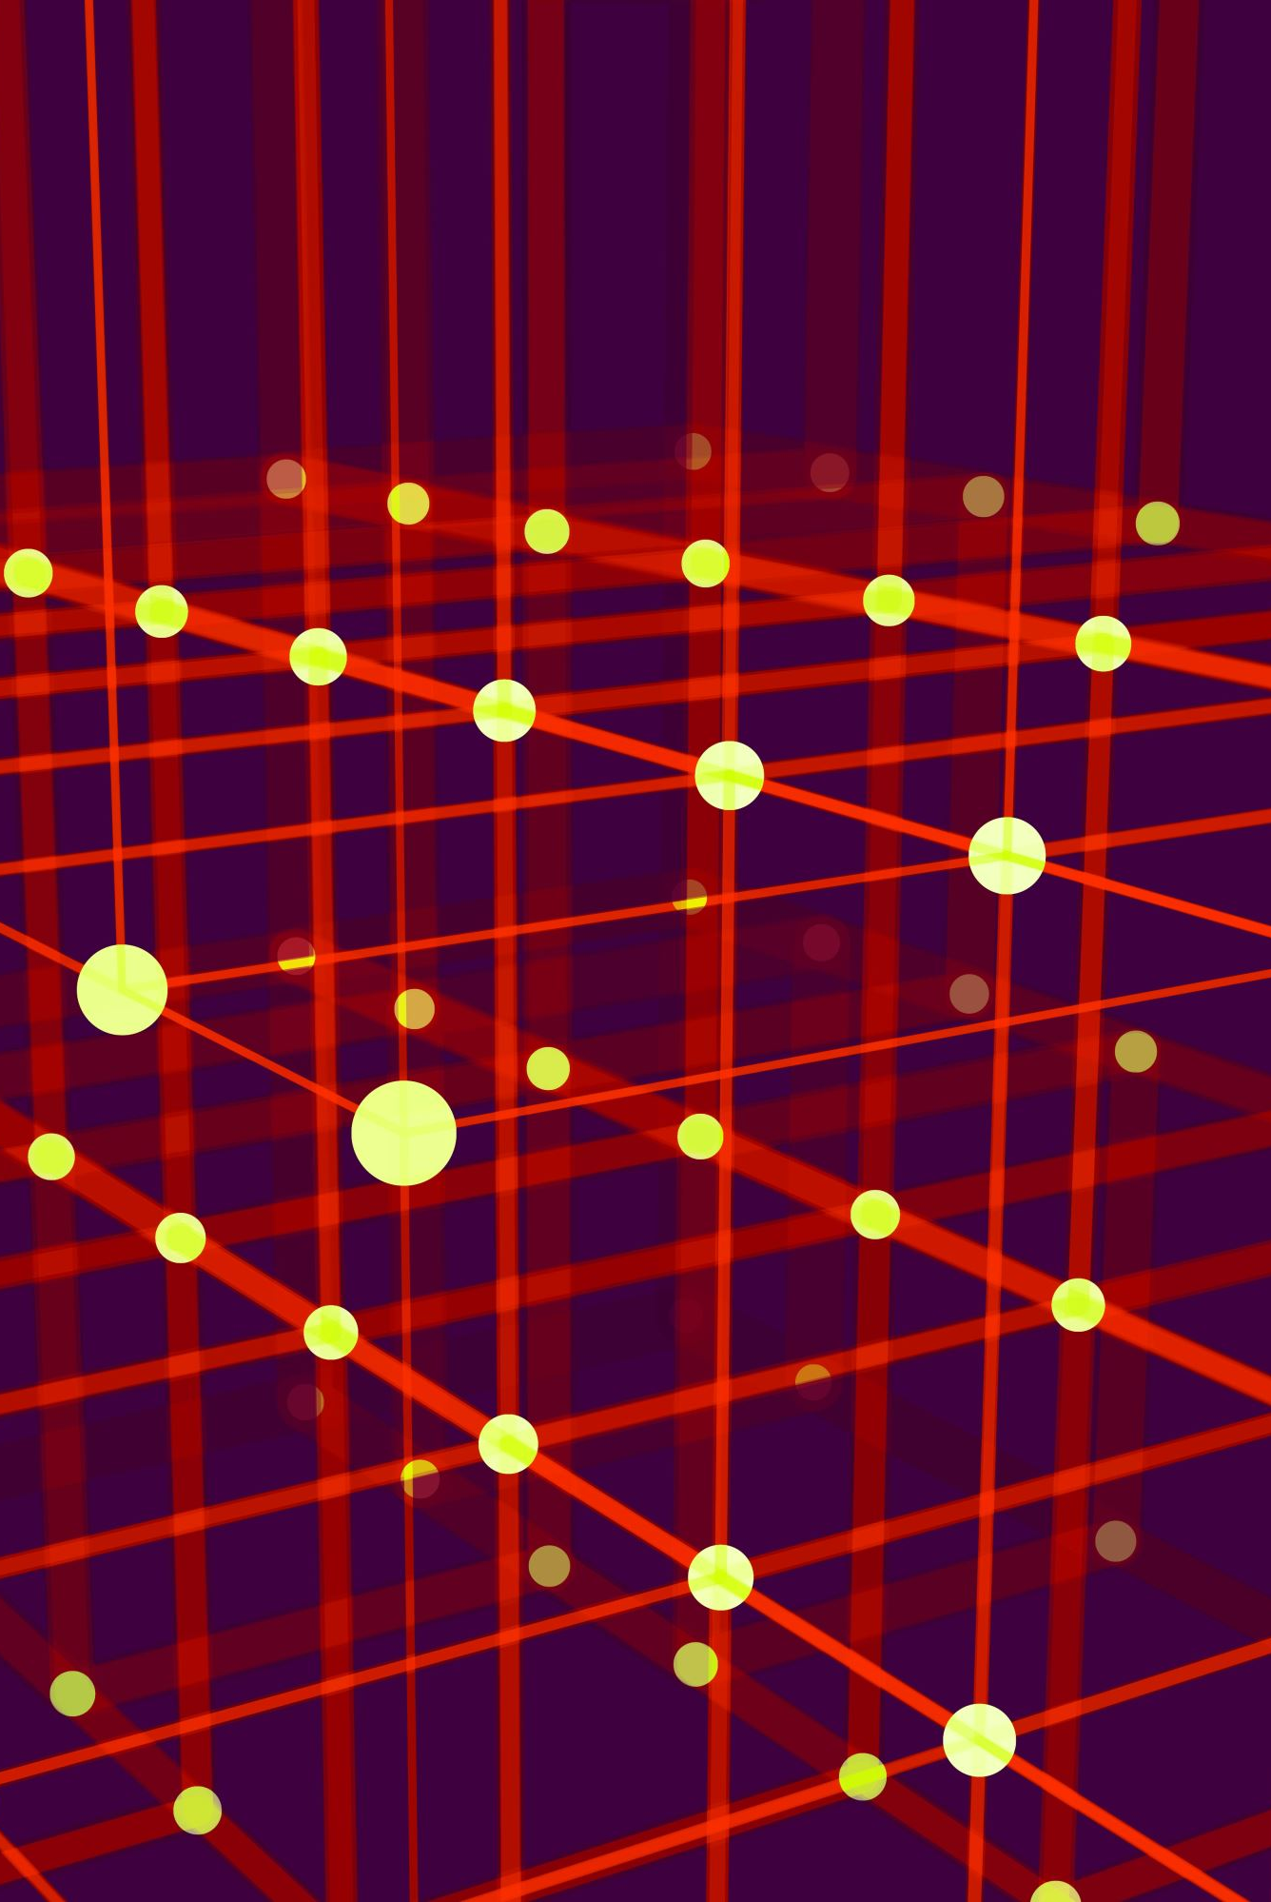
Project Goals & Objectives
Make cryptography accessible through interactive gameplay.
Teach cryptographic principles like Caesar Cipher, Rail Fence Cipher, and Vigenère Cipher.
Encourage learning by experimentation.
Provide a structured learning progression with increasing difficulty.

Slide 9


Analysis of Existing Solutions
CryptoClub CYPHER

Slide 10
How is Enigma academy different?
Target Audience
Educational scope
Gameplay
Complexity and depth
Learning outcomes

Slide 11
Overview of Enigma Academy
A single-player 2D puzzle game built in Unity.
Players solve cryptographic challenges by decrypting messages using discovered tools.
Each room represents a new level with increasing difficulty.
Players store and manage encrypted texts in an interactive inventory.

Slide 12
What is cryptography
Cryptography secures communication by transforming data into an unreadable format to prevent unauthorized access.
Encryption & Decryption
Used in Security
data security, online banking, encrypted messaging
Notes:
Cryptography is the science of securing communication by transforming information into an unreadable format to protect it from unauthorized access.
Used in data security, online banking, encrypted messaging, and cybersecurity.
Encryption & Decryption: Converts data into ciphertext and back to plaintext.
Used in Security: Protects passwords, banking, and messaging.
Real-World Examples: WhatsApp encryption, online transactions, and password protection.

Slide 13

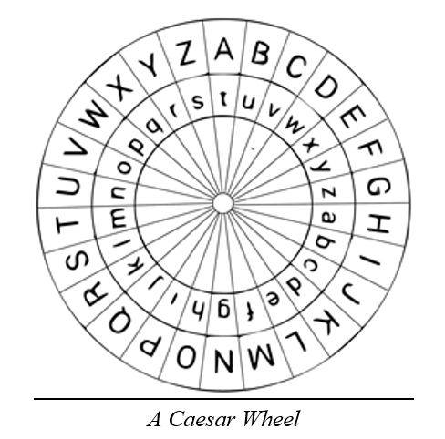
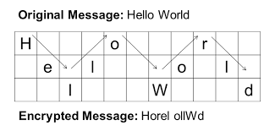
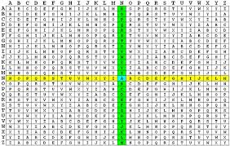
Cipher Tools we Focus on
Cipher tools are algorithms used to encrypt and decrypt messages by transforming plaintext into ciphertext.
Caesar Cipher
Rail Fence Cipher
Vigenère Cipher
Notes:
Cipher tools are methods or algorithms used to encrypt and decrypt messages.They follow mathematical rules to transform plaintext into ciphertext and vice versa.
Caesar Cipher: A simple shift cipher where letters are replaced by others a fixed number of positions away.
Rail Fence Cipher: A transposition cipher that arranges text in a zigzag pattern and reads it in a different order.
Vigenère Cipher: A polyalphabetic substitution cipher that uses a keyword to shift letters differently for each position.

Slide 14




Unity Engine
2D Game Development – Unity’s tools help create top-down environments, player movement, and interactive objects.
Scripting & Logic – C# scripting allows implementing game mechanics like the inventory system, puzzle logic, and room transitions.
Data Management – Unity enables local storage (JSON/Game Cache) to save player progress and inventory.
Notes:
2D Game Development:
Unity provides built-in 2D physics and tile-based rendering, making it ideal for creating a structured game world.
We used sprite-based assets to design interactive elements like bookshelves, puzzles, and glowing objects.
Scripting & Logic:
The game is coded in C#, which manages game mechanics such as puzzle validation and real-time inventory updates.
Unity’s event system allows smooth interaction between the player and game objects (e.g., picking up texts, using cipher tools).
Data Management:
Instead of cloud storage, we use local JSON files and Unity’s PlayerPrefs for lightweight storage of game progress.
The game’s caching system ensures fast load times and keeps track of solved puzzles and collected tools.

Slide 15
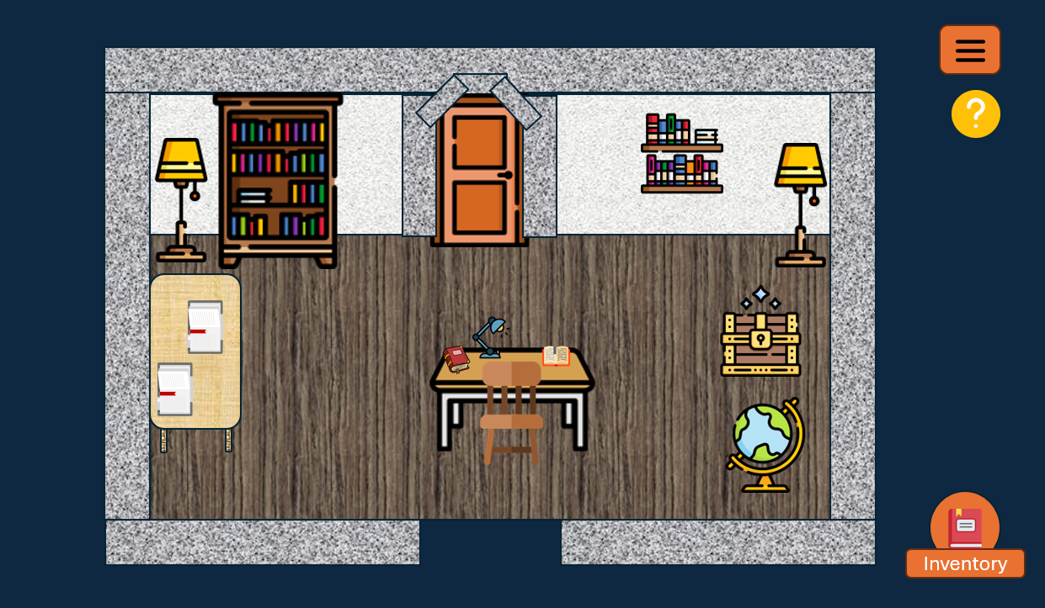
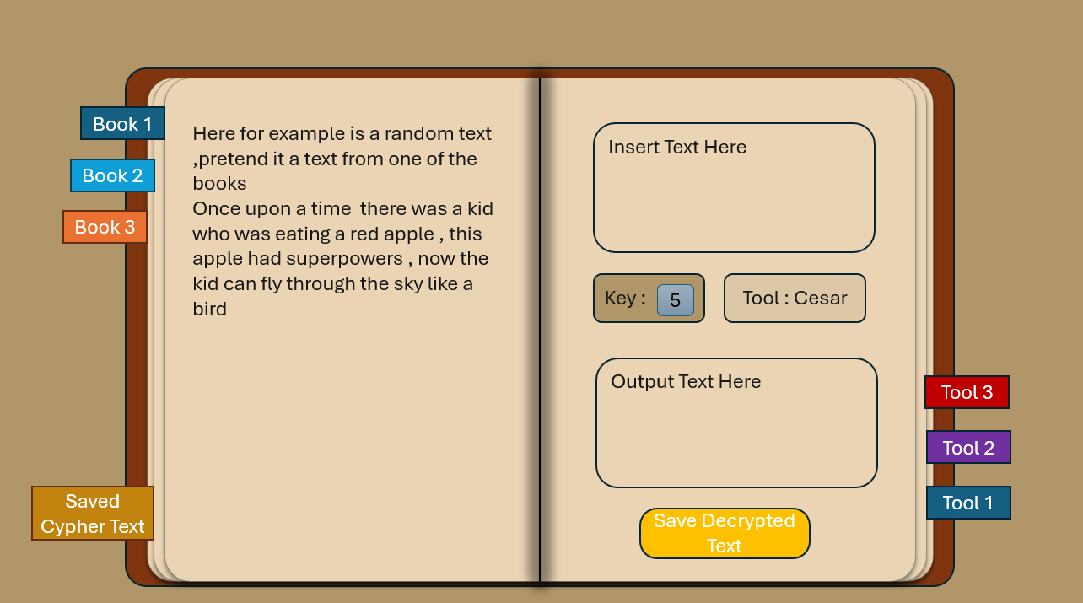
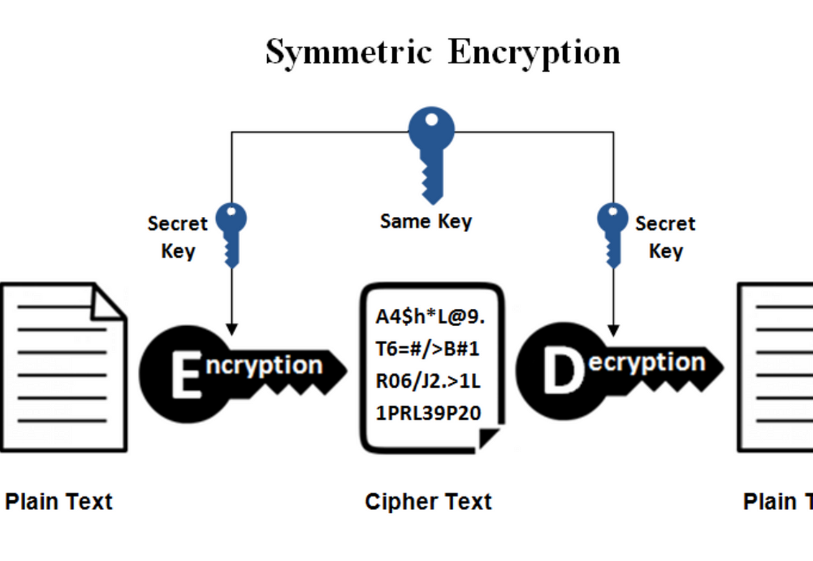
Key Features
Interactive Puzzle Rooms-
Dynamic Inventory System
Cryptographic Learning
Achievement & Reward System
Incremental Learning Progression

Slide 16
Functional & non-Functional Requirements
# | FR | NFR
1 | The system allows players to apply decryption tools to any text in the inventory. | The game must be engaging and enjoyable for players of all skill levels.
2 | The system progresses players to the next room when a puzzle is successfully solved. | Tutorials must dynamically integrate into the gameplay without disrupting player immersion.
3 | The system allows players to revisit earlier rooms to solve puzzles using newly discovered tools. | The game must maintain smooth performance, even as the inventory grows or puzzles become more complex.
4 | The system provides feedback (correct / incorrect solution) when players submit puzzle solutions. | The system must ensure stable and secure storage of player progress, preventing data loss or corruption.

Slide 17
Technical Aspects
Built in Unity using C# scripting.
Single Player & Offline-game
Visual Learning & Hands on Approach
Puzzle & Mind challenges
Dynamic User Interaction
Uses local file-based storage (JSON/Game Cache).

Slide 18
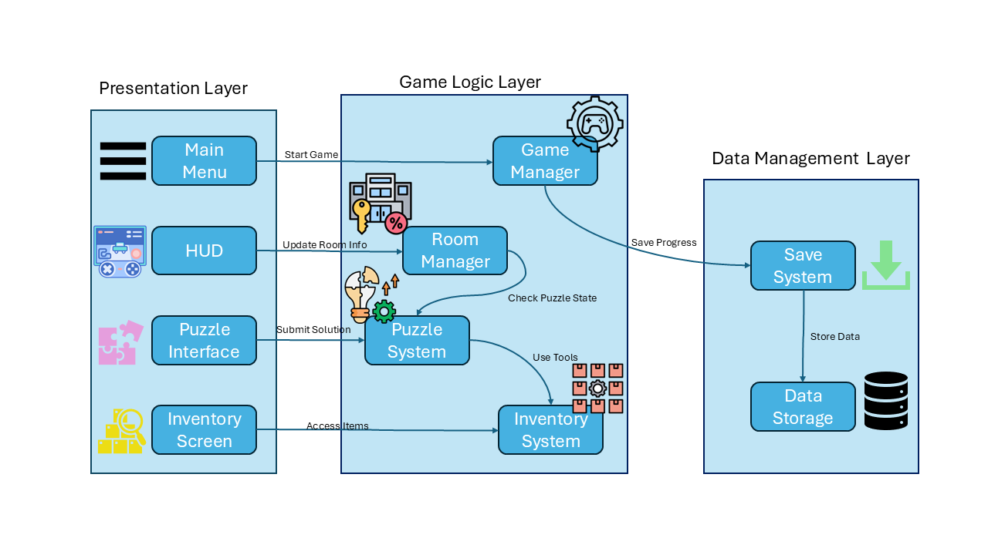
Game Architecture Diagram
Notes:
Present the architecture overview diagram.
Explain the three-layer structure:
- Presentation Layer: UI components like Inventory and Puzzle Interface.
- Game Logic Layer: Manages game flow and logic.
- Data Management Layer: Saves player progress and game state.

Slide 19
Presentation Layer
Notes:
Present the architecture overview diagram.
Explain the three-layer structure:
- Presentation Layer: UI components like Inventory and Puzzle Interface.
- Game Logic Layer: Manages game flow and logic.
- Data Management Layer: Saves player progress and game state.

Slide 20
Game Logic Layer
Notes:
Present the architecture overview diagram.
Explain the three-layer structure:
- Presentation Layer: UI components like Inventory and Puzzle Interface.
- Game Logic Layer: Manages game flow and logic.
- Data Management Layer: Saves player progress and game state.

Slide 21
Data Management Layer
Notes:
Present the architecture overview diagram.
Explain the three-layer structure:
- Presentation Layer: UI components like Inventory and Puzzle Interface.
- Game Logic Layer: Manages game flow and logic.
- Data Management Layer: Saves player progress and game state.

Slide 22

Game Flow and Scenes – How the Player Progresses
Notes:
Step 1: Player enters Room 1 (Beginner Level) and finds the first puzzle.
Step 2: Player discovers a cryptographic tool (e.g., Caesar Cipher).
Step 3: Player solves puzzles and unlocks the next room.
Step 4: New tools are introduced, requiring the player to revisit previous rooms.
Step 5: Final Graduation Room – Completing all puzzles grants full graduation attire.

Slide 23
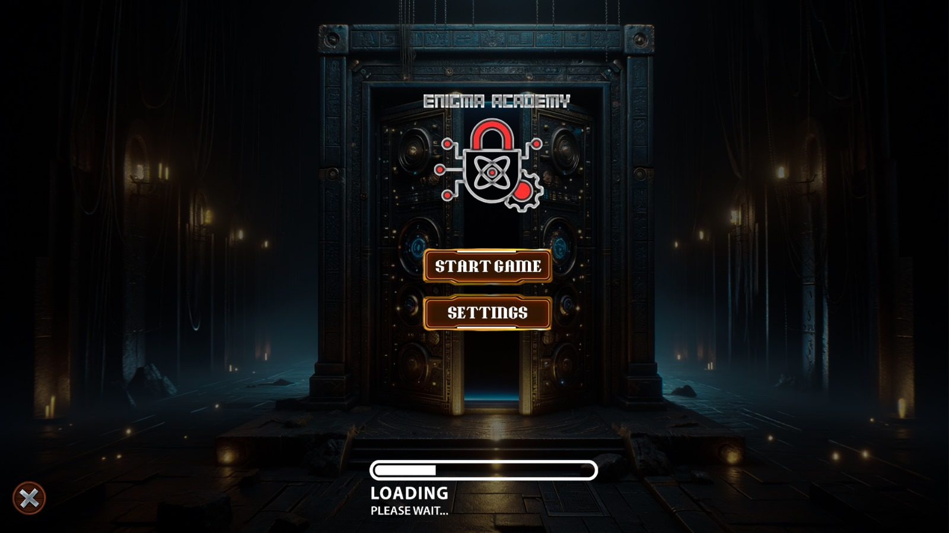
Main menu

Slide 24
Puzzle Room
Game Menu
Guide

Slide 25
Room Objects
Interactable Objects

Slide 26

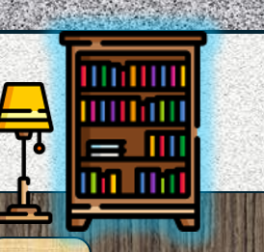


Interactable objects

Slide 27

Text Interaction

Slide 28
Inventory Screen

Slide 29
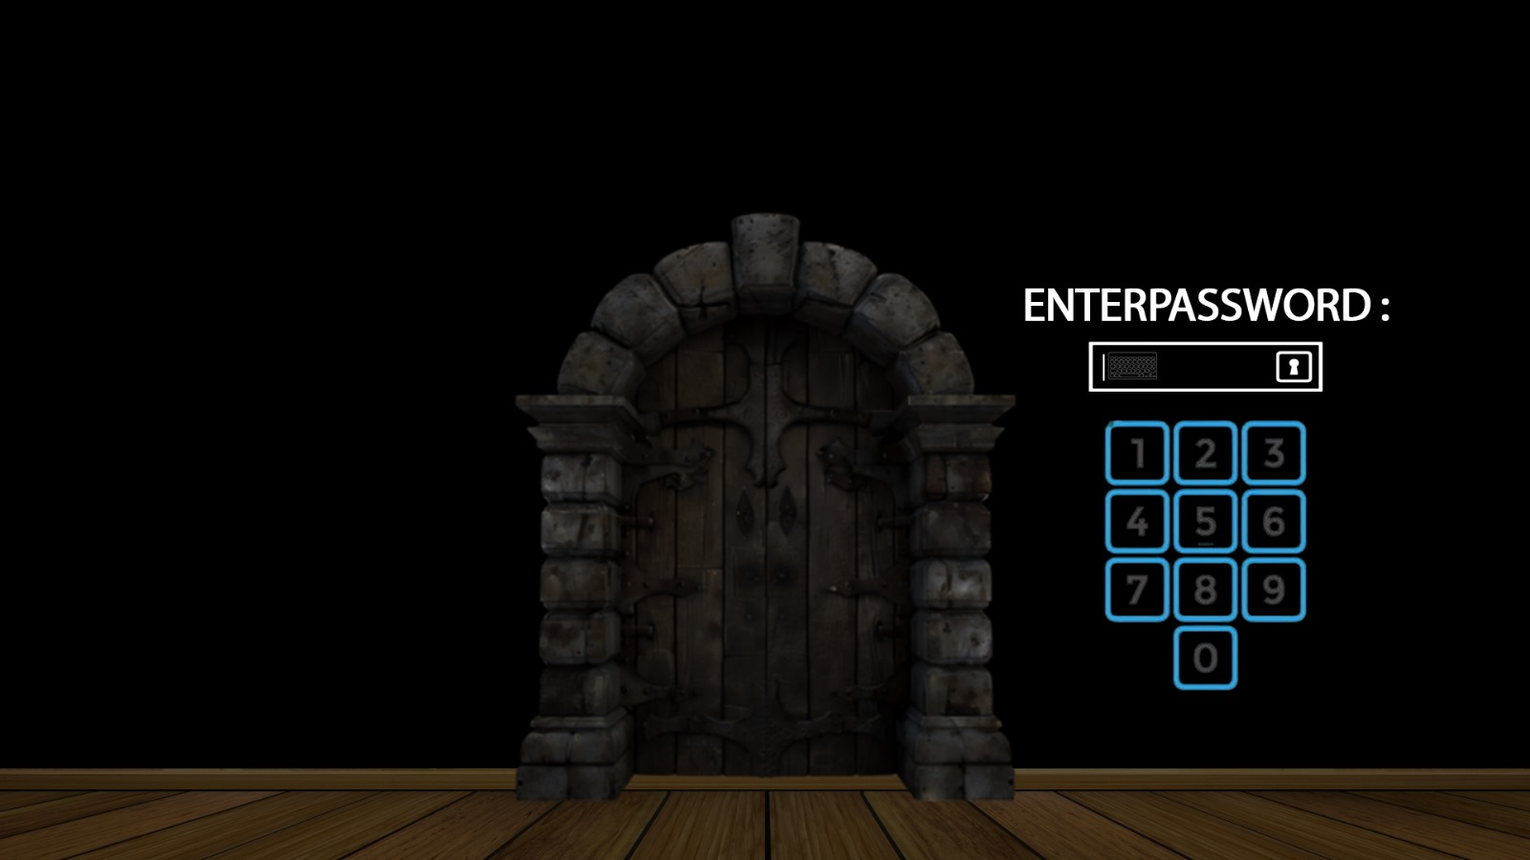
Puzzle Door
Notes:
Side note Each Door password can be made of either numbers or words

Slide 30
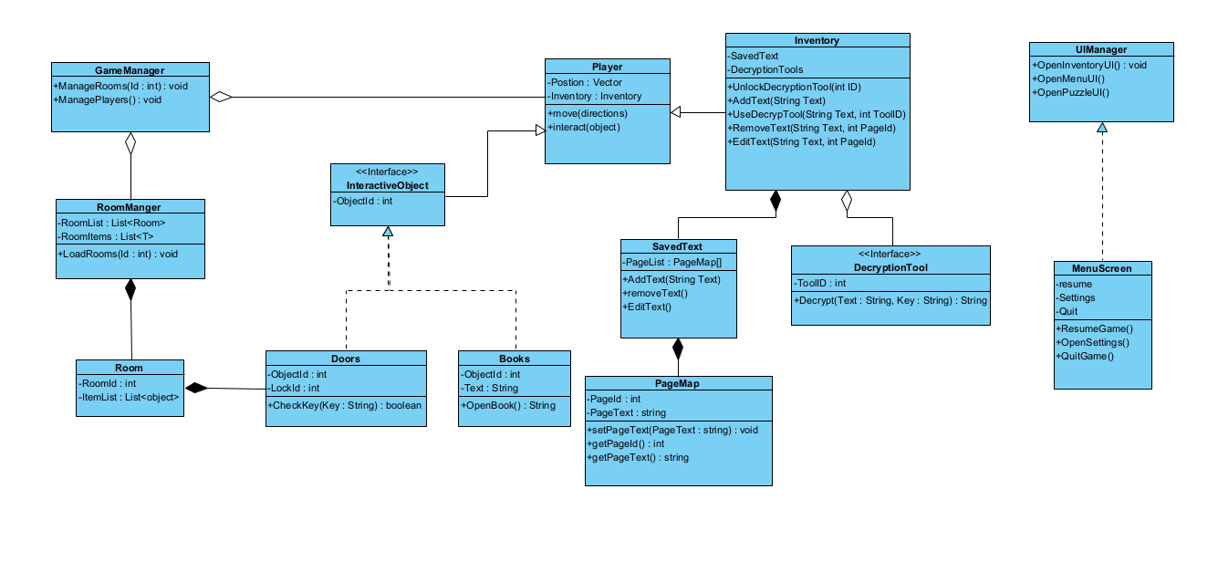
Class Diagram

Slide 31
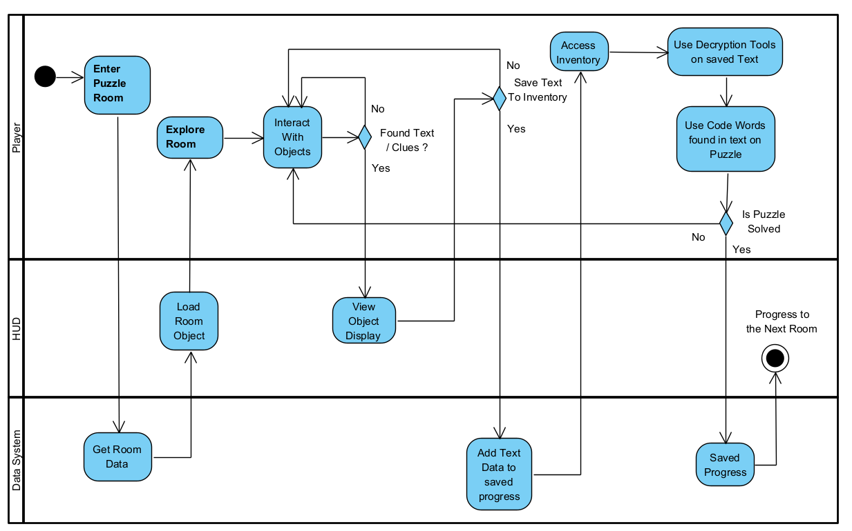
Activity Diagram

Slide 32
Verification & Evaluation Plan
Verification
Evaluation

Slide 33
Verification
Unity Test Framework (UTF)
Unit testing
Integration testing
Regression testing
Functional testing
Performance testing

Slide 34

Evaluation
Playability
Usability
Quality

Slide 35
Project Impact & Future Improvements
Impact: Teaching cryptography through gaming makes learning more accessible.
Future Improvements:
- Add more rooms and cryptographic challenges.
- Introduce an adaptive difficulty system.
- Expand cryptographic tools beyond classical ciphers.

Slide 36
Conclusion
Enigma Academy transforms the complexities of cryptography into an immersive adventure, where every puzzle solved unlocks a deeper understanding of digital security.

Slide 37
Thank you!
Questions?

