Slide 1


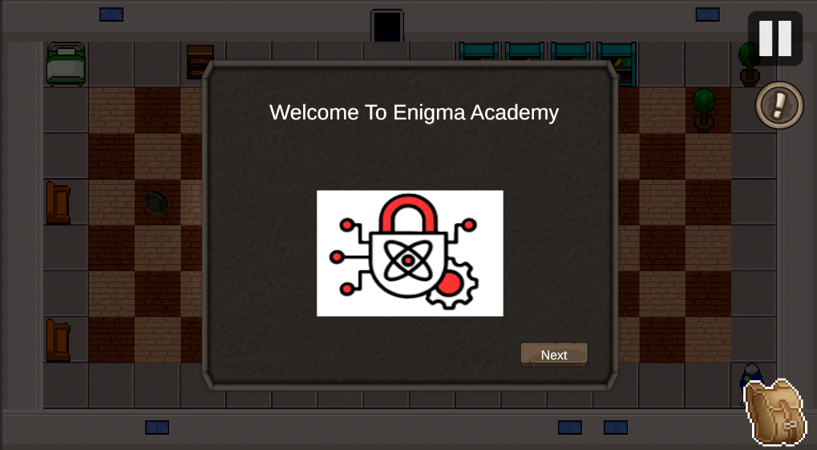

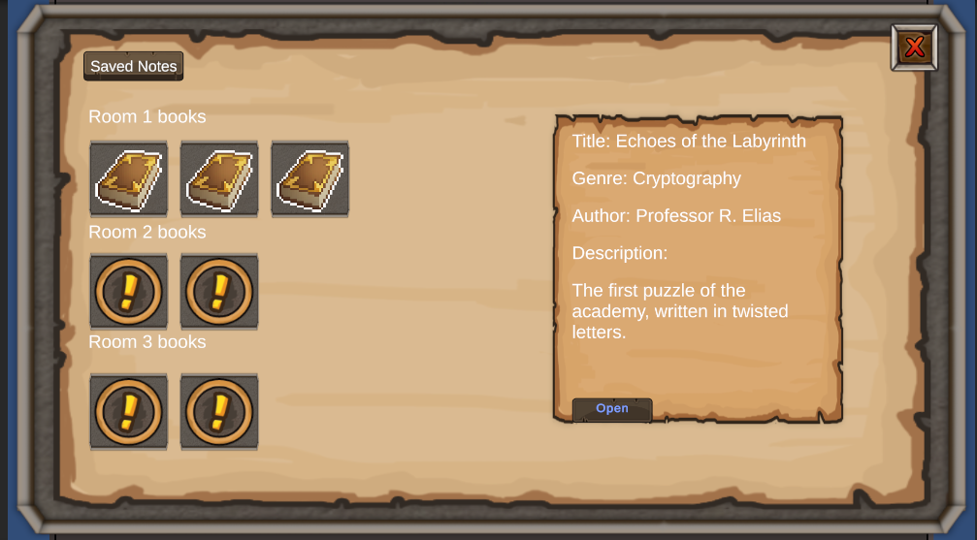
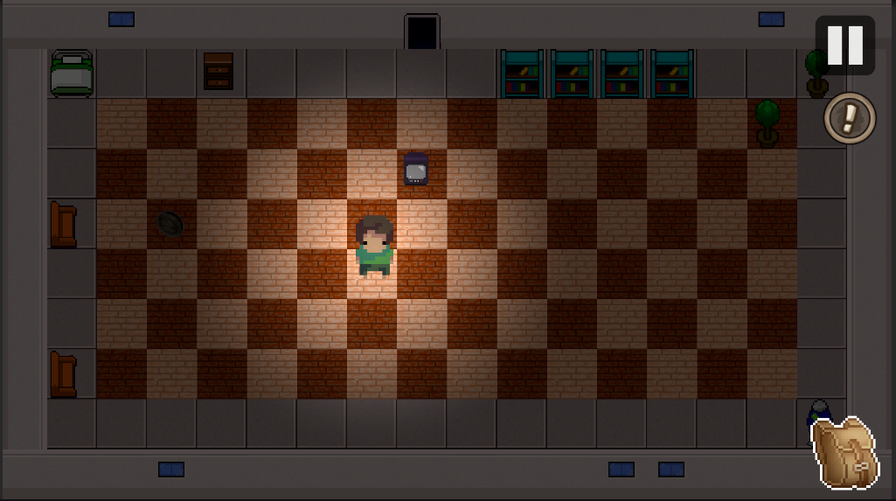
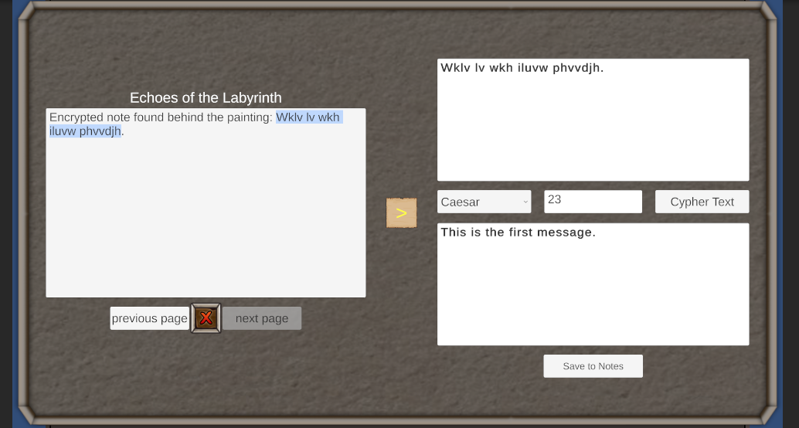


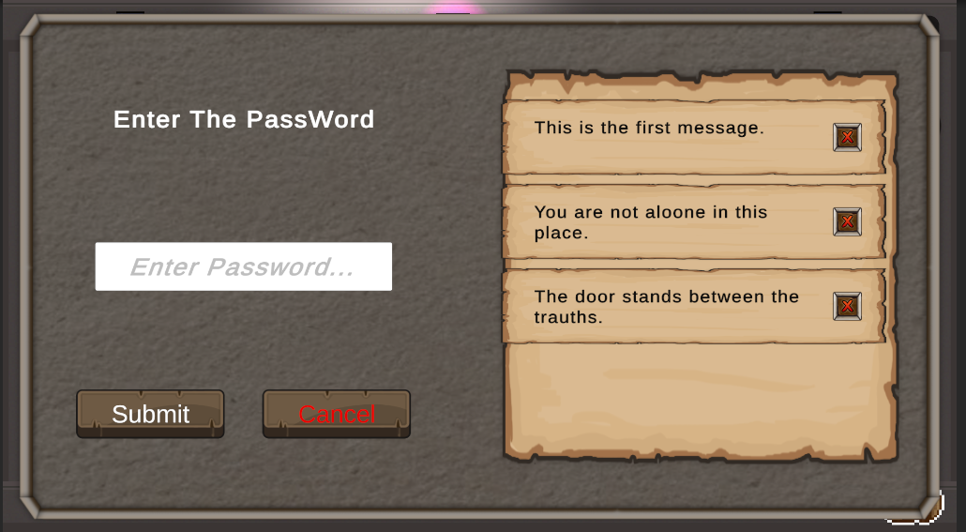
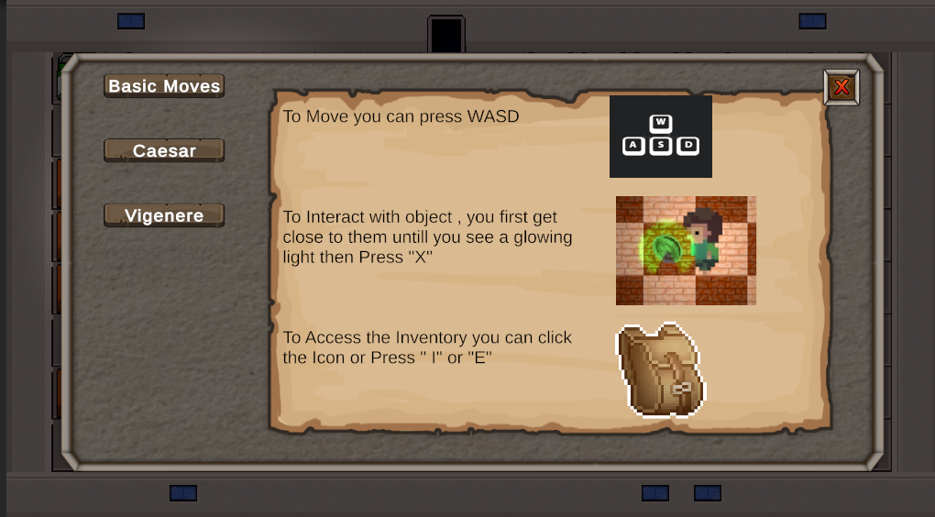
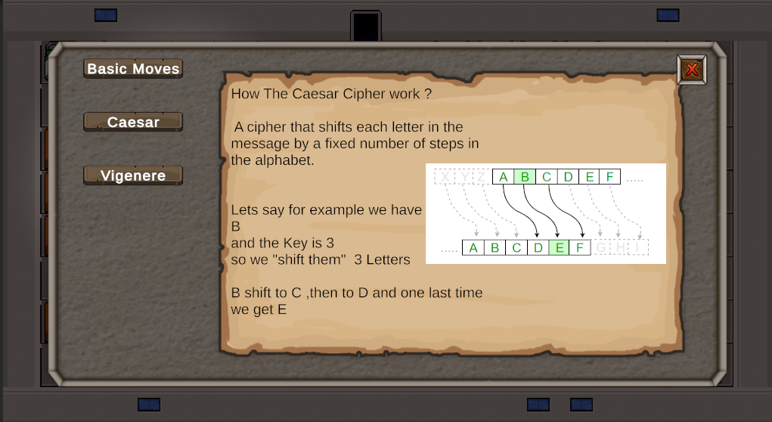
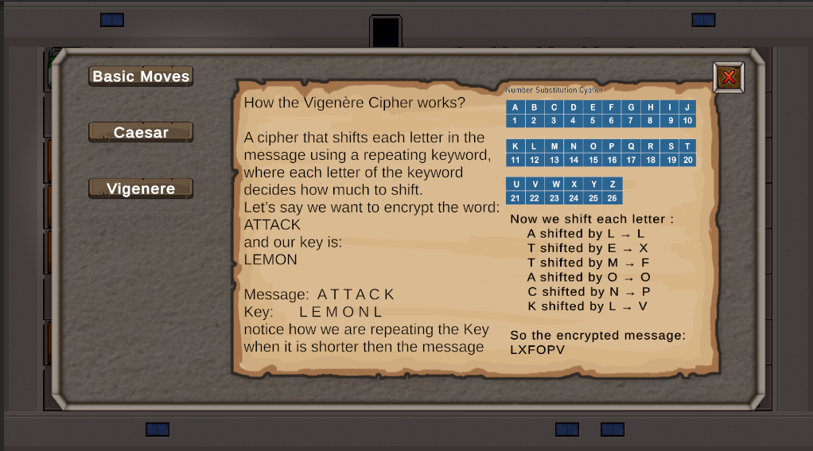


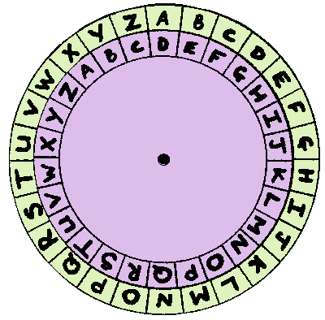


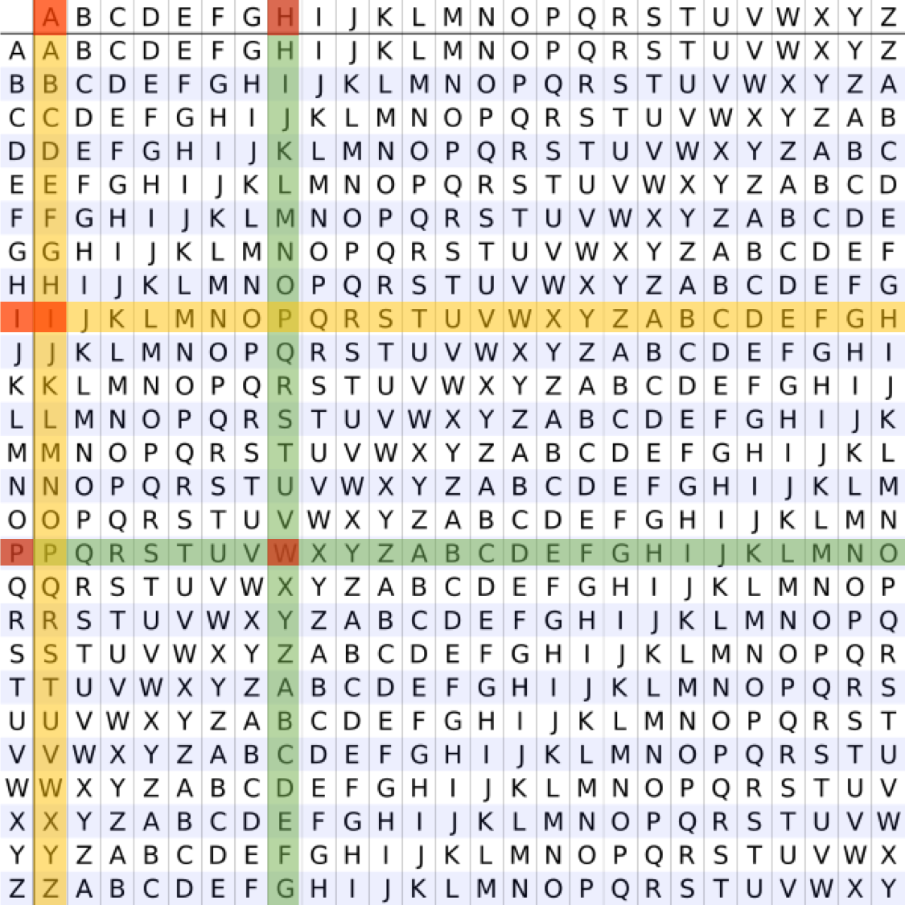
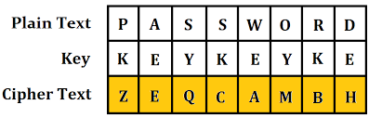


Enigma Academy
A Game-Based Platform for Learning Classical Cryptography
Abed Ellateef Zoabi, Firas Amaria
Advisor : PhD. Sulamy Moshe
The Problem :
Cryptography is often taught through dry theory, making it difficult to understand. Most learning tools are either too basic or lack hands-on interaction.
The Solution :
Enigma Academy is a 2D puzzle-adventure game that teaches cryptography through interactive play. Players decrypt real ciphers, solve logic puzzles, and learn by doing.
Inventory Screen UI
Find Books and hint through out the game to find the Lock Password
Room Screen Overview
Use the inventory UI to Decrypt the hidden messages
Puzzle Door UI
Unlock Guide UI through your progress
Use Hints you Saved from Decrypted Text to help find the Password to the final Door
The Ciphers We Used in Our Project:
Caesar Cipher
Vigenère Cipher
Technologies Used:
Unity 2D Engine
C# Scripting
Modular UI Architecture
Offline Educational Platform

