Slide 1

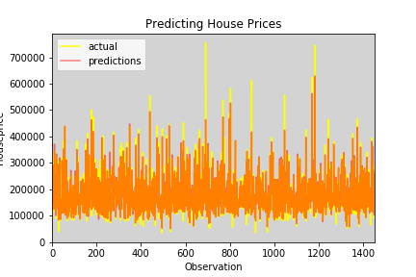
Advanced Group 2
1. Understood the Data.
2. Cleaned and preprocessed the data.
3. Build Random Forest Model and check the result.

Slide 2
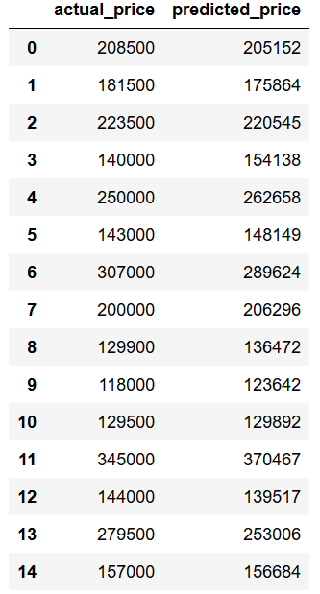
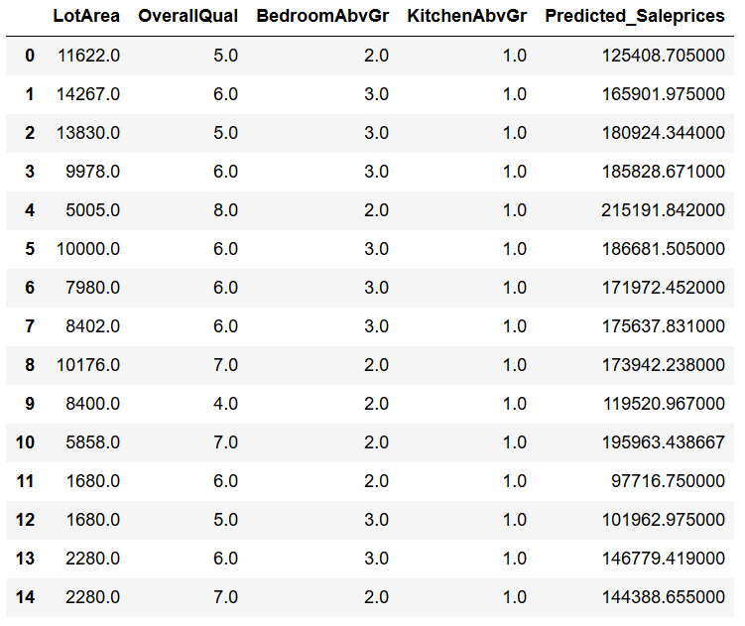
Example Data and Results

