Slide 1

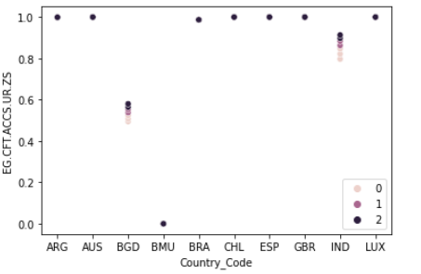
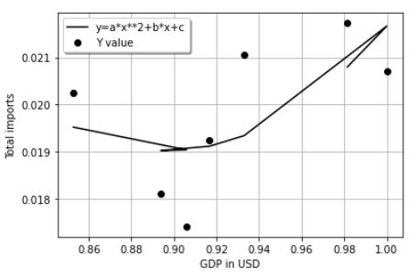
APPLIED DATA SCIENCE 3
Name : Firasath
Introduction
The analysis in this project is aimed at analysing different countries based on various indicators related to economy and climate of a country.
The countries considered for analysis are: Brazil, Chile, Bangladesh, Luxembourg, India, Argentina, Bermuda, Spain, Great Britain and Australia.
The clustering analysis for different countries would be based on the access to clean fuels and technologies The types would be High, Low and Medium
The fitting analysis would compare the results of countries with High, Low and Medium access to access to clean fuels and technologies and then find out the relationship between the current GDP and the total imports of that country
E-Poster Title
Researchers’/Presenters’ Names Institution/Organization/Company
E-Poster No.
Clustering
The clustering analysis is based on the the access to clean fuels and technologies. From the visualization it is clear which country is in High, Medium and Low category
Fitting
The line plot shows that for the country which has a high access to clean fuels and technologies, the relationship between the GDP and total import is indirect at the beginning but as the GDP of the country crossed 0.90 as the normalized value, the relationship becomes direct.
References
Wbgapi 1.0.7. (n.d.). Retrieved from https://pypi.org/project/wbgapi/

