Slide 1
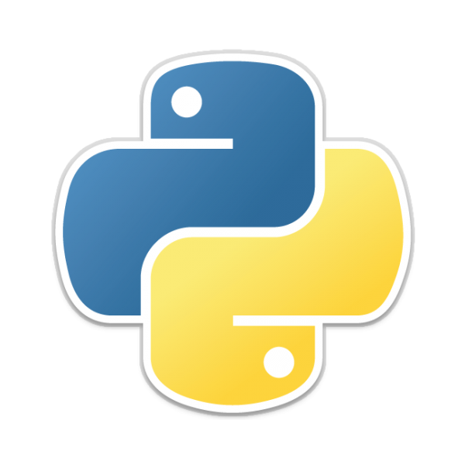
PROJECT-3 DEPLOYING PYTHON WEB APPLICATION IN AWS
Done By:-
Mohammed Firasat SAYEED
firasatsayeed99@gmail.com

Slide 2
FLASK :
Flask is a small and lightweight Python web framework that provides useful tools and features that make creating web applications in Python easier.
It gives developers flexibility and is a more accessible framework for new developers since you can build a web application quickly using only a single Python file.
Flask is easy to code.
Flask is easy to configure.

Slide 3
PYTHON:
Python is a general-purpose programming language that is often applied in scripting roles.
So, python is a programming language as well as a scripting language.
Python is also called an Interpreted language
It is open source
It is object-oriented
It is easy to use and learn
Pip:
PIP is a package management system used to install and manage software packages written in Python.
It stands for “preferred installer program”

Slide 4
Prerequisites :
Aws account
EC2 instance
VPC
Git hub
Basic understanding of Python.
Deploying of Python web application by using :
AWS Services Manually
Jenkins
Terraform Script

Slide 5
Module .1:-Deployment of car-prediction python application by AWS Services Manually
Create a IAM user and attach policies to it.
Create a custom VPC
Create a EC2 instance with any operating system.
Connect to EC2 instance by using Git bash.
Update the operating machine.
Install required packages related for deployment of project.
Clone the project source code from Git hub to your machine.
Now go to the directory and install requirement packages.
Modify the app.py file and run the flask server.
Now copy the instance public IP address and browse it to see the python web application.

Slide 6
Module.2:-Deployment of car-Prediction python application by Jenkins
Create a IAM user and attach policies to it.
Create a custom VPC
Create a EC2 instance with any operating system.
Connect to EC2 instance by using Git bash.
Install Jenkins in EC2 instance by using certain commands.
Provide security credentials of git hub in security code management.
Give certain commands in execute shell to deploy python web application.
Save the commands and click on build now .
Browse the IP address of EC2 instance to see the python web application.

Slide 7
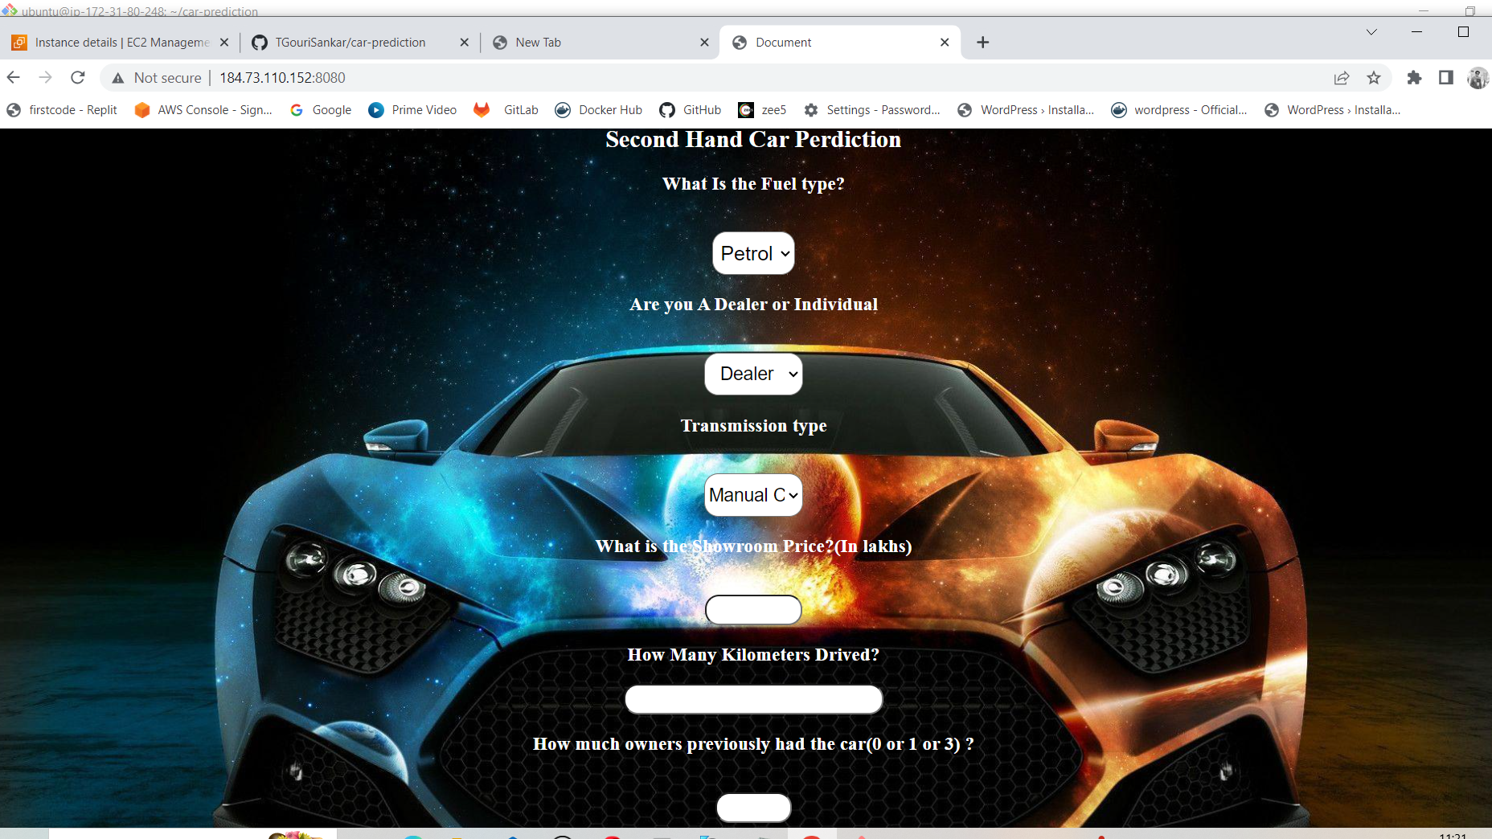
Car-prediction web application

Slide 8
THANKYOU

