Slide 1

Best Restaurants in Riyadh
Faisal Alzhrani
Alaa Alahmadi
Mohammed Alamri
Firas Almoqhim

Slide 2
TABLE OF CONTENTS
01
02
03
04
Introduction
Web Scraping and Dataset
Data Cleaning Process and Visualizations
Model Development

Slide 3




01
Introduction

Slide 4
When planning a party in Riyadh, choosing the right restaurant with the perfect ambiance and high-quality food is key. With so many cuisines available, analyzing restaurant data is essential for making the best choice.

Slide 5
02
Web Scraping and Dataset

Slide 6
Dataset Source
The data for this project was sourced from Welcome Saudi, a website featuring restaurant listings across Saudi Arabia. we used web scraping to extract key details such as restaurant names, cuisines, locations, ratings, and reviews for analysis.

Slide 7
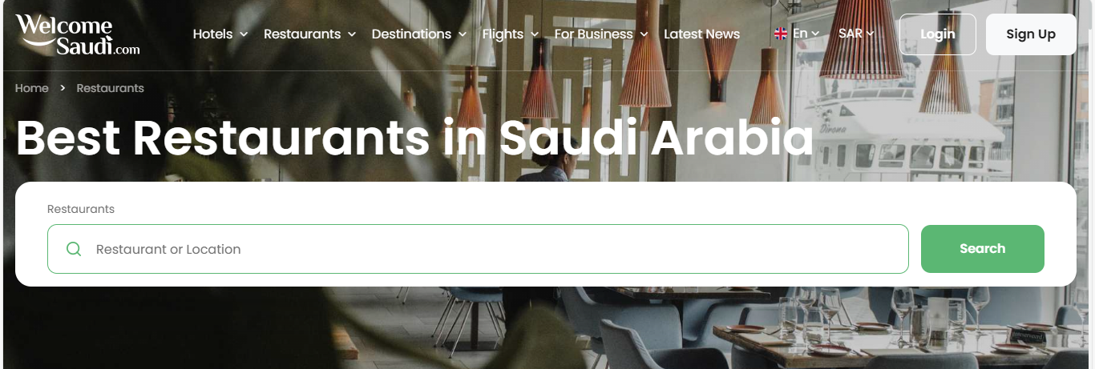

Slide 8
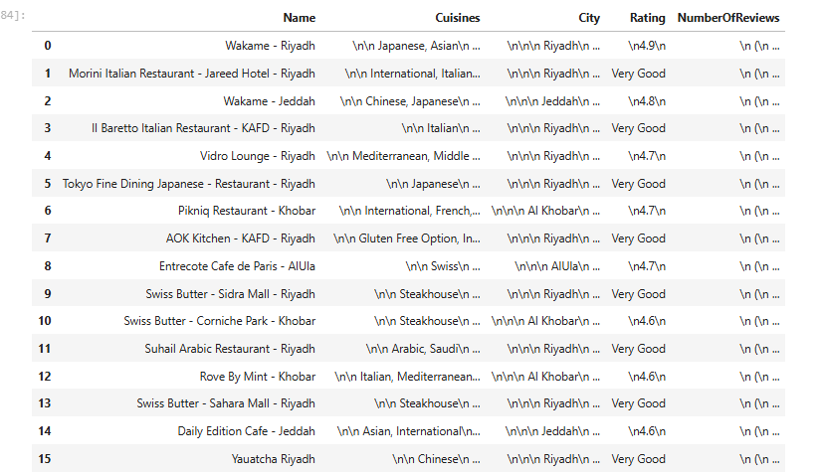
Data before cleaning

Slide 9
03
Data Cleaning Process and Visualizations

Slide 10
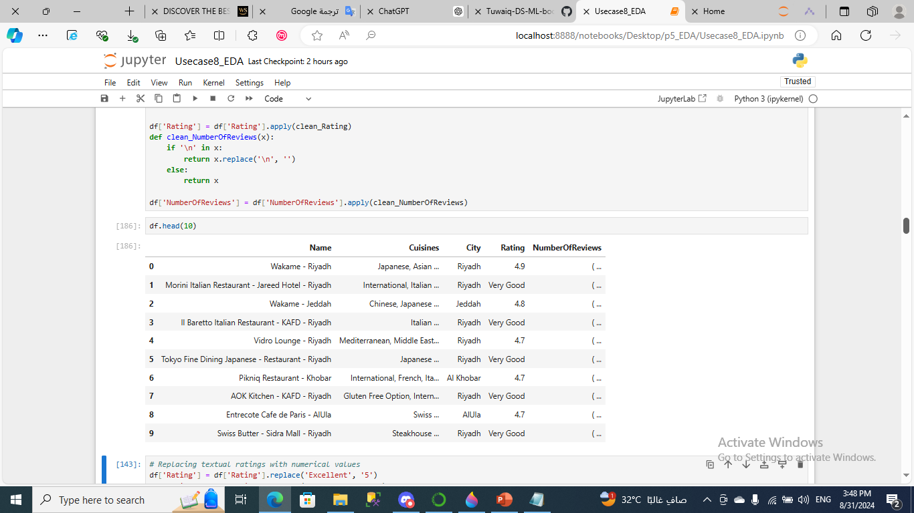
Dealing with ‘ \n ‘
- Before :
- After :

Slide 11
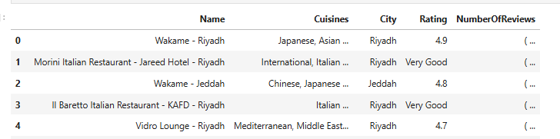
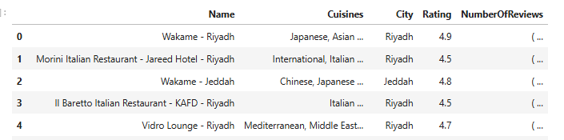
Replacing textual ratings with numerical values
- Before :
- After :

Slide 12
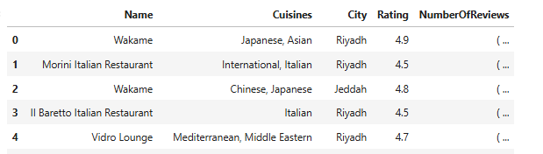
Dealing with ‘ - ‘
- Before :
- After :

Slide 13
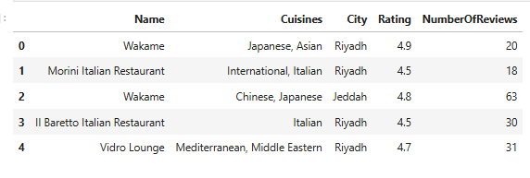
standardizing the NumberOfReviews column
- Before :
- After :

Slide 14
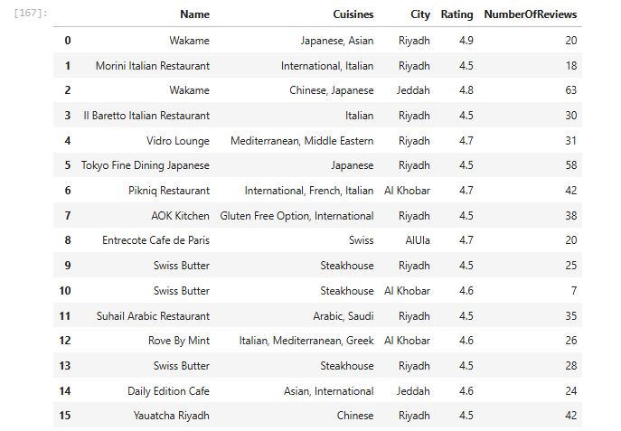
Data after cleaning

Slide 15
03
Visualizations

Slide 16
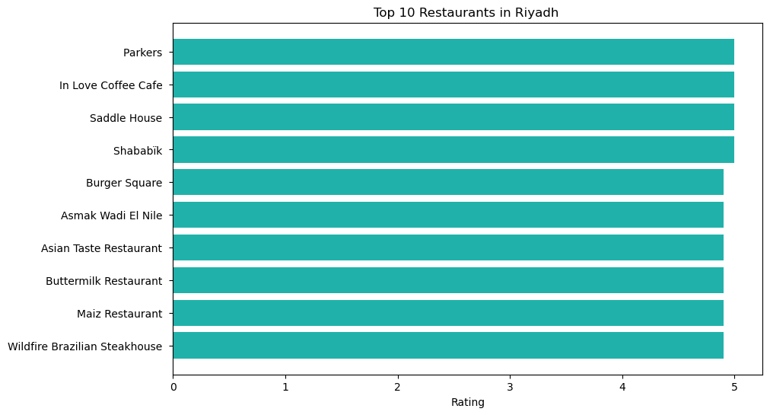

Slide 17
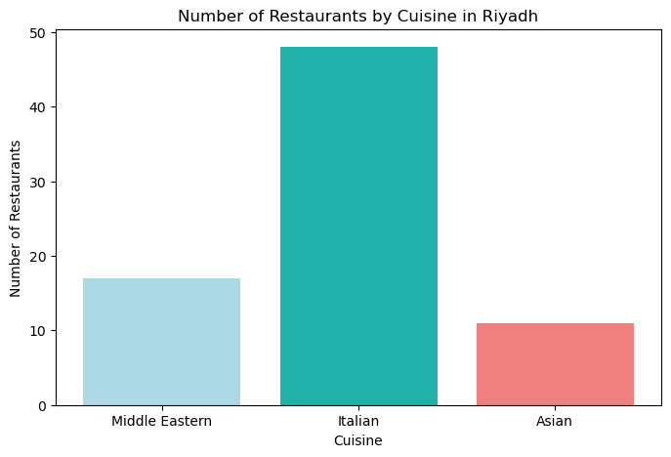

Slide 18
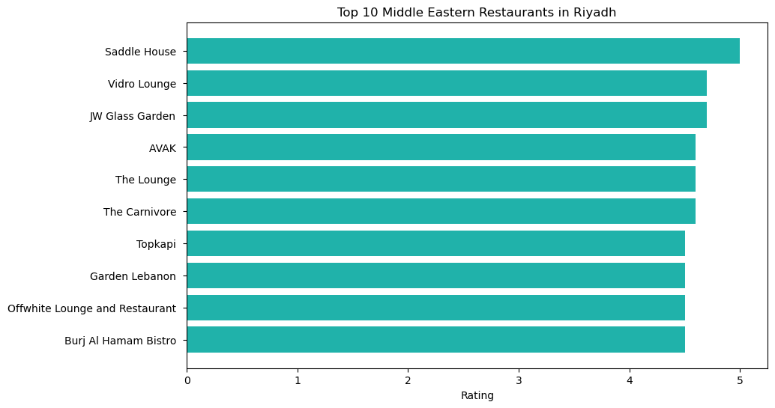

Slide 19
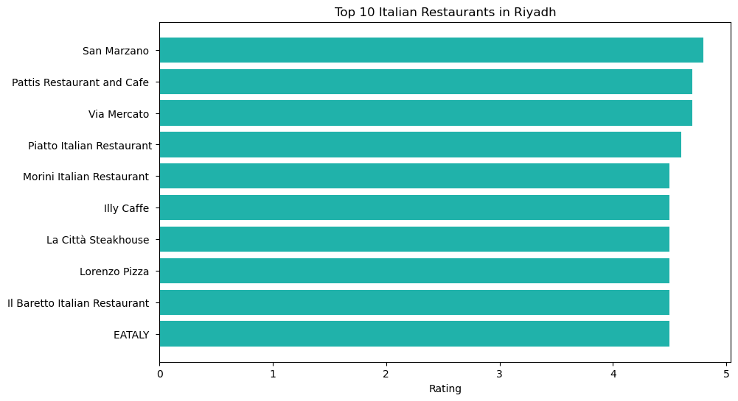

Slide 20
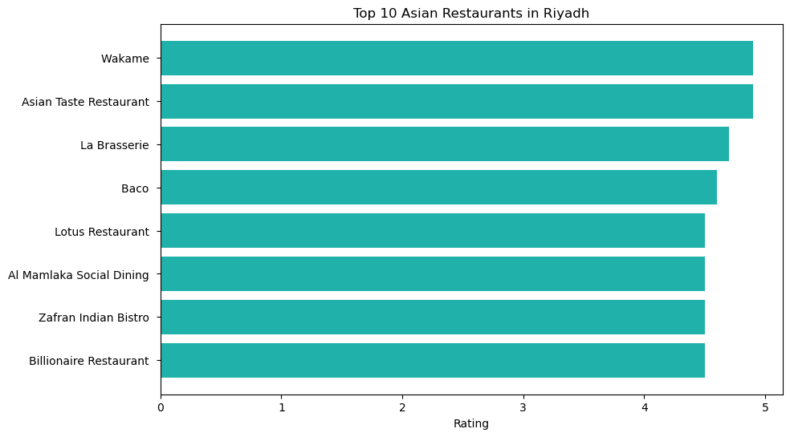

Slide 21
05
Model Development

Slide 22
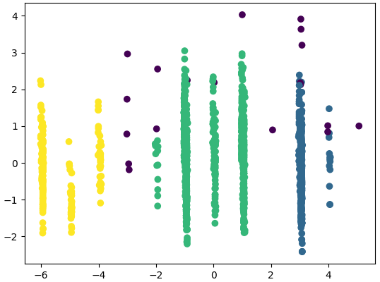
DBSCAN Clustering
PCA Component 2
PCA Component 1

Slide 23
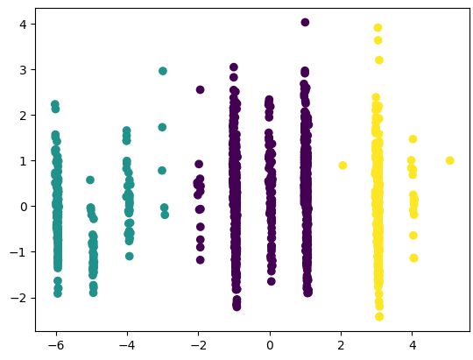
Kmeans
PCA Component 2
PCA Component 1

Slide 24
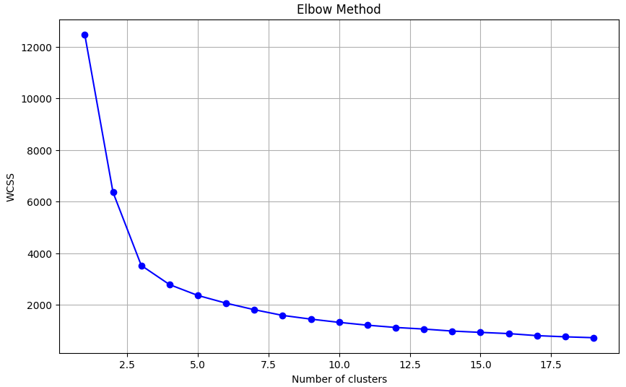

Slide 25
THANK YOU !

