Slide 1

CROP PRODUCTION ANALYSIS
Firdous Anjum
STU65d4f773ed1251708455795

Slide 2

PROBLEM STATEMENT
Total production by season
Total Agriculture Land
Total Production
Sum of Area by Season
Sum of production by Crop
Sum of production by State_Name

Slide 3
Project Description
No. of rows: 73827
No. of columns: 8
Name of dataset: Crop production analysis.csv
Column name: State Name, District Name, Crop year, Season, Crop, Area, Production.

Slide 4

WHO ARE THE END USERS?
Farmers.
Agriculture enterprise.
Agriculture management.

Slide 5

Technology Used
PowerBI

Slide 6
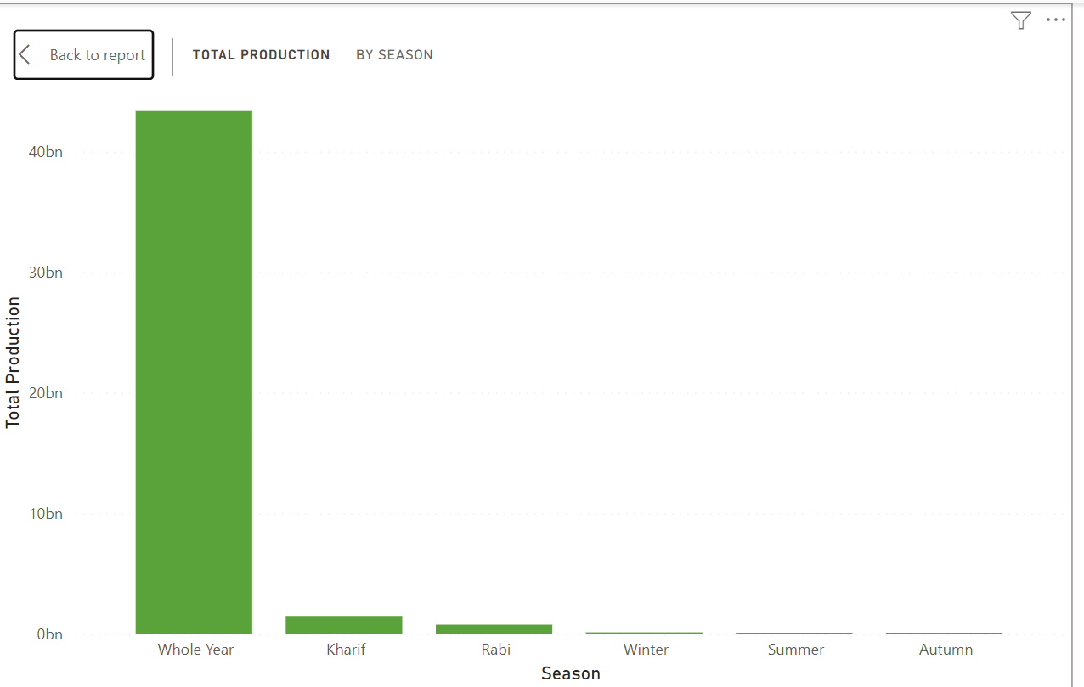
RESULTS
Total production by season
Demo Link

Slide 7
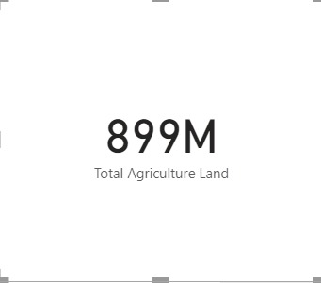
RESULTS
Total Agriculture Land
Demo Link

Slide 8
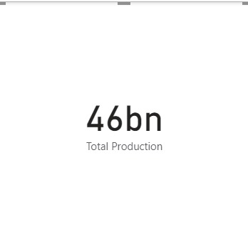
RESULTS
Total Production
Demo Link

Slide 9
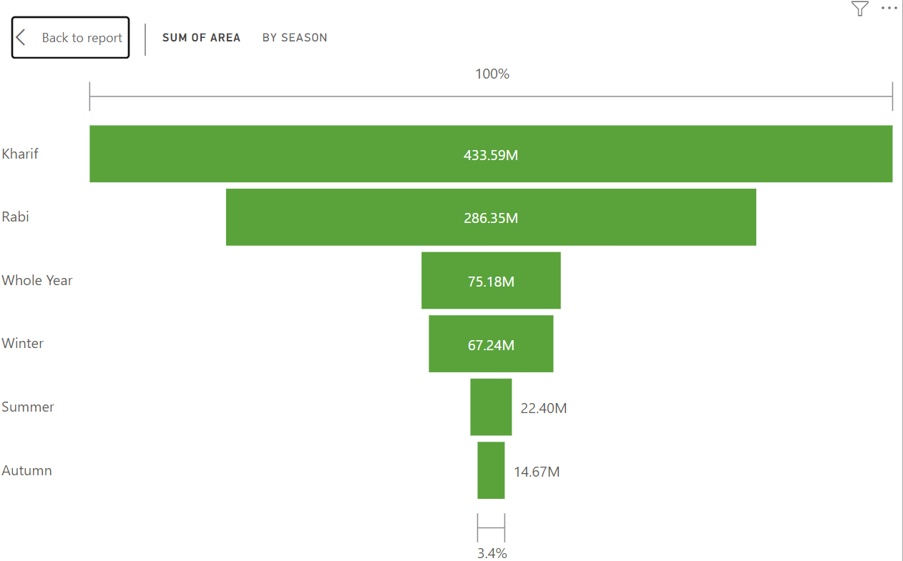
RESULTS
Sum of Area by Season
Demo Link

Slide 10
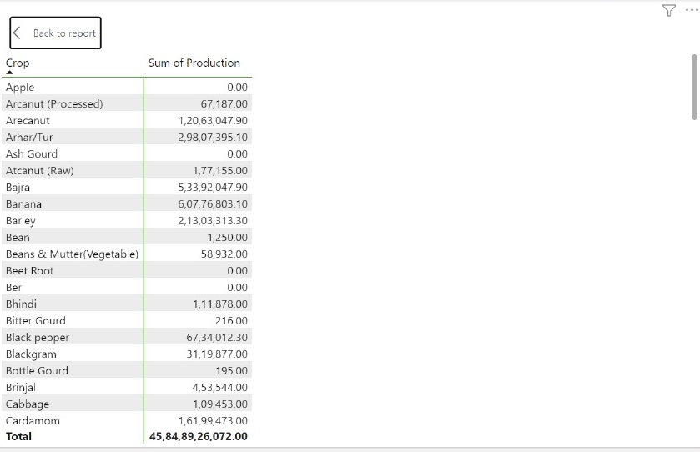
RESULTS
Sum of production by Crop
Demo Link

Slide 11
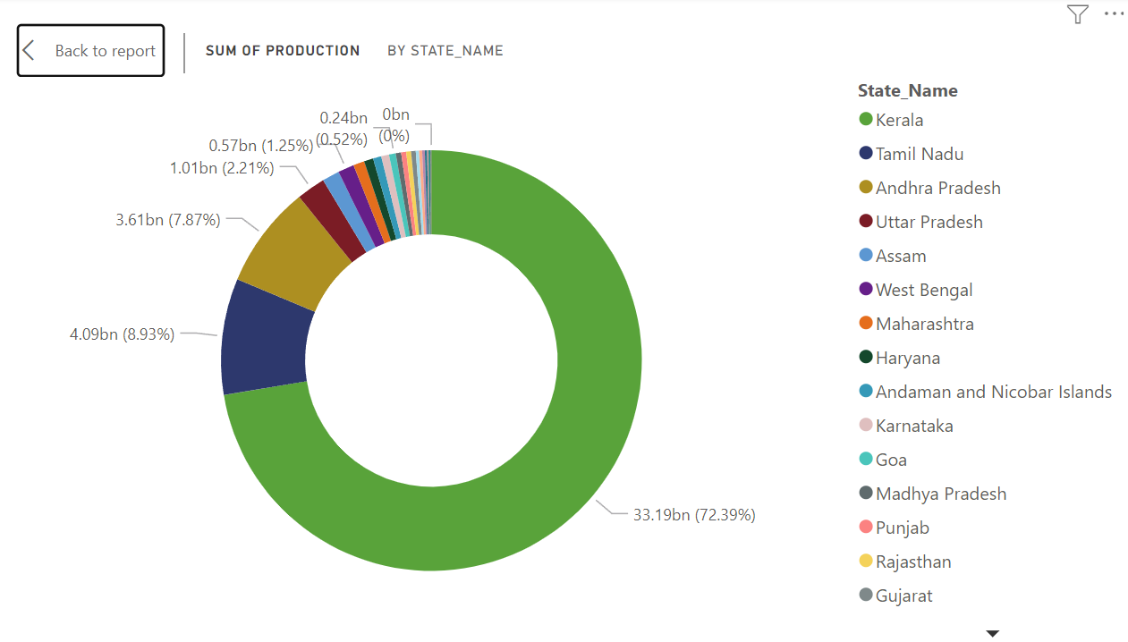
RESULTS
Sum of production by State_Name
Demo Link

Slide 12
Thank you
STU65d4f773ed1251708455795
.
.

