Slide 1


NEXT GEN EMPLOYABILITY PROGRAM
CREATING A FUTURE-READY WORKFORCE
Student Name :
Firdous Anjum
Student ID :
STU65d4f773ed1251708455795
Mobile No:
6202600583
Mail ID:
firdousanjum620@gmail.com
College Name :
C.V.Raman Global University

Slide 2
CAPSTONE PROJECT SHOWCASE
Project Title
Power BI Enabled Comprehensive Analysis on Unicorn Businesses
Abstract | Problem Statement | Project Overview | Proposed Solution | Technology Used | Modelling & Results | Conclusion | Q&A

Slide 3
Abstract
1
Define unicorn businesses as startups with valuations exceeding $1 billion and highlight their significance in the global economy.
2
Analyze the business models, market strategies, and innovation mechanisms driving unicorn success through case studies, industry insights, and academic research.
3
Explore the ecosystem surrounding unicorn businesses, including the role of venture capital, regulatory frameworks, and emerging trends shaping their trajectory.
4
Provide actionable recommendations for entrepreneurs, investors, and policymakers to foster sustainable growth and innovation, covering scaling strategies, risk mitigation tactics, and opportunities for leveraging the unicorn phenomenon.

Slide 4


Problem Statement
Which investor funded for most of the Unicorns?
Which country(s) dominates in terms of the
number of unicorn companies?
What is the total valuation of unicorn companies?
What are the top 15 industries ranked by valuation, and what insights can be derived?
How many unicorn companies have there been in the past 10 years?
What is the average time from establishment to becoming a unicorn company?
How has the number of unicorn companies joining the market evolved over the years?

Slide 5
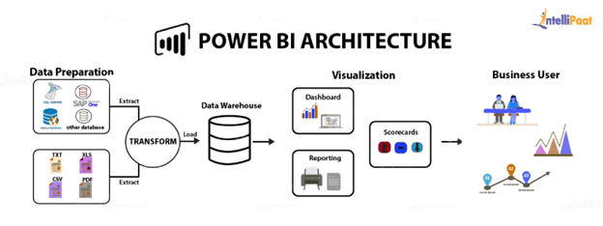
Project Overview
STEP1:
Data Collection , Data Cleaning and Pre Processing.
STEP2:
DAX Functions and Basic Visualization.
STEP3:
Analysis/Visualization.
STEP4:
Formatting and Testing.
STEP5:
Story Telling, Sharing.

Slide 6
Proposed Solution
I have identified the investor who funded most of the Unicorns using stacked bar chart.
I have identified which country(s) dominates in terms of the
number of unicorn companies using map chart.
I have identified total valuation of unicorn companies using card.
I have identified top 15 industries ranked by valuation using line and stacked column chart.
I have identified the number of unicorn companies in the past 10 years.
I have identified the average years of companies to become Unicorns using card.
I have identified the number of unicorn companies joining the market evolved over the years using line chart.

Slide 7

Technology used
PowerBI

Slide 8
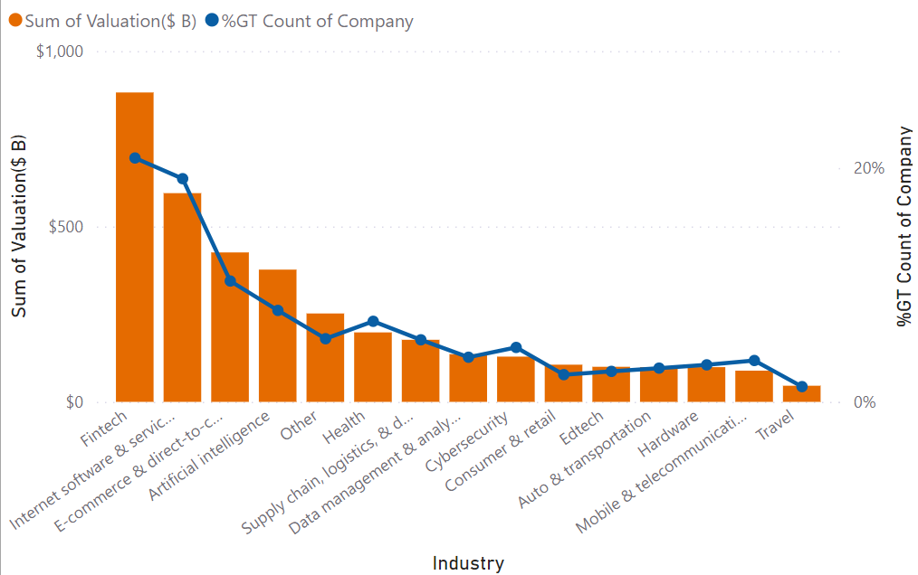
Modelling & Result
We can see the massive drive in valuation as we move away from Fintech Industry to Travel industries, despite the sinusoidal (rise and fall of) funding due to intermittent recession, the valuation of unicorn companies keep rising especially in the Fintech industry. At the highest valuation $882 of the Fintech Industry , this industry had total 20.86% companies. Other industries having counting percentage of company less than 20%.Internet software and E-commerce as they are the global leader holding more than 50% in total valuation.

Slide 9
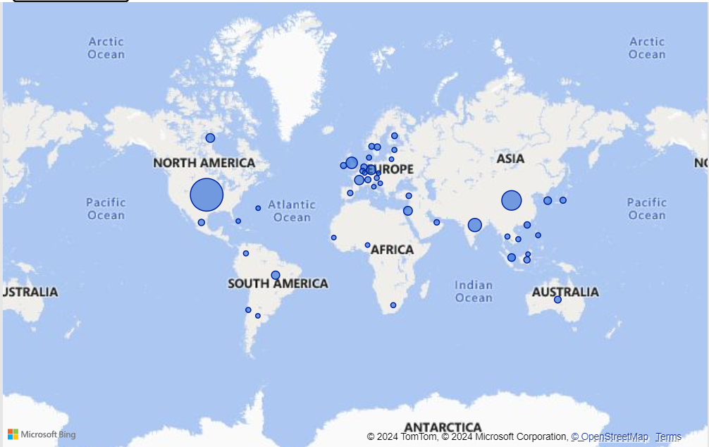
Modelling & Result
This represent the country(s) dominates in terms of the number of unicorn companies.In the dynamic landscape of unicorn companies, North America and Asia have seen a remarkable surge in their numbers. Notably, the United States(562), China(173), and India(65) maintain their top positions globally, owing to their robust ecosystems fostering innovation, access to capital, and market opportunities, thereby solidifying their dominance and influence in the global unicorn ecosystem.

Slide 10
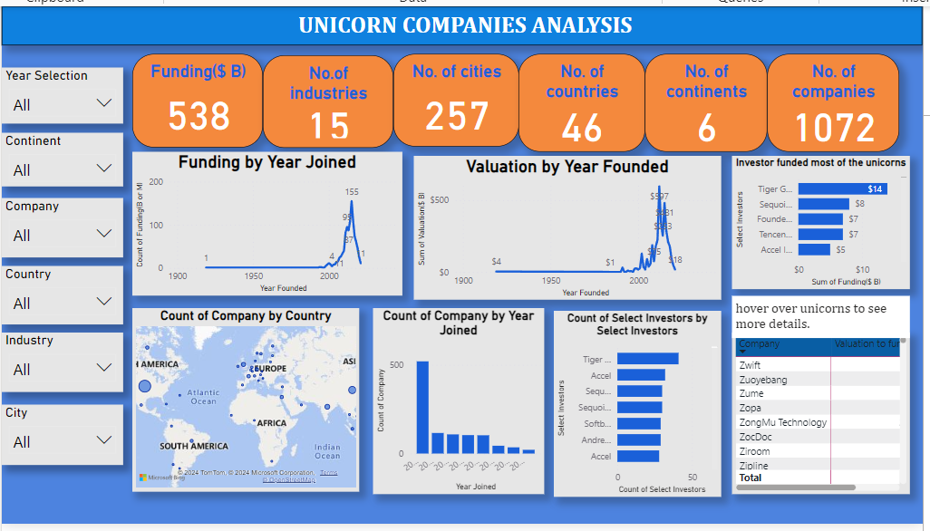
Modelling & Result

Slide 11
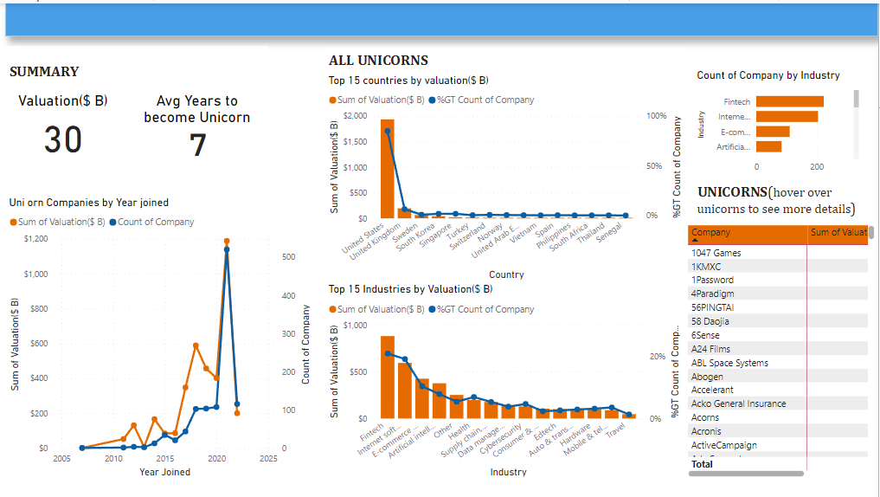
Dashboard2

Slide 12

Conclusion
This project was not just an exercise in data analysis but also a deep dive into the dynamic world of high-value startups.
The insights gained from this PowerBI analysis are invaluable for understanding the evolving patterns in the investment world.
As the unicorn company landscape continues to evolve, further analysis could focus on linking these trends with broader economic indicators.
The intersection of startup valuation with global economic shifts presents an intriguing area for future exploration.

Slide 13


Notes:
Thank You !!

