Slide 1
EmporiUm
Analysis
By Jordan Worrobah
Year Up United Data Analytics Academy
May 2026 | Internal Sales Analysis
Notes:
Good afternoon everyone. My name is Jordan Worrobah, and today I'll be presenting my EmporiUm Sales Analysis project. The goal of this analysis was to evaluate sales performance, customer behavior, and product trends across the Colorado and Florida territories to identify marketing opportunities

Slide 2

01
Project Overview
Business performance & market position
02
Data Cleaning & Preparation
Strengths, weaknesses, opportunities & threats
03
Territory Revenue Trends
Growth segments & competitive landscape
04
Product Performance Analysis
Key projects & implementation roadmap
Agenda
05
Rewards Program Opportunity
Revenue forecasts & investment requirements
06
Marketing Recommendation
Risk factors & mitigation strategies
07
Conclusion & Next Steps
Revenue forecasts & investment requirements
Notes:
I'll briefly cover the project overview, data preparation, key sales insights, customer and product analysis, my dashboard, and finally my marketing recommendations.

Slide 3
Project Overview
Key performance indicators and business health metrics
Project Goal
Analyze sales performance, customer purchasing behavior, and product trends to identify marketing opportunities for EmporiUm.
Territories Analyzed
Colorado
Florida
Datasets Used
customer_list
ProductCategories
Products
StoreDetail
StoreSales
Tools Used
Python
Pandas
NumPy
Matplotlib
Jupyter Notebook
Notes:
For this project, I analyzed five datasets including customer, product, store, and sales information. Using Python, Pandas, NumPy, and Matplotlib, I combined these datasets to identify trends in revenue, customer behavior, and product performance. The two territories analyzed were Colorado and Florida.

Slide 4
DATA CLEANING & PREPARATION
Data Cleaning
Dataset Integration
• Removed duplicate records
• Checked for missing values
• Standardized column formatting
• Converted date columns to datetime
• Combined StoreSales with Products
• Merged ProductCategories data
• Linked customer_list with RewardsID
• Created completed_sales_data table
Analysis Preparation
Visualization & Reporting
• Created monthly revenue metrics
• Grouped sales by territory
• Built product category summaries
• Calculated customer spending trends
• Built revenue trend charts
• Created rewards participation visuals
• Compared product category performance
• Designed dashboard summaries
Notes:
Before analysis, the data needed to be cleaned and integrated. I removed duplicates, checked for missing values, standardized formats, converted date fields, and merged multiple datasets into a single analytical dataset. This allowed me to create revenue trends, customer insights, and product performance reports.

Slide 5
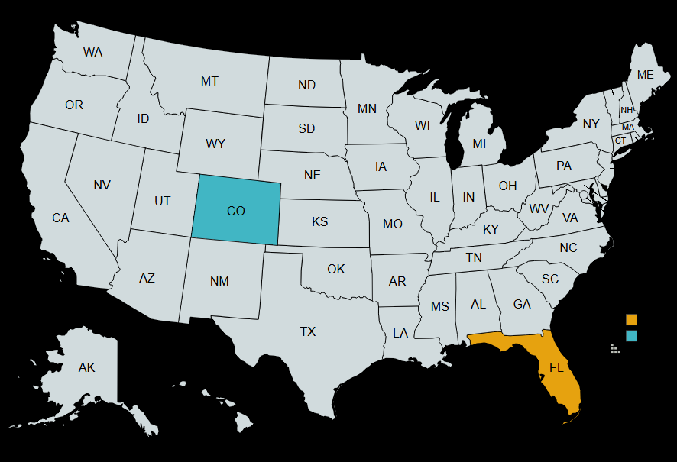
Territory & Store Insights
Comparing territory performance, store distribution, and revenue trends
Territory Managers
Store Locations
Colorado
Florida
Colorado (18)
Florida (11)
Jim Heck
Regional Manager, West
18 stores | $6.4M revenue
Lana Ilana
Regional VP, South
11 stores | $3.9M revenue
Denver Central, Boulder Plaza
Colorado Springs, Fort Collins
Aurora, Lakewood, Pueblo +5
Miami Flagship, Orlando Metro
Tampa Bay, Jacksonville
Fort Lauderdale, Naples +9
Territory Map
Territory Comparison
Metric
Colorado
Florida
Total Revenue
$6.4M
$3.9M
Store Count
18
11
Avg Revenue/Store
$359,212
$360,024
Top Store Revenue
$900K
$623K
Key Findings
•Colorado generated $6.4M in revenue, outperforming Florida's $3.9M during the analysis period.
Technology & Accessories was the highest-performing product category in both territories.
Colorado's top store generated $900K in revenue, while Florida's top store generated $623K.
Both territories experienced significant revenue spikes during holiday shopping periods, indicating strong seasonal demand
Top Category
Tech & Accessories
Tech & Accessories
Analysis period: January 2022 – December 2025 | Revenue figures shown in USD
Notes:
Colorado outperformed Florida in total revenue, generating $6.4 million compared to Florida's $3.9 million. Technology and Accessories was the top category in both territories. Colorado's highest-performing store generated $900,000 in revenue, while Florida's top store generated $623,000. These results suggest stronger overall performance in Colorado while both territories benefited from strong technology sales.

Slide 6
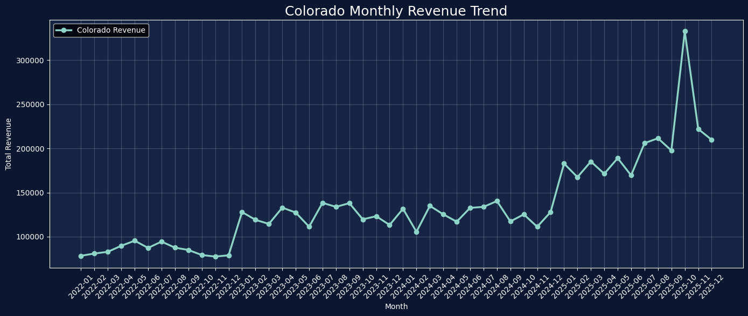
Monthly Revenue Insight
Colorado
2022
2023
2024
2025
Year-Month Sale Amount
Year-Month Sale Amount
Year-Month Sale Amount
Year-Month Sale Amount
2022-01 78,395.85
2022-02 80,954.78
2022-03 82,923.78
2022-04 89,744.65
2022-05 95,478.58
2022-06 87,313.86
2022-07 94,486.21
2022-08 87,594.39
2022-09 85,006.71
2022-10 79,259.43
2022-11 77,502.88
2022-12 78,952.14
2023-01 127,917.47
2023-02 119,171.52
2023-03 114,488.30
2023-04 132,922.50
2023-05 127,410.86
2023-06 111,296.09
2023-07 138,390.91
2023-08 133,808.33
2023-09 138,035.42
2023-10 119,690.04
2023-11 123,217.96
2023-12 113,347.61
2024-01 131,675.55
2024-02 105,561.36
2024-03 134,963.55
2024-04 125,369.81
2024-05 116,987.72
2024-06 132,699.28
2024-07 133,808.33
2024-08 140,398.04
2024-09 117,327.42
2024-10 125,294.68
2024-11 111,270.89
2024-12 127,917.47
2025-01 182,886.78
2025-02 167,510.14
2025-03 185,166.50
2025-04 171,301.53
2025-05 188,975.64
2025-06 169,489.59
2025-07 206,038.09
2025-08 211,498.13
2025-09 197,680.18
2025-10 332,771.12
2025-11 222,040.27
2025-12 209,879.57
Notes:
Looking at revenue trends over time, both territories showed consistent growth from 2022 through 2025. The most significant spikes occurred during the holiday shopping season, particularly in October through December. This suggests that seasonal demand plays a major role in driving revenue and supports the need for earlier holiday marketing campaigns.

Slide 7
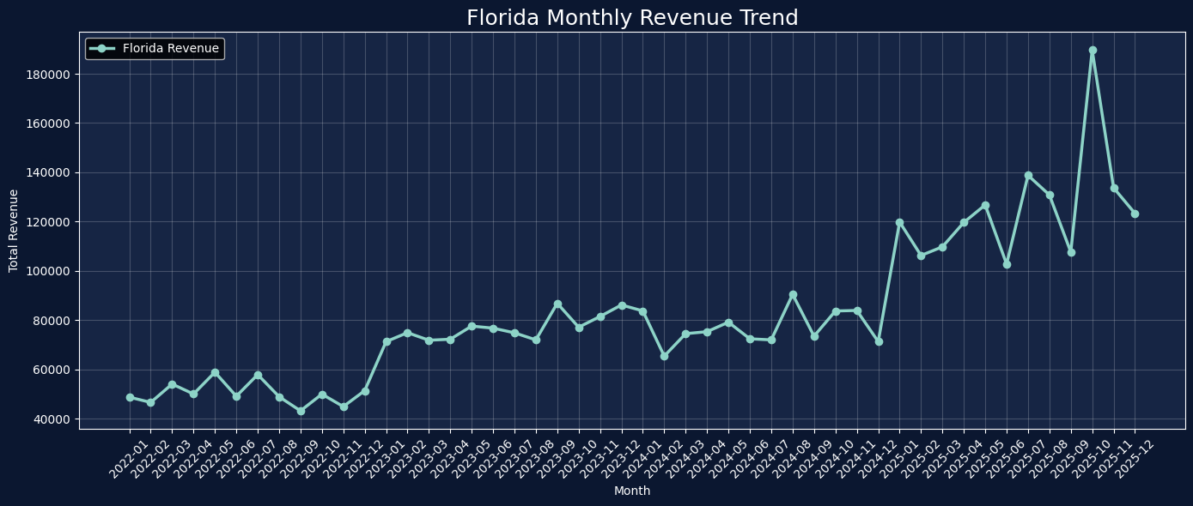
Monthly Revenue Insight
Florida
2022
2023
2024
2025
Year-Month Sale Amount
Year-Month Sale Amount
Year-Month Sale Amount
Year-Month Sale Amount
2022-01 48,714.32
2022-02 46,584.27
2022-03 54,035.48
2022-04 49,992.58
2022-05 58,840.26
2022-06 49,094.30
2022-07 57,878.63
2022-08 48,894.58
2022-09 43,158.35
2022-10 49,940.49
2022-11 44,889.15
2022-12 51,341.52
2023-01 71,256.76
2023-02 74,897.15
2023-03 71,825.23
2023-04 72,229.54
2023-05 77,567.47
2023-06 76,731.43
2023-07 74,824.49
2023-08 71,969.34
2023-09 86,814.75
2023-10 77,102.21
2023-11 81,471.29
2023-12 86,153.52
2024-01 83,723.98
2024-02 65,369.70
2024-03 74,495.18
2024-04 75,301.83
2024-05 79,150.41
2024-06 72,405.51
2024-07 71,969.34
2024-08 90,439.44
2024-09 73,477.52
2024-10 83,709.15
2024-11 83,915.66
2024-12 71,256.76
2025-01 119,833.44
2025-02 106,236.92
2025-03 109,751.26
2025-04 119,652.61
2025-05 126,761.48
2025-06 102,722.61
2025-07 138,769.94
2025-08 130,828.97
2025-09 107,625.79
2025-10 189,635.49
2025-11 133,705.08
2025-12 123,321.62
Notes:
Looking at revenue trends over time, both territories showed consistent growth from 2022 through 2025. The most significant spikes occurred during the holiday shopping season, particularly in October through December. This suggests that seasonal demand plays a major role in driving revenue and supports the need for earlier holiday marketing campaigns.

Slide 8
STORE PERFORMANCE INSIGHT
Ranked store performance, territory comparisons, and actionable business insights
Top Performing Stores
Territory Comparison
#
Store
Territory
Revenue
Store ID
Colorado
Florida
1
Denver
Colorado
$900K
705
$6.4M
18 stores | Avg $359,212/store
$3.9M
11 stores | Avg $360,024/store
2
Greeley
Colorado
$646K
709
3
Miami
Florida
$623K
724
4
Tallahassee
Florida
$546K
728
5
Cape Canaveral
Florida
$333K
722
6
Jacksonville
Florida
$333K
721
7
Sebring
Florida
$332K
727
Ranked by 48-month revenue | All stores showing growth
Business Insights
Denver generated the highest revenue among all stores.
Colorado contains 2 of the top 3 performing stores.
Florida stores remain competitive with strong transaction volume.
Notes:
When ranking stores by revenue, Denver was the top-performing store overall. Colorado contained two of the top three stores in the analysis. Florida remained competitive with multiple high-performing locations, but Colorado generated stronger overall territory performance.

Slide 9
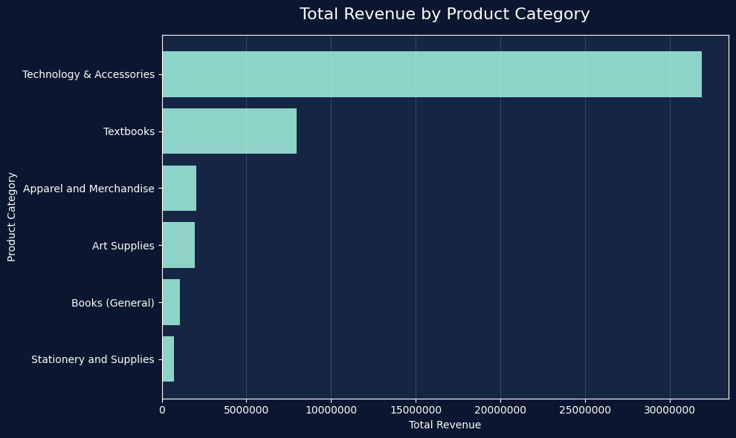
Transaction & Product Insights
Key Financial Metrics
$31,891,406.58
Revenue Generated
$45.2M
$7,961357.21
Top Category
Technology& Accessories
$2,043382.60
Peak Sales Period
Holiday Season
$1,938,358.84
Lowest Category
Stationery & Supplies
$1,070,718.51
Strongest Territory
Colorado
$702,088.52
Key Demand Driver
Technology Purchases
Notes:
Technology and Accessories was the dominant product category, generating more than $31.9 million in revenue. Lower-performing categories such as Stationery, Books, and Art Supplies contributed significantly less revenue. This creates an opportunity to use promotions, bundles, and rewards incentives to increase sales in those categories.

Slide 10
Customers Insight
Spending behavior, rewards program participation, and high-value customer insights
184,320
10.4%
$17,534.76
Total Customers
Rewards Participation
Highest Revenue Customer
Customer Spending
Rewards Participation
Top Customers
Customers
Gloria Mendoza
$17,534
Ben Chang
$17,494
Cole Brown
$17,440
Key Customer Insights
Only 10.4% of transactions are tied to rewards members
Rewards Avg Transaction = $133.38
Non-Rewards Avg Transaction = $131.44
Spending is nearly identical between groups
Biggest opportunity = increase rewards enrollment
Stanley H.
$16,533
C.J. Cregg
$16,520
Data as of May 2026 | Trailing 12-month period | All spend figures monthly avg
Notes:
Customer analysis revealed that only 10.4% of transactions were tied to rewards members. Interestingly, rewards customers and non-rewards customers spent almost the same amount per transaction, around $133 and $131 respectively. This suggests the biggest opportunity is not increasing spending per purchase, but increasing rewards program participation.

Slide 11
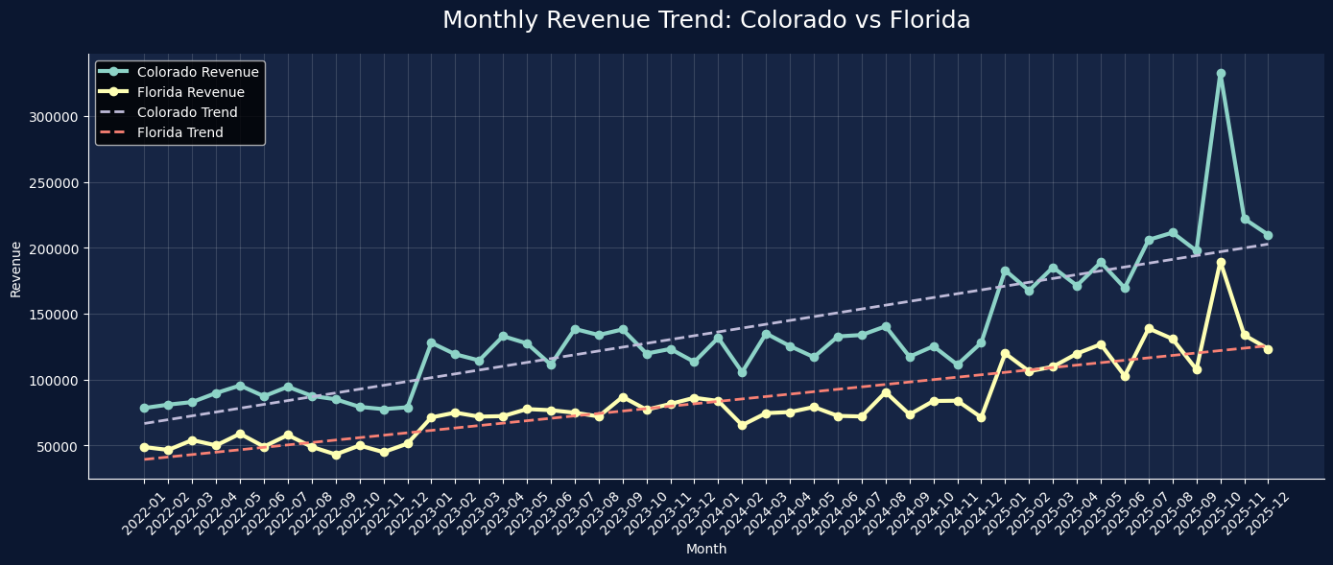
Dashboard Overview
EmporiUm sales performance, territory trends, and rewards program insights
$45.2M
347K+
Colorado
Tech & Accessories
Total Revenue
Total Transactions
Top Territory
Top Product Category
Key Insights
Revenue trended upward across both territories, with a major holiday-season spike.
Colorado led territory performance, while Florida still showed strong transaction volume.
Technology & Accessories was the top revenue category, creating a clear seasonal promotion opportunity.
• Most transactions came from non-rewards customers, showing an opportunity to expand rewards enrollment.
10.4%
89.6%
Notes:
This dashboard summarizes the key findings from the analysis. It highlights total revenue of $45.2 million, more than 347,000 transactions, Colorado as the top territory, Technology and Accessories as the leading category, and the opportunity to expand rewards enrollment

Slide 12


Marketing Recommendation
Holiday Promotion Strategy
Rewards Program Expansion
Promote top-selling Technology & Accessories products before holiday shopping periods to capture demand earlier and maximize seasonal revenue.
Increase rewards enrollment by targeting non-rewards customers and offering bonus points for repeat purchases.
Expected Impact: Increase seasonal revenue
Expected Impact: Improve customer retention
Customer Retention Focus
Lower Category Support
Use customer purchase data to identify high-value shoppers and create targeted offers that encourage repeat visits.
Use bundles, discounts, and rewards incentives to increase sales for lower-performing categories like Stationery, Books, and Art Supplies.
Expected Impact: Increase repeat purchases
Expected Impact: Diversify revenue sources
The recommendation is based on revenue trends, product category performance, store rankings, and customer rewards behavior.
Notes:
Based on the analysis, I recommend focusing on four areas. First, promote Technology and Accessories before holiday shopping periods. Second, expand rewards enrollment to improve customer retention. Third, use customer data to target high-value shoppers with personalized offers. Finally, support lower-performing categories through promotions, bundles, and rewards incentives

Slide 13

Conclusion & Next Steps
Key Takeaways
Recommended Next Steps
Generated $45.2M in total revenue across the analysis period
Expand Rewards Enrollment
Q1
Colorado outperformed Florida in total revenue
Offer sign-up incentives at checkout
Promote bonus point campaigns
Launch Holiday Marketing Campaigns
Q2
Technology & Accessories generated over $31.9M, making it the strongest category
Focus on Technology & Accessories
Start promotions before peak shopping periods
Only 10.4% of transactions were tied to rewards members, creating a major growth opportunity
Retain Top Customers
Q3
Personalized offers
Exclusive rewards benefits
Revenue consistently increased over time, with strong holiday-season spikes
Grow Lower Performing Categories
Q4
Bundle products
Cross-sell during checkout
Category-specific discounts
Notes:
To conclude, the analysis showed that Colorado led overall revenue performance, Technology and Accessories dominated sales, holiday periods generated the strongest revenue growth, and the rewards program presents a significant opportunity for expansion. By focusing marketing efforts in these areas, EmporiUm can improve both customer retention and future revenue growth. Thank you, and I'm happy to answer any questions.

Slide 14
Thank You
EmporiUm Sales Analysis | May 2026
Jordan Worrobah
Year Up United Data Analytics Academy
Email: JordanWorrobah@gmail.com
LinkedIn: Jordan Worrobah
Date: May 2026
GitHub: https://github.com/Fire-Cricket

