Slide 1
Jordan Worrobah Data Analyst
EmporiUm Sales Performance South Region Analysis
Notes:
Today I'd like to walk you through an investigation, EmporiUm has four years of sales history across both online and physical stores. Rather than just asking what happened, I wanted to answer a more valuable business question

Slide 2
Agenda
The Business Problem
Initial Hypotheses
Preparing the Data
Testing the Evidence
South Region Findings
Business Recommendations
Key Takeaways & Questions
Notes:
First, we'll define the business problem.
Then I'll explain the assumptions I made before looking at the data.
Next I'll briefly explain how the data was prepared so we know the analysis is trustworthy.
From there we'll test those assumptions using Power BI before finishing with recommendations for the South Region.

Slide 3
Before I even opened Power BI I wanted to answer one question
Can the South Region Predict Seasonal Demand?
Notes:
Before I even opened Power BI, I wanted to answer one question…Can the South Region Predict Seasonal Demand? If seasonal demand exists, we can make smarter decisions around inventory planning, staffing, promotions, and online campaigns. If it doesn't exist, then reacting month by month may be the best strategy.
At this point we don't know the answer.
Before looking at any data, I created several hypotheses that I expected the analysis might support.

Slide 4
To answer our business question, I analyzed four years of sales data looking for recurring patterns.
• Sales trends over time
• Highest-performing categories
• Strongest and weakest states
• Top-selling books
• Opportunities within the South region
Notes:
To answer this question I analyzed four years of sales data, and I discovered

Slide 5
What Did We Expect to Find?
Initial
Hypotheses

Slide 6
Predictions Timeline
Sales decline after the holidays as consumer spending slows
Students return to school, creating increased demand for educational books and technology products
Q1
Winter Slowdown
Q2
Spring Purchasing
Q3
Back-to-School
Q4
Holiday Season
Students begin preparing for finals and summer courses, increasing purchases of textbooks and technology
Holiday shopping and promotional events create the year's largest sales spike
Notes:
I first considered what I would expect to happen throughout a typical retail year. I expected January and February to be the slowest months after holiday spending declines. Second, I anticipated stronger sales during the spring as students prepare for finals and summer classes. I expected another increase during the back-to-school season when students purchase textbooks and technology. Finally, I predicted the largest spike would occur during the holiday shopping season. These are only predictions. Now let's see if the data supports them.

Slide 7
Predictions Timeline
Sales decline after the holidays as consumer spending slows
Students return to school, creating increased demand for educational books and technology products
Q1
Winter Slowdown
Q2
Spring Purchasing
Q3
Back-to-School
Q4
Holiday Season
Students begin preparing for finals and summer courses, increasing purchases of textbooks and technology
Holiday shopping and promotional events create the year's largest sales spike
Notes:
I first considered what I would expect to happen throughout a typical retail year. I expected January and February to be the slowest months after holiday spending declines. Second, I anticipated stronger sales during the spring as students prepare for finals and summer classes. I expected another increase during the back-to-school season when students purchase textbooks and technology. Finally, I predicted the largest spike would occur during the holiday shopping season. These are only predictions. Now let's see if the data supports them.

Slide 8
Predictions Timeline
Sales decline after the holidays as consumer spending slows
Students return to school, creating increased demand for educational books and technology products
Q1
Winter Slowdown
Q2
Spring Purchasing
Q3
Back-to-School
Q4
Holiday Season
Students begin preparing for finals and summer courses, increasing purchases of textbooks and technology
Holiday shopping and promotional events create the year's largest sales spike
Notes:
I first considered what I would expect to happen throughout a typical retail year. I expected January and February to be the slowest months after holiday spending declines. Second, I anticipated stronger sales during the spring as students prepare for finals and summer classes. I expected another increase during the back-to-school season when students purchase textbooks and technology. Finally, I predicted the largest spike would occur during the holiday shopping season. These are only predictions. Now let's see if the data supports them.

Slide 9
Predictions Timeline
Sales decline after the holidays as consumer spending slows
Students return to school, creating increased demand for educational books and technology products
Q1
Winter Slowdown
Q2
Spring Purchasing
Q3
Back-to-School
Q4
Holiday Season
Students begin preparing for finals and summer courses, increasing purchases of textbooks and technology
Holiday shopping and promotional events create the year's largest sales spike
Notes:
I first considered what I would expect to happen throughout a typical retail year. I expected January and February to be the slowest months after holiday spending declines. Second, I anticipated stronger sales during the spring as students prepare for finals and summer classes. I expected another increase during the back-to-school season when students purchase textbooks and technology. Finally, I predicted the largest spike would occur during the holiday shopping season. These are only predictions. Now let's see if the data supports them.

Slide 10
Predictions Timeline
Sales decline after the holidays as consumer spending slows
Students return to school, creating increased demand for educational books and technology products
Q1
Winter Slowdown
Q2
Spring Purchasing
Q3
Back-to-School
Q4
Holiday Season
Students begin preparing for finals and summer courses, increasing purchases of textbooks and technology
Holiday shopping and promotional events create the year's largest sales spike
Notes:
I first considered what I would expect to happen throughout a typical retail year. I expected January and February to be the slowest months after holiday spending declines. Second, I anticipated stronger sales during the spring as students prepare for finals and summer classes. I expected another increase during the back-to-school season when students purchase textbooks and technology. Finally, I predicted the largest spike would occur during the holiday shopping season. These are only predictions. Now let's see if the data supports them.

Slide 11
The cleaning process
Preparing
Reliable Data

Slide 12
Building a Reliable Data Model
Import Data | Merged multiple business tables into one Power BI model.
Clean & Transform | Removed unnecessary columns Corrected data types Handled missing values
Build Relationships | Connected sales, products, regions, stores, and dates.
Create Date Table | Enabled accurate monthly and yearly trend analysis.
Create DAX Measures | Top State, 4-Year Revenue, Top Store, Online Revenue, In-Store Revenue
Validate Results | Verified South Region assignments Confirmed totals matched source data
Notes:
Before testing any of our hypotheses, we first needed to make sure the data was reliable.
I imported multiple tables into Power BI and cleaned the data by removing unnecessary fields, correcting data types, and ensuring consistent formatting.
Next, I built relationships between the tables and created a dedicated Date table to support time-based analysis.
I then created DAX measures to calculate key business metrics such as revenue, online sales, and orders.
Finally, I validated the calculations and confirmed that stores were assigned to the correct regions.
Once I trusted the data, I could confidently test our hypotheses.

Slide 13
Testing the Evidence

Slide 14
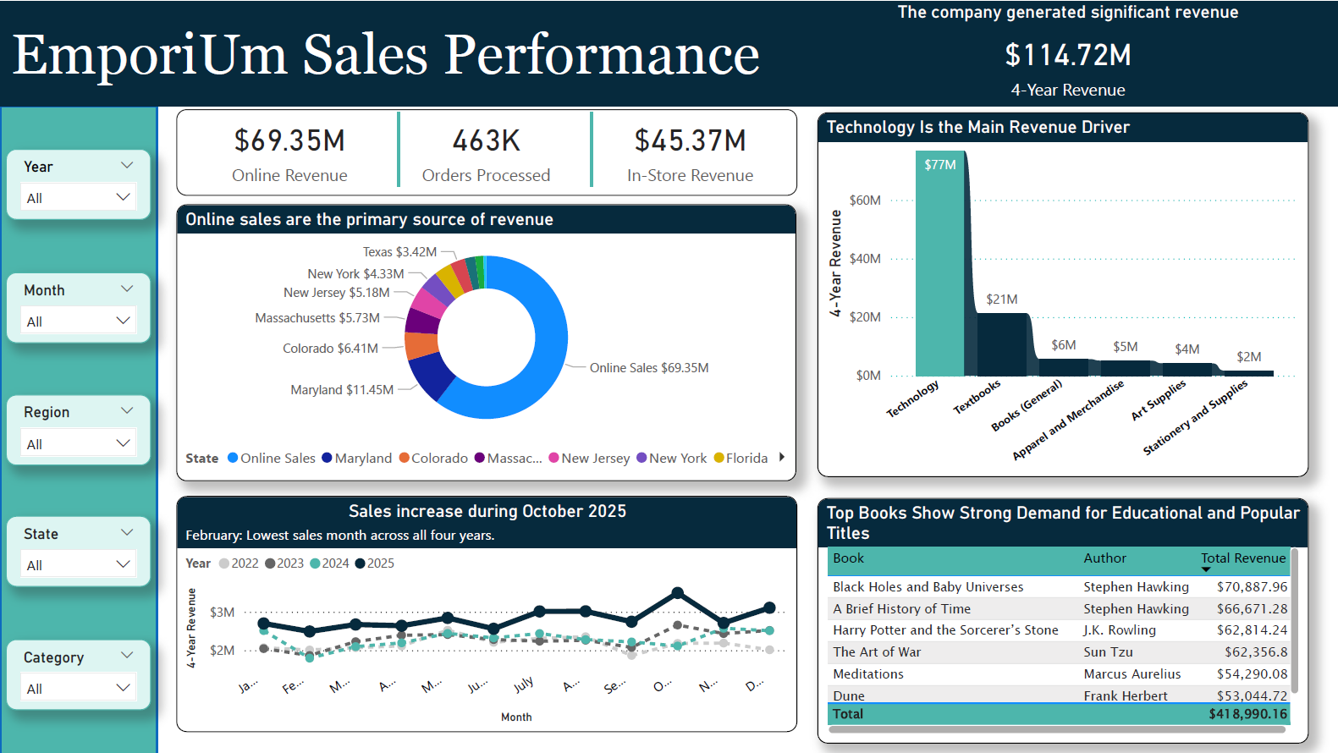
Notes:
The first thing I looked for was whether demand followed a predictable pattern.
Immediately one trend stood out.
February consistently produced the weakest sales across multiple years.
I also noticed Technology generated substantially more revenue than every other category.
Finally, online revenue exceeded in-store revenue, suggesting changing customer buying habits.
At this point, several of my original hypotheses had been supported.
But one question remained.
Did these same patterns exist in the South Region?

Slide 15
South Region Findings

Slide 16
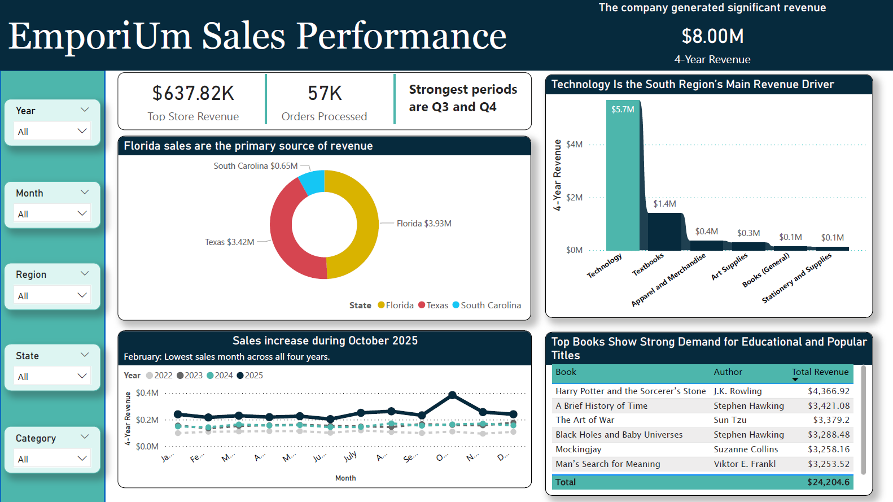
Notes:
When I narrowed the analysis to the South Region, three findings stood out immediately. Florida dominates. Technology dominates. February remains weak.

Slide 17
Business Recommendations

Slide 18
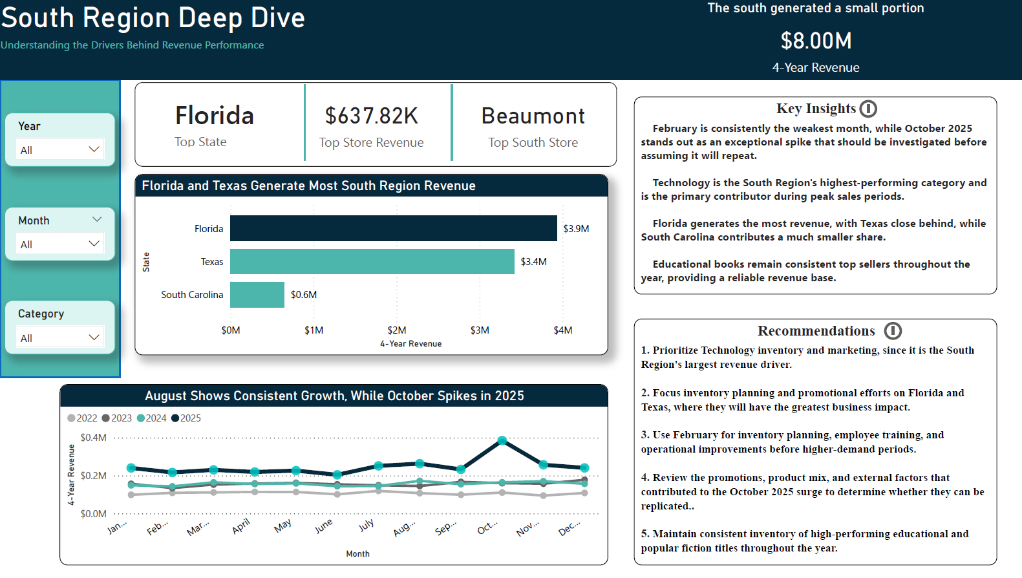
Notes:
Technology generates the highest revenue by a wide margin. Florida and Texas generate nearly all South Region revenue. February is consistently the weakest sales month. October 2025 experienced an exceptional spike that was not repeated every year. Educational books remain among the top-selling titles.

Slide 19
Key Takeaways
&
Questions

Slide 20
CASE CLOSED
✓ YES
The analysis identified recurring sales patterns and clear revenue drivers that can be used to improve planning.
Can the South Region Predict Seasonal Demand?
The opportunity isn't finding more data—it's using the insights already available to prepare earlier, allocate resources more effectively, and make more proactive business decisions.
Notes:
We began with one question. Are there predictable seasonal trends we can prepare for? The answer is yes.

Slide 21
Thank you
Jordan wORROBAH linkedin: jordan worrobah Jordanworrobah@gmail.com github: Fire-Cricket

