Slide 1
Bengaluru / Hyderabad Housing Market Analysis
All 5 Tableau dashboards, one slide each. Full workbook and write-up: github.com/FirePhoenix007/housing-market-analytics

Slide 2
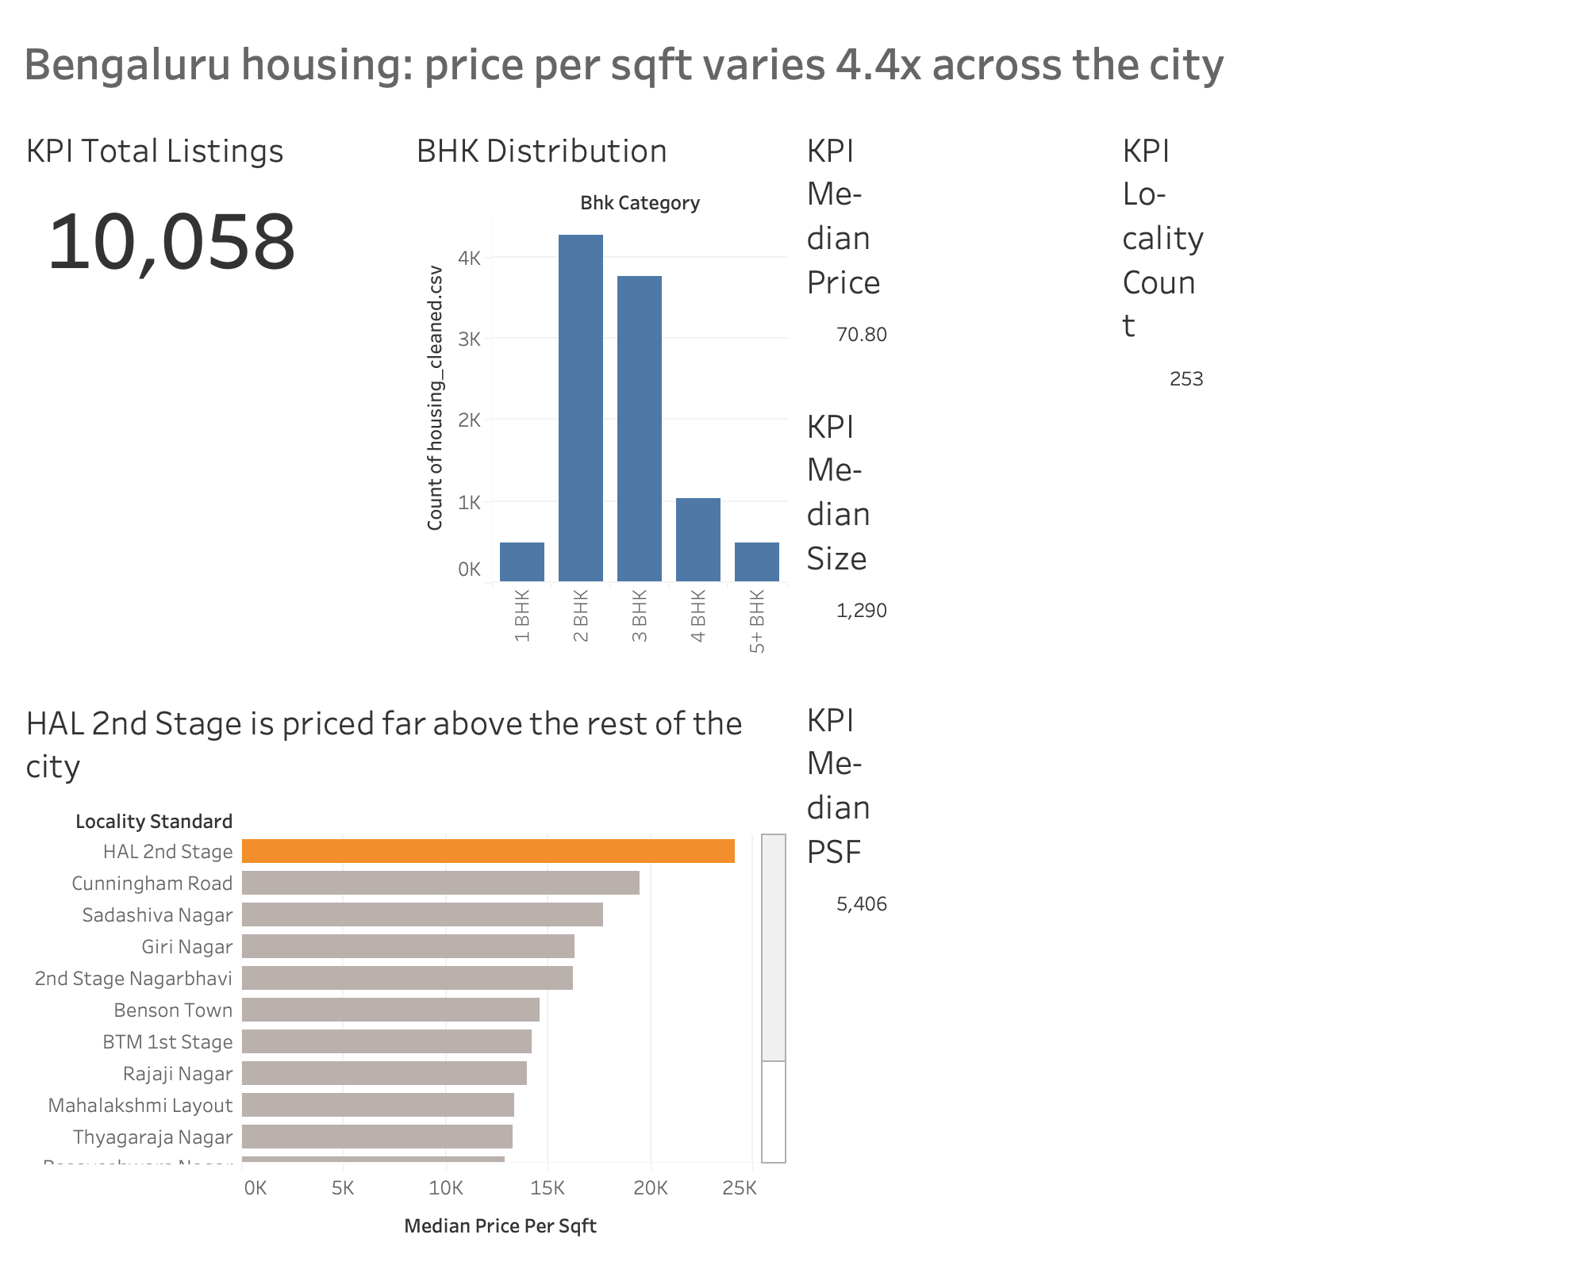
1. Market Overview
A live KPI strip, BHK breakdown, and the top 15 areas by price per sqft.

Slide 3
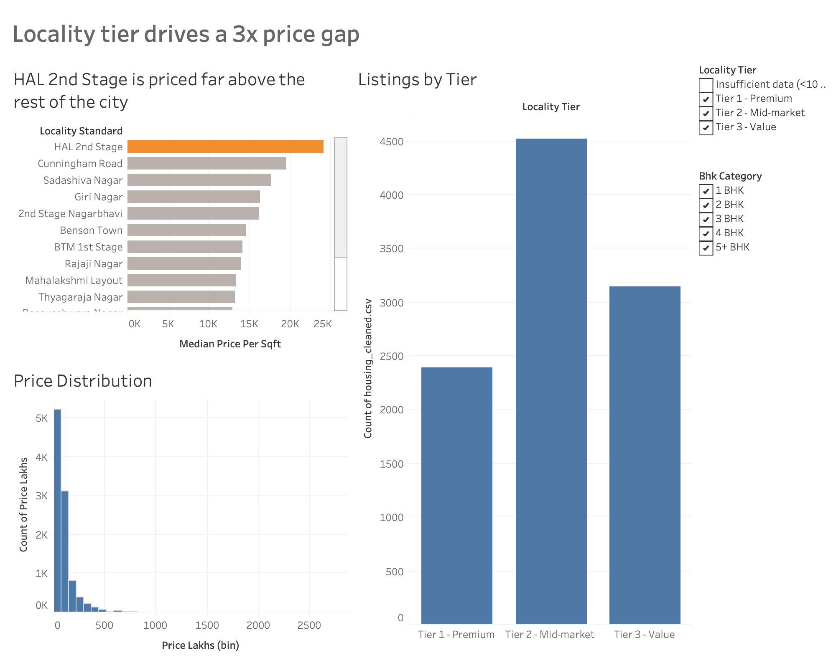
2. Locality Intelligence
Top areas by price, a price-distribution histogram, and listings by tier.

Slide 4
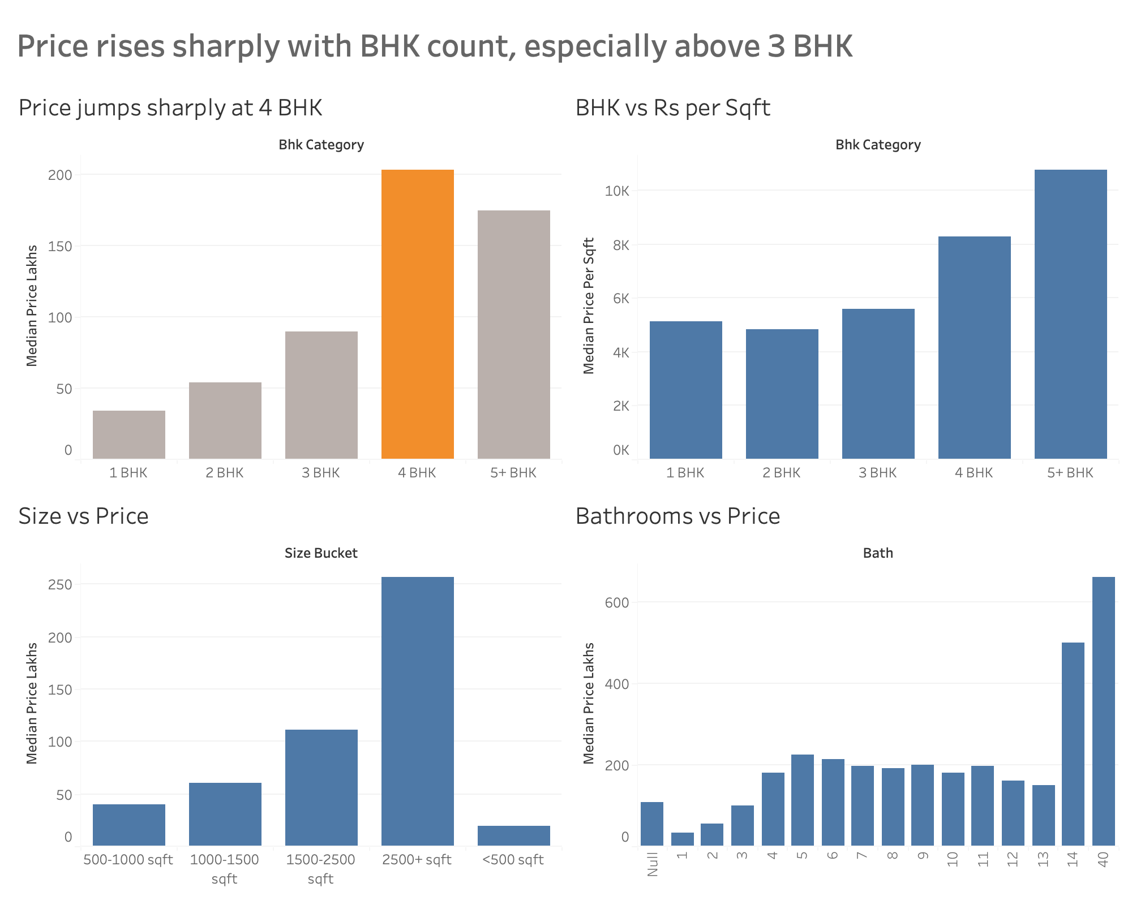
3. Property and BHK Analysis
How price changes with BHK count, floor size, and bathroom count.

Slide 5
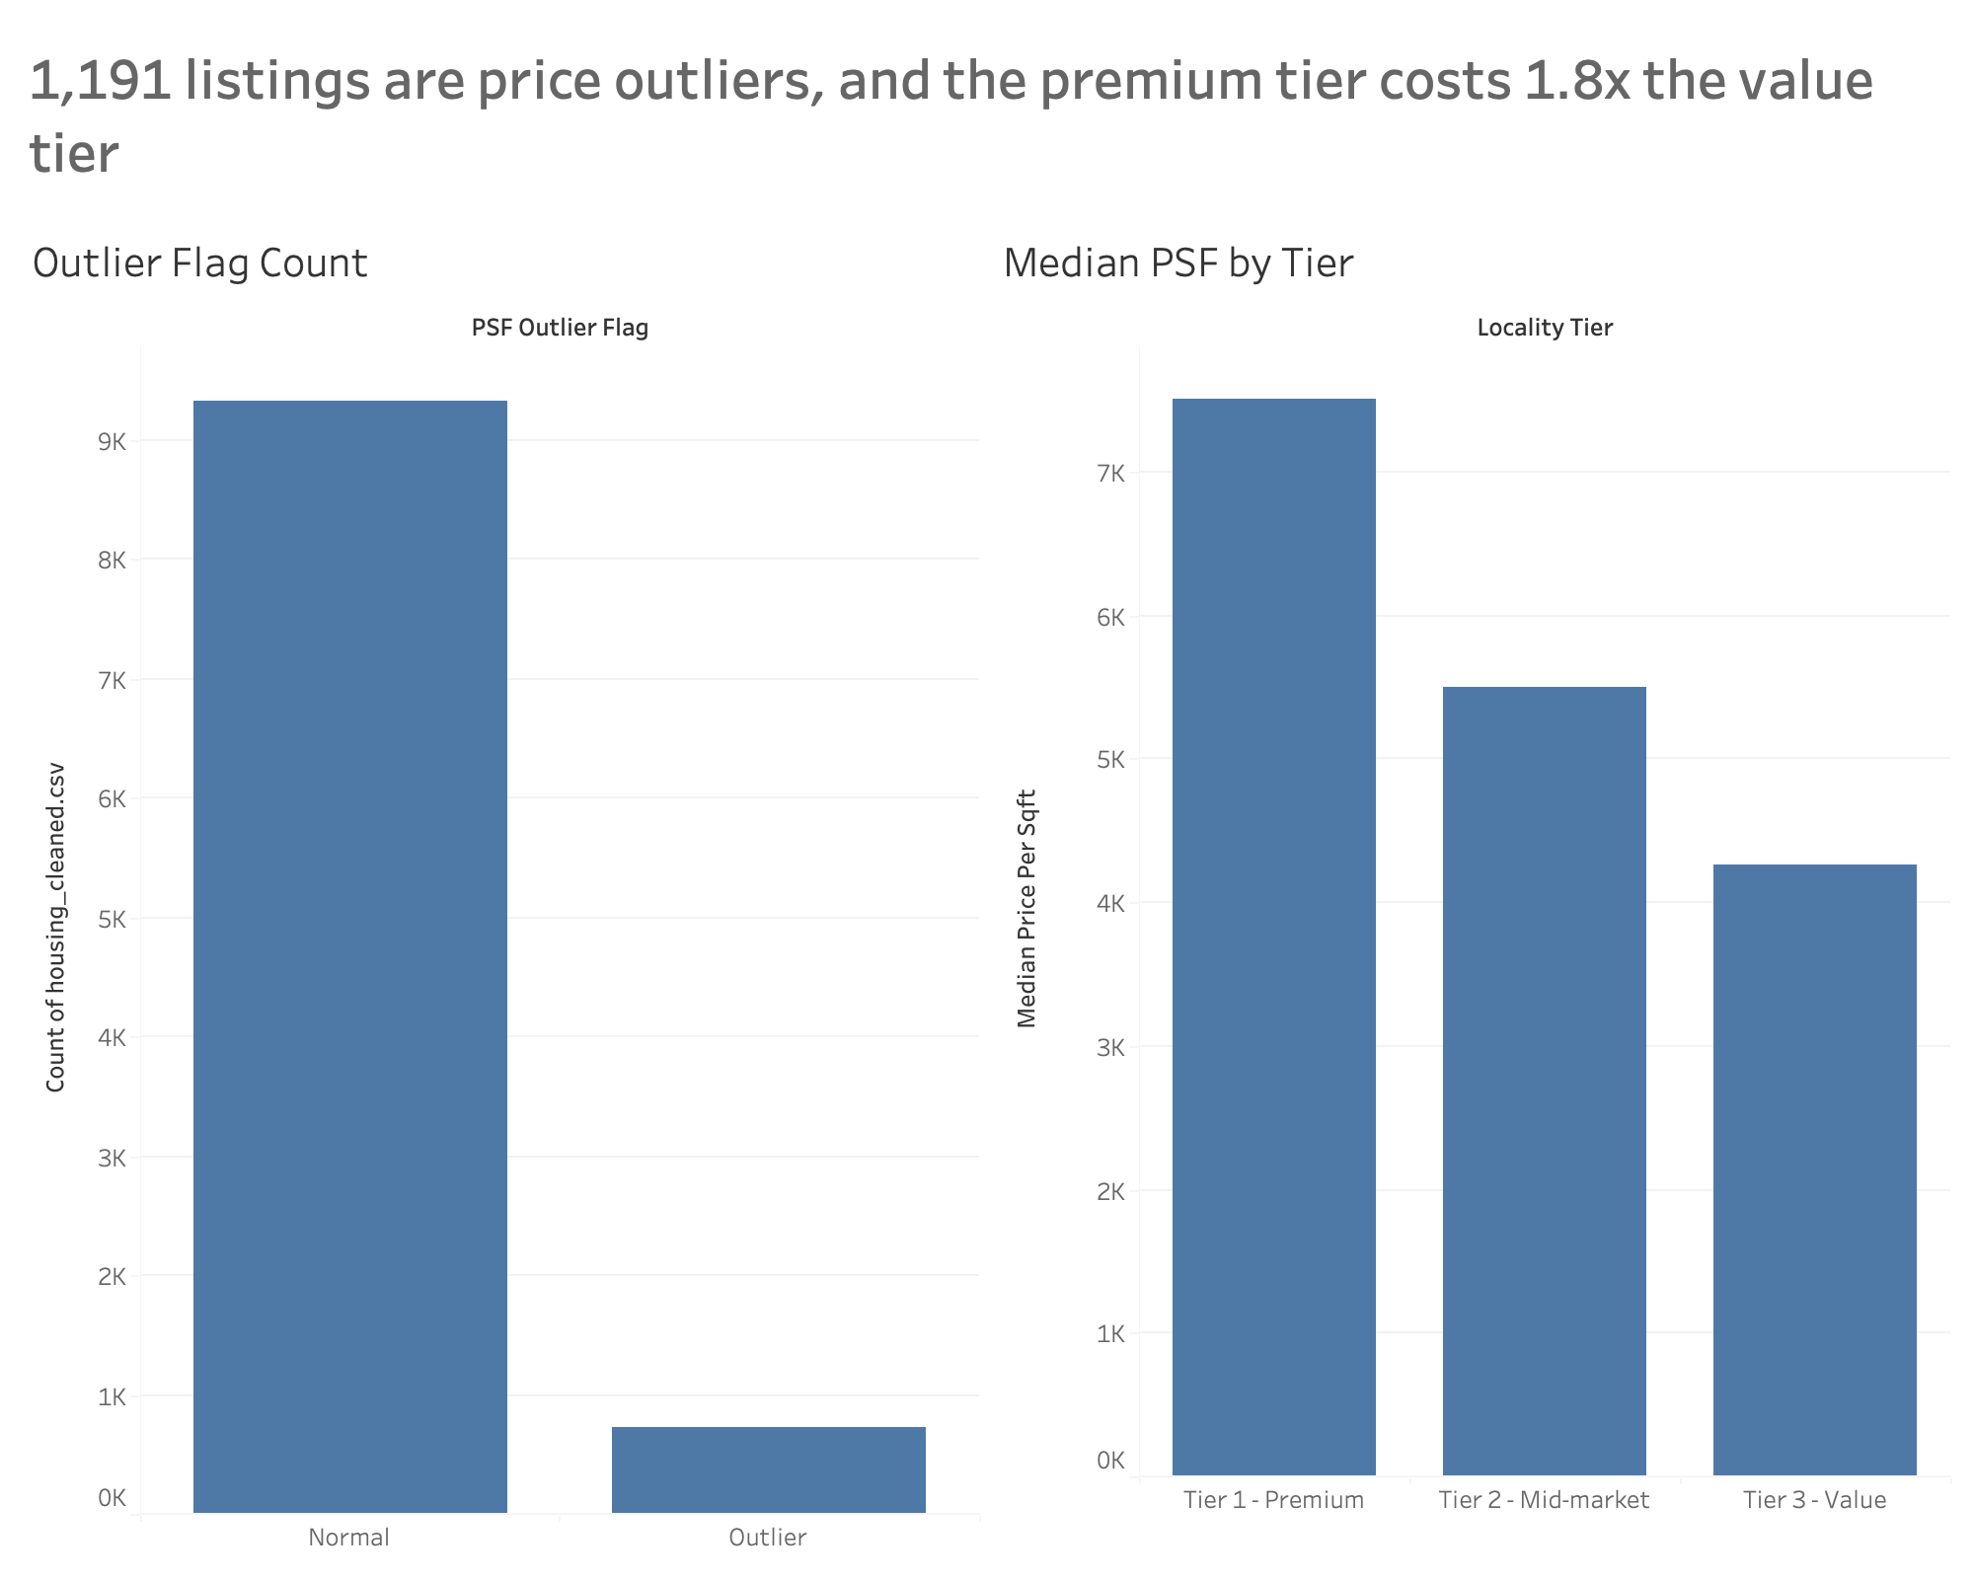
4. Value and Outlier Analysis
Which listings look like statistical outliers, and median price per sqft by tier.

Slide 6
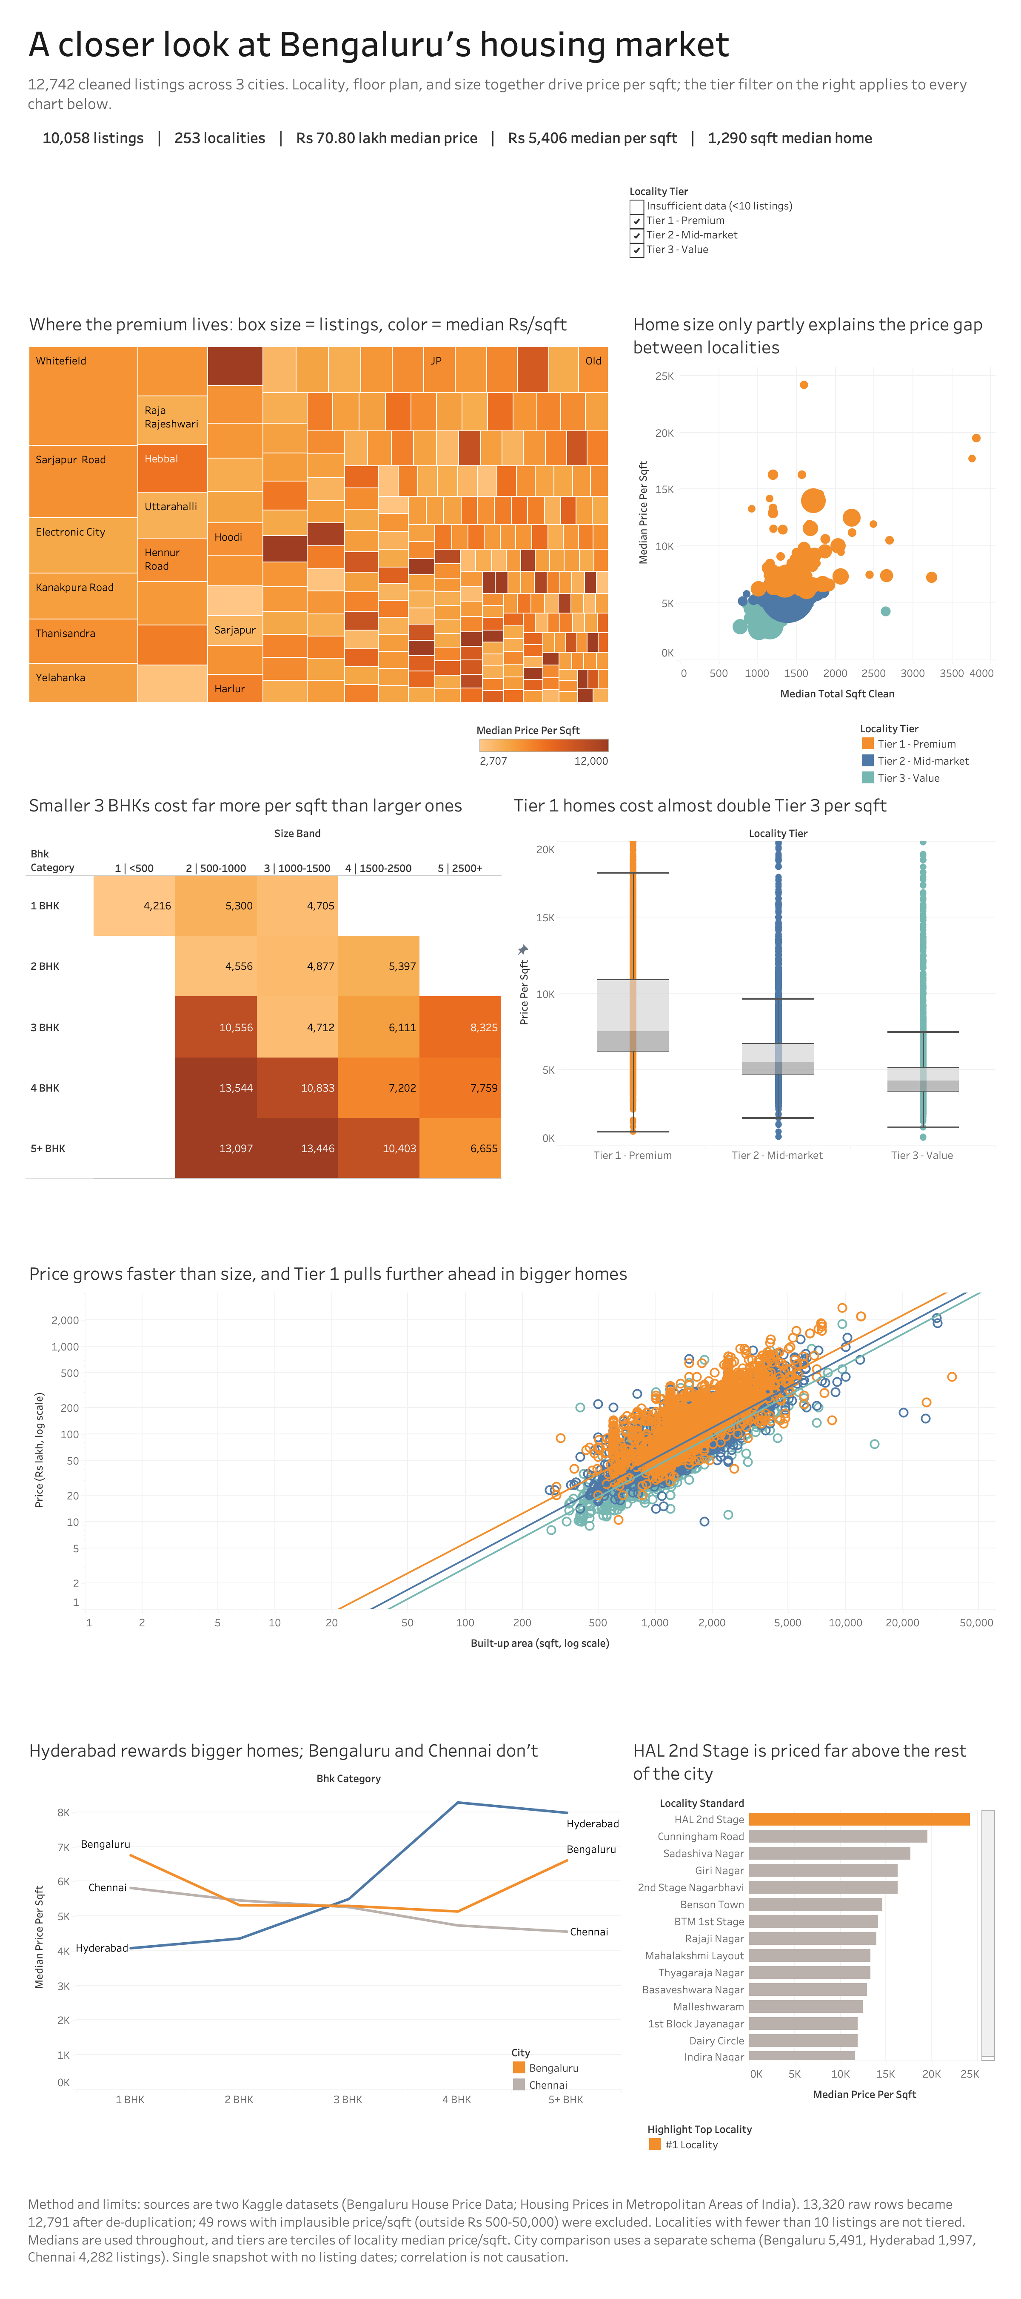
5. Market Story
The full scrolling story: treemap, bubble chart, heat map, box plot, scatter plot, city comparison, and top 15 areas -- all on one filter.

