Slide 1
Maps and tiles FULL
Examples
Map
>1 collections
Tiled Map
>1 collections
Tiled features
>1 collections
Tiled coverages
>1 collections
Domains
Maps
Domains
Tiles
Domains
Features
Domains
Coverages
Domains
Domains
Maps and Tiles
Domains
Common

Slide 2
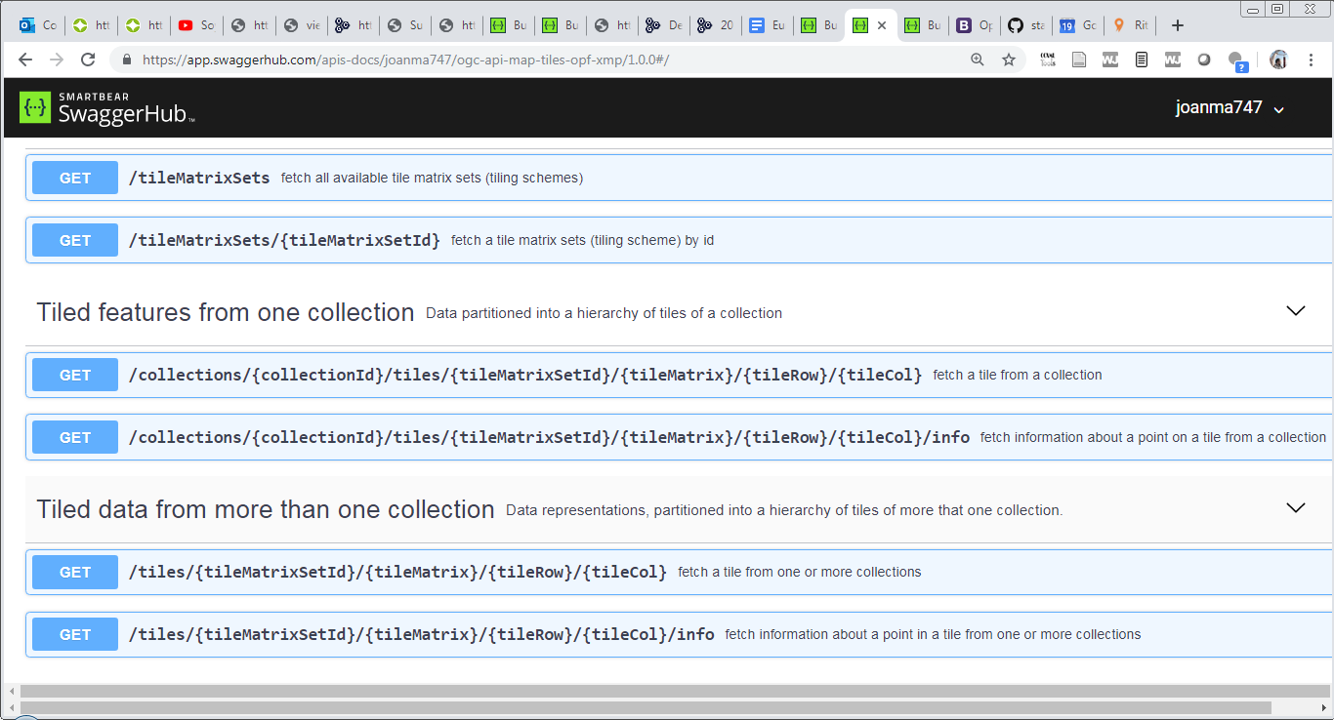
ogc-api-tiles-opf-xmp-vt-more-1-collection

Slide 3
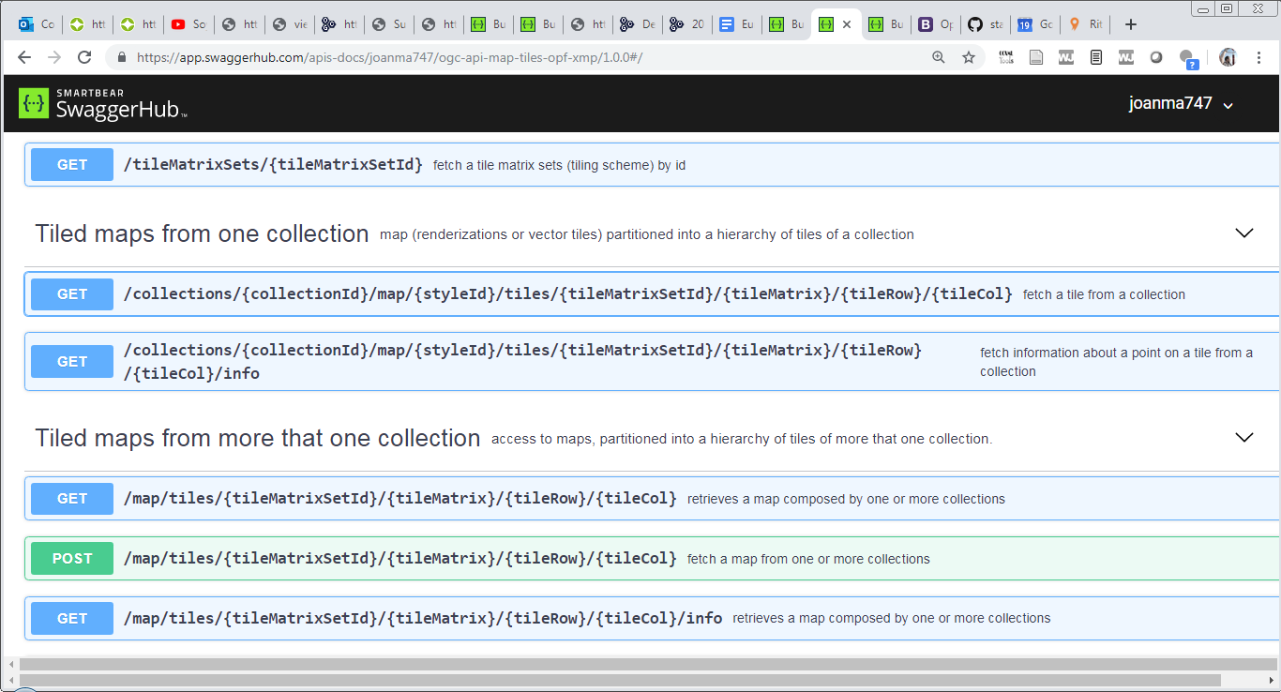
ogc-api-map-tiles-opf-xmp-mt-more-1-collection

Slide 4
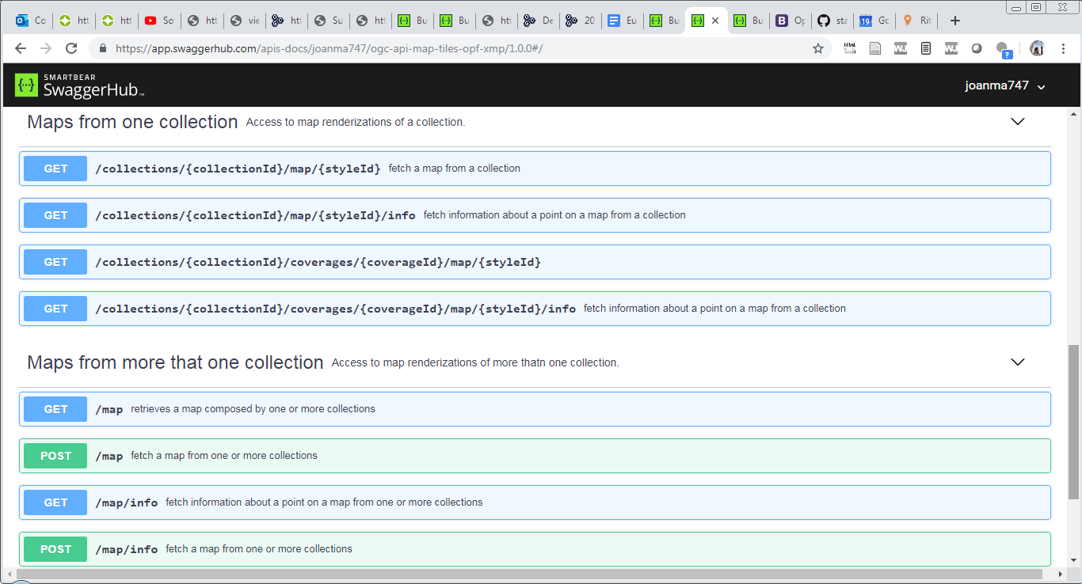
ogc-api-maps-opf-xmp-more-1-collection

