Slide 1
Other OGC API work
Scope of the TB15 work
Maps and tiles FULL
API Examples
Tiled coverages
>1 collections
Tiled features
>1 collections
Styles API
Tiled Map
>1 collections
Images API
Map
>1 collections
Coverages
Features
Tiles
Images
Map
API Domains
Map Styles
Tiles Checkpoint
Map and Tiles
Common
Checkpoint

Slide 2
Other OGC API work
Scope of the TB15 work
API Examples
Tiled features
>1 collections
Tiled Map
>1 collections
Images API
Features
Tiles
Images
API Domains
Tiles Checkpoint
Map and Tiles
Checkpoint
Common

Slide 3
Tiles core
Done!
Only one collection
Only support the 8 options in 2D-TMS Annex D
No TileMatrixSet definition
TileMatrixSet Link (but not TileMatrixSetLimits)
No featureInfo
Only one tile at a time
No information updates

Slide 4
Tiles extensions
TileMatrixSet (4th SWG)
Info (featureInfo) (5th SWG)
Done!
Collections (more than one) (1st TB15)
Collections-info (6th SWG)
Done!
Multi-tile (3rt TB15)
Etag for each tile
Delta-updates (2nd TB15)
Time/elevation (7th SWG)
Extra dimensions (8th SWG)

Slide 5
Maps core
Done!
This would be something that allows to create a map that cannot be necessarily retrievable (yet)
The reason:
We need to support /maps/{styleID}/tiles/…
It has no resolution
No parameters related with width, height, bbox, crs… etc.
Actually, it is map that can only be retrieved by extending it to (one of):
a tile
a map+resolution
It will not have styles (because this forces a dependency to the styles API that I would like to avoid): {styleID}=“default”.

Slide 6
Map extensions (building block)
StyleIds (1st TB15)
Map+resolution (3rt SWG)
Adds: width, height, bbox, crs
Done!
Info (SWG)
Collections (more than one) (2on TB15)
Done!
Collections-info (SWG)
Maps with styles on the fly (SWG)
Time/elevation (SWG)
Other dimensions (SWG)

Slide 7
Architecture/Scenario: Adding an image
An image is loaded in an OGC API image server
The image API server and the tiles API server are internally connected
Somehow new tiles are created.
The new tiles are exposed as:
Vector tiles
Coverage tiles ? (small geotiff’s?)
Map tiles? (small jpeg’s in grayscale?) Minimum style is needed to re-scale values to 256 gray colors or RGB or hillshade.
A client requests a multi-tile (with a checkpoint and collectionId as parameters)
The client receives the package and updates the changes.

Slide 8
Architecture/Scenario: Deleting an image
An image is removed in an OGC API image server
The image server and the tiles server are internally connected.
Some tiles disappear (or are “down-dated”)
The new tiles are exposed as:
Coverage tiles ?
Map tiles?
A client requests… what format? (with a checkpoint and collectionId as parameters)
The server should be able to tell the client that some tiles has been deleted?. The multitile format can no longer be a ZIP with some tiles. We need something more.
An empty tile can solve it.
The client receives the package and updates the changes.

Slide 9
An image is deleted in the OGC API images

Slide 10
Checkpoint
Any request for resources can communicate a checkpoint to the client.
Response to a checkpoint is:
A checkpoint report
A package with resources
A request for resources can have a checkpoint parameters will return only changes
Checkpoints are not resources but queries (changed to pvretanos)
Applicable to
Items
multitiles
Response has been extended with a extent.
Specify response to tiles includes
scale range
Path structure.

Slide 11
Multitiles
Request based on
bbox
scaleDenominator (range)
Response can be
tiles in a package (ZIP)
list of URIs of individual tiles for later retrieve
Request can be overloaded with checkpoint
Response is
tiles in a package (ZIP)
Checkpoint summary with bbox and scales.

Slide 12
Division of the work in two deliverables
Tiles
Core
TMS
Collections
Multitiles
Collections multitiles
Maps
Core
Styles
Maps
Collections
Image API
Checkpoint
Core
Tiles

Slide 13
Checkpoint
Features
/collections/{collectionId}/changesets/{checkpointId}
/collections/{collectionId}/changesets/{checkpointId}/features
/collections/{collectionId}/items?checkPoint={checkPointId}
/collections/{collectionId}/items/checkPoint/{checkPointId}
Tiles
??
/collections/{collectionId}/changesets/{checkpointId}/tiles
/collections/{collectionId}/map/{styleId}/tiles/{tileMatrixSetId}? checkPoint={checkPointId}

Slide 14
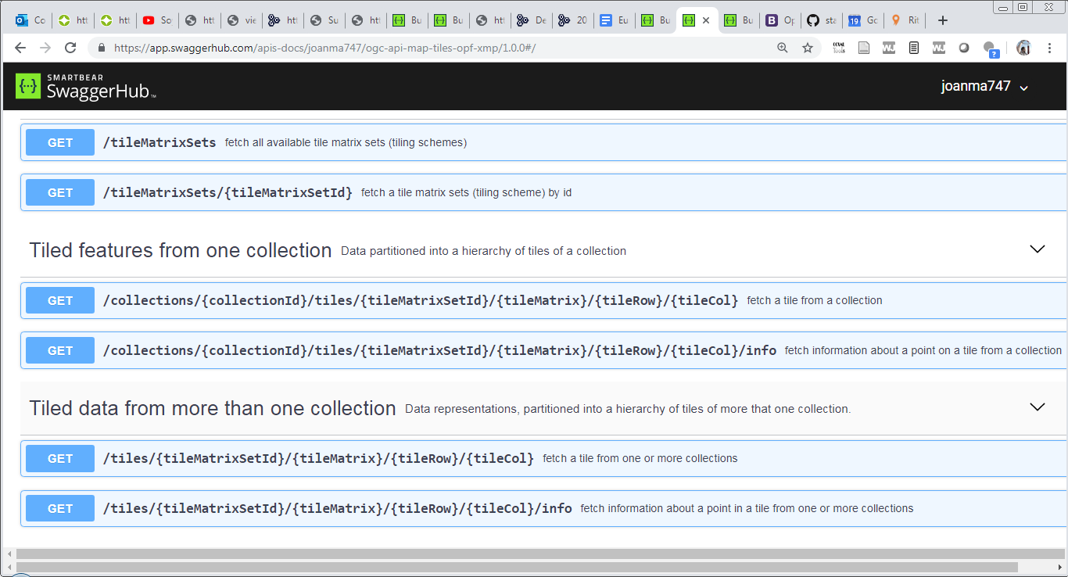
ogc-api-tiles-opf-xmp-vt-more-1-collection

Slide 15
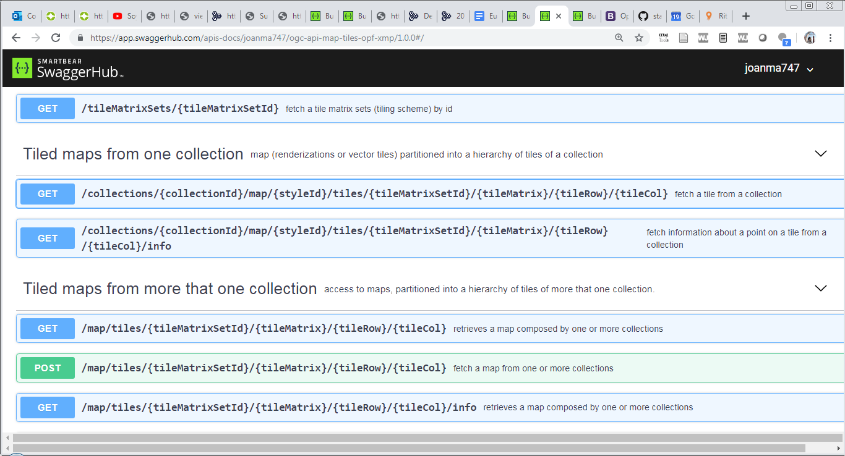
ogc-api-map-tiles-opf-xmp-mt-more-1-collection

Slide 16
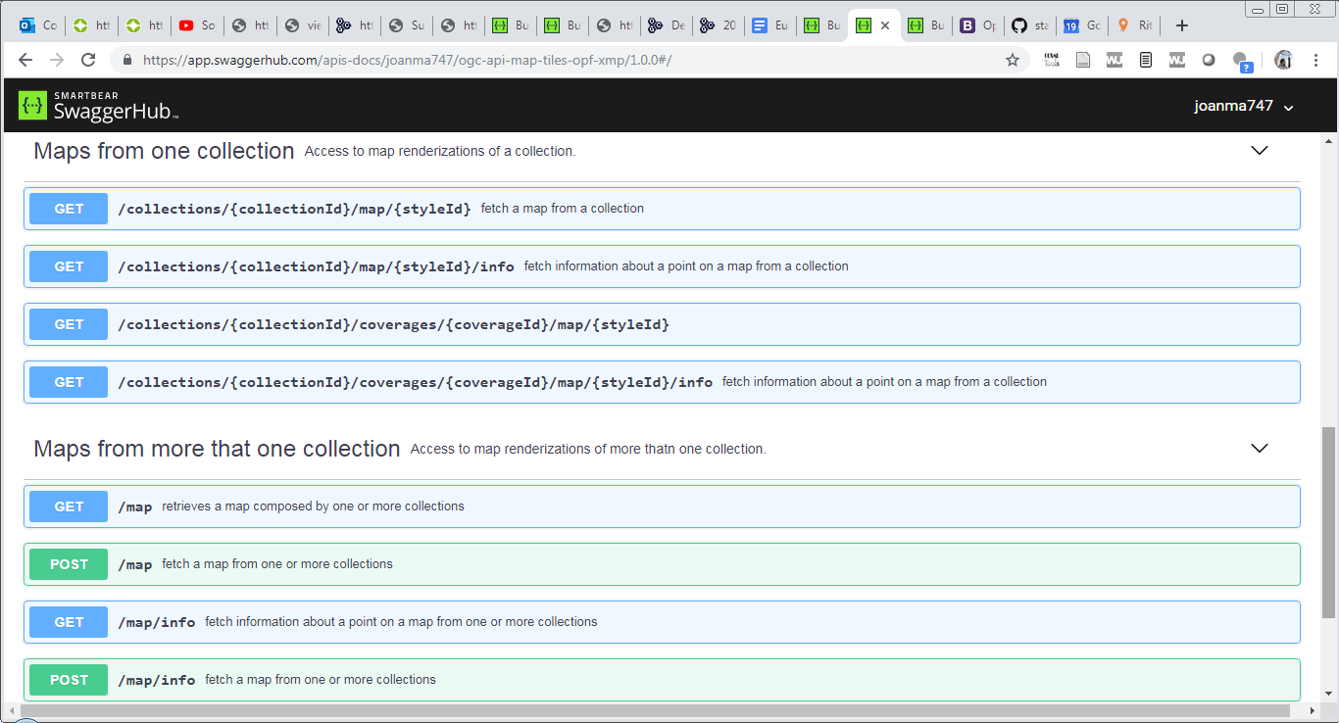
ogc-api-maps-opf-xmp-more-1-collection

Slide 17
Map and tiles API
https://htmlpreview.github.io/?https://github.com/opengeospatial/OGC-API-Map-Tiles/blob/master/standard/OAPI_MapsTiles.html

Slide 18
Current
Landing page links to:
/collections
/tileMatrixSets
/tileMatrixSets links to
/tileMatrixSet/myTileMateixSets (leaf).
/collections links to:
/collections/myCollectionsIds (specific content in the response will be moved to /collections/{collectionId}/tiles and /collections/{collectionId}/map. TBD)
/collections/{collectionId} links to:
/collections/{collectionId}/tiles/myTileMatrixSetId/{tileMatrix}/{tileCol}/{tileRow} (leaf)
/collections/{collectionId}/map/myStyleId (leaf)

Slide 19
Remaining questions
What happens with
/collections/{collectionId}/tiles
How to advertise tiles from multiple collections? Where are we including the link?
/tiles/{tileMatrixSetId}/{tileMatrix}/{tileRow} /{tileCol}

Slide 20
Proposal (alternative A)
Landing page links to:
/collections
/tileMatrixSets
/tiles/myTileMatrixSetId (NEW) This is for make evident that tiles of multiple collections are available. This link will return the "quasi-all collections" tiles (because query parameters are not shown)
/map (NEW) This is for make evident that maps of multiple collections are available. This link will return the "quasi-all collections" map (because query parameters are not shown)
/tileMatrixSets links to
/tileMatrixSet/myTileMateixSets (leaf).
/collections links to:
/collections/myCollectionsIds (specific content in the response will be moved to /collections/{collectionId}/tiles and /collections/{collectionId}/map. TBD)
/collections/{collectionId} links to:
/collections/{collectionId}/tiles (NEW and TBD: returns specific content about tile support for this collection: tileMatrixSetLink...)
/collections/{collectionId}/tiles/myTileMatrixSetId/{tileMatrix}/{tileCol}/{tileRow} (leaf)
/collections/{collectionId/map (NEW and TBD: returns specific content about map support for this collection.
/collections/{collectionId}/map/myStyleId (leaf)

Slide 21
Proposal (alternative B)
Landing page links to:
Like in alternative A
/tileMatrixSets links to
Like in alternative A
/collections links to:
Like in alternative A
/collections/{collectionId} links to:
/collections/{collectionId}/tiles (NEW and TBD: returns specific content about tile support for this collection: tileMatrixSetLink...)
/collections/{collectionId/map (NEW and TBD: returns specific content about map support for this collection
/collections/{collectionId}/tiles links to:
/collections/{collectionId}/tiles/myTileMatrixSetId/{tileMatrix}/{tileCol}/{tileRow} (leaf)
/collections/{collectionId/map links to:
/collections/{collectionId}/map/myStyleId (leaf)

Slide 22
Next
Close discussions on OGC API maps and tiles
Produce the specification of the OGC API Image
That describes the Swagger HUB
Produce the two Dxx specifications using all the content agreed.

