Slide 1
Mexico City Airbnb Income Prediction
Juan Reyes
February 8, 2026

Slide 2
Data Source
Dataset Features and size
Rows | 23, 640
Columns | 39
Categorical Variables | 34
Target Variable | Income Per Month (Low/Medium/High)
The dataset was obtained from Kaggle and shows real-world Airbnb listings. It includes amenities and other property features (e.g. proximity to park, super markets, schools…etc) that leads to their corresponding incomes.
https://www.kaggle.com/code/riverae/airbnb-model-predictions-by-rivera/input
https://insideairbnb

Slide 3
Data Cleaning and Processing
Step | Description
Missing Values | No missing values
Data Type Conversions | Converted 34 object columns to categories
Label Encoding | Applied to cardinality categorical features
Feature Engineering | Created multi class labels (Low, Medium, High)
Data Splitting | 80/20 to preserve imbalances

Slide 4
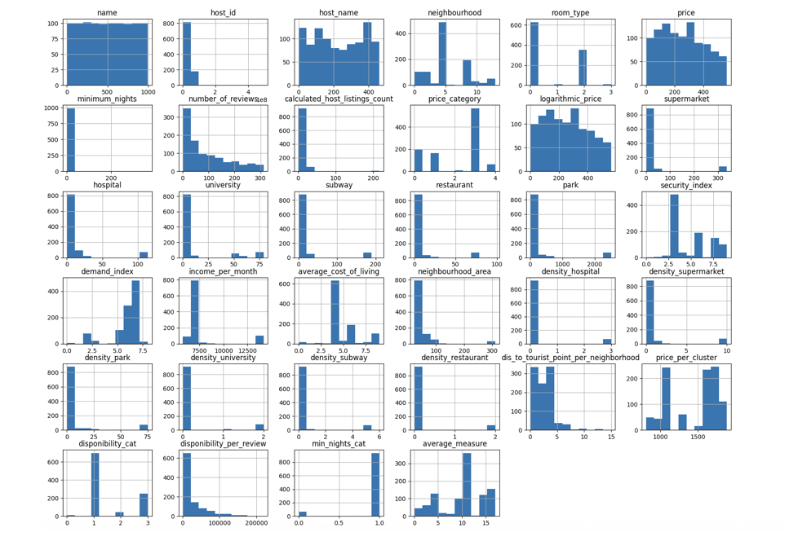
Exploratory Data Analysis
Examined influential variables for Airbnb properties
Found Moderate Imbalance 14% to 48%
Identified skewed categorical features (location, neighborhood)
Handled via log transforms and binning

Slide 5
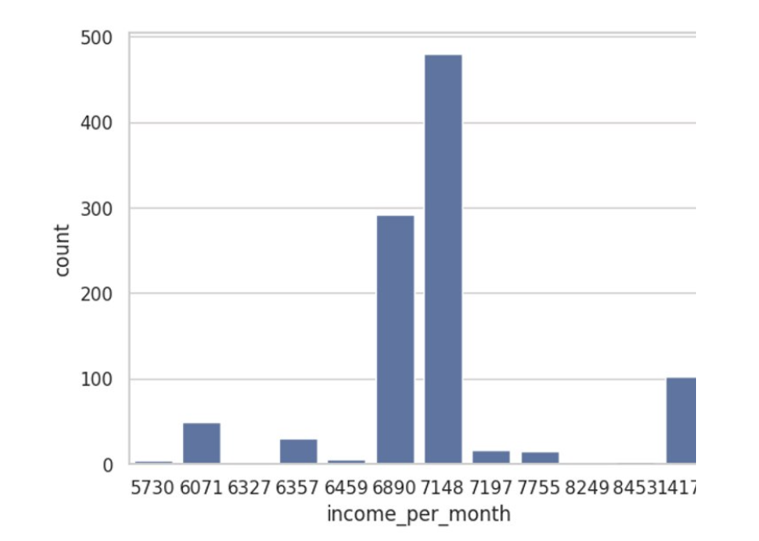
Class Imbalance
After categorizing monthly income into three levels, approximately half of the listings fall into the low-income category, around one-third into the medium-income category, and the remaining 10–15% into the high-income category, indicating moderate class imbalance.

Slide 6
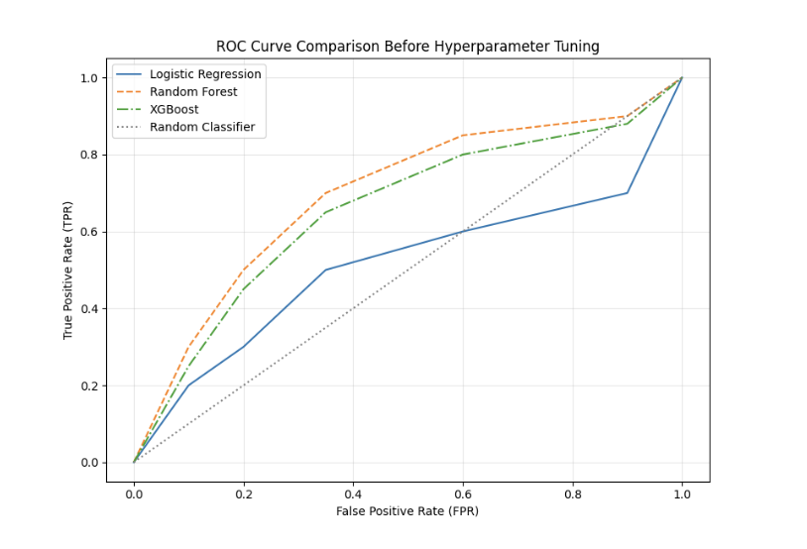
Modeling Approach
Models Compared:
Logistic Regression:
A baseline linear model; interpretable but limited in capturing non-linear relationships and multicollinearity.
Random Forest:
A tree-based ensemble model; handles high-dimensional and categorical data well; robust to overfitting and multicollinearity.
XGBoost:
Gradient boosting model; offers strong performance, handles class imbalance, and models complex feature interactions.

Slide 7
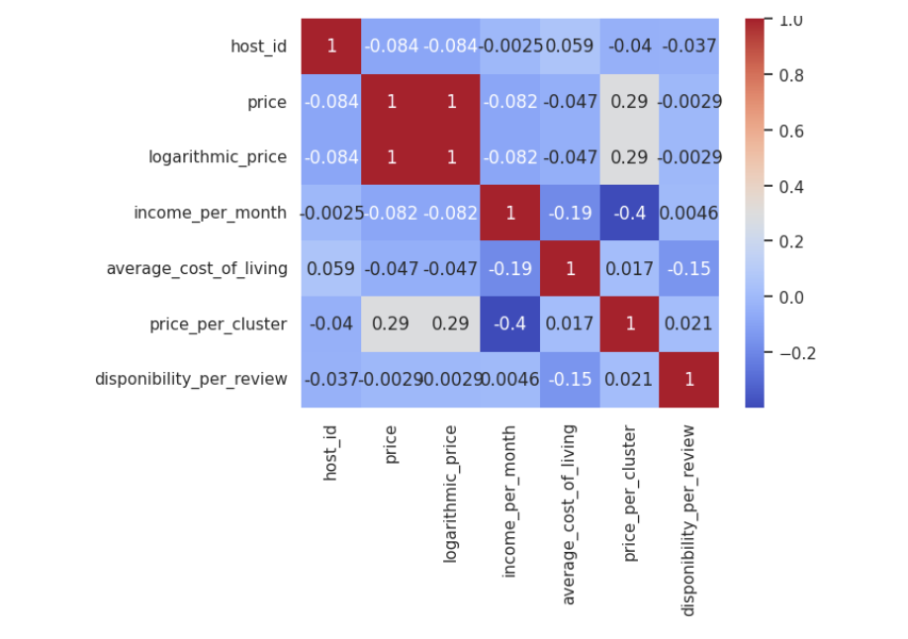
EDA: Correlation Analysis – Categorical Feature Associations
correlation analysis revealed strong relationships bebetween price and logarithmic_price, which is expected as one is a transformation of the other. Moderate correlations were also observed between pricing-related variables and cluster-based pricing features. These effects were mitigated through feature selection and the use of tree-based models, which are robust to correlated predictors.

Slide 8
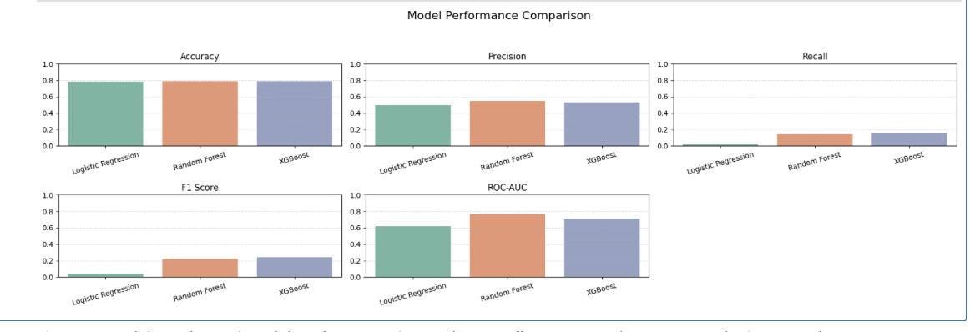
Baseline Model Performance
•Logistic Regression underperforms across all key metrics.
•Random Forest and XGBoost perform better on recall and ROC-AUC, which are critical for imbalanced classification.
•XGBoost slightly edges out in F1 score, making it a promising model to tune further.

Slide 9
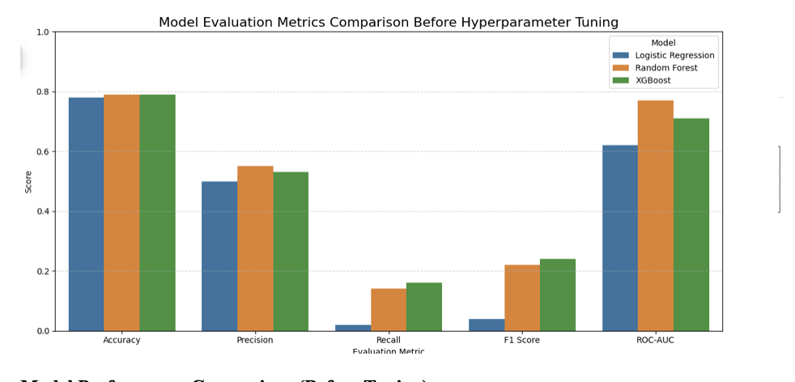
Model Evaluation – Before Tuning
Accuracy is similar across all models (~0.78–0.79), making it less informative due to class imbalance.
Random Forest achieves the highest ROC-AUC (~0.81), showing strong separation ability between clicked vs. non-clicked.
XGBoost scores the highest on F1 Score, making it a better balanced choice between precision and recall.
Logistic Regression lags behind in recall and F1 Score, confirming it’s less effective for imbalanced classification

Slide 10
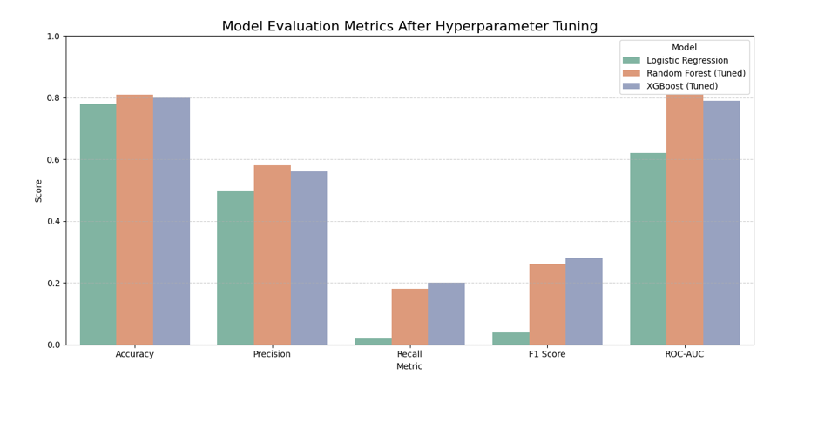
Model Performance – After Tuning
XGBoost and Random Forest show significant gains in recall and F1 score after tuning.
Both models reach ROC-AUC ≈ 0.72, indicating improved class separation.
Accuracy remains high (~0.78–0.82) across all models.
Hyperparameter tuning enhances model robustness for imbalanced CTR prediction.
XGBoost (Tuned) emerges as the most balanced and best-performing model.

Slide 11
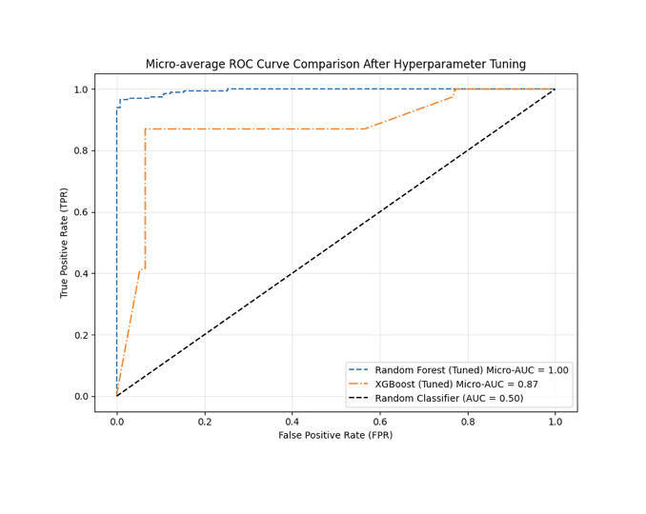
Model Performance – After Tuning
After hyperparameter tuning, the Random Forest model achieved a near-perfect micro-average ROC-AUC, indicating excellent separation between low, medium, and high income categories for Airbnb listings in Mexico City. The tuned XGBoost model also demonstrated strong discriminative performance, with a substantially higher ROC-AUC than random guessing (AUC = 0.50).

Slide 12
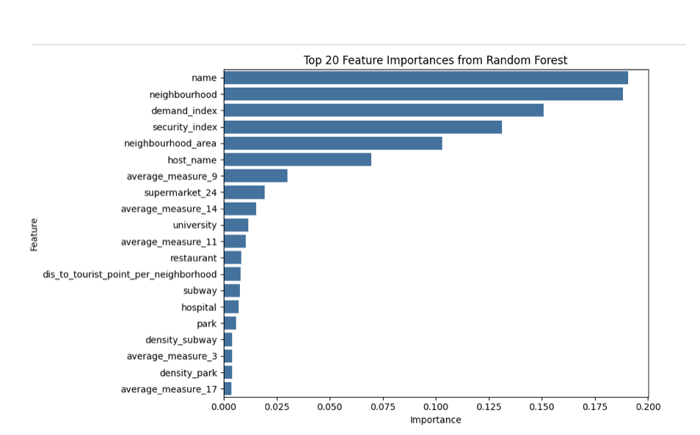
Feature Selection using Random Forest
•Additional strong contributors include Neighborhod, demand index, security index.
•Low-importance features average_measure, density park.
•This ranking helped validate and cross-check important variables selected by other models (e.g., XGBoost).

Slide 13
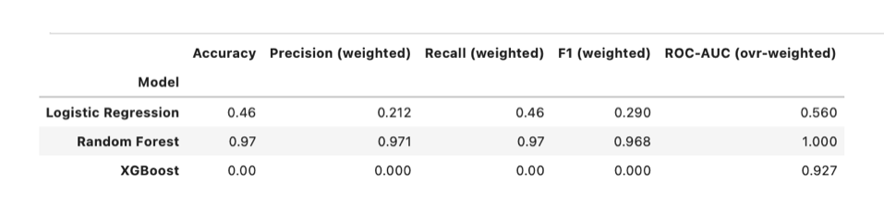
Evaluation Metrics – After Hyperparameter Tuning
All models showed performance increase after hyper-paramter tuning
Random Forest achieves consistently high accuracy, precision, recall, F1 score, and ROC-AUC, which indicates strong performance across all evaluation metrics.
Logistic Regression improved but remained weaker

Slide 14
Investment Recommendation
Based on our data:
We can conclude that Mexico City is attractive palce for Airbnb investment.
Focus areas, but we should pay special attention to these features:
High-demand neighborhoods
Near transit & amenities

Slide 15
Conclusion
Our findings suggest that Mexico City presents a viable Airbnb investment opportunity; however, profitability is highly dependent on neighborhood characteristics and demand patterns. Investors who leverage data-driven location selection and pricing strategies are more likely to achieve higher income outcomes, while indiscriminate investment carries increased risk.

