Slide 1

1
CSCU9A1 JAVA LECTURES
INTRODUCTION
Copyright © 2013 by John Wiley & Sons. All rights reserved.

Slide 2
Lecture Goals
To learn about computers and programming
To meet your first Java program
To learn about compile-time and run-time errors
Related Reading:
Java for Everyone 2nd ed, Horstmann, 2013
  Chapter 1 (Introduction)
Copyright © 2013 by John Wiley & Sons. All rights reserved.
Page <number>

Slide 3
1.1 Computer Programs
A Computer Program is a sequence of instructions and decisions
Computers execute very basic instructions in rapid succession
Programming is the act of designing and implementing computer programs
Copyright © 2013 by John Wiley & Sons. All rights reserved.
Page <number>
Notes:
Typical speeds nowadays: the Intel Core i7 875K does 92,100 MIPS at 2.93 GHz (that’s 92,100,000,000 instructions per second) [Wikipedia/Instructions_per_second]

Slide 4
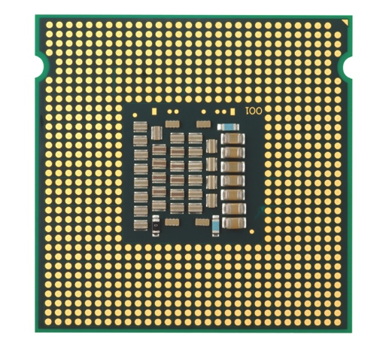
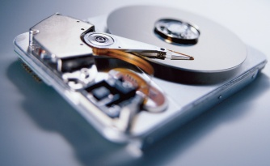
1.2 The Anatomy of a Computer
The central processing unit (CPU) performs program control and data processing
Storage devices include memory (RAM) and secondary storage
  Hard disk
  Flash drives
  CD/DVD drives
Input/Output devices allow the user to interact with the computer
  Mouse, keyboard, printer, screen…
Copyright © 2013 by John Wiley & Sons. All rights reserved.
Page <number>
Notes:
They have already seen this in the Systems lecture

Slide 5
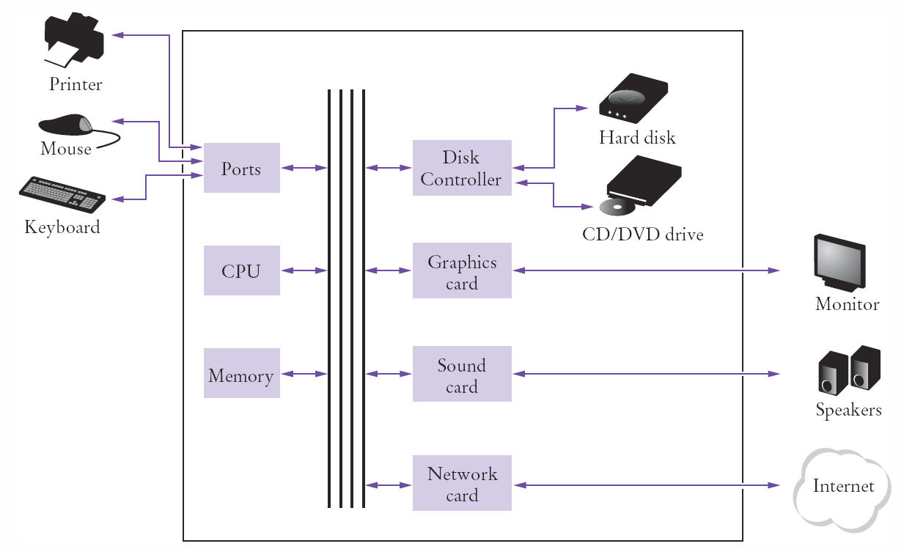
Schematic Design of a PC
Copyright © 2013 by John Wiley & Sons. All rights reserved.
Page <number>
Notes:
They have already seen this in the systems lecture

Slide 6
When you‘run’ a program
Program instructions and data (such as text, numbers, audio, or video) are stored on the hard disk, external storage, or elsewhere on the network.
When a program is started, it is brought into memory, where the CPU can read it.
The CPU runs the program one instruction at a time. The program may react to user input
As directed by these instructions and the user, the CPU reads data, modifies it, and writes it back to memory, the screen or secondary storage.
Copyright © 2013 by John Wiley & Sons. All rights reserved.
Page <number>

Slide 7
The hierarchy of languages
Every CPU has its own native language, consisting of instructions that the CPU can execute directly.
This is called machine code. Example instructions:
  MOV A 50 ADD A B JMP 35
Programming directly in machine code is extremely difficult and complex. Therefore, high-level languages were developed, eg, BASIC, FORTRAN
Programs written in these languages must be translated into machine code before they can be executed. The translation is done by software called compilers or interpreters.
Copyright © 2013 by John Wiley & Sons. All rights reserved.
Page <number>

Slide 8
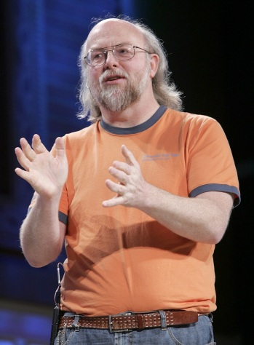
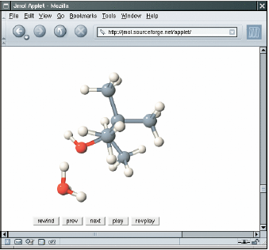
1.3 The Java Language
In 1991, James Gosling of Sun Microsystems designed what would become the Java programming language
Java was originally designed for programming consumer devices, but it was first successfully used to write Internet applets
  An applet was typically embedded inside a web page and ran in the context of a browser
Copyright © 2013 by John Wiley & Sons. All rights reserved.
Page <number>

Slide 9
Java History
Java Design Goals
  Safe: Can be run inside a browser and will not attack your computer
  Portable: Run on many Operating Systems
    Windows, Mac OS, Linux, …
Java programs are distributed as instructions for a ‘virtual machine,’ making them platform-independent
  Virtual machines are available for most Operating Systems. (The iPhone is a notable exception)
Copyright © 2013 by John Wiley & Sons. All rights reserved.
Page <number>

Slide 10
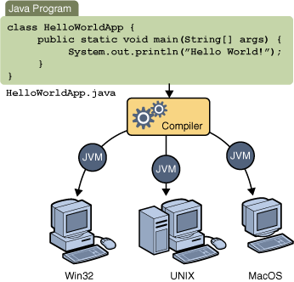
Java Virtual Machines
Source code
Portable ‘byte code’
  The compiler generates byte code in a ‘class’ file which can be run on any Java Virtual Machine
The JVM translates the byte code into machine code instructions for a specific CPU
Copyright © 2013 by John Wiley & Sons. All rights reserved.
Page <number>

Slide 11
Your Programming Environment
Programs are usually created using an Integrated Development Environment (IDE)
  In CSCU9A1 we use the BlueJ IDE.
  (Later modules use the Eclipse IDE.)
Components of an IDE:
  Source code editor helps programming by:
    Listing line numbers of code
    Coloring lines of code (comments, text…)
    Automatically formatting source code
  Output window
  Debugger
Copyright © 2013 by John Wiley & Sons. All rights reserved.
Page <number>

Slide 12
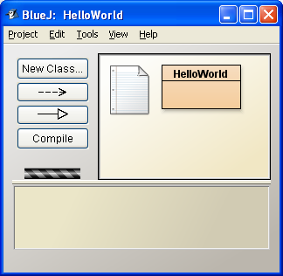
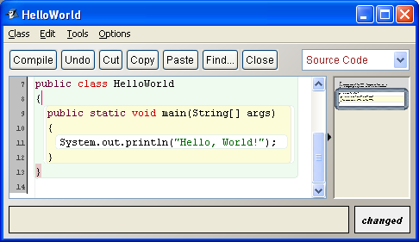
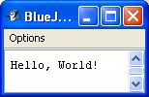
The BlueJ IDE
Main BlueJ Window
Editor
Output
BlueJ was designed to help students to learn Java.
Copyright © 2013 by John Wiley & Sons. All rights reserved.
Page <number>

Slide 13
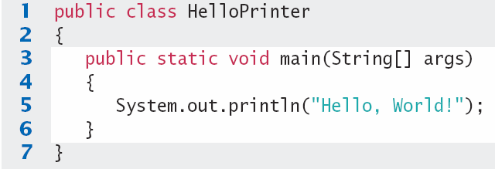
Your First Program
Traditional ‘Hello World’ program in Java
We will examine this program in the next section
  Typing it into BlueJ would be good practice!
  Be careful of spelling
  JaVa iS CaSe SeNsItiVe
  Java uses special characters, e.g. { } ( ) ;
Copyright © 2013 by John Wiley & Sons. All rights reserved.
Page <number>

Slide 14
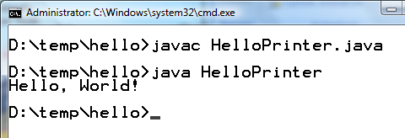
Text Editor Programming
You can also use a simple text editor such as Notepad to write your source code
Once saved as HelloPrinter.java, you can use a console window to:
  Compile the program
  Run the program
Compile
Execute
Output
Copyright © 2013 by John Wiley & Sons. All rights reserved.
Page <number>

Slide 15
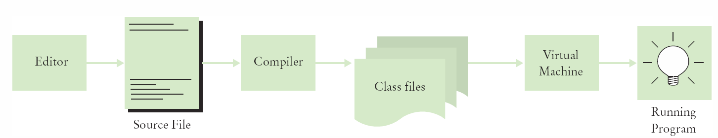
Source Code to Running Program
The compiler generates the .class file which contains instructions for the Java Virtual machine
Class files contain ‘byte code’ that you cannot edit
  D:\temp\hello>Type HelloPrinter.class
  ╩■║╛ 2 ↔ ♠ ☼ ► ↕ ‼ ¶ § ▬☺ ♠<init>☺ ♥()V☺ ♦Code☺ ☼LineNumberTable☺ ♦main▬([Ljava/lang/String;)V☺
  Hello, World! elloPrinter.java♀ ↨♀ ↑ ↓☺
Copyright © 2013 by John Wiley & Sons. All rights reserved.
Page <number>

Slide 16

Analyzing your First Program
1: Declares a ‘class’ HelloPrinter
-- Every Java program has one or more classes.
3: Declares a method called ‘main’
-- Every Java application has exactly one ‘ main’ method
-- Entry point where the program starts
5: Method System.out.println outputs ‘Hello, World!’
-- A statement must end with a semicolon (;)
Copyright © 2013 by John Wiley & Sons. All rights reserved.
Page <number>

Slide 17
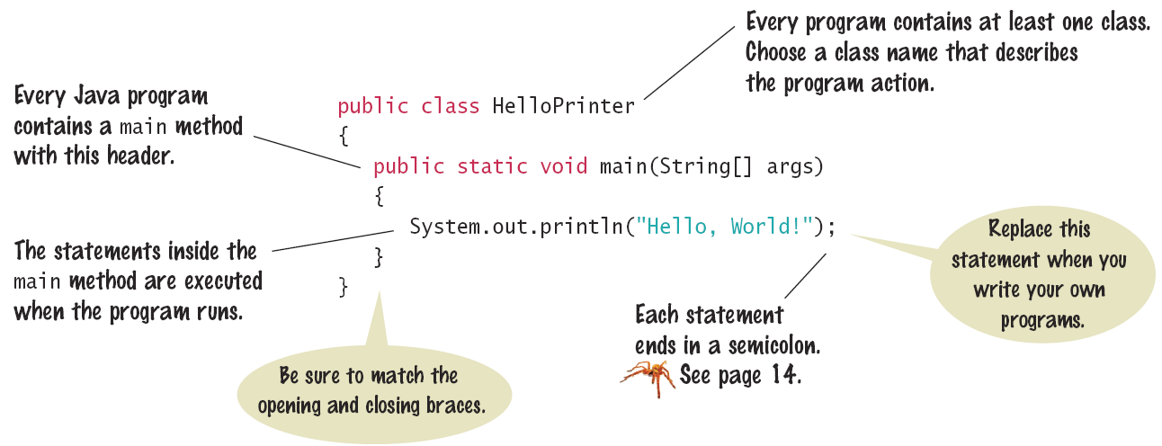
Syntax: The Java Program
Every application has the same basic layout
  Add your ‘code’ inside the main method
Copyright © 2013 by John Wiley & Sons. All rights reserved.
Page <number>

Slide 18
Calling Java Library methods
Line 5 shows how to call a ‘method’ from the Java API: System.out.println
  API: Code that somebody else wrote for you!
  Parentheses surround the arguments that you ‘pass’ to a method
  We are passing a String “Hello World”
    Note the double quotes which denote a String inside
  You can also print numerical values
    System.out.println(3 + 4);
Copyright © 2013 by John Wiley & Sons. All rights reserved.
Page <number>

Slide 19
Getting to know println
The println method prints a string or a number and then starts a new line.
    System.out.println("Hello");
    System.out.println("World!”);
Hello
Hello
World!
println has a ‘cousin’ method named print that does not print a new line.
    System.out.print("00");
    System.out.println(3+4);
00
007
A method is called by specifying the method and its agruments
Copyright © 2013 by John Wiley & Sons. All rights reserved.
Page <number>

Slide 20

Common Error
Omitting Semicolons
  In Java, every statement must end in a semicolon. Forgetting to type a semicolon is a common error. It confuses the compiler, because the compiler uses the semicolon to find where one statement ends and the next one starts. For example, the compiler sees this:
  As this:
  It doesn’t understand this statement, because it does not expect the word System following the closing parenthesis after Hello.
System.out.println("Hello")
System.out.println("World!");
System.out.println("Hello") System.out.println("World!");
Copyright © 2013 by John Wiley & Sons. All rights reserved.
Page <number>

Slide 21

Errors
The Two Categories of Errors:
  1) Compile-time Errors
    Syntax Errors
      Spelling, Capitalization, punctuation
      Ordering of statements, matching of braces/parenthesis…
    No .class file is generated by the compiler
    Correct first error listed, then compile again
  2) Run-time Errors
    Logic Errors
    Program runs, but produces unintended results
    Program may ‘crash’
Copyright © 2013 by John Wiley & Sons. All rights reserved.
Page <number>

Slide 22
Syntax Errors
What happens if you
  Misspell a word: System.ou.println
  Don’t Capitalize a word system.out.println
  Leave out a word void
  Forget a Semicolon after ("Hello, World!")
  Don’t match a curly brace? Remove line 6
Try it to see what error messages are generated
Copyright © 2013 by John Wiley & Sons. All rights reserved.
Page <number>

Slide 23
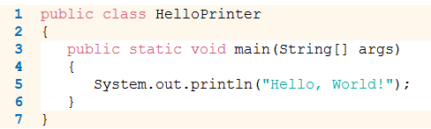
Logic Errors
What happens if you
  Divide by Zero System.out.println(1/0);
  Mis-spell output ("Hello, Word!")
  Forget to output Remove line 5
Programs will compile and run
  The output may not be as expected
Copyright © 2013 by John Wiley & Sons. All rights reserved.
Page <number>

Slide 24
End of Lecture
Additional reading: Chapter 1 of Java for Everyone.
  Attempt the Self-Check exercises
Tutorial Worksheet 1 is on the CSCU9A1 website
  Solutions will be discussed at tutorials in week 3
  Prepare your answers before coming to the tutorial
Programming Practical Worksheet 1 is also available
Copyright © 2013 by John Wiley & Sons. All rights reserved.
Page <number>

Slide 25
CSCU9A1 Java 2
Ken Reid
  Email: Ken@kenreid.co.uk
  Room: 4B101

Slide 26
Lecture goals..
Note on practicals.
Some useful resources
Recap
Java tips
  Commenting
  Elegant code
  Examples of design
  What is null?

Slide 27
Practical notes
Worth 50% of your grade.
Must be completed roughly 3 weeks after being given out
Practicals are not compulsory (but recommended!)
Make use of demonstrators.

Slide 28
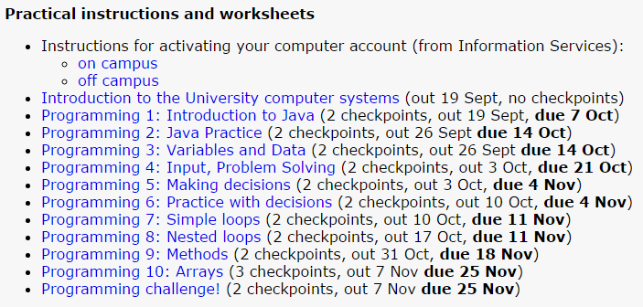
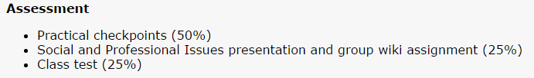

Slide 29
The BlueJ IDE
BlueJ was designed to help students to learn Java.
Copyright © 2013 by John Wiley & Sons. All rights reserved.
Page <number>

Slide 30
Tutorials
http://www.cs.stir.ac.uk/courses/CSCU9A1/special/tutorials/

Slide 31
Resources
Stack Overflow
-"Effective Java 2nd Edition" -Joshua Bloch, 2008
-“Java SE8 for the Really Impatient” - Cay S. Horstmann
The very useful cheat sheets website.
http://www.cheat-sheets.org/
Learning to code… (Java!)
https://www.codecademy.com/

Slide 32
Quick recap…
What is the difference between memory and storage?
  Example of each….

Slide 33
Quick recap…
What does CPU stand for?
How many instructions can be run at a time?

Slide 34
Quick recap…
What is machine code?

Slide 35
Quick recap…
What is a high level language?

Slide 36
Quick recap…
Give 3 examples of high level languages…

Slide 37
Quick recap…
What is the difference between a compiler and an intepretor?

Slide 38
Quick recap…
What is an API?

Slide 39
Quick recap…
API = Application Programming Interface

Slide 40
Quick recap…
Give examples of where Java is used today.

Slide 41
Quick recap…
What is Java byte code? What is the JVM?

Slide 42
Quick recap…
What is an IDE?

Slide 43
Quick recap…
Java…
  Is CaSe SensItivE
  String takeNote = “Java uses \”special characters\” to work”;
  System.out.println(takNote + “, and spelling is important!”);
  Semi colons are necessary too! Like a full stop in English.

Slide 44
Quick recap…
What is a run-time error?
What is a compile-time error?

Slide 45
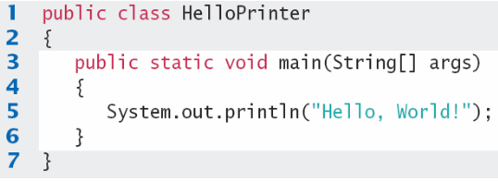
Quick recap…
What is the “main” class?

Slide 46
Java examples
public class Test{
public static void main(String[] args){
String module = “CSCU9A1”;
System.out.println(“Hello “+module);
}
}

Slide 47
Java examples
public class Test{
public static void main(String[] args){
String module = “CSCU9A1”;
System.out.print(“Hello “);
System.out.print(module);
}
}

Slide 48
Java examples
public class Test{
public static void main(String[] args){
System.out.println(1+1);
}
}

Slide 49
Java examples
public class Test{
public static void main(String[] args){
System.out.println(1+”1”);
}
}

Slide 50
Java examples
public class Test{
public static void main(String[] args){
System.out.println(“1”+1);
}
}

Slide 51
Java examples
public class Test{
public static void main(String[] args){
System.out.println(“1+1”);
}
}

Slide 52
Java examples
public class Test{
public static void main(String[] args){
System.out.println(“Epictetus”);
}
}

Slide 53
Java examples
public class Test{
public static void main(String[] args){
System.out.println(‘Epictetus’);
}
}

Slide 54
Java examples
public class Test{
public static void main(String[] args){
System.out.println(epictetus);
}
}

Slide 55
Java examples
public class Test{
public static void main(String[] args){
System.out.println(“”);
}
}

Slide 56
Java examples
public class Test{
public static void main(String[] args){
System.out.println();
}
}

Slide 57
Note on best practice
There is a difference between functional and readable code.
If code isn’t readable it will rarely be functional!
Write code as if you’re writing it for someone who isn’t a programmer.
  Or at least someone who isn’t you!

Slide 58
Note on best practice
Comments!
  Documentation is very important. There are 3 “tiers” of code…
  Functional code
  Functional code with comments
  Elegant code (code that describes WHAT it’s doing in itself)
    With comments explaining WHY it’s doing that.

Slide 59
Comments..
String s = “3.14159265358979”;
String pi = “3.14159265358979”;
String pi = “3.14159265358979”; //pi is stored for display on calculator

Slide 60
Note on best practice
float f, c;
f = c = 0;
int a;
System.out.println("1 4 C->F or 2 4 F->C");
a = c();
if (a == 1)
cCtoF();
else
cFtoC();
C(){
Scanner s = new Scanner (System.in);
c = s.nextInt();
return c;
}
s(){
System.out.println(s);
return scan.nextInt();
}

Slide 61
Note on best practice
float fahrenheit, celsius;
fahrenheit = celsius = 0;
int userInput;
System.out.println("Press 1 for C->F or 2 for F->C"");
userInput = new Scanner (System.in).nextInt();
if (userInput == 1)
convertCelsiusToFahrenheit();
else
convertFahrenheitToCelsius();

Slide 62
Note on best practice
http://www.cs.stir.ac.uk/~kjt/
http://www.washington.edu/willow/home.html

Slide 63
Note on best practice
Windty
https://www.windyty.com/?27.450,-8.965,4
What is a DDOS? Where are they happening?
http://www.digitalattackmap.com/#anim=1&color=0&country=ALL&list=0&time=16757&view=map

Slide 64
Note on best practice
Version Control….
  Dropbox
  SVN
  GitHub

Slide 65
What is null?
What is null?
  Nothing! Except… something?

Slide 66
What is null?
Null is nothing stored in a memory location.
String myName = “”;
String myName;
String myName = null;

Slide 67
Any questions, assistance, email / drop by
We have an open door policy in the department…
No such thing as a stupid question!
Ken@kenreid.co.uk
4B101

