Slide 1

2
CSCU9A1 JAVA LECTURE
VARIABLES AND BASIC DATA TYPES
Copyright © 2013 by John Wiley & Sons. All rights reserved.

Slide 2
Lecture Goals
To declare and initialize variables and constants
To understand the properties and limitations of integers and floating-point numbers
To write arithmetic expressions and assignment statements
To create programs that read and process inputs
To learn how to use the Java String type
Related Reading:
Java for Everyone 2nd ed, Horstmann, 2013
  Chapter 2 (Fundamental Data Types)
Copyright © 2013 by John Wiley & Sons. All rights reserved.
Page <number>

Slide 3
2.1 Variables
Most computer programs hold temporary values in named storage locations
  Programmers name them for easy access
There are many different types (sizes) of storage to hold different things
You ‘declare’ a variable by telling the compiler:
  What type (size) of variable you need
  What name you will use to refer to it
Copyright © 2013 by John Wiley & Sons. All rights reserved.
Page <number>

Slide 4
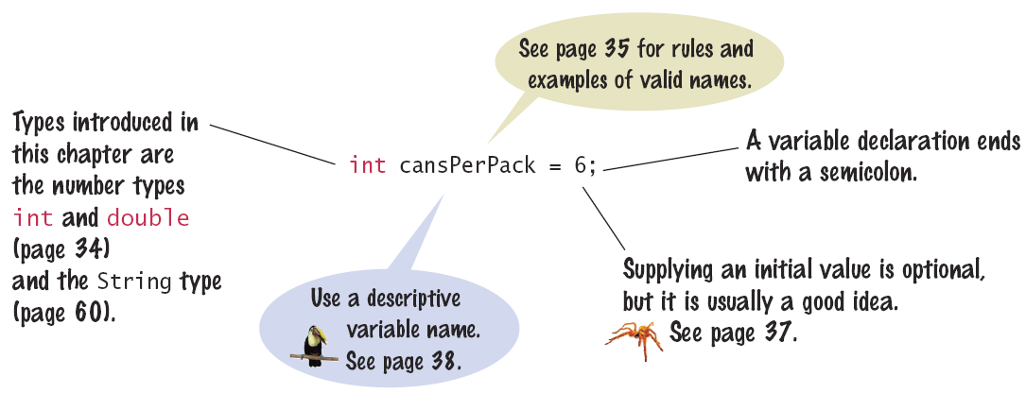
Syntax 2.1: Variable Declaration
When declaring a variable, you often specify an initial value
This is also where you tell the compiler the size (type) it will hold
Copyright © 2013 by John Wiley & Sons. All rights reserved.
Page <number>

Slide 5

Example: American Soda Deal
Soft drinks are sold in cans and bottles. A US shop offers a six-pack of 12-ounce cans for the same price as a 2-litre bottle. Which should you buy? (12 fluid ounces equal about 0.355 litres.)
List of variables: Type of Number
  Number of cans per pack Whole number
  Ounces per can Whole number
  Ounces per bottle Number with fraction
Copyright © 2013 by John Wiley & Sons. All rights reserved.
Page <number>

Slide 6
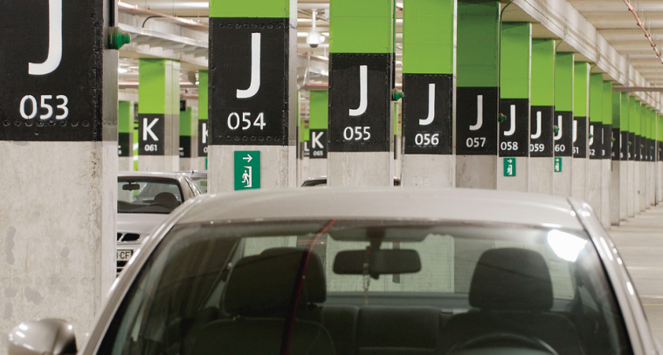
Variables and contents
Each variable has an identifier (name) and contents
You can (optionally) set the contents of a variable when you declare it
  int cansPerPack = 6;
Imagine a parking space in a car park
  Identifier: J053
  Contents: Bob’s Ferrari
cansPerPack
6
A variable is a storage location with a name
Copyright © 2013 by John Wiley & Sons. All rights reserved.
Page <number>

Slide 7
Why different types?
There are three types of variables that we will focus on in this lecture:
  1) A whole number (no fractional part) int
  2) A number with a fraction part double
  3) A string (a sequence of characters) String
Specify the type before the name in the declaration
  int cansPerPack = 6;
  double canVolume = 12.0;

Slide 8
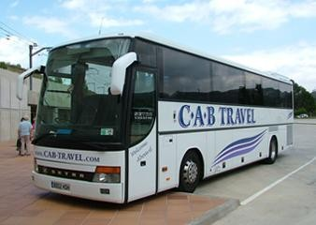

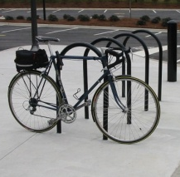
Why different types?
Back to the parking analogy, parking spaces may be different sizes for different types of vehicles
  Bicycle
  Car
  Coach
Copyright © 2013 by John Wiley & Sons. All rights reserved.
Page <number>
Notes:
Ask: which do you think needs most space (int, double or String)? Which needs the least space?
Answer:
int uses 32 bits (4 bytes) Values can be from -2,147,483,648 to 2,147,483,647
double uses 64 bits (8 bytes)
String is more complicated: it is not a primitive type, but an object, represented by an array of characters. Each character takes 15 bits (2 bytes) and the maximum length of an array is MAX_INT (2,147,483,647). So the maximum space needed to store a string is 2*MAX_INT bytes. But a variable of type String holds a reference to a String object, not the object itself, so its size is actually quite small (4 or 8 bytes).

Slide 9
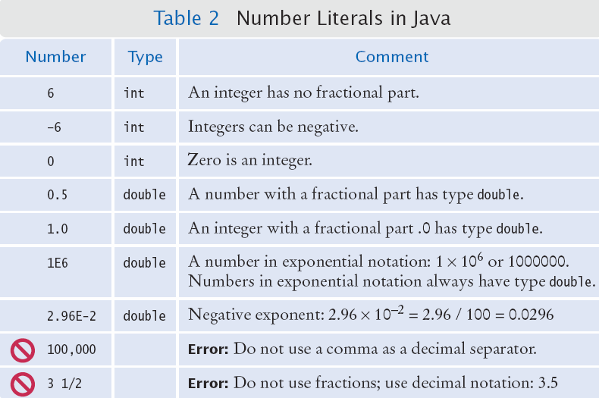
Number Literals in Java
Sometimes when you just type a number, the compiler has to ‘guess’ what type it is
amt = 6 * 12.0;
PI = 3.14;
canVol = 0.335;
Use the double
type for floating-
point numbers.
Copyright © 2013 by John Wiley & Sons. All rights reserved.
Page <number>

Slide 10
Floating-Point Numbers
Java stores numbers with fractional parts as ‘floating point’ numbers.
They are stored in four parts
  Sign
  Mantissa
  Radix
  Exponent
A ‘double’ is a double-precision floating point number: It takes twice the storage (52 bit mantissa) as the smaller ‘float’ (23 bit mantissa)
Parts of a floating point number -5:
Sign | Mantissa | Radix ^{exponent}
-1 | 5 | 10 ⁰
See JavaWorld article for more detail
Copyright © 2013 by John Wiley & Sons. All rights reserved.
Page <number>

Slide 11

Naming Variables
Name should describe the purpose
  ‘canVolume’ is better than ‘cv’
Use These Simple Rules
  1) Variable names must start with a letter or the
  underscore ( _ ) character
    Continue with letters (upper or lower case), digits or the underscore
  2) You cannot use other symbols (? or %...) and spaces are not permitted
  3) Separate words with ‘camelHump’ notation
    Use upper case letters to signify word boundaries
  4) Don’t use reserved ‘Java’ words (Textbook Appendix C)
Copyright © 2013 by John Wiley & Sons. All rights reserved.
Page <number>

Slide 12
The Assignment Statement
Use the ‘assignment statement’ ( with an '=' ) to place a new value into a variable
  int cansPerPack = 6; // declare & initialize
  cansPerPack = 8; // assignment
Beware: The = sign is NOT used for comparison:
  It copies the value on the right side into the variable on the left side
  You will learn about the comparison operator in the next lecture
Copyright © 2013 by John Wiley & Sons. All rights reserved.
Page <number>

Slide 13
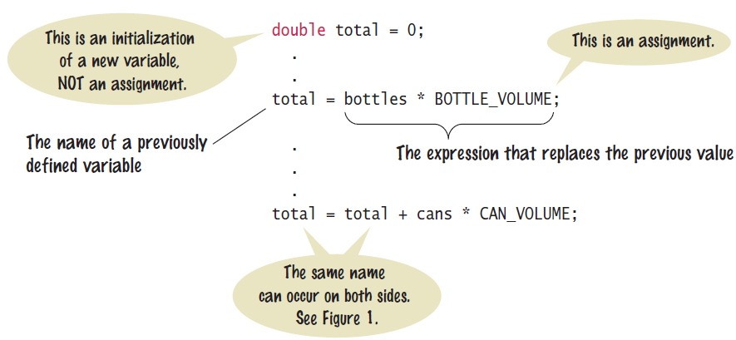
Assignment Syntax
The value on the right of the '=' sign is copied to the variable on the left
Copyright © 2013 by John Wiley & Sons. All rights reserved.
Page <number>

Slide 14
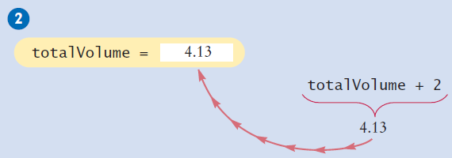
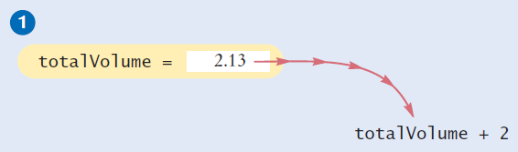
Updating a Variable
Step by Step:
  totalVolume = totalVolume + 2;
Calculate the right hand side of the assignment Find the value of totalVolume, and add 2 to it
Store the result in the variable named on the left side of the assignment operator (totalVolume in this case)
Copyright © 2013 by John Wiley & Sons. All rights reserved.
Page <number>

Slide 15
Constants
When a variable is defined with the reserved word final, its value can never be changed
final double BOTTLE_VOLUME = 2;
It is good style to use named constants to explain numerical values to be used in calculations
  Which is clearer?
    double totalVolume = bottles * 2;
    double totalVolume = bottles * BOTTLE_VOLUME;
A programmer reading the first statement may not understand the significance of the 2
Also, if the constant is used in multiple places and needs to be changed, only the initialization changes
Copyright © 2013 by John Wiley & Sons. All rights reserved.
Page <number>

Slide 16
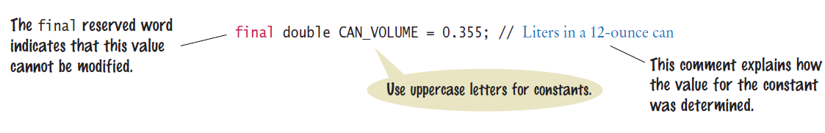
Constant Declaration
It is customary to use all UPPER_CASE letters for constants
Copyright © 2013 by John Wiley & Sons. All rights reserved.
Page <number>

Slide 17
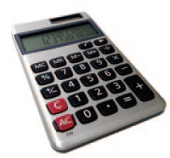


2.2 Arithmetic
Java supports all of the same basic math as a calculator:
  Addition +
  Subtraction -
You write your expressions a bit differently though.. Algebra Java
Precedence is similar to Algebra:
  PEMDAS
    Parenthesis, Exponent, Multiply/Divide, Add/Subtract
  Multiplication *
  Division /
Copyright © 2013 by John Wiley & Sons. All rights reserved.
Page <number>

Slide 18
Mixing Numeric Types
It is safe to convert a value from an integer type to a floating-point type
  No ‘precision’ is lost
But going the other way can be dangerous
  All fractional information is lost
  The fractional part is discarded (not rounded)
If you mix types integer and floating-point types in an expression, no precision is lost:
  double area, pi = 3.14;
  int radius = 3;
  area = radius * radius * pi;
Mixing integers and floating-point values in an arithmetic expression yields a floating-point value.
Copyright © 2013 by John Wiley & Sons. All rights reserved.
Page <number>

Slide 19
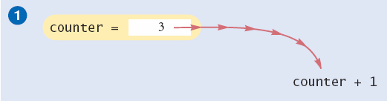
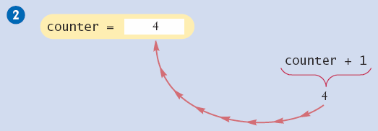
Incrementing a Variable
Step by Step:
  counter = counter + 1;
Do the right hand side of the assignment first:
Find the value stored in counter, and add 1 to it
Store the result in the variable named on the left side of the assignment operator (counter in this case)
Copyright © 2013 by John Wiley & Sons. All rights reserved.
Page <number>

Slide 20
Shorthand for Incrementing
Incrementing (+1) and decrementing (-1) integer variables is so common that there are shorthand version for each
Long Way | Shortcut
counter = counter + 1; | counter++ ;
counter = counter - 1; | counter-- ;
Copyright © 2013 by John Wiley & Sons. All rights reserved.
Page <number>

Slide 21
Integer Division and Remainder
When both parts of division are integers, the result is an integer.
  All fractional information is lost (no rounding)
  int result = 7 / 4;
  The value of result will be 1
If you are interested in the remainder of dividing two integers, use the % operator (called modulus):
  int remainder = 7 % 4;
  The value of remainder will be 3
  Sometimes called modulo divide
Integer division loses all fractional parts of the result and does not round
Copyright © 2013 by John Wiley & Sons. All rights reserved.
Page <number>

Slide 22
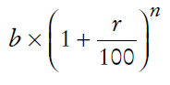
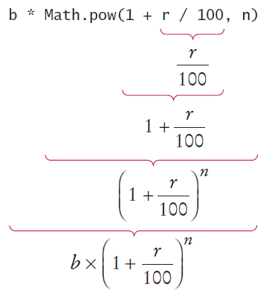
Powers and Roots
In Java, there are no symbols for power and roots
        Becomes:
        b * Math.pow(1 + r / 100, n)
Analyzing the expression:
The Java library declares many
Mathematical functions, such as
Math.sqrt (square root) and Math.pow (raising to a power).
Copyright © 2013 by John Wiley & Sons. All rights reserved.
Page <number>

Slide 23
Floating-Point to Integer Conversion
The Java compiler does not allow direct assignment of a floating-point value to an integer variable
    double balance = total + tax;
    int dollars = balance; // Error
You can use the ‘cast’ operator: (int) to force the conversion:
    double balance = total + tax;
    int dollars = (int) balance; // no Error
You lose the fractional part of the floating-point value (no rounding occurs)
Copyright © 2013 by John Wiley & Sons. All rights reserved.
Page <number>

Slide 24
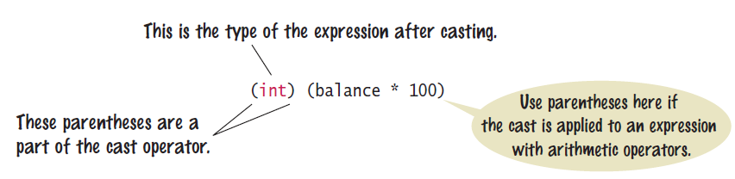
Cast Syntax
Casting is a very powerful tool and should be used carefully
To round a floating-point number to the nearest whole number, use the Math.round method
This method returns a long integer, because large floating-point numbers cannot be stored in an int
  long rounded = Math.round(balance);
Copyright © 2013 by John Wiley & Sons. All rights reserved.
Page <number>

Slide 25
2.3 Input and Output
Reading Input
You might need to ask for input and then save what was entered.
  We will be reading input from the keyboard
  For now, don’t worry about the details
This is a three step process in Java
  Import the Scanner class from its ‘package’ java.util import java.util.Scanner;
  Setup an object of the Scanner class
    Scanner in = new Scanner(System.in);
  Use methods of the new Scanner object to get input
  int bottles = in.nextInt();
  double price = in.nextDouble();
Copyright © 2013 by John Wiley & Sons. All rights reserved.
Page <number>

Slide 26
2.5 Strings
The String Type:
  Type Variable Literal
  String name = “Harry”
Once you have a String variable, you can use methods such as:
  int n = name.length(); // n will be assigned 5
A String’s length is the number of characters inside:
  An empty String (length 0) is shown as “”
  The maximum length is quite large (an int)
Copyright © 2013 by John Wiley & Sons. All rights reserved.
Page <number>

Slide 27
String Concatenation (+)
You can ‘add’ one String onto the end of another
  String fName = “Harry”
  String lName = “Morgan“
  String name = fname + lname; // HarryMorgan
You wanted a space in between?
  String name = fname + “ “ + lname; // Harry Morgan
To concatenate a numeric variable to a String:
  String a = “Agent“;
  int n = 7;
  String bond = a + n; // Agent7
Concatenate Strings and numerics inside println:
  System.out.println("The total is " + total);
Copyright © 2013 by John Wiley & Sons. All rights reserved.
Page <number>

Slide 28
String Input
You can read a String from the console with:
  System.out.print("Please enter your name: ");
  String name = in.next();
  The next method reads one word at a time
  It looks for ‘white space’ delimiters
You can read an entire line from the console with:
  System.out.print("Please enter your address: ");
  String address = in.nextLine();
  The nextLine method reads until the user hits ‘Enter’
Copyright © 2013 by John Wiley & Sons. All rights reserved.
Page <number>

Slide 29
String Escape Sequences
How would you print a double quote?
  Preface the " with a \ inside the double quoted String
  System.out.print("He said \"Hello\"");
OK, then how do you print a backslash?
  Preface the \ with another \!
  System.out.print("“C:\\Temp\\Secret.txt“);
Special characters inside Strings
  Output a newline with a ‘\n’
  System.out.print("*\n**\n***\n");
*
**
***
Copyright © 2013 by John Wiley & Sons. All rights reserved.
Page <number>

Slide 30

Strings and Characters
Strings are sequences of characters
  Unicode characters to be exact
  Characters have their own type: char
  Characters have numeric values
    See the ASCII code chart in Appendix B
    For example, the letter ‘H’ has a value of 72 if it were a number
Use single quotes around a char
  char initial = ‘B’;
Use double quotes around a String
  String initials = “BRL”;
Copyright © 2013 by John Wiley & Sons. All rights reserved.
Page <number>

Slide 31
Copying a char from a String
Each char inside a String has an index number:
The first char is index zero (0)
The charAt method returns a char at a given index inside a String:
  String greeting = "Harry";
  char start = greeting.charAt(0);
  char last = greeting.charAt(4);
0 | 1 | 2 | 3 | 4 | 5 | 6 | 7 | 8 | 9
c | h | a | r | s |  | h | e | r | e
0 | 1 | 2 | 3 | 4
H | a | r | r | y
Copyright © 2013 by John Wiley & Sons. All rights reserved.
Page <number>

Slide 32
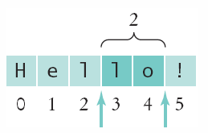
Copying portion of a String
A substring is a portion of a String
The substring method returns a portion of a String at a given index for a number of chars, starting at an index:
  String greeting = "Hello!";
  String sub = greeting.substring(0, 2);
  String sub2 = greeting.substring(3, 5);
0 | 1 | 2 | 3 | 4 | 5
H | e | l | l | o | !
0 | 1
H | e
Copyright © 2013 by John Wiley & Sons. All rights reserved.
Page <number>

Slide 33
End of Lecture
Additional slides including summary and reference slides follow: use these in your study.
To deepen your understanding of the lecture, read Chapter 2 of Java for Everyone.
Attempt the Self-Check exercises!
Tutorial Worksheet 2 is on the CSC9A1 website
  Solutions will be discussed at tutorials in week 4
  Prepare your answers before coming to the tutorial
Programming Practical Worksheets 3 and 4 are also available
  Note the deadlines on the worksheets!
Copyright © 2013 by John Wiley & Sons. All rights reserved.
Page <number>

Slide 34
Java Comments
There are three forms of comments:
  1: // single line (or rest of line to right)
  2: /*
  multi-line – all comment until matching
  */
  3: /**
  multi-line Javadoc comments
  */
Use comments at the beginning of each program, and to clarify details of the code
Use comments to
add explanations for
humans who read
your code. The
compiler ignores
comments.
Copyright © 2013 by John Wiley & Sons. All rights reserved.
Page <number>

Slide 35
Summary: Variables
A variable is a storage location with a name.
When declaring a variable, you usually specify an initial value.
When declaring a variable, you also specify the type of its values.
Use the int type for numbers that cannot have a fractional part.
Use the double type for floating-point numbers.
By convention, variable names should start with a lower case letter.
An assignment statement stores a new value in a variable, replacing the previously stored value
Copyright © 2013 by John Wiley & Sons. All rights reserved.
Page <number>

Slide 36
Summary: Operators
The assignment operator = does not denote mathematical equality.
You cannot change the value of a variable that is defined as final.
The ++ operator adds 1 to a variable; the -- operator subtracts 1.
If both arguments of / are integers, the remainder is discarded.
The % operator computes the remainder of an integer division.
Copyright © 2013 by John Wiley & Sons. All rights reserved.
Page <number>

Slide 37
Summary: Java API
The Java library declares many mathematical functions, such as Math.sqrt and Math.pow.
You use a cast (typeName) to convert a value to a different type.
Java classes are grouped into packages. Use the import statement to use classes from packages.
Use the Scanner class to read keyboard input in a console window.
Use the printf method to specify how values should be formatted.
The API (Application Programming Interface) documentation lists the classes and methods of the Java library.
Copyright © 2013 by John Wiley & Sons. All rights reserved.
Page <number>

Slide 38
Summary: Strings
Strings are sequences of characters.
The length method yields the number of characters in a String.
Use the + operator to concatenate Strings; that is, to put them together to yield a longer String.
Use the next (one word) or nextLine (entire line) methods of the Scanner class to read a String.
Whenever one of the arguments of the + operator is a String, the other argument is converted to a String.
If a String contains the digits of a number, you use the Integer.parseInt or Double.parseDouble method to obtain the number value.
String index numbers are counted starting with 0.
Use the substring method to extract a part of a String
Copyright © 2013 by John Wiley & Sons. All rights reserved.
Page <number>

Slide 39
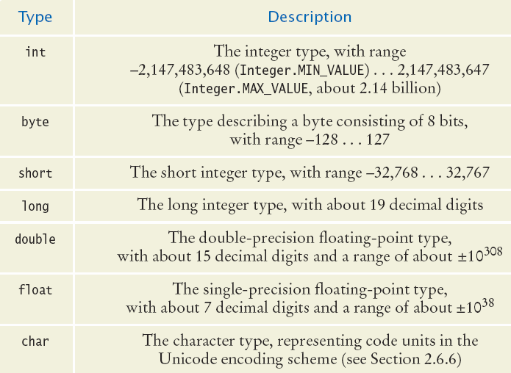
All of the Java Numeric Types
Whole Numbers (no fractions)
Floating point Numbers
Characters
(no math)
Each type has a range of values that it can hold
Copyright © 2013 by John Wiley & Sons. All rights reserved.
Page <number>

Slide 40
Value Ranges per Type
Integer Types
  byte: A very small number (-128 to +127)
  short: A small number (-32768 to +32767)
  int: A large number (-2,147,483,648 to +2,147,483,647)
  long: A huge number
Floating Point Types
  float: A huge number with decimal places
  double: Much more precise, for heavy math
Other Types
  boolean: true or false
  char: One symbol in single quotes ‘a’
Copyright © 2013 by John Wiley & Sons. All rights reserved.
Page <number>

Slide 41
Storage per Type (in bytes)
Integer Types
  byte:
  short:
  int:
  long:
Floating Point Types
  float:
  double:
Other Types
  boolean:
  char:
Copyright © 2013 by John Wiley & Sons. All rights reserved.
Page <number>

Slide 42
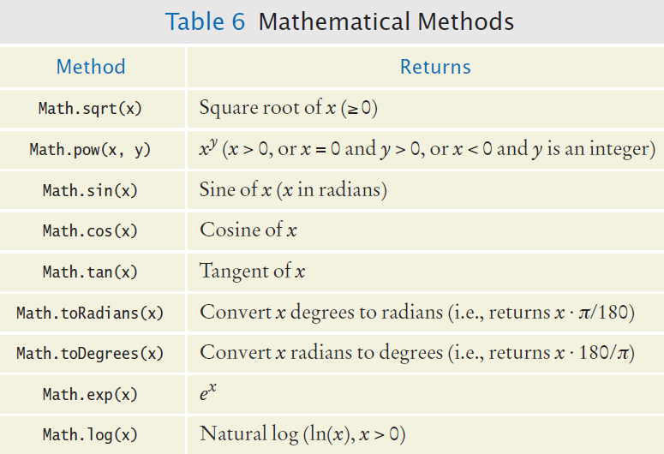
Mathematical Methods
Copyright © 2013 by John Wiley & Sons. All rights reserved.
Page <number>

Slide 43
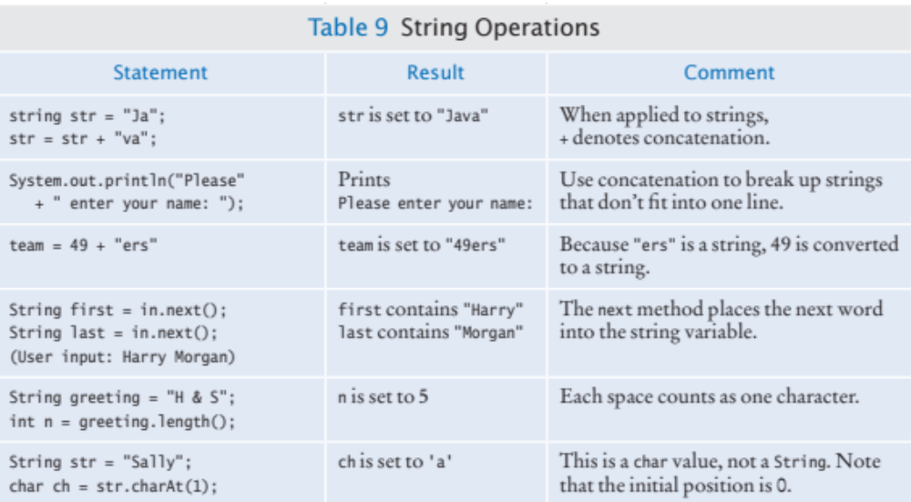
Table 9: String Operations (1)
Copyright © 2013 by John Wiley & Sons. All rights reserved.
Page <number>

Slide 44
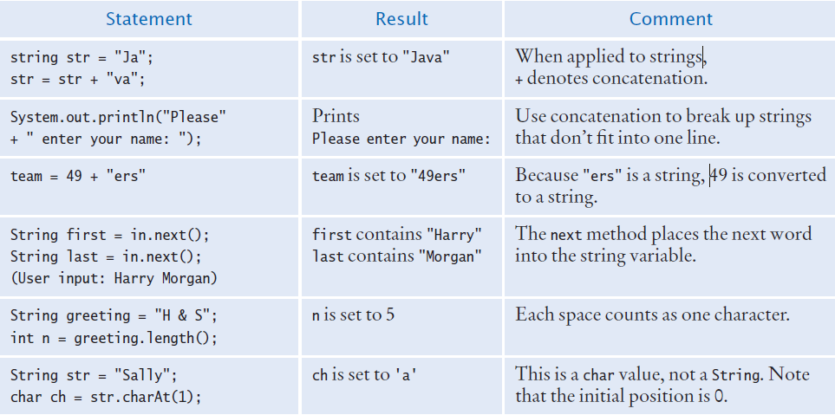
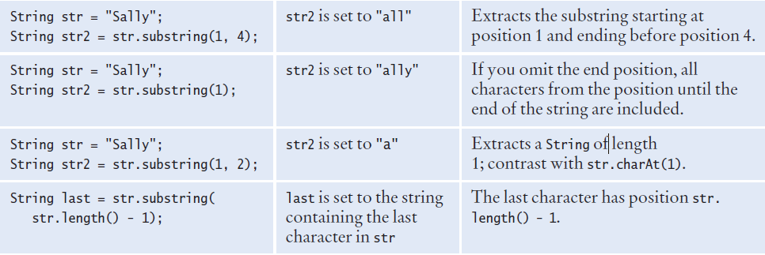
Table 9: String Operations (2)
Copyright © 2013 by John Wiley & Sons. All rights reserved.
Page <number>

