Slide 1
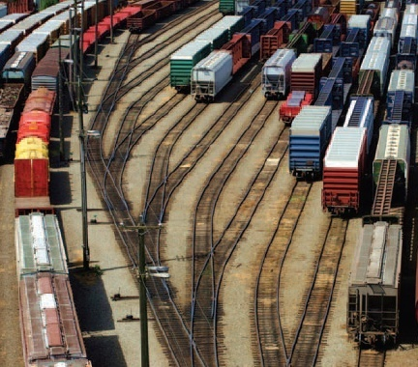
3
CSCU9A1 JAVA LECTURE
DECISIONS
Copyright © 2013 by John Wiley & Sons. All rights reserved.

Slide 2
Lecture Goals
To implement decisions using the if statement
To compare integers, floating-point numbers, and Strings
To write statements using the Boolean data type
To develop strategies for testing your programs
To validate user input
Related reading:
Java for Everyone 2nd ed, Horstmann, 2013
  Chapter 3 (Decisions)
Copyright © 2013 by John Wiley & Sons. All rights reserved.
Page <number>

Slide 3
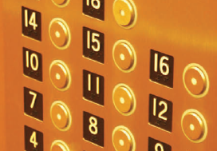
The if Statement
A computer program often needs to make decisions based on input, or circumstances
For example, US buildings often ‘skip’ the 13th floor, and lifts do this too
  The 14th floor is really the 13th floor
  So every floor above 12 is really ‘floor - 1’
    If floor > 12, actual floor = floor - 1
The two keywords of the if statement are:
  if
  else
The if statement allows a program to carry out different actions depending on the nature of the data to be processed.
Copyright © 2013 by John Wiley & Sons. All rights reserved.
Page <number>

Slide 4
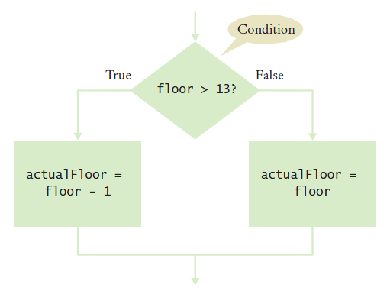
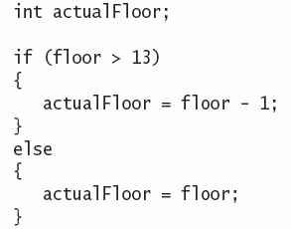
Flowchart of the if statement
One of the two branches is executed once
  True (if) branch or False (else) branch
Copyright © 2013 by John Wiley & Sons. All rights reserved.
Page <number>

Slide 5
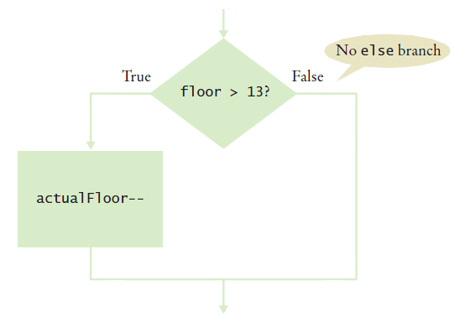
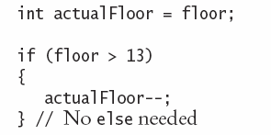
Flowchart with only true branch
An if statement may not need a ‘False’ (else) branch
Copyright © 2013 by John Wiley & Sons. All rights reserved.
Page <number>

Slide 6
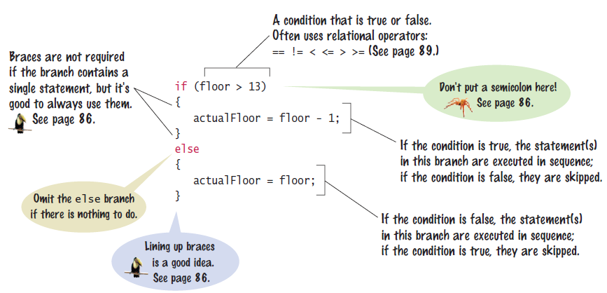
Syntax: The if statement
Copyright © 2013 by John Wiley & Sons. All rights reserved.
Page <number>

Slide 7
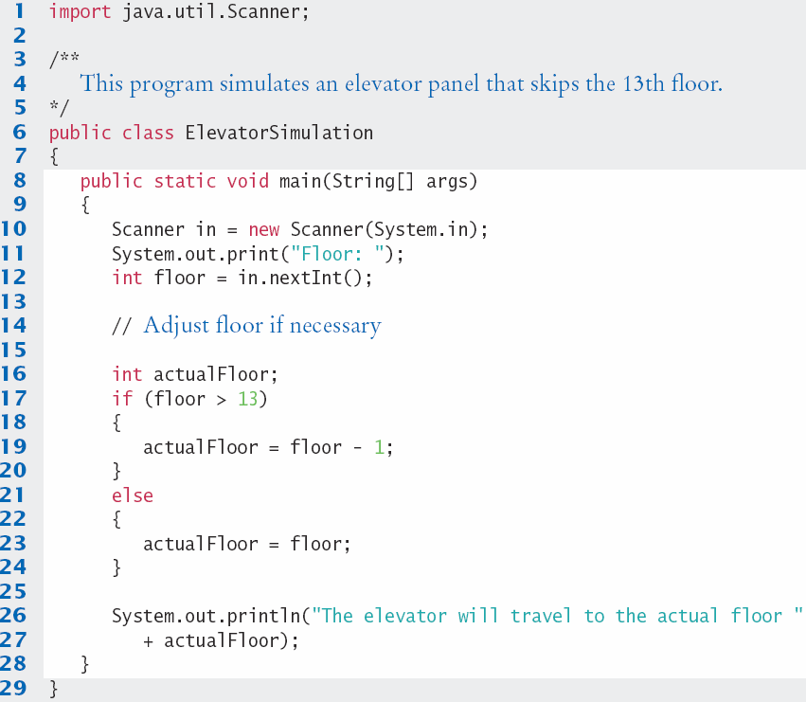

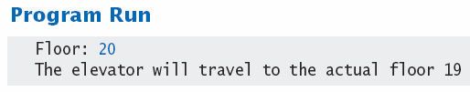
ElevatorSimulation.java
Copyright © 2013 by John Wiley & Sons. All rights reserved.
Page <number>

Slide 8




Tips On Using Braces
Line up all pairs of braces vertically
  Lined up Not aligned (saves lines)
Always use braces
  Although single statement clauses do not require them
Most programmer’s editors have a tool to align matching braces.
Copyright © 2013 by John Wiley & Sons. All rights reserved.
Page <number>

Slide 9
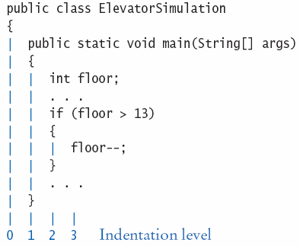
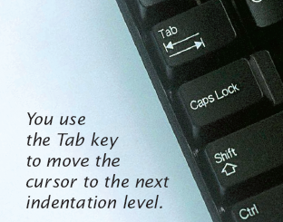
Tips on indenting blocks
Use Tab to indent a consistent number of spaces
This is referred to as ‘block- structured’ code. Indenting consistently makes code much
easier for humans to follow.
Copyright © 2013 by John Wiley & Sons. All rights reserved.
Page <number>

Slide 10

Common Error
A semicolon after an if statement
It is easy to forget and add a semicolon
after an if statement.
  The true path is now the space just before the semicolon
  The ‘body’ (between the curly braces) will always be executed in this case
if (floor > 13) ;
{
floor--;
}
Copyright © 2013 by John Wiley & Sons. All rights reserved.
Page <number>

Slide 11
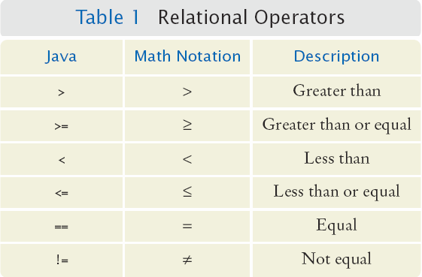
Comparing Numbers
Every if statement has a condition
  Usually compares two values with an operator
if (floor > 13) ..
if (floor >= 13)
..
if (floor < 13) ..
if (floor <= 13)
..
if (floor == 13) ..
Beware!
Copyright © 2013 by John Wiley & Sons. All rights reserved.
Page <number>

Slide 12
Comparing Strings
Strings are a bit ‘special’ in Java
Do not use the == operator with Strings
  The following compares the locations of two strings, and not their contents
Instead use the String’s equals method:
if (string1 == string2) ...
if (string1.equals(string2)) ...
Copyright © 2013 by John Wiley & Sons. All rights reserved.
Page <number>

Slide 13
Lexicographical Order
To compare Strings in ‘dictionary’ order
  When compared using compareTo, string1 comes:
    Before string2 if
    After string2 if
    Equal to string2 if
  Notes
    All UPPERCASE letters come before lowercase
    ‘space’ comes before all other printable characters
    Digits (0-9) come before all letters
    See Appendix A for the Basic Latin Unicode (ASCII) table
string1.compareTo(string2) < 0
string1.compareTo(string2) > 0
string1.compareTo(string2) == 0
Copyright © 2013 by John Wiley & Sons. All rights reserved.
Page <number>

Slide 14
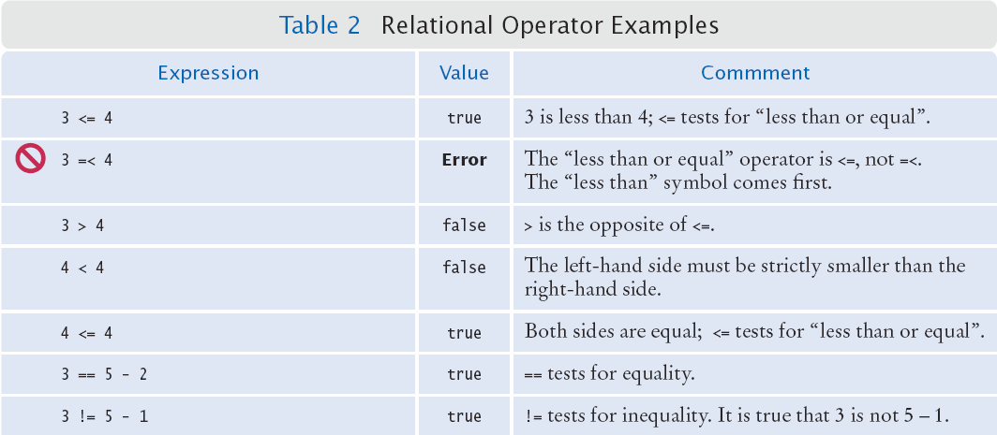
Relational Operator Use (1)
Copyright © 2013 by John Wiley & Sons. All rights reserved.
Page <number>

Slide 15
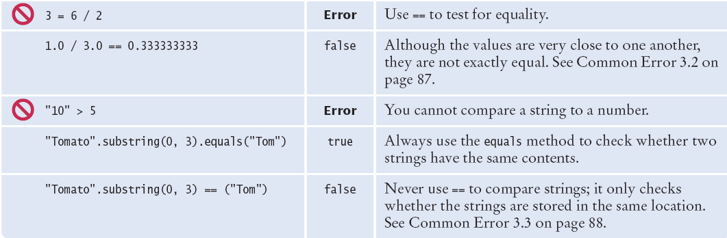
Relational Operator Use (2)
Copyright © 2013 by John Wiley & Sons. All rights reserved.
Page <number>

Slide 16
Implementing an If statement
The university bookstore has a Kilobyte Day sale every October 24, giving an 8 percent discount on all computer accessory purchases if the price is less than £128, and a 16 percent discount if the price is at least £128.
How can we write code to calculate the discounted price? We need an if statement.
  Let’s look at how to implement this systematically.
Copyright © 2013 by John Wiley & Sons. All rights reserved.
Page <number>

Slide 17


Implementing an if Statement
Decide on a branching condition
Write pseudocode for the true branch
Write pseudocode for the false branch
Double-check relational operators
  Test values below, at, and above the comparison (127, 128, 129)
Copyright © 2013 by John Wiley & Sons. All rights reserved.
Page <number>

Slide 18


Implementing an if Statement (cont.)
Remove duplication
Test both branches
Write the code in Java
Copyright © 2011 by John Wiley & Sons. All rights reserved.
Page <number>

Slide 19
Implemented Example
The university bookstore has a Kilobyte Day sale every October 24, giving an 8 percent discount on all computer accessory purchases if the price is less than $128, and a 16 percent discount if the price is at least $128.
if (originalPrice < 128)
{
discountRate = 0.92;
}
else
{
discountRate = 0.84;
}
discountedPrice = discountRate * originalPrice;
Copyright © 2013 by John Wiley & Sons. All rights reserved.
Page <number>

Slide 20
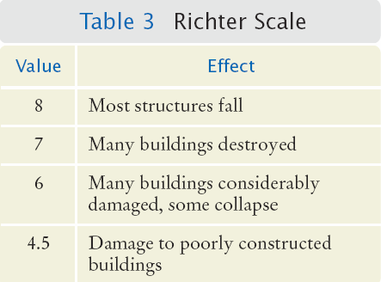
Multiple Alternatives
What if you have more than two branches?
Count the branches for the following earthquake effect example:
  8 (or greater)
  7 to 7.99
  6 to 6.99
  4.5 to 5.99
  Less than 4.5
When using multiple if statements, test general conditions after more specific conditions.
Copyright © 2013 by John Wiley & Sons. All rights reserved.
Page <number>

Slide 21
Flowchart of Multiway branching
>= 8.0?
True
Most Structures Fall
False
>= 7.0?
True
Many Buildings Destroyed
False
>= 6.0?
True
Many buildings considerably damaged, some collapse
False
>= 4.5?
True
Damage to poorly constructed buildings
False
No destruction of buildings
Copyright © 2013 by John Wiley & Sons. All rights reserved.
Page <number>

Slide 22
if, else if multiway branching
if (richter >= 8.0) // Handle the ‘special case’ first
{
System.out.println("Most structures fall");
}
else if (richter >= 7.0)
{
System.out.println("Many buildings destroyed");
}
else if (richter >= 6.0)
{
System.out.println("Many buildings damaged, some collapse");
}
else if (richter >= 4.5)
{
System.out.println("Damage to poorly constructed buildings");
}
else // so that the ‘general case’ can be handled last
{
System.out.println("No destruction of buildings");
}
Copyright © 2013 by John Wiley & Sons. All rights reserved.
Page <number>

Slide 23
What is wrong with this code?
if (richter >= 8.0)
{
System.out.println("Most structures fall");
}
if (richter >= 7.0)
{
System.out.println("Many buildings destroyed");
}
if (richter >= 6.0)
{
System.out.println("Many buildings damaged, some collapse");
}
if (richter >= 4.5)
{
System.out.println("Damage to poorly constructed buildings");
}
Copyright © 2013 by John Wiley & Sons. All rights reserved.
Page <number>

Slide 24
Another way to multiway branch
The switch statement chooses a case based on an integer value.
int digit = . . .;
switch (digit)
{
case 1: digitName = "one"; break;
case 2: digitName = "two"; break;
case 3: digitName = "three"; break;
case 4: digitName = "four"; break;
case 5: digitName = "five"; break;
case 6: digitName = "six"; break;
case 7: digitName = "seven"; break;
case 8: digitName = "eight"; break;
case 9: digitName = "nine"; break;
default: digitName = ""; break;
}
break ends each case
default catches all other values
If the break is missing, the case falls through to the next case’s statements.
Copyright © 2013 by John Wiley & Sons. All rights reserved.
Page <number>

Slide 25
Nested if Statements
You can nest an if inside either branch of an if statement.
Simple example: Ordering drinks
  Ask the customer for their drink order
  if customer orders beer
    Ask customer for ID
    if customer’s age is 18 or over
      Serve beer
    Else
      Politely explain the law to the customer
  Else
    Serve customers a non-alcoholic drink
Copyright © 2013 by John Wiley & Sons. All rights reserved.
Page <number>

Slide 26
Flowchart of a Nested if
Ask for order
Nested if-else inside true branch of an if statement.
  Three paths
Beer?
True
Check ID
False
>= 18?
True
Serve beer
Serve non-alcoholic drink
False
Read law
Done
Copyright © 2013 by John Wiley & Sons. All rights reserved.
Page <number>

Slide 27
Problem Solving: Test Cases
Aim for complete coverage of all decision points:
  There are two possibilities for the customer’s order and two age brackets, yielding four test cases
  Test a handful of boundary conditions, such as an age that is at the boundary between two age brackets, and ages close to the boundary
  If you are responsible for error checking (which is discussed next), also test an invalid input, such as a negative age
Each branch of your code should be covered with a test case
Copyright © 2013 by John Wiley & Sons. All rights reserved.
Page <number>

Slide 28

Boolean Variables
Boolean Variables
  A Boolean variable is often called a flag because it can be either up (true) or down (false)
  boolean is a Java data type
    boolean failed = true;
    Can be either true or false
Boolean Operators: && and ||
  They combine multiple conditions
  && is the and operator
  || is the or operator
Copyright © 2013 by John Wiley & Sons. All rights reserved.
Page <number>

Slide 29
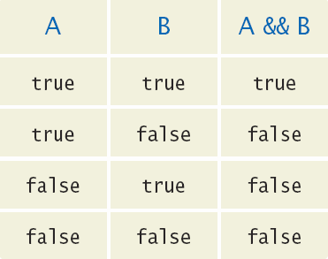
Combined Conditions: &&
Combining two conditions is often used in range checking
  Is a value between two other values?
Both sides of the and must be true for the result to be true
if (temp > 0 && temp < 100)
{
System.out.println("Liquid");
}
Copyright © 2013 by John Wiley & Sons. All rights reserved.
Page <number>

Slide 30
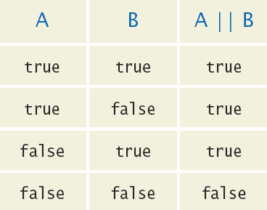
Combined Conditions: ||
If only one of two conditions need to be true
  Use a compound conditional with an or:
If either is true
  The result is true
if (balance > 100 || credit > 100)
{
System.out.println(“Accepted");
}
Copyright © 2013 by John Wiley & Sons. All rights reserved.
Page <number>

Slide 31
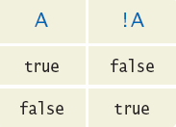
The not Operator: !
If you need to invert a boolean variable or comparison, precede it with !
If using !, try to use simpler logic:
if (!attending || grade < 60)
{
System.out.println(“Drop?");
}
if (attending && !(grade < 60))
{
System.out.println(“Stay");
}
if (attending && (grade >= 60))
Copyright © 2013 by John Wiley & Sons. All rights reserved.
Page <number>

Slide 32
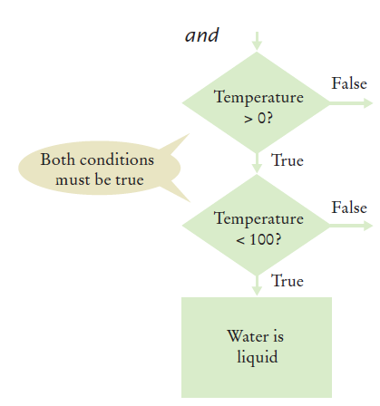
and Flowchart
if (temp > 0 && temp < 100)
{
System.out.println("Liquid");
}
This is often called ‘range checking’
  Used to validate that input is between two values
Copyright © 2013 by John Wiley & Sons. All rights reserved.
Page <number>

Slide 33
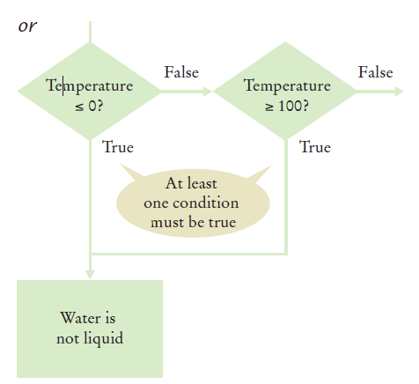
or Flowchart
Another form of ‘range checking’
  Checks if value is outside a range
if (temp <= 0 || temp >= 100)
{
System.out.println(“Not Liquid");
}
Copyright © 2013 by John Wiley & Sons. All rights reserved.
Page <number>

Slide 34
3.8 Input Validation
Accepting user input is dangerous
  Consider the Elevator program:
  The user may input an invalid character or value
  Must be an integer
    Scanner can help!
    hasNextInt()
      True if integer
      False if not
  Then range check value
  We expect a floor number to be between 1 and 20
    NOT 0, 13 or > 20
if (in.hasNextInt())
{
int floor = in.nextInt();
// Process the input value
}
else
{
System.out.println("Not integer.");
}
Copyright © 2013 by John Wiley & Sons. All rights reserved.
Page <number>

Slide 35
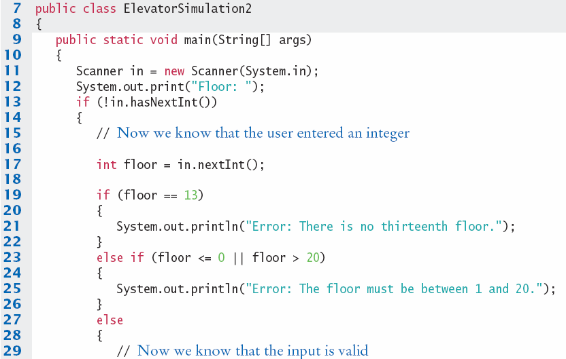
ElevatorSimulation2.java
Input value validity checking
Input value range checking
Copyright © 2013 by John Wiley & Sons. All rights reserved.
Page <number>

Slide 36
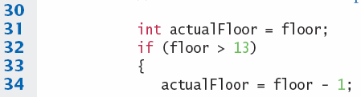
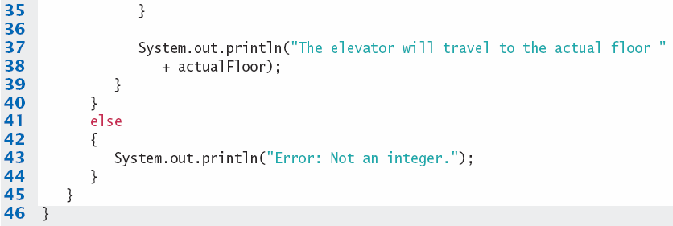

ElevatorSimulation2.java
Copyright © 2013 by John Wiley & Sons. All rights reserved.
Page <number>

Slide 37
End of Lecture
Read the slides on the module website: they contain additional material that supplements the lecture.
To deepen your understanding, read Chapter 3 of Java for Everyone.
Attempt the Self-Check exercises!
Programming Practical Worksheets 5 and 6 are available on the module website.
Copyright © 2013 by John Wiley & Sons. All rights reserved.
Page <number>

Slide 38
Summary: if Statement
The if statement allows a program to carry out different actions depending on the nature of the data to be processed.
Relational operators ( < <= > >= == != ) are used to compare numbers and Strings.
Do not use the == operator to compare Strings.
  Use the equals method instead.
  The compareTo method compares Strings in lexicographic order.
Multiple if statements can be combined to evaluate complex decisions.
When using multiple if statements, test general conditions after more specific conditions.
Copyright © 2013 by John Wiley & Sons. All rights reserved.
Page <number>

Slide 39
Summary: Flowcharts and Testing
When a decision statement is contained inside the branch of another decision statement, the statements are nested.
Nested decisions are required for problems that have two levels of decision making.
Flow charts are made up of elements for tasks, input/ output, and decisions.
Each branch of a decision can contain tasks and further decisions.
Never point an arrow inside another branch.
Each branch of your program should be covered by a test case.
It is a good idea to design test cases before implementing a program.
Copyright © 2013 by John Wiley & Sons. All rights reserved.
Page <number>

Slide 40
Summary: Boolean
The Boolean type boolean has two values, true and false.
  Java has two Boolean operators that combine conditions: && (and) and || (or).
  To invert a condition, use the ! (not) operator.
  The && and || operators are computed lazily: As soon as the truth value is determined, no further conditions are evaluated.
  De Morgan’s law tells you how to negate && and || conditions.
You can use Scanner hasNext methods to ensure that the data is what you expect.
Copyright © 2011 by John Wiley & Sons. All rights reserved.
Page <number>

