Slide 1

4
CSCU9A1 JAVA LECTURE
LOOPS
Copyright © 2013 by John Wiley & Sons. All rights reserved.

Slide 2
Lecture Goals
To implement while, for, and do loops
To hand-trace the execution of a program
To become familiar with common loop algorithms
To understand nested loops
Related reading:
Java for Everyone 2nd ed, Horstmann, 2013
  Chapter 4 (Loops)
Copyright © 2013 by John Wiley & Sons. All rights reserved.
Page <number>

Slide 3
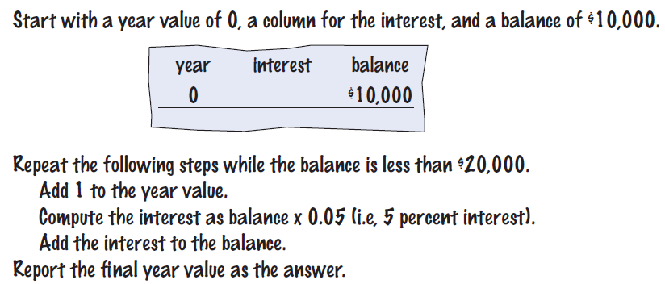

The while Loop
Examples of loop applications
  Calculating compound interest
  Simulations, event driven programs…
Compound interest algorithm
Steps
Copyright © 2013 by John Wiley & Sons. All rights reserved.
Page <number>

Slide 4
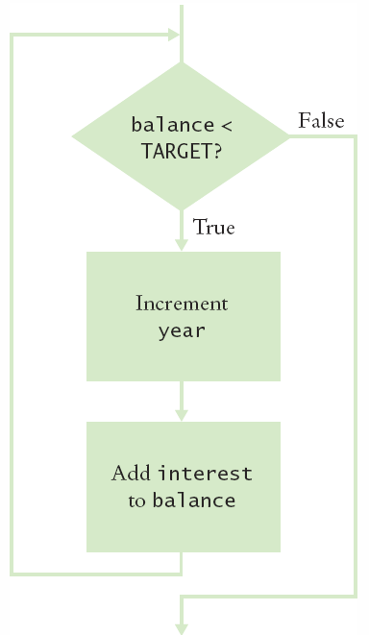
Planning the while Loop
    A loop executes instructions
    repeatedly while a condition is true.
while (balance < TARGET)
{
year++;
double interest = balance * RATE/100;
balance = balance + interest;
}
Copyright © 2013 by John Wiley & Sons. All rights reserved.
Page <number>

Slide 5
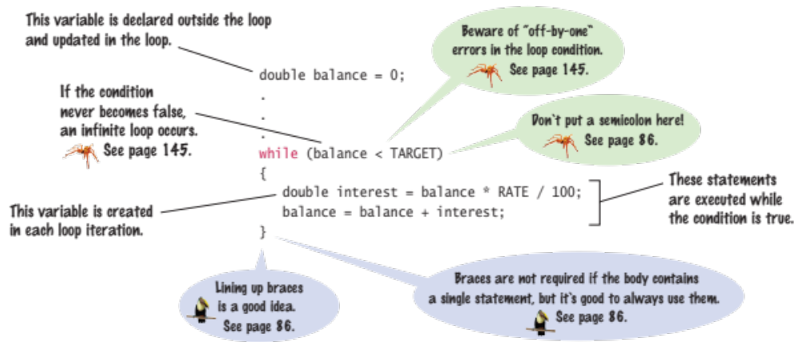
Syntax: while Statement
Copyright © 2013 by John Wiley & Sons. All rights reserved.
Page <number>

Slide 6
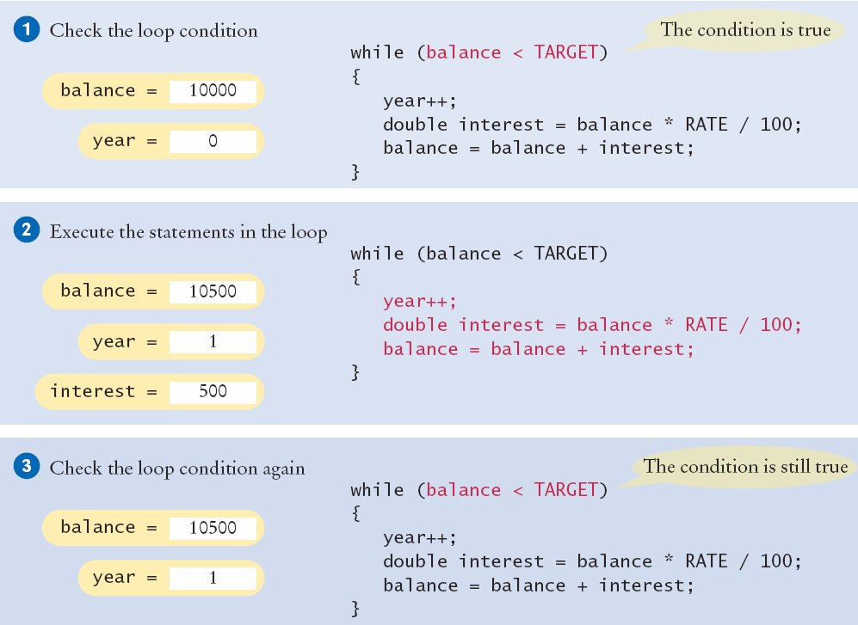
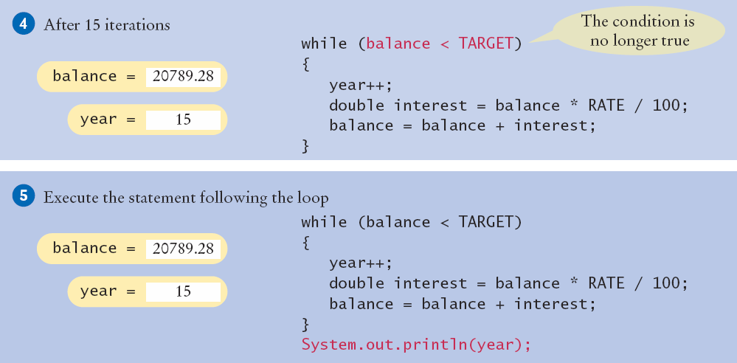
Execution of the Loop
Copyright © 2013 by John Wiley & Sons. All rights reserved.
Page <number>

Slide 7
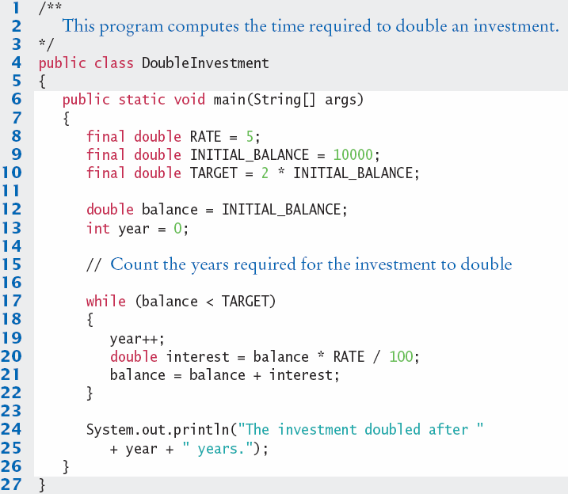

DoubleInvestment.java
    Declare and initialize a variable outside of the loop to count years
    Increment the years variable each time through
Copyright © 2013 by John Wiley & Sons. All rights reserved.
Page <number>

Slide 8
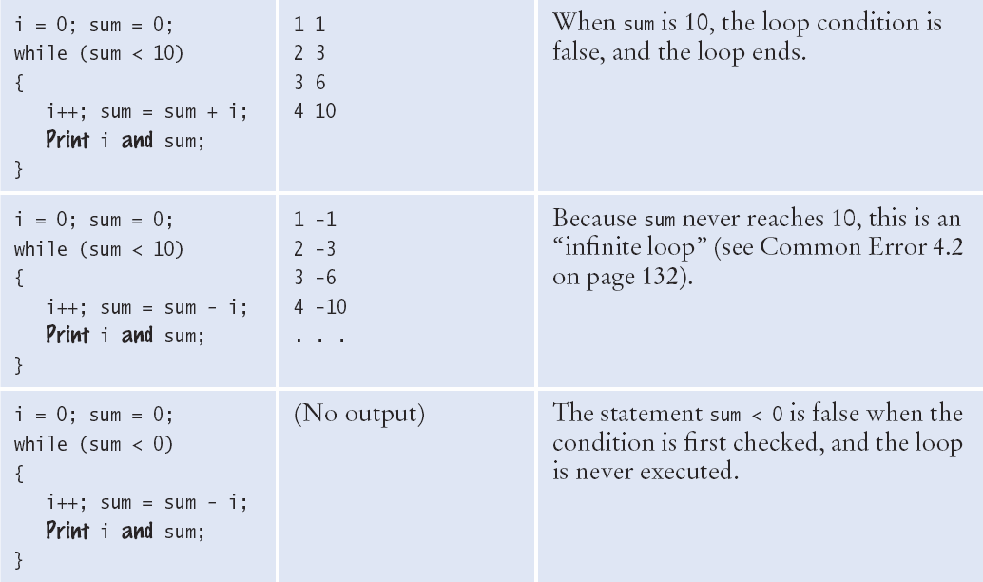
while Loop Examples (1)
Copyright © 2013 by John Wiley & Sons. All rights reserved.
Page <number>

Slide 9
while Loop Examples (1)
Copyright © 2013 by John Wiley & Sons. All rights reserved.
Page <number>

Slide 10
while Loop Examples (1)
Copyright © 2013 by John Wiley & Sons. All rights reserved.
Page <number>

Slide 11
while Loop Examples (1)
Copyright © 2013 by John Wiley & Sons. All rights reserved.
Page <number>

Slide 12
while Loop Examples (1)
Copyright © 2013 by John Wiley & Sons. All rights reserved.
Page <number>

Slide 13
while Loop Examples (1)
Copyright © 2013 by John Wiley & Sons. All rights reserved.
Page <number>

Slide 14
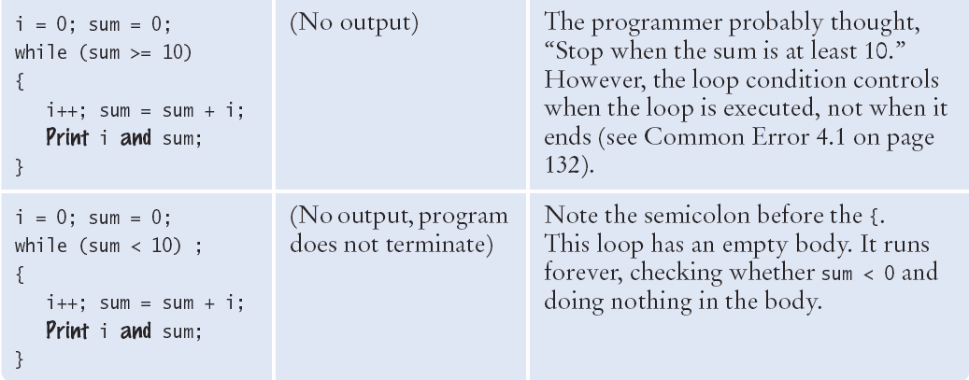
while Loop Examples (2)
Copyright © 2013 by John Wiley & Sons. All rights reserved.
Page <number>

Slide 15
while Loop Examples (2)
Copyright © 2013 by John Wiley & Sons. All rights reserved.
Page <number>

Slide 16
while Loop Examples (2)
Copyright © 2013 by John Wiley & Sons. All rights reserved.
Page <number>

Slide 17
while Loop Examples (2)
Copyright © 2013 by John Wiley & Sons. All rights reserved.
Page <number>

Slide 18

Common Error
Don’t think “Are we there yet?”
  The loop body will only execute if the test condition is True.
  “Are we there yet?” should continue if False
  If bal should grow until it reaches TARGET
    Which version will execute the loop body?
while (bal < TARGET)
{
year++;
interest = bal * RATE;
bal = bal + interest;
}
while (bal >= TARGET)
{
year++;
interest = bal * RATE;
bal = bal + interest;
}
Copyright © 2013 by John Wiley & Sons. All rights reserved.
Page <number>

Slide 19
Common Error
Infinite Loops
  The loop body will execute until the test condition becomes False.
  What if you forget to update the test variable?
    bal is the test variable (TARGET doesn’t change)
    You will loop forever! (or until you stop the program)
while (bal < TARGET)
{
year++;
interest = bal * RATE;
}
bal = bal + interest;
}
Copyright © 2013 by John Wiley & Sons. All rights reserved.
Page <number>

Slide 20
Common Error
Off-by-One Errors
  A ‘counter’ variable is often used in the test condition
  Your counter can start at 0 or 1, but programmers often start a counter at 0
  If I want to paint all 5 fingers, when I am done?
    Start at 0, use < Start at 1, use <=
    0, 1, 2, 3, 4 1, 2, 3, 4, 5
int finger = 0;
final int FINGERS = 5;
while (finger < FINGERS)
{
// paint finger
finger++;
}
int finger = 1;
final int FINGERS = 5;
while (finger <= FINGERS)
{
// paint finger
finger++;
}
Copyright © 2013 by John Wiley & Sons. All rights reserved.
Page <number>

Slide 21
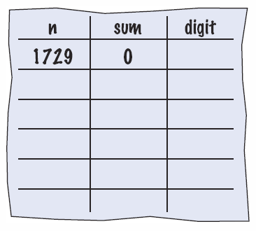
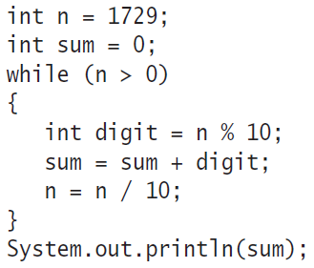
4.2: Hand-Tracing
Example: Calculate the sum of digits (1+7+2+9)
  Make columns for key variables (n, sum, digit)
  Examine the code and number the steps
  Set variables to state before loop begins
Copyright © 2013 by John Wiley & Sons. All rights reserved.
Page <number>

Slide 22
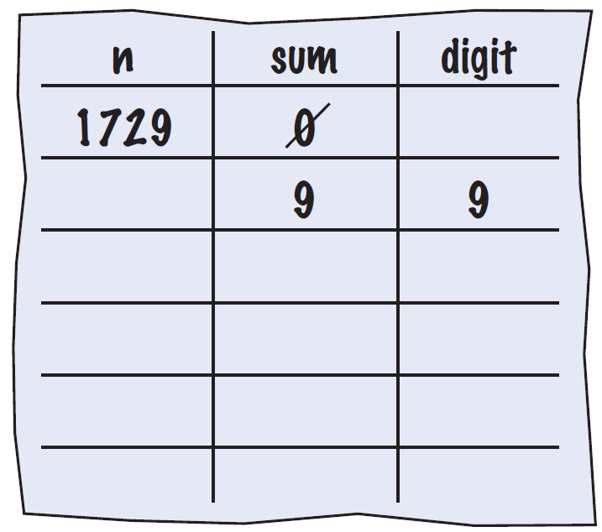
Tracing Sum of Digits
Start executing loop body statements changing variable values on a new line
  Cross out values in previous line
Copyright © 2013 by John Wiley & Sons. All rights reserved.
Page <number>

Slide 23
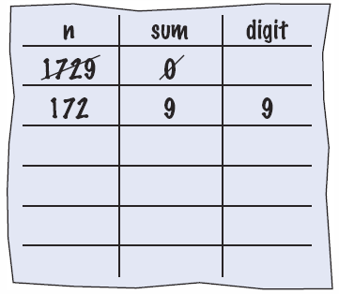
Tracing Sum of Digits
Continue executing loop statements changing variables
  1729 / 10 leaves 172 (no remainder)
Copyright © 2013 by John Wiley & Sons. All rights reserved.
Page <number>

Slide 24
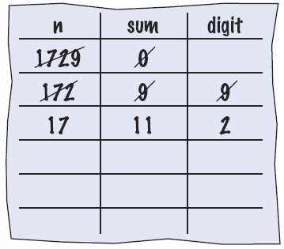
Tracing Sum of Digits
Test condition. If true, execute loop again
  Variable n is 172, Is 172 > 0?, True!
Make a new line for the second time through and update variables
Copyright © 2013 by John Wiley & Sons. All rights reserved.
Page <number>

Slide 25
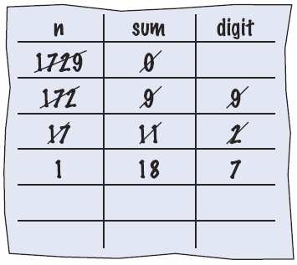
Tracing Sum of Digits
Third time through
  Variable n is 17 which is still greater than 0
Execute loop statements and update variables
Copyright © 2013 by John Wiley & Sons. All rights reserved.
Page <number>

Slide 26
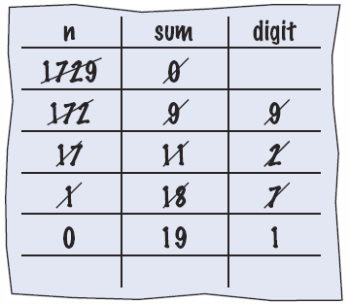
Tracing Sum of Digits
Fourth loop iteration:
  Variable n is 1 at start of loop. 1 > 0? True
  Executes loop and changes variable n to 0 (1/10 = 0)
Copyright © 2013 by John Wiley & Sons. All rights reserved.
Page <number>

Slide 27
Tracing Sum of Digits
Because n is 0, the expression(n > 0) is False
Loop body is not executed
  Jumps to next statement after the loop body
Finally prints the sum!
Copyright © 2013 by John Wiley & Sons. All rights reserved.
Page <number>

Slide 28
Summary of the while Loop
while loops are very commonly used
  Initialize variables before you test
  The condition is tested BEFORE the loop body
    This is called pre-test
    The condition often uses a counter variable
  Something inside the loop should change one of the variables used in the test
Watch out for infinite loops!
Copyright © 2013 by John Wiley & Sons. All rights reserved.
Page <number>

Slide 29
4.3 The for Loop
Use a for loop when you:
  Can use an integer counter variable
  Have a constant increment (or decrement)
  Have a fixed starting and ending value for the counter
int i = 5; // initialize
while (i <= 10) // test
{
sum = sum + i;
i++; // update
}
    Use a for loop when a value runs from a starting point to an
    ending point with a constant increment or decrement.
while version
for (int i = 5; i <= 10; i++)
{
sum = sum + i;
}
for version
Copyright © 2013 by John Wiley & Sons. All rights reserved.
Page <number>

Slide 30
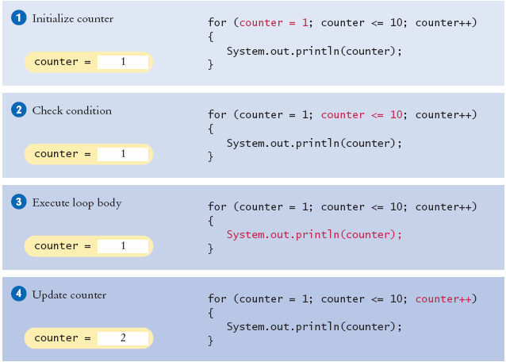

Execution of a for Loop
2
3
2
3
2
3
Copyright © 2013 by John Wiley & Sons. All rights reserved.
Page <number>

Slide 31
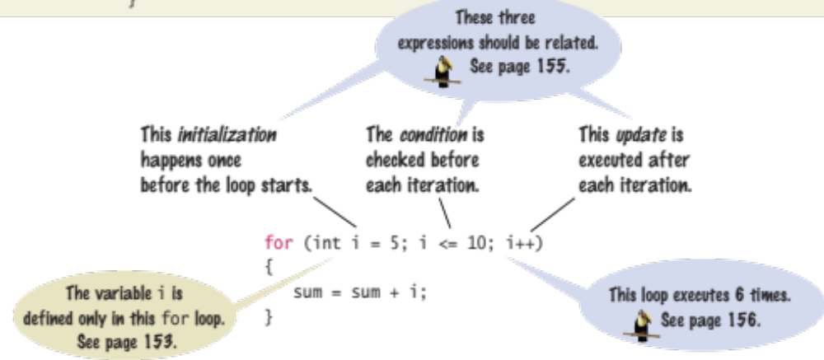
Syntax 4.2: for Statement
Two semicolons separate the three parts
  Initialization ; Condition ; Update
Copyright © 2013 by John Wiley & Sons. All rights reserved.
Page <number>

Slide 32
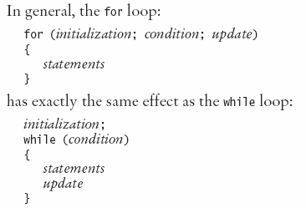
When to use a for Loop?
Yes, a while loop can do everything a for loop can do
Programmers like it because it is concise
    Initialization
    Condition
    Update
  All on one line!
Copyright © 2013 by John Wiley & Sons. All rights reserved.
Page <number>

Slide 33
for Loop variable Scope
  for( int x = 1; x < 10; x = x + 1) {
  // steps to do inside the loop
  // You can use ‘x’ anywhere in this box
  }
  if (x > 100) // Error! x is out of scope!
Scope is the ‘visibility’ of a variable.
When ‘x’ is declared in the for statement:
  ‘x’ exists only inside the ‘block’ of the for loop { }
Solution: Declare‘x’outside the for loop
  int x;
  for(x = 1; x < 10; x = x + 1)
Copyright © 2013 by John Wiley & Sons. All rights reserved.
Page <number>

Slide 34
Summary of the for Loop
for loops are very commonly used
They have a very concise notation
  Initialization ; Condition ; Update
  Initialization happens once at the start
  Condition is tested every time BEFORE executing the body (pre-test)
  Increment is done at the end of the body
Great for integer counting, String (array) processing and more
Copyright © 2013 by John Wiley & Sons. All rights reserved.
Page <number>

Slide 35
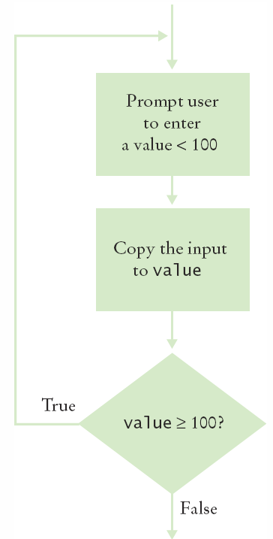
4.4 The do Loop
Use a do loop when you want to:
  Execute the body at least once
  Test the condition AFTER your first loop
int i = 1; // initialize
final int FINGERS = 5;
do
{
// paint finger
i++; // update
}
while (i <= FINGERS); // test
Note the semicolon at the end!
Copyright © 2013 by John Wiley & Sons. All rights reserved.
.
Page <number>

Slide 36
Steps to Writing a Loop
Planning:
Decide what work to do inside the loop
Specify the loop condition
Determine loop type
Setup variables before the first loop
Process results when the loop is finished
Trace the loop with typical examples
Coding:
Implement the loop in Java
Copyright © 2013 by John Wiley & Sons. All rights reserved.
Page <number>

Slide 37
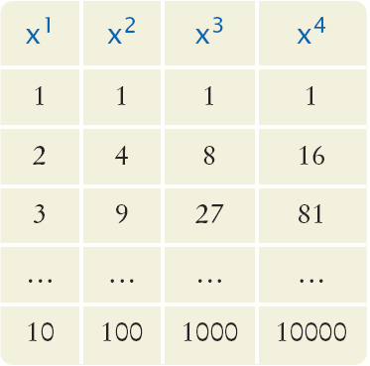
4.8 Nested Loops
How would you print a table with rows and columns?
  Print top line (header)
    Use a for loop
  Print table body…
    How many rows?
    How many columns?
  Loop per row
    Loop per column
Copyright © 2013 by John Wiley & Sons. All rights reserved.
Page <number>

Slide 38
Flowchart of a Nested Loop
x = 1
x <= 10?
True
n= 1
Inner Loop
False
n <= 4?
True
Print x^n
False
n++
Print new line
x++
Done
Copyright © 2013 by John Wiley & Sons. All rights reserved.
Page <number>

Slide 39
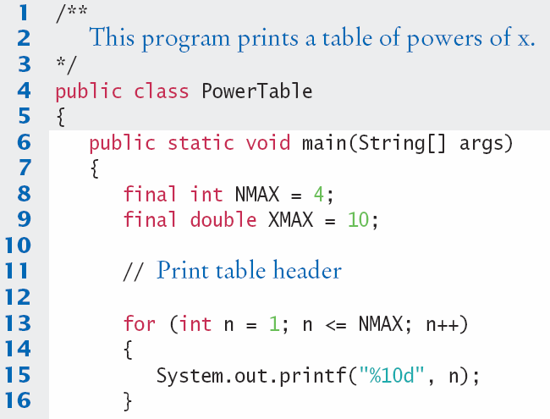
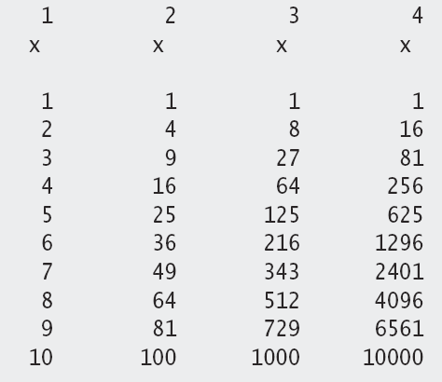
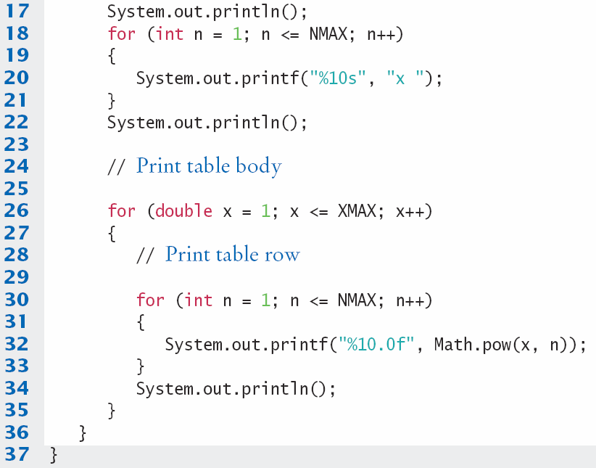
PowerTable.java
    Body of outer loop
    Body of inner loop
Copyright © 2013 by John Wiley & Sons. All rights reserved.
Page <number>

Slide 40
End of Lecture
Summary slides and reference slides follow: use these to help you study
To deepen your understanding of the lecture, read Chapter 4 of Java for Everyone.
Attempt the Self-Check exercises!
Tutorial Worksheet 4 is on the CSC9A1 website
  Solutions will be discussed at tutorials in week 6
  Prepare your answers before coming to the tutorial
Programming Practical Worksheets 7 and 8 are also available
Copyright © 2013 by John Wiley & Sons. All rights reserved.
Page <number>

Slide 41
Summary: Types of Loops
There are three types of loops:
  while Loops
  for Loops
  do Loops
Each loop requires the following steps:
  Initialization (setup variables to start looping)
  Condition (test if we should execute loop body)
  Update (change something each time through)
Copyright © 2013 by John Wiley & Sons. All rights reserved.
Page <number>

Slide 42
Summary
A loop executes instructions repeatedly while a condition is true.
An off-by-one error is a common error when programming loops.
  Think through simple test cases to avoid this type of error.
The for loop is used when a value runs from a starting point to an ending point with a constant increment or decrement.
The do loop is appropriate when the loop body must be executed at least once.
Copyright © 2013 by John Wiley & Sons. All rights reserved.
Page <number>

Slide 43
Summary
A sentinel value denotes the end of a data set, but it is not part of the data.
You can use a boolean variable to control a loop.
  Set the variable to true before entering the loop, then set it to false to leave the loop.
When the body of a loop contains another loop, the loops are nested.
  A typical use of nested loops is printing a table with rows and columns.
In a simulation, you use the computer to simulate an activity.
  You can introduce randomness by calling the random number generator.
Copyright © 2013 by John Wiley & Sons. All rights reserved.
Page <number>

Slide 44
4.7 Common Loop Algorithms
1: Sum and Average Value
2: Counting Matches
3: Finding the First Match
4: Prompting until a match is found
5: Maximum and Minimum
6: Comparing Adjacent Values
Copyright © 2013 by John Wiley & Sons. All rights reserved.
Page <number>

Slide 45
Sum and Average Examples
double total = 0;
while (in.hasNextDouble())
{
double input = in.nextDouble();
total = total + input;
}
Sum of Values
  Initialize total to 0
  Use while loop with sentinel
double total = 0;
int count = 0;
while (in.hasNextDouble())
{
double input = in.nextDouble();
total = total + input;
count++;
}
double average = 0;
if (count > 0)
{ average = total / count; }
Average of Values
  Use Sum of Values
  Initialize count to 0
    Increment per input
  Check for count 0
    Before divide!
Copyright © 2013 by John Wiley & Sons. All rights reserved.
Page <number>

Slide 46
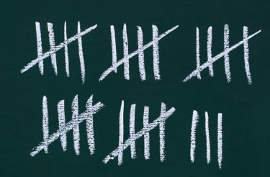
Counting Matches
int upperCaseLetters = 0;
for (int i = 0; i < str.length(); i++)
{
char ch = str.charAt(i);
if (Character.isUpperCase(ch))
{
upperCaseLetters++;
}
}
Counting Matches
  Initialize count to 0
  Use a for loop
  Add to count per match
Copyright © 2013 by John Wiley & Sons. All rights reserved.
Page <number>

Slide 47

Finding the First Match
boolean found = false;
char ch;
int position = 0;
while (!found &&
position < str.length())
{
ch = str.charAt(position);
if (Character.isLowerCase(ch))
{
found = true;
}
else { position++; }
}
Initialize boolean sentinel to false
Initialize position counter to 0
  First char in String
Use a compound conditional in loop
    A pre-test loop (while or for) will handle the case where the string is empty!
Copyright © 2013 by John Wiley & Sons. All rights reserved.
Page <number>

Slide 48
Prompt Until a Match is Found
boolean valid = false;
double input;
while (!valid)
{
System.out.print("Please enter a positive value < 100: ");
input = in.nextDouble();
if (0 < input && input < 100) { valid = true; }
else { System.out.println("Invalid input."); }
}
Initialize boolean flag to false
Test sentinel in while loop
  Get input, and compare to range
    If input is in range, change flag to true
    Loop will stop executing
Copyright © 2013 by John Wiley & Sons. All rights reserved.
Page <number>

Slide 49
Maximum and Minimum
double largest = in.nextDouble();
while (in.hasNextDouble())
{
double input = in.nextDouble();
if (input > largest)
{
largest = input;
}
}
double smallest = in.nextDouble();
while (in.hasNextDouble())
{
double input = in.nextDouble();
if (input > smallest)
{
smallest = input;
}
}
Get first input value
  This is the largest (or smallest) that you have seen so far!
Loop while you have a valid number (non-sentinel)
  Get another input value
  Compare new input to largest (or smallest)
  Update largest (or smallest) if necessary
Copyright © 2013 by John Wiley & Sons. All rights reserved.
Page <number>

Slide 50

Comparing Adjacent Values
double input = in.nextDouble();
while (in.hasNextDouble())
{
double previous = input;
input = nextDouble();
if (input == previous)
{
System.out.println("Duplicate input");
}
}
Get first input value
Use while to determine if there are more to check
  Copy input to previous variable
  Get next value into input variable
  Compare input to previous, and output if same
Copyright © 2013 by John Wiley & Sons. All rights reserved.
Page <number>

Slide 51
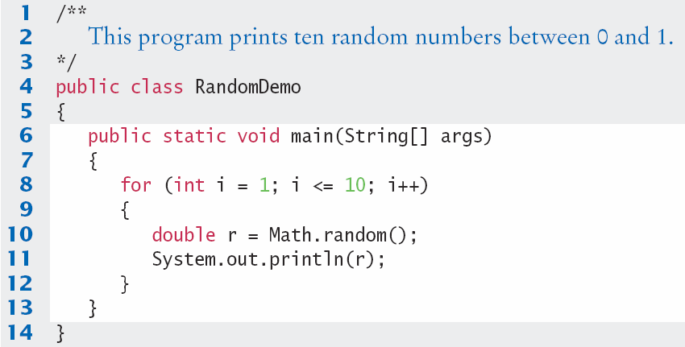
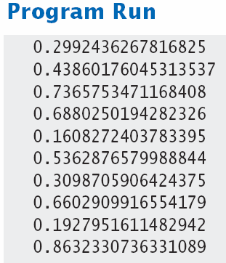
RandomDemo.java
Copyright © 2013 by John Wiley & Sons. All rights reserved.
Page <number>

