Slide 1

5
CSCU9A1 JAVA LECTURE
METHODS
Copyright © 2013 by John Wiley & Sons. All rights reserved.

Slide 2
Lecture Goals
To be able to implement methods
To become familiar with the concept of parameter passing
To develop strategies for decomposing complex tasks into simpler ones
To be able to determine the scope of a variable
Related reading:
Java for Everyone 2nd ed, Horstmann, 2013
  Chapter 5 (Methods)
Copyright © 2013 by John Wiley & Sons. All rights reserved.
Page <number>

Slide 3
Methods as Black Boxes
A method is a sequence of instructions with a name
  You declare a method by defining a named block of code
  You call a method in order to execute its instructions
public static void main(String[] args)
{
double result = Math.pow(2, 3);
. . .
}
A method packages a computation consisting of multiple steps into a form that can be easily understood and reused.
Copyright © 2013 by John Wiley & Sons. All rights reserved.
Page <number>

Slide 4
What is a method?
Some methods you have already used are:
  Math.pow()
  String.length()
  Scanner.nextInt()
  main()
They have:
  May have a capitalized name and a dot (.) before them
  A method name
    Follow the same rules as variable names, camelHump style
  ( ) - a set of parentheses at the end
    A place to provide the method input information
Copyright © 2013 by John Wiley & Sons. All rights reserved.
Page <number>

Slide 5
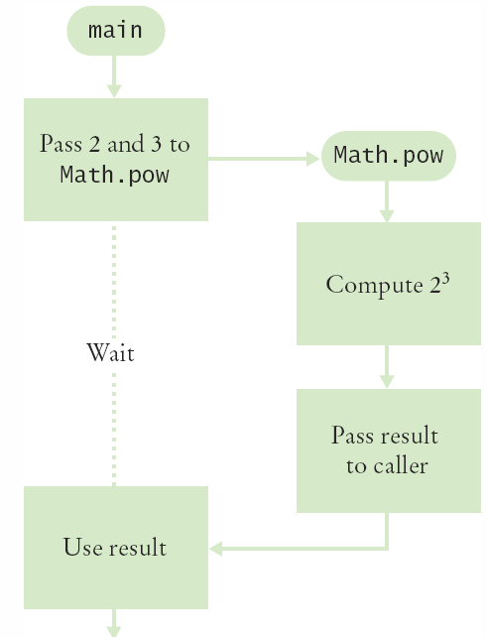
Flowchart of Calling a Method
public static void main(String[] args)
{
double result = Math.pow(2, 3);
. . .
}
One method ‘calls’ another
  main calls Math.pow()
  Passes two arguments
    2 and 3
  Math.pow starts
    Uses variables (2, 3)
    Does its job
    Returns the answer
  main uses result
Copyright © 2013 by John Wiley & Sons. All rights reserved.
Page <number>

Slide 6
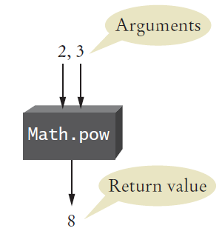
Arguments and Return Values
public static void main(String[] args)
{
double result = Math.pow(2,3);
. . .
}
main ‘passes’ two arguments (2 and 3) to Math.pow
Math.pow calculates and returns a value of 8 to main
main stores the return value to variable ‘result’
Copyright © 2013 by John Wiley & Sons. All rights reserved.
Page <number>

Slide 7

Black Box Analogy
A thermostat is a ‘black box’
  Set a desired temperature
  Turns on heater/AC as required
  You don’t have to know how it really works!
    How does it know the current temp?
    What signals/commands does it send to the heater or A/C?
Use methods like ‘black boxes’
  Pass the method what it needs to do its job
  Receive the answer
Copyright © 2013 by John Wiley & Sons. All rights reserved.
Page <number>

Slide 8
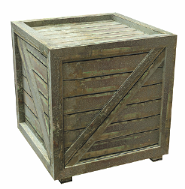
5.2 Implementing Methods
A method to calculate the volume of a cube
  What does it need to do its job?
  What does it answer with?
When writing this method:
  Pick a name for the method (cubeVolume).
  Declare a variable for each incoming argument
  (double sideLength) (called parameter variables)
  Specify the type of the return value ( double )
  Add modifiers such as public static
    (see Chapter 8)
When declaring a method, you provide a name for the method, a variable for each argument, and a type for the result
public static double cubeVolume(double sideLength)
Copyright © 2013 by John Wiley & Sons. All rights reserved.
Page <number>

Slide 9
Inside the Box
Then write the body of the method
  The body is surrounded by curly braces { }
  The body contains the variable declarations and statements that are executed when the method is called
  It will also return the calculated answer
public static double cubeVolume(double sideLength)
{
double volume = sideLength * sideLength * sideLength;
return volume;
}
Copyright © 2013 by John Wiley & Sons. All rights reserved.
Page <number>

Slide 10
Back from the Box
The values returned from cubeVolume are stored in local variables inside main
The results are then printed out
public static void main(String[] args)
{
double result1 = cubeVolume(2);
double result2 = cubeVolume(10);
System.out.println("A cube of side length 2 has volume
" + result1);
System.out.println("A cube of side length 10 has volume
" + result2);
}
Copyright © 2013 by John Wiley & Sons. All rights reserved.
Page <number>

Slide 11
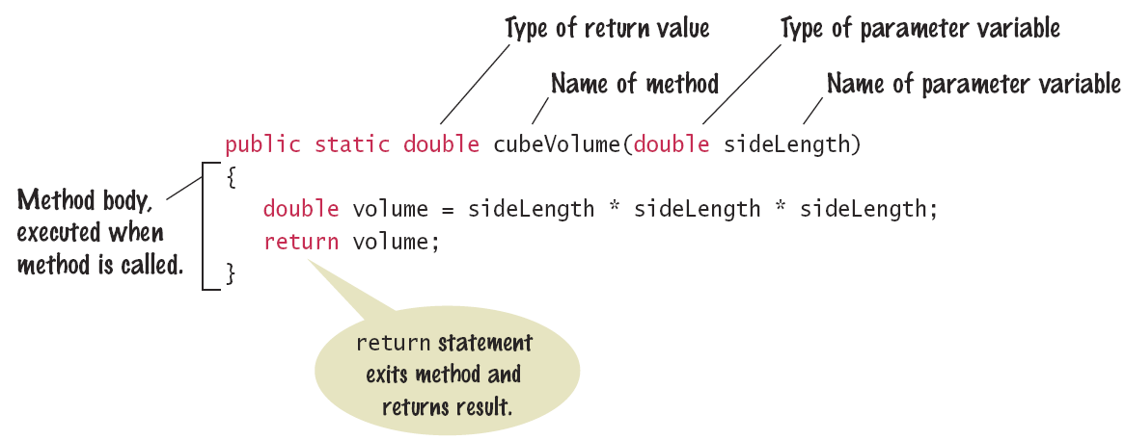
Syntax: Method Declaration
Copyright © 2013 by John Wiley & Sons. All rights reserved.
Page <number>

Slide 12
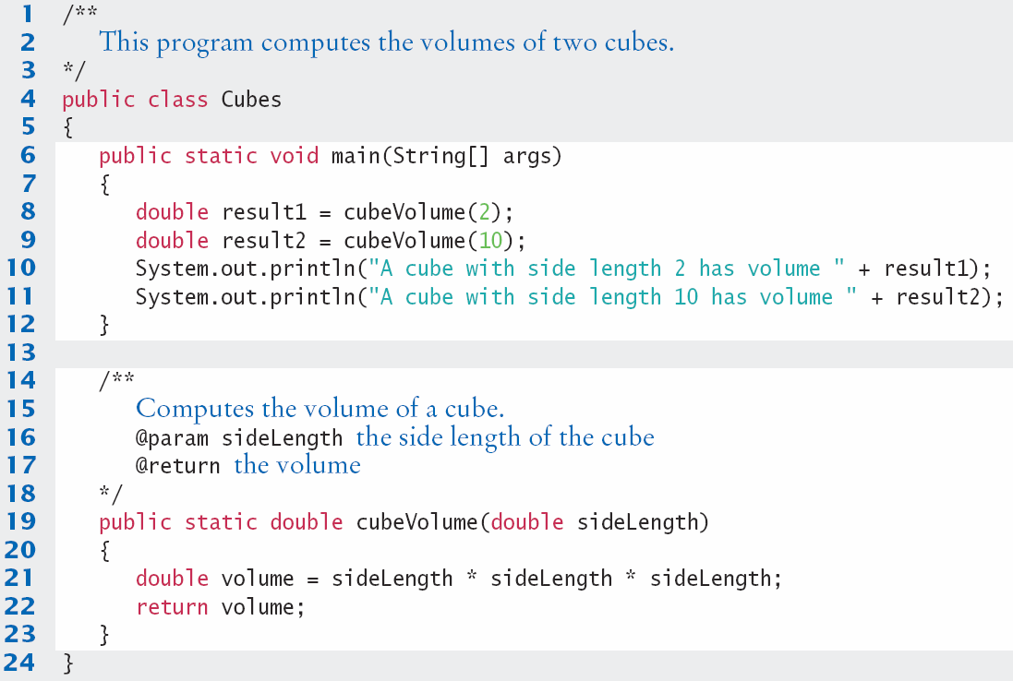
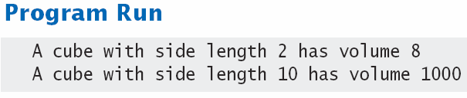
Cubes.java
Copyright © 2013 by John Wiley & Sons. All rights reserved.
Page <number>

Slide 13

Method Comments
Write a Javadoc comment above each method
Start with /**
  Note the purpose of the method
  @param Describe each parameter variable
  @return Describe the return value
End with */
/**
Computes the volume of a cube.
@param sideLength the side length of the cube
@return the volume
*/
public static double cubeVolume(double sideLength)
Copyright © 2013 by John Wiley & Sons. All rights reserved.
Page <number>

Slide 14



Parameter Passing
Parameter variables receive the argument values supplied in the method call
  They both must be the same type
The argument value may be:
  An expression
  A ‘literal’ value (2)
  aka. actual parameter or argument
The parameter variable is:
  Declared in the called method
  Initialized with the value of the argument value
  Used as a variable inside the called method
  aka. formal parameter
Calling Method
out
Argument value
Parameter variable
in
Called Method
Copyright © 2013 by John Wiley & Sons. All rights reserved.
Page <number>

Slide 15




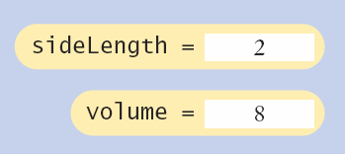
Parameter Passing Steps
public static void main(String[] args)
{
double result1 = cubeVolume(2);
. . .
}
public static double cubeVolume(double sideLength)
{
double volume = sideLength * sideLength * sideLength;
return volume;
}
Copyright © 2013 by John Wiley & Sons. All rights reserved.
Page <number>

Slide 16
Return Values
Methods can (optionally) return one value
  Declare a return type in the method declaration
  Add a return statement that returns a value
    A return statement does two things:
      Immediately terminates the method
      Passes the return value back to the calling method
return type
public static double cubeVolume (double sideLength)
{
double volume = sideLength * sideLength * sideLength;
return volume;
}
The return value may be a value, a variable or a calculation
  Type must match return type
return statement
Copyright © 2013 by John Wiley & Sons. All rights reserved.
Page <number>

Slide 17
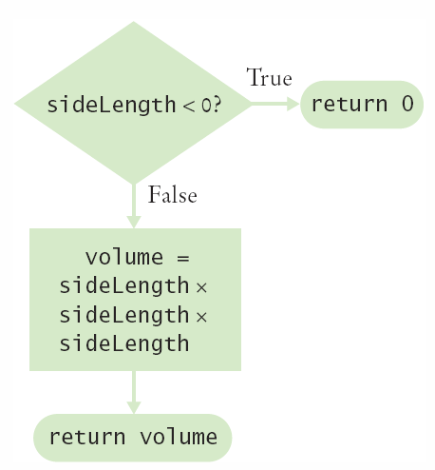
Multiple return Statements
A method can use multiple return statements
  But every branch must have a return statement
public static double cubeVolume(double sideLength)
{
if (sideLength < 0)
{
return 0;
}
return sideLength * sideLength * sideLength;
}
Copyright © 2013 by John Wiley & Sons. All rights reserved.
Page <number>

Slide 18

Common Error
Missing return Statement
  Make sure all conditions are handled
  In this case, x could be equal to 0
    No return statement for this condition
    The compiler will complain if any branch has no return statement
public static int sign(double x)
{
if (x < 0) { return -1; }
if (x > 0) { return 1; }
// Error: missing return value if x equals 0
}
Copyright © 2013 by John Wiley & Sons. All rights reserved.
Page <number>

Slide 19
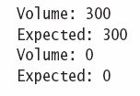
Implementing a Method: Steps
Describe what the method should do.
Determine the method’s “inputs”.
Determine the types of parameter values and the return value.
Write pseudocode for obtaining the desired result.
Implement the method body.
Test your method.
  Design test cases and code
public static double pyramidVolume(double height, double baseLength)
{
double baseArea = baseLength * baseLength;
return height * baseArea / 3;
}
Copyright © 2013 by John Wiley & Sons. All rights reserved.
Page <number>

Slide 20

5.5 Methods without Return Values
Methods are not required to return a value
  The return type of void means nothing is returned
  No return statement is required
  The method can generate output though!
...
boxString(“Hello”);
...
public static void boxString(String str)
{
int n = str.length();
for (int i = 0; i < n + 2; i++)
{ System.out.print("-"); }
System.out.println();
System.out.println("!" + str + "!");
for (int i = 0; i < n + 2; i++)
{ System.out.print("-"); }
System.out.println();
}
Copyright © 2013 by John Wiley & Sons. All rights reserved.
Page <number>

Slide 21
Using return Without a Value
You can use the return statement without a value
  In methods with void return type
  The method will terminate immediately!
public static void boxString(String str)
{
int n = str.length();
if (n == 0)
{
return; // Return immediately
}
for (int i = 0; i < n + 2; i++) { System.out.print("-"); }
System.out.println();
System.out.println("!" + str + "!");
for (int i = 0; i < n + 2; i++) { System.out.print("-"); }
System.out.println();
}
Copyright © 2013 by John Wiley & Sons. All rights reserved.
Page <number>

Slide 22
5.8 Variable Scope
The scope of a variable is the part of the program in which
it is visible.
Variables can be declared:
  Inside a method
    Known as ‘local variables’
    Only available inside this method
    Parameter variables are like local variables
  Inside a block of code { }
    Sometimes called ‘block scope’
    If declared inside block { ends at end of block }
  Outside of a method
    Sometimes called ‘global scope’
    Can be used (and changed) by code in any method
How do you choose?
Copyright © 2013 by John Wiley & Sons. All rights reserved.
Page <number>

Slide 23
Examples of Scope
  sum is a local variable in main
  square is only visible inside the for loop block
  i is only visible inside the for loop
public static void main(String[] args)
{
int sum = 0;
for (int i = 1; i <= 10; i++)
{
int square = i * i;
sum = sum + square;
}
System.out.println(sum);
}
sum
i
square
The scope of a variable is the part of the program in which
it is visible.
Copyright © 2013 by John Wiley & Sons. All rights reserved.
Page <number>

Slide 24
Local Variables of Methods
Variables declared inside one method are not visible to other methods
  sideLength is local to main
  Using it outside main will cause a compiler error
public static void main(String[] args)
{
double sideLength = 10;
int result = cubeVolume();
System.out.println(result);
}
public static double cubeVolume()
{
return sideLength * sideLength * sideLength; // ERROR
}
Copyright © 2013 by John Wiley & Sons. All rights reserved.
Page <number>

Slide 25
Global variables
Global variables and constants are declared outside all methods
They are visible to all methods
They need an additional modifier (usually private)
public class Geometry
{
private static final double PI = 3.1415927;
public static void main(String[] args) { … }
public static double circleArea(double radius)
{
return PI * radius * radius;
}
}
Copyright © 2013 by John Wiley & Sons. All rights reserved.
Page <number>

Slide 26
Re-using names for local variables
Variables declared inside one method are not visible to other methods
  result is local to square and result is local to main
  They are two different variables and do not overlap
public static int square(int n)
{
int result = n * n;
return result;
}
public static void main(String[] args)
{
int result = square(3) + square(4);
System.out.println(result);
}
result
result
Copyright © 2013 by John Wiley & Sons. All rights reserved.
Page <number>

Slide 27
Re-using names for block variables
Variables declared inside one block are not visible to other methods
  i is inside the first for block and i is inside the second
  They are two different variables and do not overlap
public static void main(String[] args)
{
int sum = 0;
for (int i = 1; i <= 10; i++)
{
sum = sum + i;
}
for (int i = 1; i <= 10; i++)
{
sum = sum + i * i;
}
System.out.println(sum);
}
i
i
Copyright © 2013 by John Wiley & Sons. All rights reserved.
Page <number>

Slide 28
End of Lecture
Summary slides: use these to help you study
To deepen your understanding of the lecture, read Chapter 5 of Java for Everyone.
Attempt the Self-Check exercises!
Copyright © 2013 by John Wiley & Sons. All rights reserved.
Page <number>

Slide 29
Overlapping Scope
Variables (including parameter variables) must have unique names within their scope
  n has local scope and n is in a block inside that scope
  The compiler will complain when the block scope n is declared
public static int sumOfSquares(int n)
{
int sum = 0;
for (int i = 1; i <= n; i++)
{
int n = i * i; // ERROR
sum = sum + n;
}
return sum;
}
Local n
block scope n
Copyright © 2013 by John Wiley & Sons. All rights reserved.
Page <number>

Slide 30
Global and Local Overlapping
Global and Local (method) variables can overlap
  The local same will be used when it is in scope
  No access to global same when local same is in scope
public class Scoper
{
public static int same; // ‘global’
public static void main(String[] args)
{
int same = 0; // local
for (int i = 1; i <= 10; i++)
{
int square = i * i;
same = same + square;
}
System.out.println(same);
}
}
same
same
Variables in different scopes with
the same name will compile, but
it is not a good idea
Copyright © 2013 by John Wiley & Sons. All rights reserved.
Page <number>

Slide 31
Implementing a Method: Steps
Describe what the method should do.
Determine the method’s “inputs”.
Determine the types of parameter values and the return value.
Write pseudocode for obtaining the desired result.
Implement the method body.
Test your method.
  Design test cases and code
public static double pyramidVolume(double height, double baseLength)
{
double baseArea = baseLength * baseLength;
return height * baseArea / 3;
}
Copyright © 2013 by John Wiley & Sons. All rights reserved.
Page <number>

Slide 32
5.5 Methods without Return Values
Methods are not required to return a value
  The return type of void means nothing is returned
  No return statement is required
  The method can generate output though!
...
boxString(“Hello”);
...
public static void boxString(String str)
{
int n = str.length();
for (int i = 0; i < n + 2; i++)
{ System.out.print("-"); }
System.out.println();
System.out.println("!" + str + "!");
for (int i = 0; i < n + 2; i++)
{ System.out.print("-"); }
System.out.println();
}
Copyright © 2013 by John Wiley & Sons. All rights reserved.
Page <number>

Slide 33
Using return Without a Value
You can use the return statement without a value
  In methods with void return type
  The method will terminate immediately!
public static void boxString(String str)
{
int n = str.length();
if (n == 0)
{
return; // Return immediately
}
for (int i = 0; i < n + 2; i++) { System.out.print("-"); }
System.out.println();
System.out.println("!" + str + "!");
for (int i = 0; i < n + 2; i++) { System.out.print("-"); }
System.out.println();
}
Copyright © 2013 by John Wiley & Sons. All rights reserved.
Page <number>

Slide 34
Problem Solving: Reusable Methods
Find Repetitive Code
  May have different values but same logic
int hours;
do
{
System.out.print("Enter a value between 1 and 12: ");
hours = in.nextInt();
}
while (hours < 1 || hours > 12);
int minutes;
do
{
System.out.print("Enter a value between 0 and 59: ");
minutes = in.nextInt();
}
while (minutes < 0 || minutes > 59);
1 - 12
0 - 59
Copyright © 2013 by John Wiley & Sons. All rights reserved.
Page <number>

Slide 35
Write a ‘Parameterized’ Method
/**
Prompts a user to enter a value in a given range until the user
provides a valid input.
@param low the low end of the range
@param high the high end of the range
@return the value provided by the user
*/
public static int readValueBetween(int low, int high)
{
int input;
do
{
System.out.print("Enter between " + low + " and " + high + ": ");
Scanner in = new Scanner(System.in);
input = in.nextInt();
}
while (input < low || input > high);
return input;
}
1, 12
0, 59
8
Copyright © 2013 by John Wiley & Sons. All rights reserved.
Page <number>

Slide 36
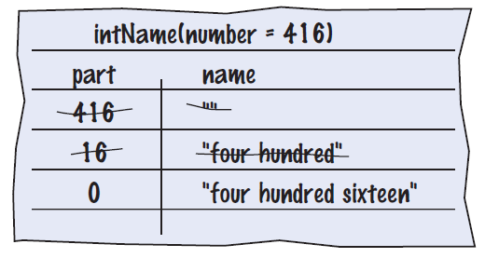

Programming Tips
Keep methods short
  If more than one screen, break into ‘sub’ methods
Trace your methods
  One line for each step
  Columns for key variables
Use Stubs as you write larger programs
  Unfinished methods that return a ‘dummy’ value
public static String digitName(int digit)
{
return "mumble";
}
Copyright © 2013 by John Wiley & Sons. All rights reserved.
Page <number>

Slide 37
Summary: Methods
A method is a named sequence of instructions.
Arguments are supplied when a method is called. The return value is the result that the method computes.
When declaring a method, you provide a name for the method, a variable for each argument, and a type for the result.
Method comments explain the purpose of the method, the meaning of the parameters and return value, as well as any special requirements.
Parameter variables hold the arguments supplied in the method call.
Copyright © 2013 by John Wiley & Sons. All rights reserved.
Page <number>

Slide 38
Summary: Method Returns
The return statement terminates a method call and yields the method result.
  Turn computations that can be reused into methods.
  Use a return type of void to indicate that a method does not return a value.
Use the process of stepwise refinement to decompose complex tasks into simpler ones.
  When you discover that you need a method, write a description of the parameter variables and return values.
  A method may require simpler methods to carry out its work.
Copyright © 2013 by John Wiley & Sons. All rights reserved.
Page <number>

Slide 39
Summary: Scope
The scope of a variable is the part of the program in which it is visible.
  Two local or parameter variables can have the same name, provided that their scopes do not overlap.
  You can use the same variable name within different methods since their scope does not overlap.
  Local variables declared inside one method are not visible to code inside other methods
Copyright © 2013 by John Wiley & Sons. All rights reserved.
Page <number>

